Slide 1

Week 1
Javascript course

Slide 2
Expectations and objectives
Will this get me a job alone?
This is one of three pieces of the web frontend technologies
You should be able to figure out if you like programming or if you do not
You will have enough to build on in order to pursue the other two languages (HTML and CSS)
It will make it much easier to learn front SPA technologies
It will challenge you

Slide 3
Expectations and objectives
Objective 1 - Fundamentals
Objective 2 – Taste of programming
Objective 3 – Acquire new skill
Objective 4 - Learn about algorithms
Making a PB&J Sandwich

Slide 4
What is javascript?
What is it? High level language JIT
One of three core technologies for the world wide web; CSS, HTML, Javascript
JavaScript- Versatile, Dynamic Language
What it’s not – It is not related to Java - Java is to Javascript as ham is to hamburger
Defacto front end language for the web
Can be used as a back end language with Node
The standard for JS is ecmascript

Slide 5
What is Javascript? (Continued)
Most popular programming language of 2019 (Stack Overflow Survey 2019)
Top three web frameworks use JS (Jquery, ReactJS, AngularJS)
Most popular back end language
Easy to learn but hard to master (stick with it)
Big evolution in the last 10 years
Prior to HTML 5 developers hated it but not many other options were available

Slide 6
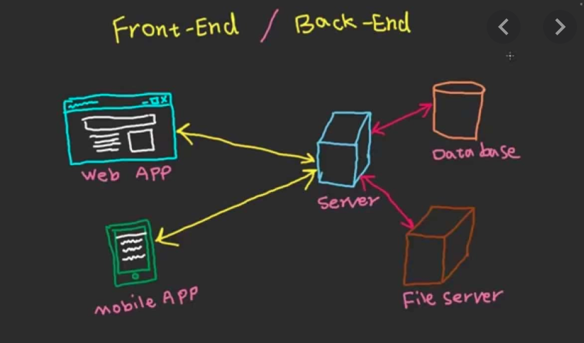
Front end vs. back end
Front end is what you see on your computer
Front end usually consists of HTML, CSS, JS
The backend stores data, files (HTML, CSS, JS)
Files and data are delivered on demand to the frontend
The JS is compiled and executed by your browser (Chrom, FireFox, IE)
JS can be used in the back end as of recent years, but it spent most of it’s infancy in the client
JS is excellent for manipulating the dom

Slide 7
Art or science?
Programming is like art
Programming is part science
Programming is like a craft
It is all abut problem solving
There will be recipes
Three things to become a good programmer: PRACTICE, PRACTICE, PRACTICE

Slide 8
Some examples of js
https://codepen.io/jeffmccarthyesq/pen/LEEKLZ
https://codepen.io/fernandozamoraj/full/JbWjZQ
Amazon drawer example
Where to begin on something like this?
Break a problem down?
Different types of problems – require different types of approaches
Fundamentals are essential to tackling complex problems

Slide 9

Break until 3PM Central/4PM Eastern

Slide 10
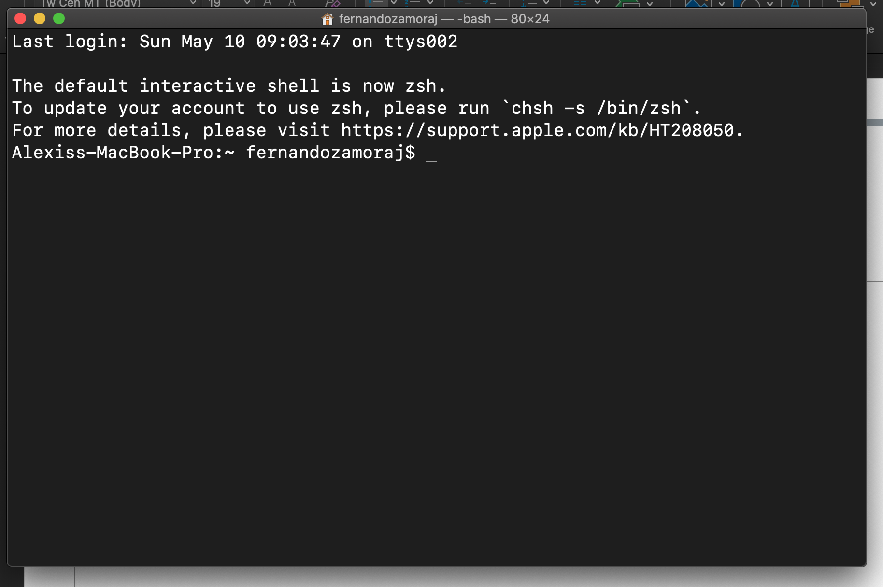
Hour 2 – Command line
And Jobs Said “Let there be GUIs”
DOS – Bill Gates baby – very basic, DIR, MKDIR, CD,
Unix Shells – Many shells most popular is BASH (Bourne Again Shell)
Let’s take a quick look…
Why the shell? Fundamental tool for developers.
There are some things that you can only do in the shell
Terminal or Console or Command Line

Slide 11
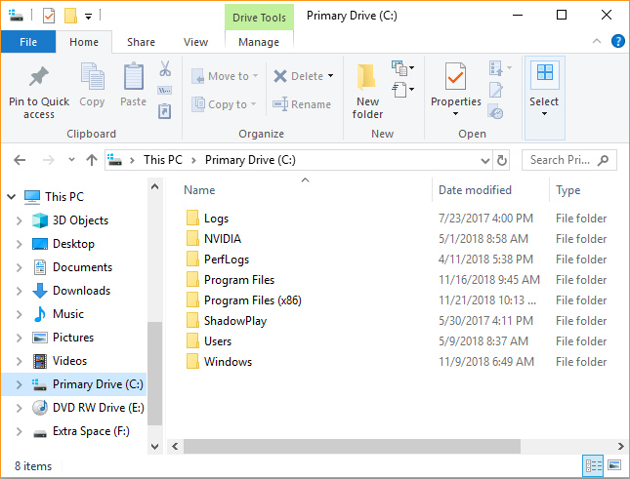
Hour 2 – Command line
Folders have other folders or files
Files have names and extensions (usually)
The full name of the file includes the left side and ext
Anything you can do using mouse you can do with terminal

Slide 12
Command line – Common commands
List all files. => BASH: ls or ls –al DOS: dir
Display current path => BASH: pwd
Move up to the parent directory: cd ..
Move to a child directory: cd childName
Create a director or folder: mkdir folderName
Run an executable file: BASH: ./filename DOS: filename
Move or rename a file: mv filename newFileName
Let’s take a look…

Slide 13
Command line – In Class lab
7. modify the file data.txt by adding a line
8. rename each data.txt file to data1.txt
9. navigate into the folder named child1
10. navigate up to the parent folder
11. use the history command to view your history
1. navigate to your home directory
2. create child folder named mydocs
3. navigate into that director
4. create another child folder name child1
5. create another child folder named child2
6. in each folder create two files named data.txt

Slide 14
Git commands
Time permitting we can cover commands
Or go to break until 4PM

