Slide 1
Music Player
Intelligent software Lab.
전재원

Slide 2
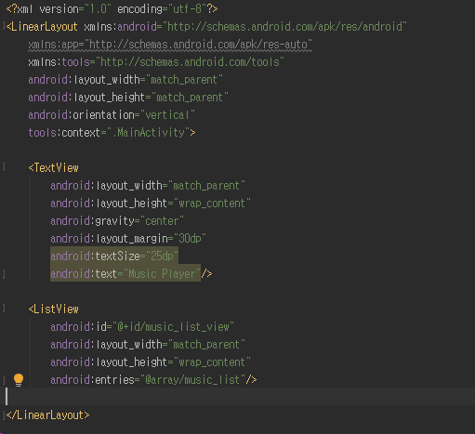
Hint
activity_main.xml

Slide 3
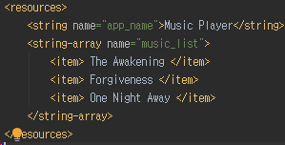
Hint
strings.xml

Slide 4
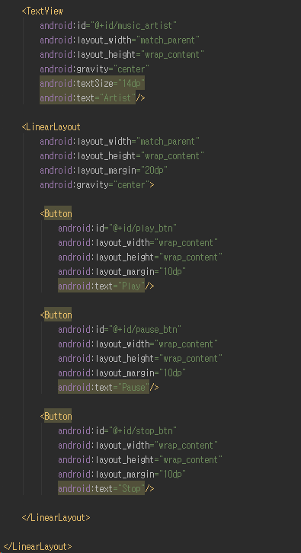
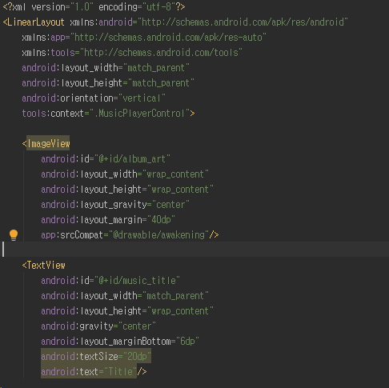
Hint
activity_music_player_control.xml

Slide 5
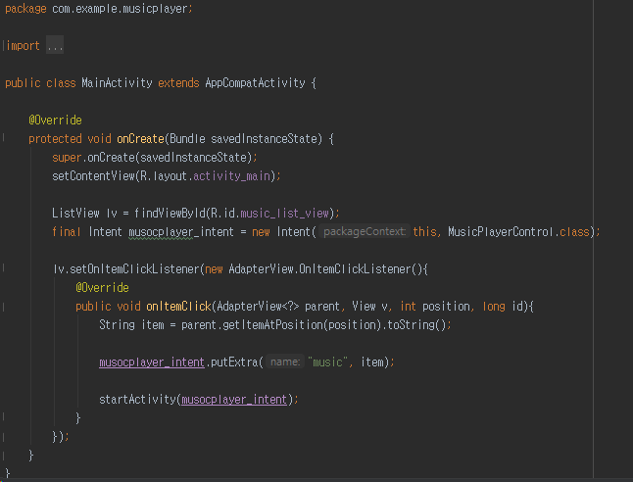
Hint
MainActivity.java

Slide 6
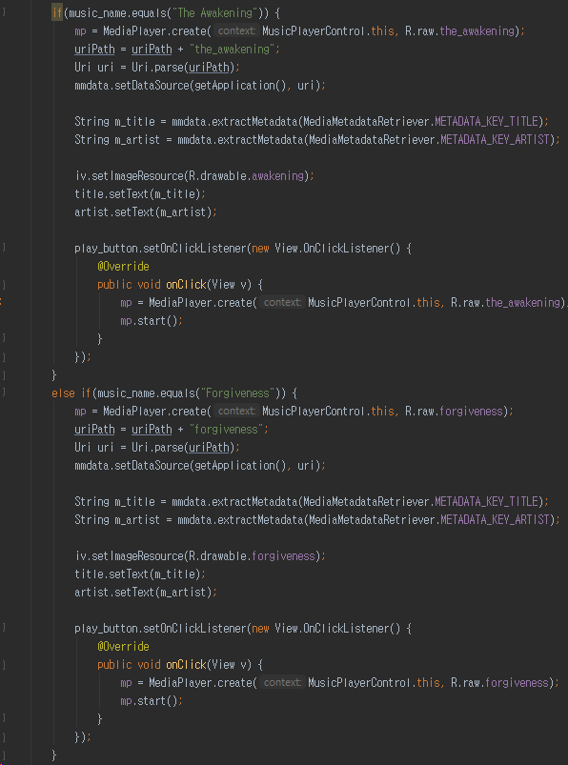
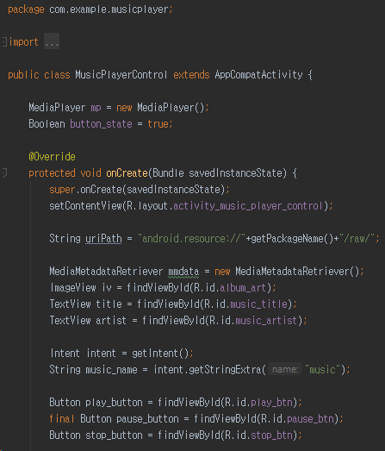
Hint
MusicPlayerControl.java

Slide 7
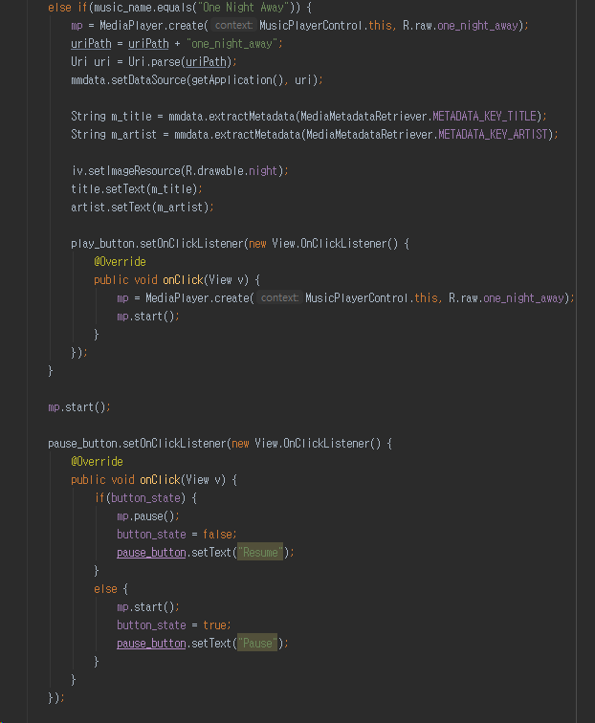
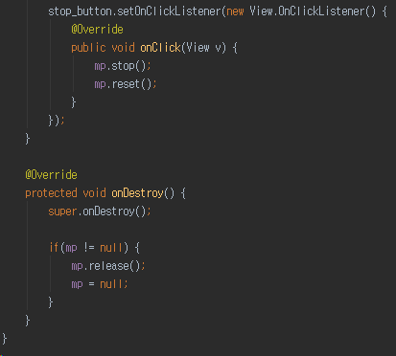
Hint
MusicPlayerControl.java

