Slide 1
⚖
✦ Powered by GenLayer Intelligent Contracts
Impact Legitimacy Court
AI judges Web3 impact claims.
Trustless verdicts. On-chain forever.
bbdim.github.io/impact-legitimacy-court
● LIVE ON GENLAYER TESTNET

Slide 2
THE PROBLEM
Web3 Impact Claims Are
Unverifiable & Unaccountable
🌿
🏛️
💸
Greenwashing Everywhere
No Trustless Judge
Fraud Goes Unchecked
Projects claim to offset carbon, fund education, or save lives — with zero verifiable proof.
Verification is manual, centralized, and easily gamed by well-funded PR teams.
Investors and donors lose millions to projects that fabricate impact metrics.
The Web3 ecosystem needs a trustless, autonomous, AI-powered system to verify impact claims.

Slide 3
THE SOLUTION
Impact Legitimacy Court
A GenLayer Intelligent Contract that autonomously investigates Web3 projects and issues permanent on-chain verdicts.
01
02
03
04
Submit Project
AI Investigates
Multi-AI Consensus
Verdict On-Chain
Enter project name, website, and impact claims
Contract fetches live web data — no oracles needed
GPT-5, Claude, Gemini, DeepSeek all vote independently
Permanent, immutable record — Verified / Suspicious / Fraud

Slide 4
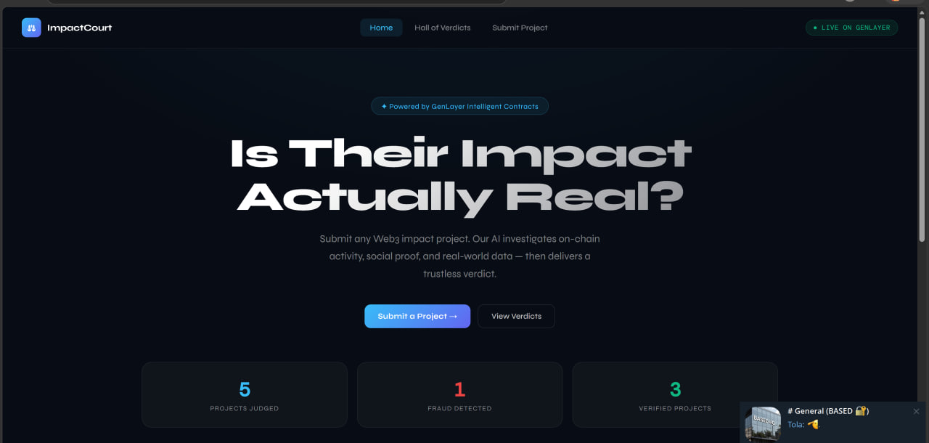
LIVE PRODUCT
Live on GenLayer Testnet
5 Projects Judged
1 Fraud Detected
3 Verified

Slide 5
REAL VERDICTS
AI Judges Real Projects
✦
Gitcoin
85
✦ Verified
Funded $60M+ in public goods
✦
KlimaDAO
75
✦ Verified
Retired 25M tonnes of carbon
◈
Worldcoin
75
◈ Verified
World's largest identity network
◈
Giveth
40
◈ Suspicious
Facilitated $10M in donations
✕
CarbonZero DAO
0
✕ Fraud
Offset 10M tonnes via NFTs

Slide 6
TECHNOLOGY
Built on GenLayer
🧠
Intelligent Contracts
⚖️
Multi-AI Consensus
Python-based smart contracts that natively access the internet — no oracles, no middleware.
GPT-5, Claude Sonnet 4.6, Gemini, DeepSeek, and Llama all vote independently on every verdict.
🌐
Live Web Fetching
🔗
On-Chain Permanence
The contract visits project websites in real-time and reads content — no cached or stale data.
Every verdict is stored immutably on the GenLayer blockchain — tamper-proof and publicly verifiable.
Contract Address: 0xFf6F8D726a325a3268FFabA8403D00EDb39Db1D3

Slide 7
TRACTION
Built, Deployed & Working
5
100%
4
1
Projects Judged
Accuracy
AI Models
Session
On GenLayer testnet
AI caught all fraud & exaggerations
Reaching consensus per verdict
Built in one vibecoding session
Milestones
✅ Intelligent Contract deployed on GenLayer testnet
✅ Live UI hosted on GitHub Pages
✅ 5 real verdicts issued including fraud detection
🔜 MetaMask wallet integration for public submissions
🔜 Mainnet deployment & $ILC governance token

Slide 8
USE OF FUNDS
How We Deploy Capital
35%
Development
MetaMask integration, public submission, UI improvements
25%
Smart Contract Audit
Security review of Intelligent Contract logic
20%
Mainnet Deployment
Gas fees and infrastructure for GenLayer mainnet
20%
Marketing & Community
X content, partnerships, ImpactFi ecosystem growth

Slide 9
⚖
Join the Court
Help us build the trust layer for Web3 impact.
Every project should face the court.
🌐 Live App
bbdim.github.io/impact-legitimacy-court/impact-legitimacy-court.html
📦 GitHub
github.com/Bbdim/impact-legitimacy-court
⛓ Contract
0xFf6F8D726a325a3268FFabA8403D00EDb39Db1D3
Built on GenLayer · Impact Legitimacy Court © 2026

