Slide 1


IRCTC Seamlessly Book, Track, and Cancel Train Tickets

Slide 2
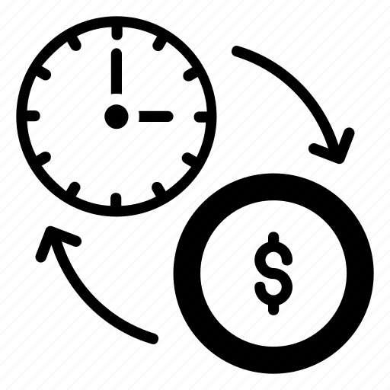
Requirements
Time Consuming Manual Flow
To avoid manual booking at stations we designed a website where user can book tickets through online

Slide 3
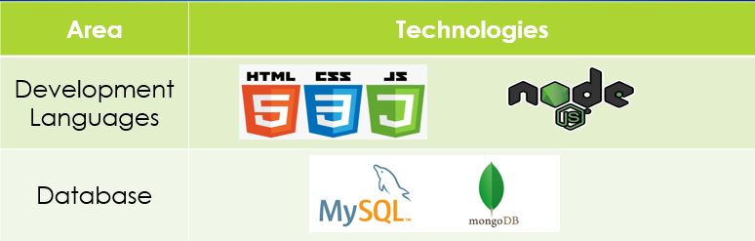
Tech Stack

Slide 4
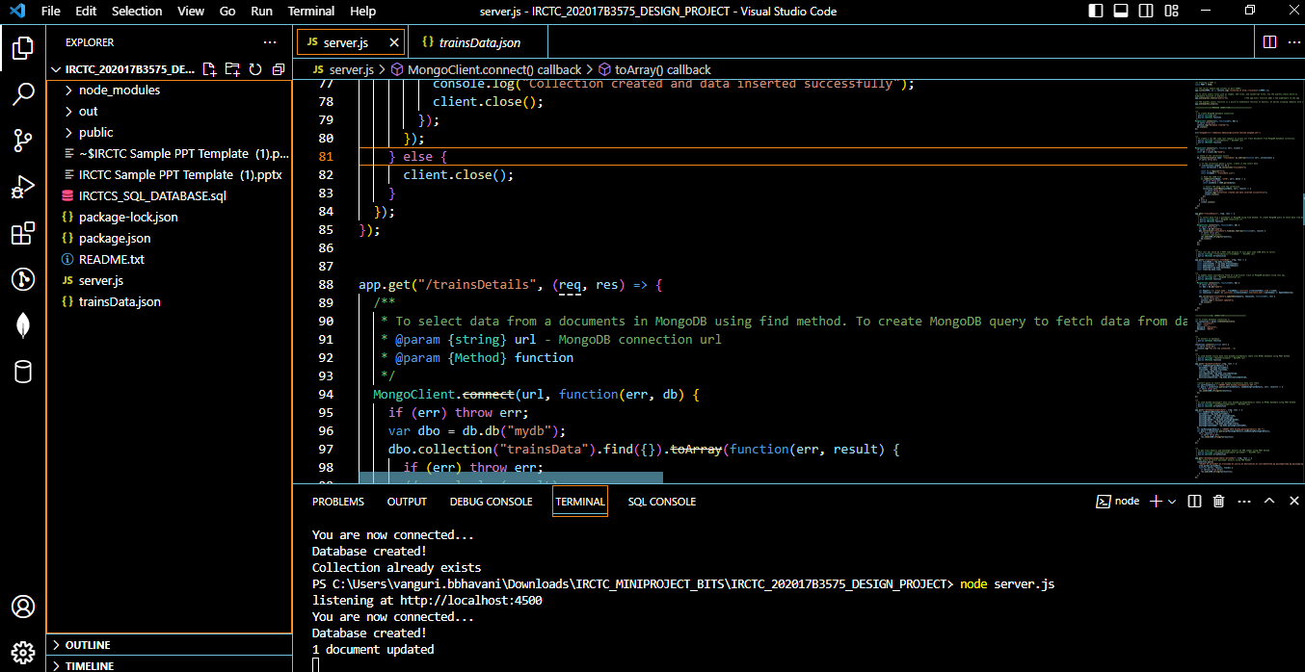
Code Structure:

Slide 5
Learnings
Developed Booking section module,Mongodb& Mysql connectivity, UI Design and Testing
Developed PNR enquiry module ,UI design and Testing
Developed Cancellation module , UI design and Testing
UI Design , Mysql connectvity and Testing

Slide 6
User Journey and Flow
Home Page
Ticket Booking
PNR Check
Cancellation
START
Train List with Seat Availability
Ticket Booking
PNR Status Check
Cancellation
Enter source and destination &
date of journey
Enter Number of Seats
Availability check and booking
PNR & Seat Number Generation
END
Enter PNR
View Ticket Details
END
Cancel Ticket and Update DB
Enter PNR
END

Slide 7
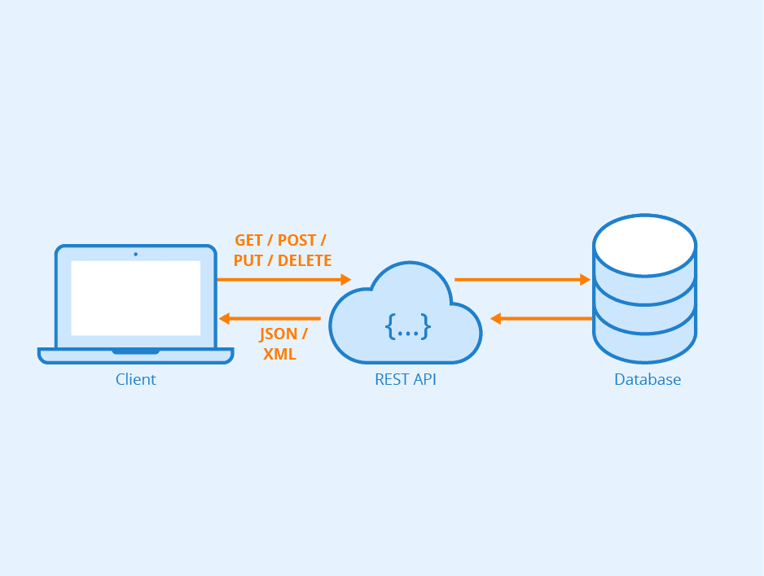
Database Connectivity Flow

Slide 8
Booking Module - Details
Features | Train Search Passenger details Seat Availability check PNR Generation
Test Scenarios | Trains listed based on search criteria Waiting list if no seats Unique 10digit PNR generation Each PNR can have up to 4 tickets Duplicate passengers are not allowed for single PNR
Technical Implementation Details | Getting train details from MongoDB cloud Fetching train data for every one second Implementing search functionality Sending the booked ticket details to Mysql database

Slide 9
PNR Status Module - Details
Features | PNR search Check ticket status Passenger details
Test Scenarios | Validating PNR number Getting details from the data base for searched PNR no Can check confirmed/waiting list/cancelled tickets from booked passengers list
Technical Implementation Details | Getting data from Mysql database Getting the ticket status

Slide 10
TICKET CANCELLATION Module - Details
Features | PNR search Passenger details Cancel passenger/s ticket
Test Scenarios | Validating PNR number Getting details from the data base for searched PNR no Can cancel one/more tickets from booked passengers list
Technical Implementation Details | Getting data from Mysql database Updating the status of cancelled ticket details in database

Slide 11
Validations Performed
Module | Test Case | Status
Booking | Trains are listed when correct source ,destination and date are provided | Passed
Booking | Unique 10 digit PNR number is generated | Passed
PNR status | Getting the passenger/s ticket status from generated PNR number | passed
cancellation | Getting the passenger/s ticket status from generated PNR number | passed
cancellation | Cancelling one/more passenger ticket at simultaneously | Passed
Booking | If a train runs on the route X->Y->Z, then ensure that junk values like booking of ticket from Z to Y or non-existing stations are not allowed. | passed

Slide 12
Challenges , Solutions and Learning
Challenges | Solution | Learning
Initially we used a traditional method of connecting a database like using servlets, server based applications but application didn’t worked as expected | Used Rest API methods (POST,GET,PUT) | Rest API is the most suitable way to retrieving and storing the data.
Initially we are using Json file, where the real time updates are not happening ,for that we shifted to a new concept to us i.e Mongodb . | Understood the concept of MongoDB and implemented with help of online resources | MongoDB is an easy and document-oriented database which stores data in JSON-like documents with dynamic schema.
concurrent booking would lead to inconsistency | After continuous testing, we found a solution to fetch data from database | For fetching data from Mongodb. we learnt Set interval and clear interval is the easy method to get rid of concurrency

