Slide 1
Get the software for this class: CS3003
Python.org
Github.com

Slide 2
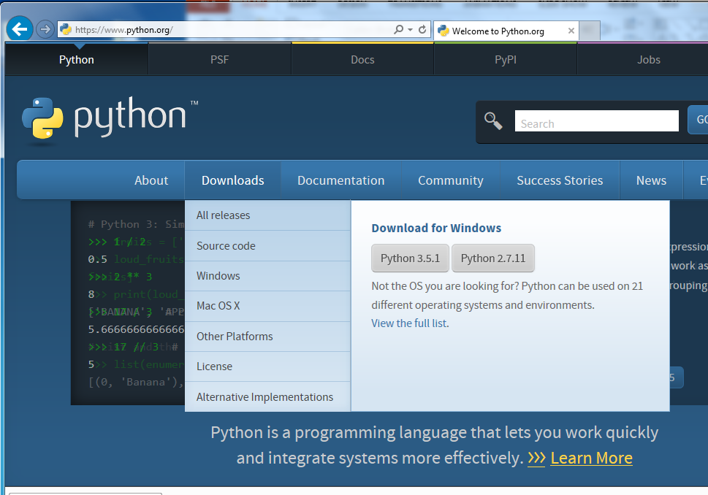
Go to python.org
Linux?
If your using Windows, download and install the latest version.
If you’re running Linux then most likely Python is already installed. Just type python at the command line.
You may want to update to the latest version of Python though.

Slide 3
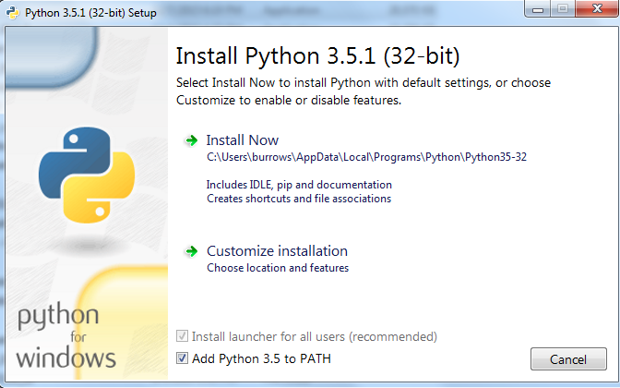
Be sure to add Python to your PATH
Do the installation:
But first--click the bottom checkbox
Add Python x.x to PATH
I just used → Install Now

Slide 4
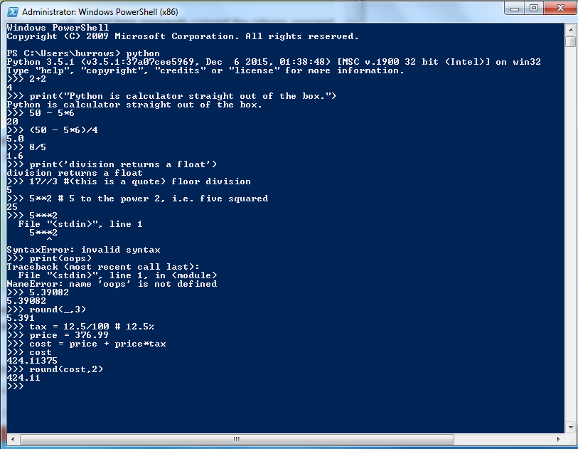
Check your Python installation
Fire up the Windows PowerShell:
Type ‘python’ at the cmd-promt to get started.
Type ‘quit()’ to exit

Slide 5
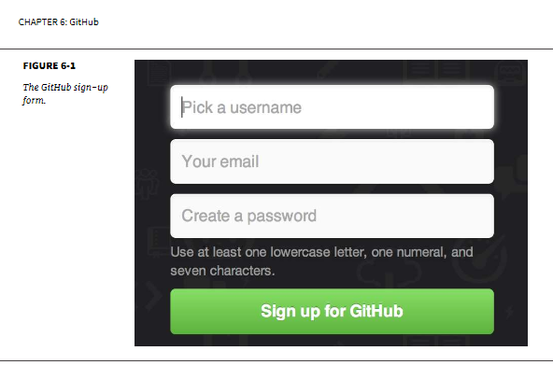
Go to github.com
We can communicate/collaborate effectively with Git hosted at github
Sign up for a free user account
Of course choose the free account!
Nothing we will do in the class is a secret—we don’t need private repositories.

Slide 6
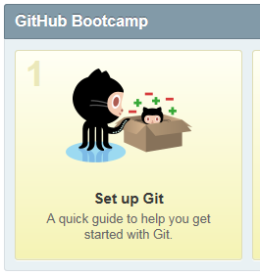
Get the GitHub Desktop
I will be using Windows Git Shell for this class.
Click on Set up Git
Follow the instructions for setting up the latest version of GitHub Desktop.
If your using Linux, follow chapter 1 of ProGit for setup instructions.

Slide 7

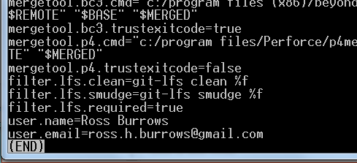
Launch a Git Shell (Powershell)
Test out the git:
Check the git setup
Type:
git config –list
git config user.name
git config user.email
You should see your user credentials here→
If not you can add them with:
git config –global user.name “John Apollo”
git config –global user.email “japollo@rad.com”

Slide 8

What is Git?
Get the free book Pro Git by Scott Chacon and Ben Straub

Slide 9
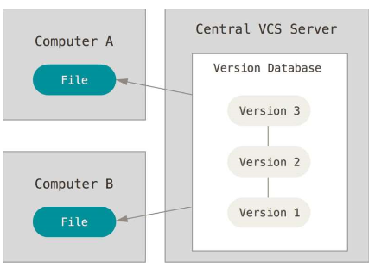
What is Git?
Git is emerging as the best (most widely used) Version Control System (VCS)
You can have a git repository on your own server. For use, its most easy just to have it at github.com
What is version control?
If we want to work together and collaborate on large (or small) projects we need a VCS.
github.com provides a free central server that we can work together with partners by pushing and pulling onto the stack.

Slide 10
Git-ing started → Launch the Git Shell:
Type these commands:
Get ready to clone the LearnPython repository:
ls
mkdir myPython
ls → list files in the directory
mkdir → make a folder named ‘myPython’ (you can use a different name if you want.)

Slide 11
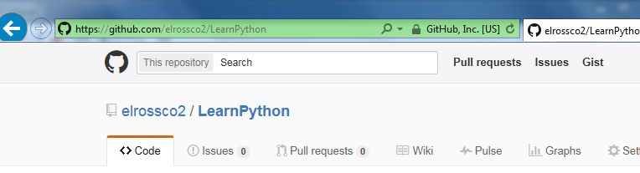

Get the first CS3003 class repository.
Fork the LearnPython repository to get your own copy:
This gives you a working copy of the CS class repo.
go to https://github.com/elrossco2/LearnPython.git
click on
to fork a copy at your account

Slide 12
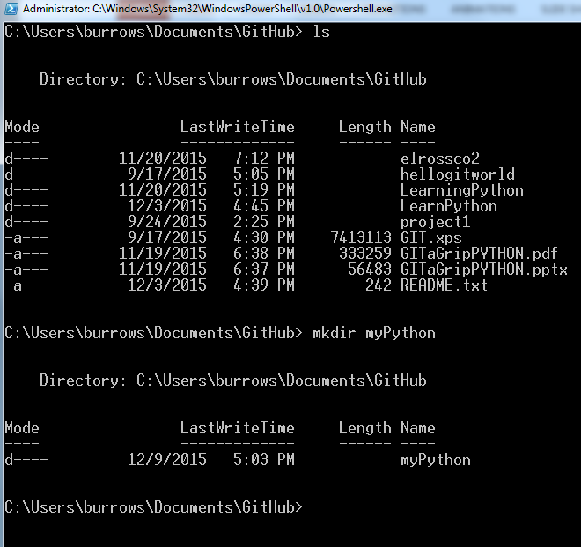
Git-ing started
output of the commands →
if there is nothing in your directory then ls wont show anything.

Slide 13
Use git clone to download the project from the remote:
Type these commands:
Get ready to clone your LearnPython repository from the remote:
cd myPython
git init
git clone https://github.com/elrossco2/LearnPython.git
cd → change into the (new) directory
init → initialize the folder as a git repository.
clone → make a local copy that’s ready to git. Note: replace elrossco2→your-account-name (i.e. use the address to your fork.)
Note you should clone from your fork of the repo. This will give you a version you can push to.

Slide 14
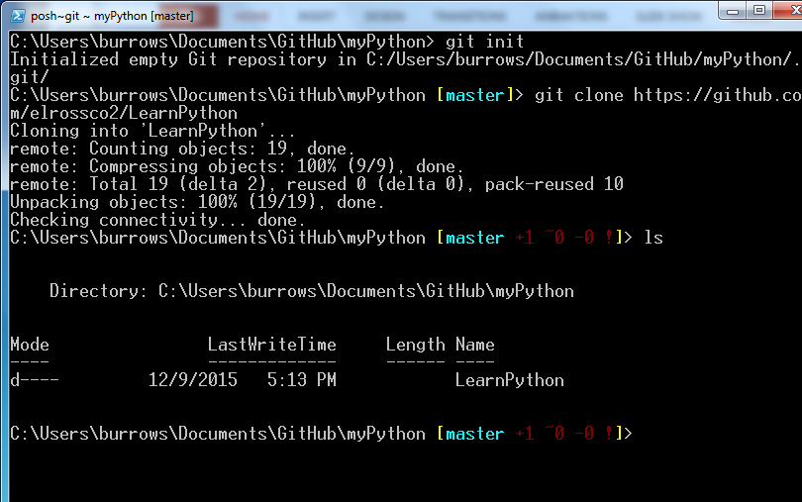
My output
cd myPython
git init
git clone https://github.com/elrossco2/LearnPython.git

Slide 15
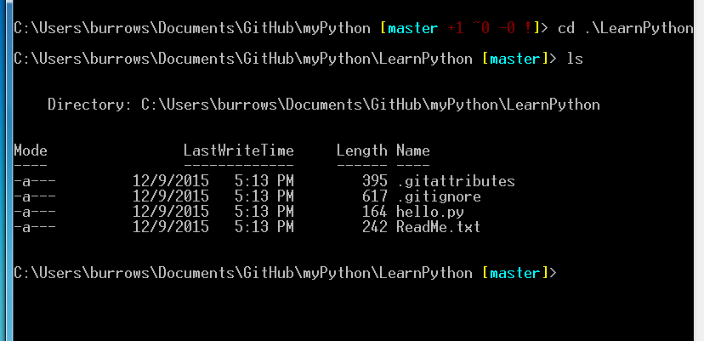
Look at the project
Commands
cd LearnPython
ls

Slide 16

Launch a new Windows PowerShell
change into the directory where the project is. Use ls as needed to find the path.
cd Documents\GitHub\myPython\LearnPython ←this was my path;
python
>>> import hello
>>> hello.hi()
>>> hello.by()

Slide 17
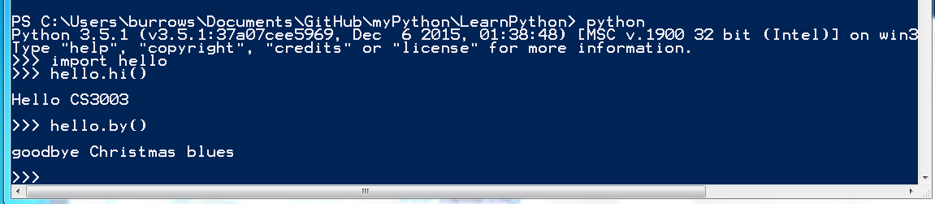
My output:

Slide 18
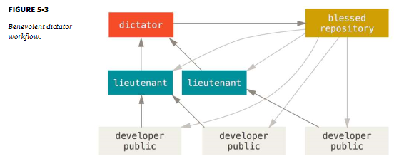
Workflow for CS3003
LearnPython (common repo.)
step 1:
push (by instructor)
step 3:
pull requests (by students = lieutenant)
then back to step 1.
step 2: pull (by students to update their local repo.)
We probably don’t need these.

Slide 19
Workflow for CS3003
step 1 is the instructor’s (my) job. After I’ve merged previous student pull requests (from step 3) I will need to do a git push to update the common repo: LearnPython. To perform your job (step 2) of updating your local version of the repo to make it up-to-date (the same) with the original, you will need to add the URL https://github.com/elrossco2/LearnPython.git as a remote for your local LearnPython repo.
cd (your LearnPython repo)
git remote add cs3003 https://github.com/elrossco2/LearnPython.git
git remote -v
This will add the class URL as a remote. You won’t be able to push to this remote, but you can pull from it to get the latest version (i.e. bring down everything you don’t have yet to your local version of the repo. Step 2:
git pull cs3003 master
Make some changes to your local repo that you want to add to the class project, like posting to the discussion board.
See Pro Git, ch 2 section Working with remotes on p. 68 for more info.

Slide 20
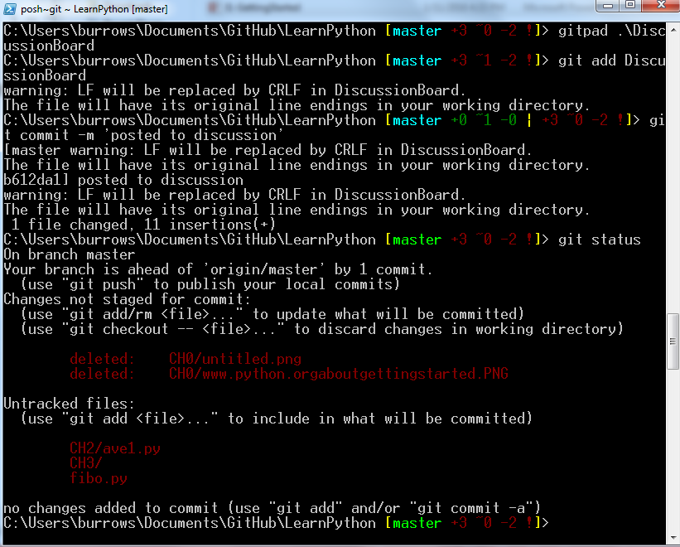
Workflow for CS3003
Posting to the DiscussionBoard:
gitpad DiscussionBoard
Make a new post.
git add DiscussionBoard
git commit –m “posted to discussion.”
git push origin master

