Slide 1
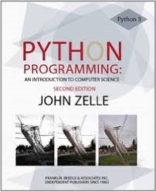
Introduction to scientific computing using Python.
CS 3003 Scientific Computing; Spring Semester, 2016;
T Th 9:40-11, SC C26.
Class Text:
Python Programming
By John Zelle

Slide 2
Chapter 1
Computers and Programs

Slide 3
What is a computer?
let’s google it. Is it the “universal machine?”

Slide 4
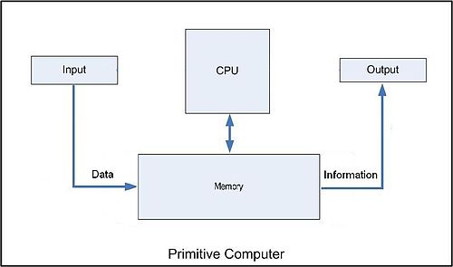
What is a Computer?
Started off as persons who did calculations. Allen Turing in 1930’s proved that any math problem that could be set up as an algorithm could be solved by machine.
Device that performs arithmetic operations (CPU.) Peripheral components stores the results (RAM.)
Computers do everything with binary arithmetic. Basically, deep under the hood all the computer can work with is sets of units that can assume only two states—{on/off or up/down or 0/1}. By keeping track of many sets of two-state units computers do everything we’ve come to expect.

Slide 5
What can computer programming do for you?
I’ve talked about code I’ve written. What would you like to do that computer programming could facilitate?

Slide 6
Programming to build software (so what?)
We’ve all heard of ‘killer apps’ e.g. spreadsheets, word processor, web browser, video games. We would certainly need to know how to program to build any such application.
There are countless applications in computer science (CS) and information technology (IT).
Intellectually challenging (like chess and crossword puzzles); Puts you in control of what the computer does.
‘Can also be loads of fun’ and its an addiction you can kick easily.
‘Programmers are in great demand’—enhances your employment opportunities.

Slide 7
What is computer science?
My answer is that computer science (CS) is needed for writing scientific programs to solve physics problems that involve heavy number crunching. That’s my answer but the truth is you can make a career out of CS if you want to, and the applications are endless.
This course considers the use of computers in science applications.

Slide 8
What is computer science (CS)?
CS is:
CS is not:
Designing programs/algorithms to solve problems by any method that will work including:
pencil and paper hand calculations.
writing code into a computer.
website development
teamwork with other programmers (via Git and github).
The study of how to use software like Excel, Word and Photoshop.
Building computers or their components.
Developing website content.

Slide 9
Hardware basics
let’s google it.

Slide 10
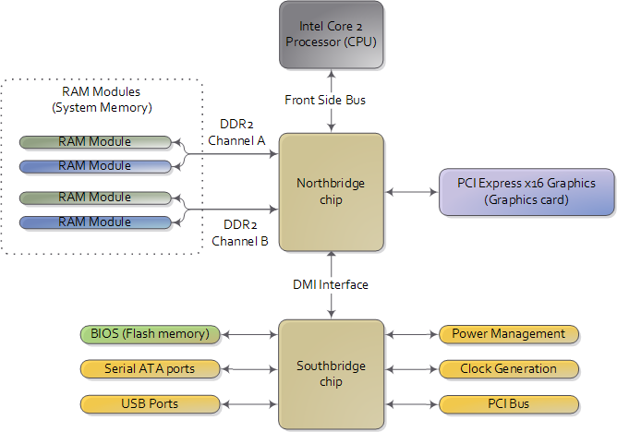
Hardware Basics

Slide 11
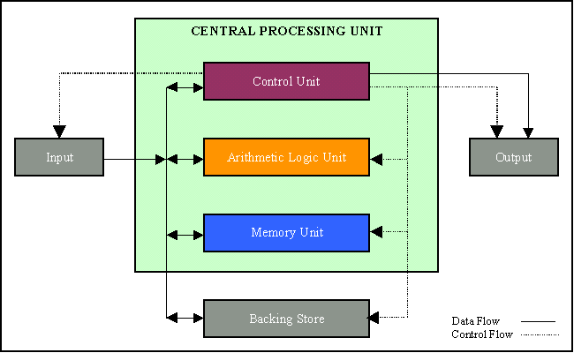
Hardware Basics
http://www.nvc.cs.vt.edu/~cegyhazy/cs4014/Chapter7.htm

Slide 12
Programming languages
Why choose Python as the language for this course?

Slide 13
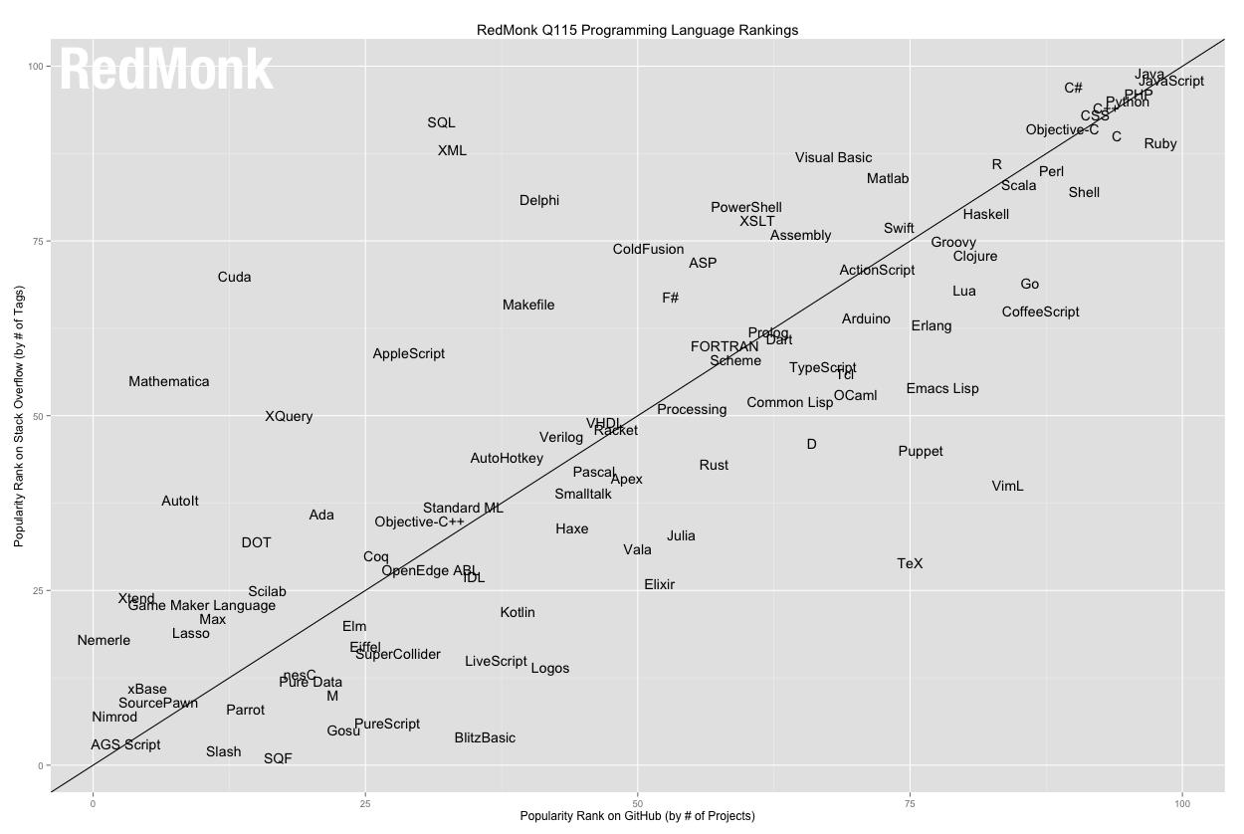
http://redmonk.com/sogrady/2015/01/14/language-rankings-1-15/

Slide 14
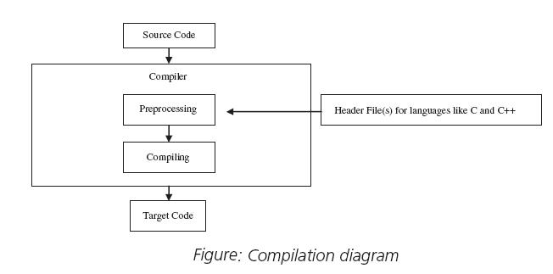
Compiling a high level language like C++ into machine language:

Slide 15
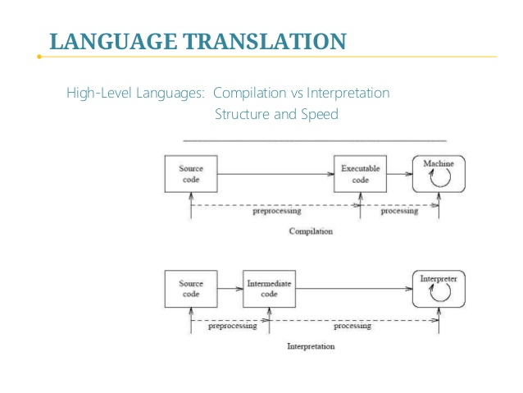
Interpreting a high level language.

Slide 16
The magic of Python
It’s not magic (or is it?)

Slide 17
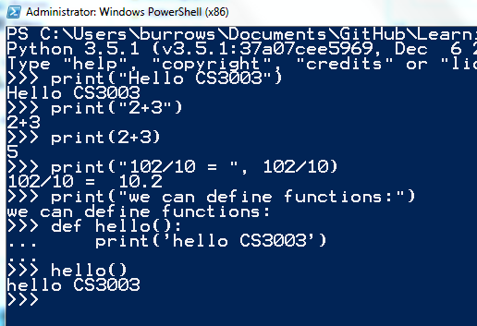
getting the Python started
type python at the command line to launch the interpreter:
since Python is interpreted we can run it live at the command line.
Python makes an awesome calculator!
we can define functions with
def <functionName>( ):

Slide 18
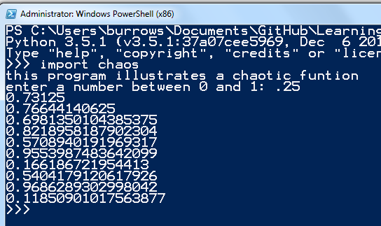
Writing Python modules
A module is a text file containing code. You can write modules in IDLE (that’s what I’m using) or any IDE you prefer (eg notepad).
The function that produced the output on the screen is an example of a chaotic function that can produce unstable results. We want to beware of these when we develop numerical algorithms.

Slide 19
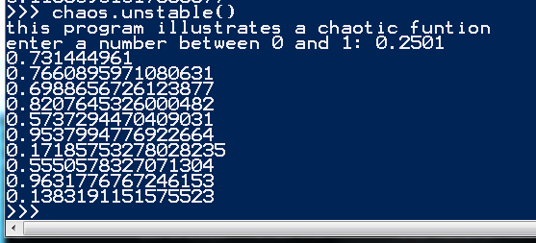
Instability of output by the chaos function
input = 0.25
input = 0.2501

Slide 20
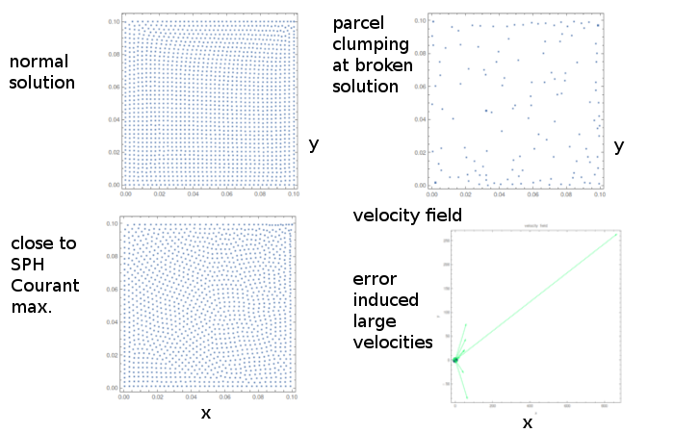
SPH Catastrophe: Shear Cavity

Slide 21
Inside a Python Program
Computers are weird (or are they?)

Slide 22
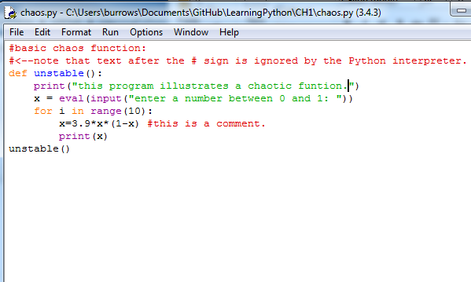
The Python IDLE helps with code construction
IDLE
color codes the text
does automatic indents
provides many features

Slide 23
you can name functions anything. here I called it unstable( ) instead of main( ).
iterative loop structure
nested function calls to Python built in functions
comments help developers, including yourself understand your code. sometimes code is self explanatory, other times a little comment helps.

Slide 24
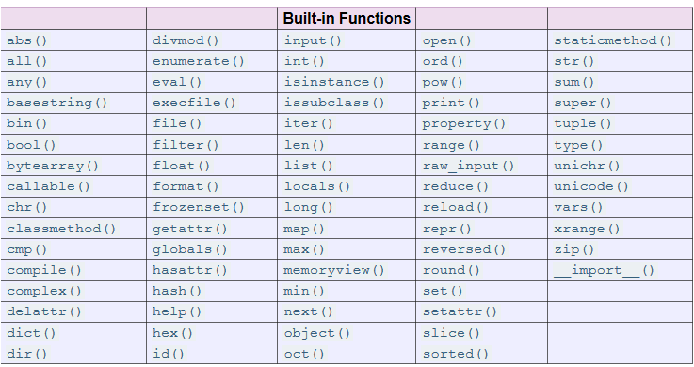
Python built in functions:
https://docs.python.org/2/library/functions.html

Slide 25
Chaos and computers
Something to be aware of when your crunching numbers with a machine.

Slide 26
The unstable chaos function points to danger:
Typically functions will be well behaved but if they’re not—watch out.
Short list of (well behaved) sample data output from my research:
A function is unstable if
small variations in the initial data lead to large variations in the final output.
small errors (like round off) can grow exponentially.
usually we can see from our results if something is unstable in our code.
0.398204 -0.109584 0.0579681
0.317161 -0.0312596 0.0626073
0.0790879 0.00334768 0.00134979
0.169625 0.0472699 -0.0119608
0.28443 0.0167447 0.0464169
0.182159 -0.0377209 -0.0086531
0.207373 0.0709511 0.0110181
0.253983 0.0465006 -0.0120759
0.155861 -0.0176867 -0.00854261
0.258698 -0.0800864 0.0483653
0.242777 -0.0213251 0.0126708
0.269536 0.0305304 -0.0480996
0.322315 0.00998351 0.0591609
0.285701 0.00288139 0.0324585
0.226802 -0.00762167 -0.00745475
the data list goes on and on

Slide 27
Chapter summary
What did I learn that I can say about this python?

Slide 28
Chapter 1 concepts
Computers—were surrounded by them so let’s make them do what we want them to.
The study of computer science gives us the knowledge we need to control the machines.
Programming provides computational instructions that can be compiled into machine language.
Python is interpreted—it knows how to feed instructions to precompiled modules (written in C++.)
In constructing numerical algorithms we need to beware of instabilities which may (or may not) be leading to broken answers to the original problem.

