Slide 1

Introduction to scientific computing using Python.
CS 3003 Scientific Computing; Spring Semester, 2016;
T Th 9:40-11, SC C26.
Class Text:
Python Programming
By John Zelle

Slide 2
Why Bother to compute? Should you?
Score = 100 → You should learn computer programming! For:
Score < 100 → You could think about it. Against:
You want to solve problems that involve large data and/or repetition (+90).
You want to be an administrator or website developer (+90).
You decided to take this class (+50)
You want to be a scientist (+50)
You want/need to be in control of what your computer is doing (+50).
You can’t stand hassling with computer problems (-50).
You don’t want to have to keep thinking and learning new stuff constantly (-50).
You prefer hard physical work, especially outdoors (-50).

Slide 3
About me, why do I compute?
My goal → develop hybrid plasma-code (uses tons of comp. power)
Runs on supercomputers → multi-threaded code, needs Linux
Parallel programing, have to split job into many inter-cooperating threads.
Community participation → version control with Git at GitHub.com
Base object oriented code development in C++ → produces lots of data
PYTHON is a great high-level and highly flexible language that can be used to administrate base code execution and perform post-processing operations on data-sets.
Too late to turn back. I’ve been working to develop scientific simulations for too long to switch career paths.

Slide 4
my Philosophy of Object Oriented (OO) code design:
First--do it any way you can! Later, you can try to make your program more efficient and robust (if needed).
Understand the problem completely before starting to write code. This rule is made to be broken. Sometimes by trying to code the solution you come to better understand the problem.
See if a solution already exists. If so this could be a starting point for you to work from.
Develop your solution in modules (bite-sized packets) that you can test independently. Arrange the modules to solve the problem. Note these modules could be useful for other projects (reusability).

Slide 5
Solutions (i.e. programs) I’ve Developed professionally (yes they paid me):
Smoothed Particle Hydrodynamics (SPH) code
Hybrid Plasma Code (beta version.)
Particle in Cell (PIC) plasma code.
Ion dynamics code, parallelized with MPI to run on a supercomputer.
Solver for a highly nonlinear modified Burgers’ (shockwave) equation.

Slide 6
SPH code development
SPH strong points:
Mesh-free: easily handles complex physics like free moving surfaces and large deformations i.e. explosions.
Action/Reaction parcel pairs description makes it easy to set up multi-phase flow and easy to add new physics to a model.
SPH (hidden) weakness:
Possibly inherent computational inefficiency due to a statistical need for many action/reaction parcel pairs in the simulation domain to avoid the development of destabilizing zero'th order errors.

Slide 7
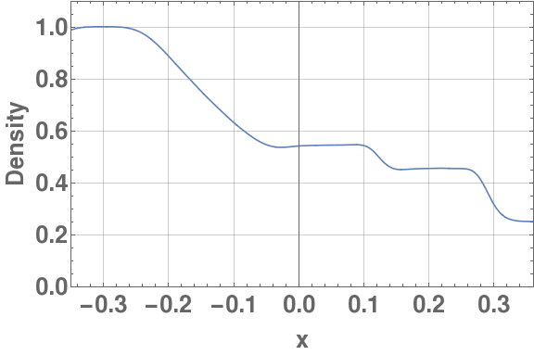
SPH code development
Written in C++ based on the textbook “Smoothed Particle Hydrodynamics” by Liu and Liu.
Our code passed all basic tests successfully.
1D Shock Tube
Solution at t = 0.005 s
Rarefaction-wave
Contact-discontinuity
Shock

Slide 8
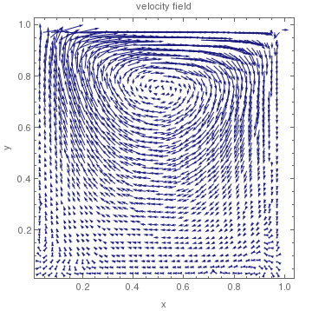
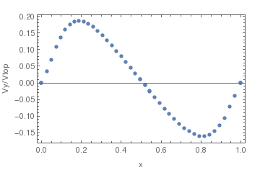
SPH: 2D Lid-driven Cavity Flow at t=0.15s
Water filled box
Reynolds Number=1
Vertical velocity along the center line.
3000 time-steps, 1600 parcels.

Slide 9
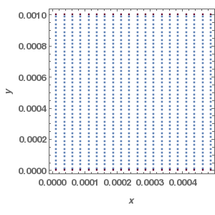
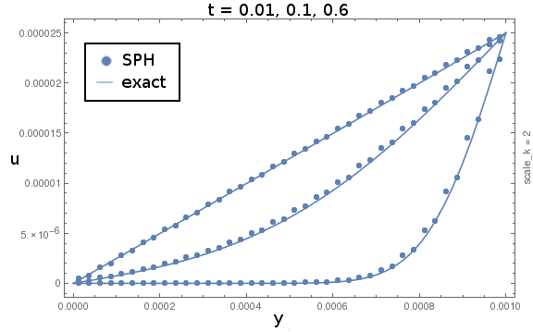
SPH: 2D flow between 2 infinite plates, cyclic boundaries
Water filled plane-slab, Re=2.5e-2,
lid-driven flow
Velocity profiles for the Couette flow, SPH verses exact solution:
moving-lid

Slide 10
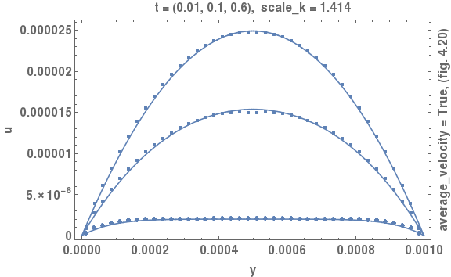
SPH: 2D flow between 2 infinite plates, cyclic boundaries
Water filled plane-slab, Re=2.5e-2,
potential-driven flow
Velocity profiles for the Poiseuille flow, SPH verses exact solution:

Slide 11
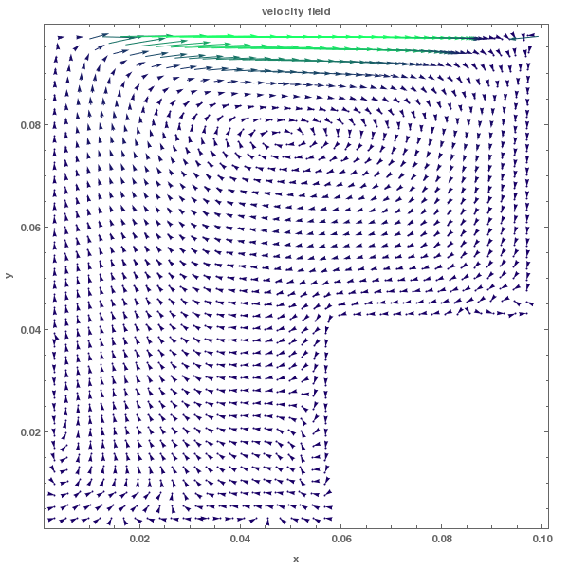
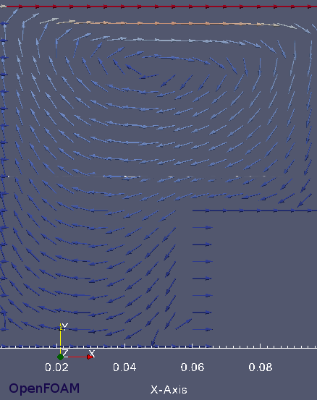
SPH Clipped Cavity Lid-driven flow, Comparison with OpenFOAM CFD:
2D water filled cavity
Reynolds Number = 1
SPH

Slide 12
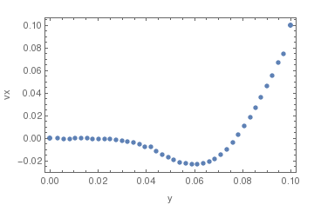
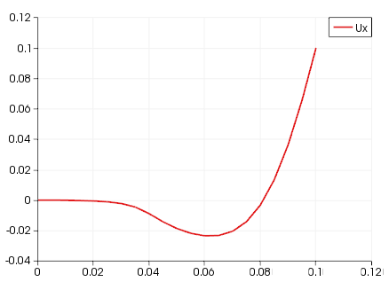
SPH Clipped Cavity Lid-driven flow, Comparison with OpenFOAM CFD:
SPH
V_{x} up the center-line
OpenFOAM

Slide 13
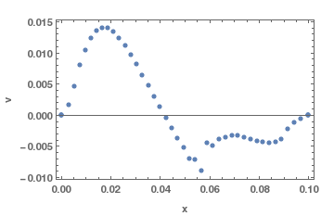
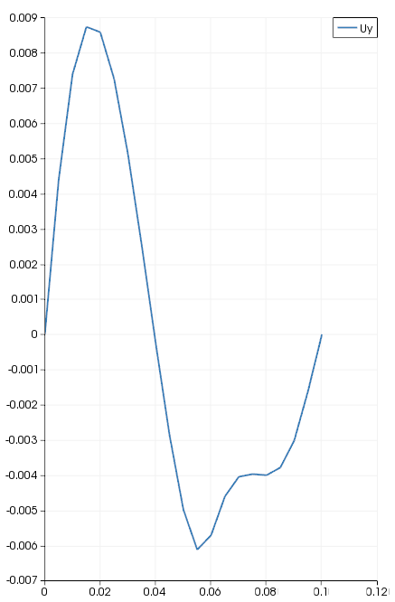
SPH Clipped Cavity Lid-driven flow, Comparison with OpenFOAM CFD:
SPH
V_{y} on horizontal-line
OpenFOAM

Slide 14
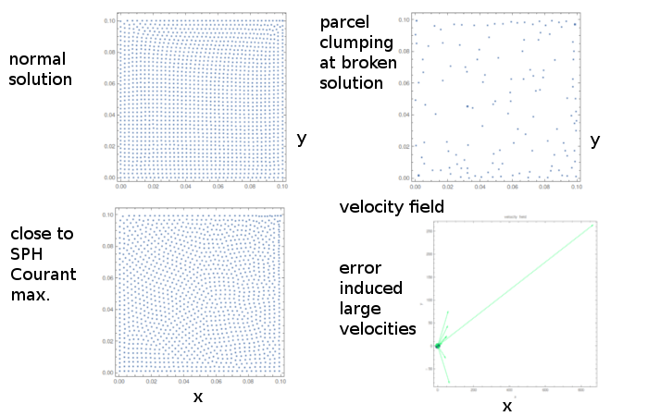
SPH Catastrophe: Shear Cavity:

Slide 15
OpenFOAM CCM
Provides a logical object-oriented modular framework for solving PDEs.
Emerging as the open source scientific communities answer to CFD making it easily competitive with proprietary CFDs.
Structured so new physics modes are straightforward to implement.
Works with other open source tools such as Blender and Salome CAD for generating complex simulation mesh structures.

Slide 16
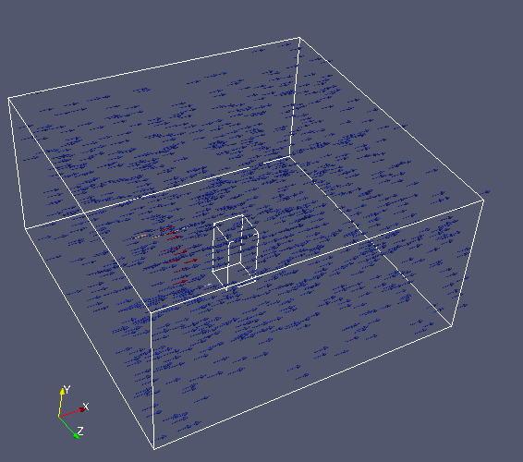
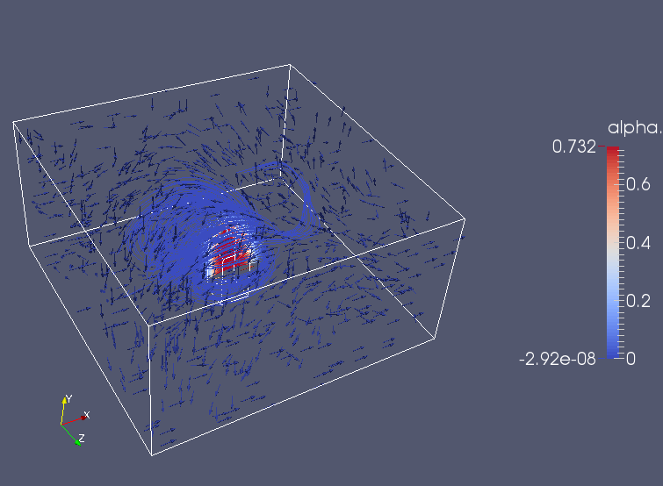
OpenFOAM CFD two-phase mixing simulation:
'Fog' or 'smoke' flowing over a 'building':
t = 0
t = 0.75

Slide 17
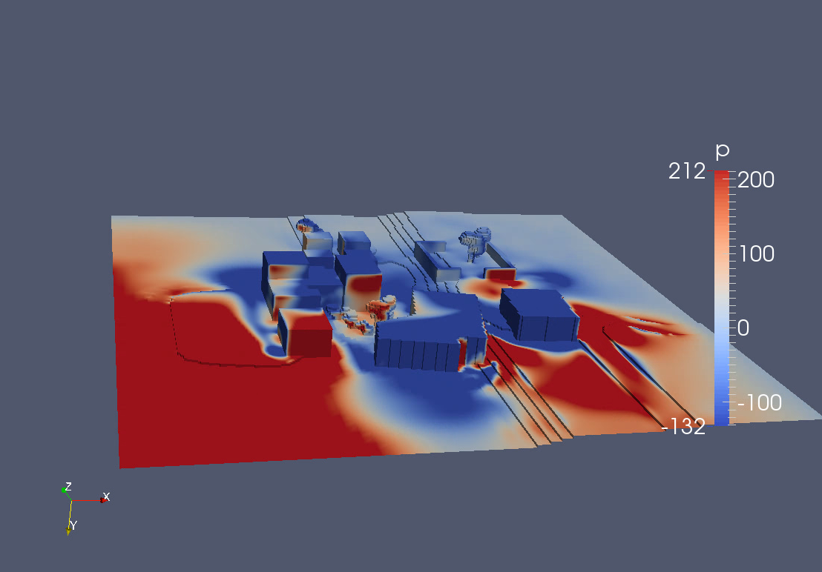
OpenFOAM CFD, airflow through SimpleTown:
CFD pressure at SimpleTown

Slide 18
OpenFOAM: has a large base of Standard Solvers
Solvers we've used
icoFoam: incompressible Newtonian fluids
pisoFoam: incompressible fluids
interFoam: like above but for two immiscible fluids.
Multiphase solvers to extend for this project
interMixingFoam: 3 incompressible fluids, two are miscible.
Parcel-tracking codes:
DPMFoam: transport of a particle cloud.
ReactingParcelFoam: turbulent flow with reacting parcels and surface film modeling

Slide 19
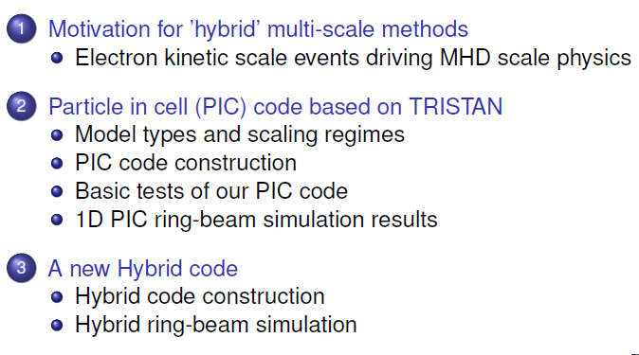
Plasma code development
As the course progresses I will draw on my experience in developing space plasma codes to motivate the introduction of various computer programming modeling and design concepts. However you do not need to understand my research. The math requirement for this class is only algebra so if you don’t understand plasma physics don’t worry! You don’t need to!

Slide 20
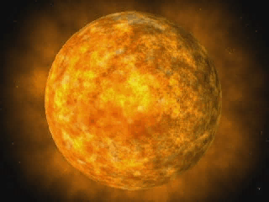
Why build a plasma code?
Most of the (know) universe is composed of plasma.
Could get paid.
Understand particle acceleration in the solar wind (major implications for space travel, thus of interest to the Air Force and NASA.)

Slide 21
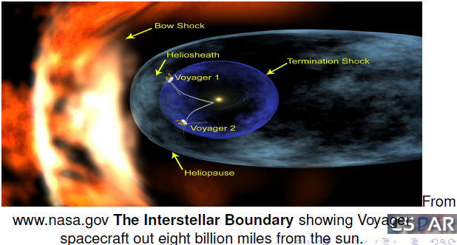
Why build a plasma code?

Slide 22
Particle in Cell (PIC) code as an example of the Code Development Process:
Why build a PIC code?
Computer Science Design Challenge:
Relatively simple from a conceptual standpoint.
Includes just about all relevant space physics.
Is a component of the hybrid code development → which is ultimately what I want to sell.
Define the overarching governing system.
Divide the parts of the system into modules that can be developed independently. (OO design.)

Slide 23
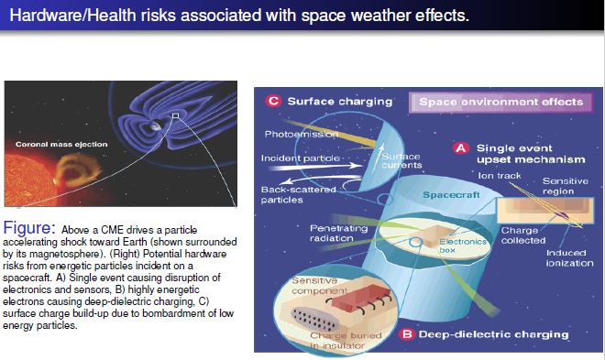
Why build a plasma code?

Slide 24
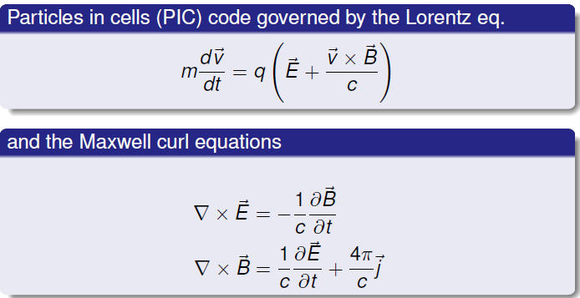
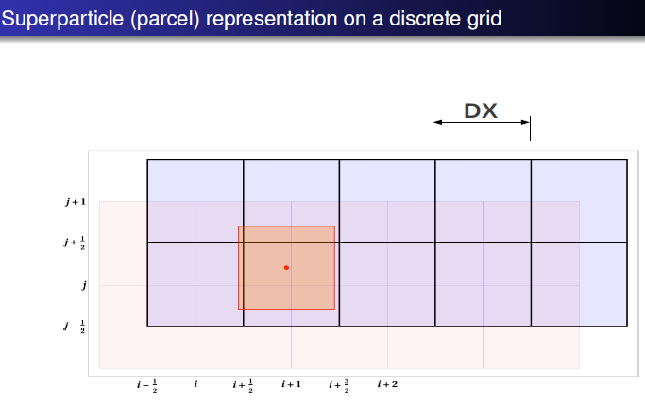
PIC governing system: OO Design Challenge
Governing equations
Computational discretization
Teamwork would be desirable on such a large project → need version control at github.com

Slide 25
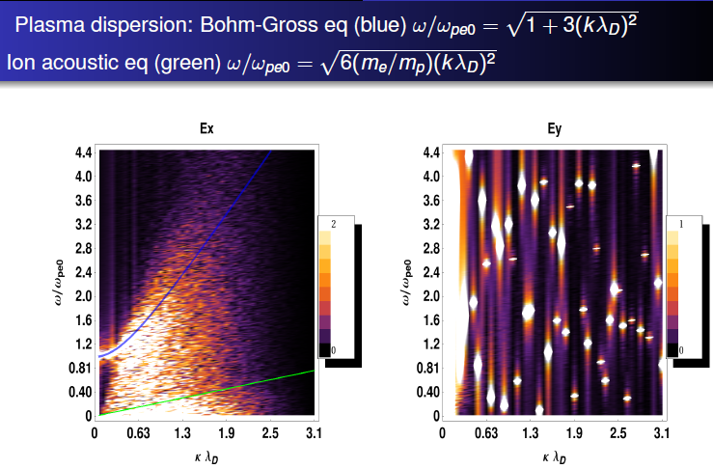
On a large project like PIC into Hybrid a compartmentalized approach like OO design is necessary
The production of the figure required:
The development of the PIC simulation as a top level input/output system where the input is the boundary conditions and setup of the initial system state. The output is large files of particle and field data.
Post processing of the output data (Python would be ideal for this phase). In this case wave analysis using the Fast Fourier Transform (FFT) was performed and the output plotted with Mathematica.

Slide 26
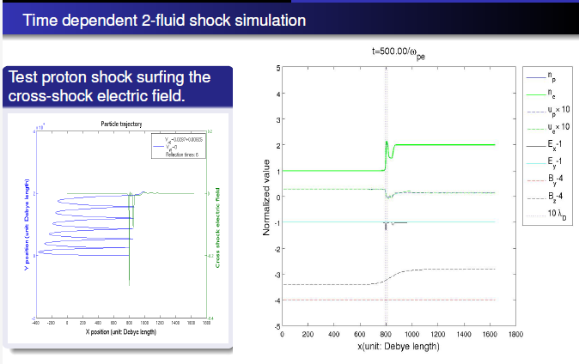
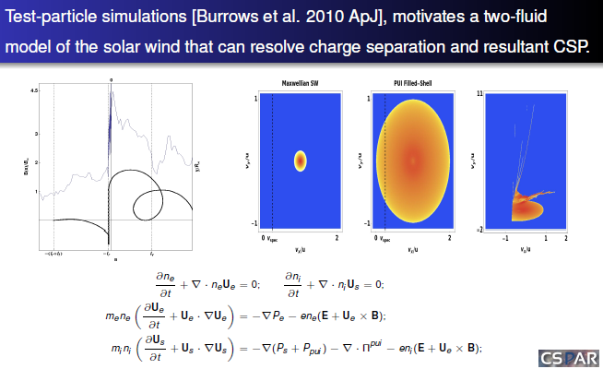
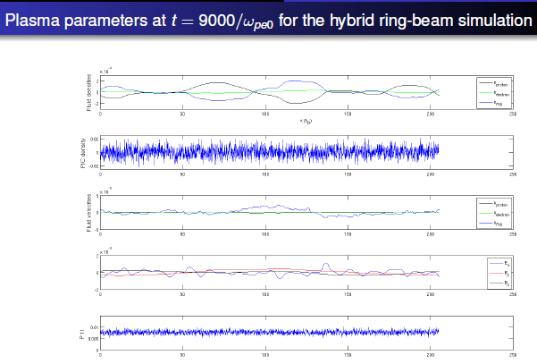
Hybrid code (beta)

Slide 27
Why develop a hybrid code?
PIC is conceptually simple and has all the physics but it is computationally to expensive for some problems.
By combining two-fluid system with selected particles treated by PIC I intend to get the computational efficiency of fluid solvers and the ability to track (selected) particles of PIC.
Ultimately, to be successful, will need:
Teamwork (github.com)
Multi-threaded parallel treatment (to run on supercomputers)
I need to code in Linux (should you be using Linux too?)

Slide 28
Should you be using Linux?
Score > 100 → you probably should use Linux.
Score < 100 → Maybe Linux isn’t worth the effort.
You want to run simulations (or anything) on supercomputers (+100)
You want to be a network or IT administrator (+100)
You want to be a scientist (+50)
You want to up your geek creds. (+20)
You want to be a software developer (+20)
You don’t want to pay for software (+20)
You just want to play games (-50)
You like paying for software (-20)
You don’t like to have to learn new things (-20)
You are already doing everything you need without it (-20).

Slide 29

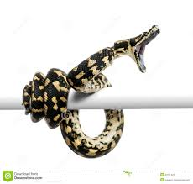
GIT a Grip on PYTHON
CS 3003 Scientific Computing; Spring Semester, 2016; T Th 9:40-11, SC C26.
Like ’em or not, computers are used by almost everyone for almost everything. If you need to show your computer who’s boss, programming is for you. Python is a high-level interpreted language. This means you get the most problem solving power per effort, compared to lower level languages like C++. Python is a perfect first (or last) language. Whether you just want to get a strangle-hold on administration, or to develop full scientific simulations, Python is a tool you can employ throughout your career.
When you save a file your doing version control. GIT is emerging as the leading version control system for collaboration on large projects, e.g. Linux and Google. If you want to collaborate with a multitude of geeks, whether they’re artists or scientists GIT is the tool. Let’s work together with GIT to stick to the man.

Slide 30
What will the format of this class be?
We will try to cover about a chapter per week from our textbook Python Programming by John Zelle.
We’ll try to keep comfortably paced and informal, with homework assignments due every other week (or so) on average.
We’ll move towards collaboration via github.com as fast as we can manage this comfortably.
We will each do a final project (due during final and is effectively the final exam.) This can be a team collaboration—but in this case each team member needs to pull their weight in terms of contribution.

Slide 31
Get Python at www.python.org

Slide 32
