Slide 1
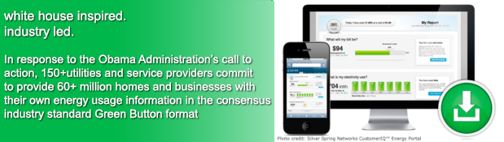
The Green Button Initiative
www.greenbuttondata.org
John Teeter, Presidential Innovation Fellow Alumni,
National Institute of Standards and Technology
john.teeter@nist.gov

Slide 2




Federal Government Interest in Data Access
Open Data Initiatives
Making government information resources more publicly accessible in “computer-readable” form and encouraging its use by entrepreneurs as fuel for the creation of new products, services, and jobs
Project Open Data: http://project-open-data.github.io
Examples: Federal Register 2.0, Data.gov, Health Data Initiative, …
My Data Initiatives
Empowering consumers with secure access to their own personal health, energy, and education data
Blue Button (health info), Green Button (energy), Education, …

Slide 3
US Federal Government Commitment
Climate Action Plan
“The Administration will leverage the ‘Green Button’ standard – which aggregates energy data in a secure, easy to use format – within federal facilities to increase their ability to manage energy consumption, reduce greenhouse gas emissions, and meet sustainability goals.” The President’s Climate Action Plan, June 25, 2013
Presidential Memorandum (to all Federal agencies)
“Sec. 3. Building Performance and Energy Management .. each agency shall: … incorporate Green Button into reporting, data analytics and automation, and processes, in consultation with local utilities …” [.. GSA, EPA pilots …] Presidential Memorandum on Federal Leadership in Energy Management, December 5, 2013

Slide 4
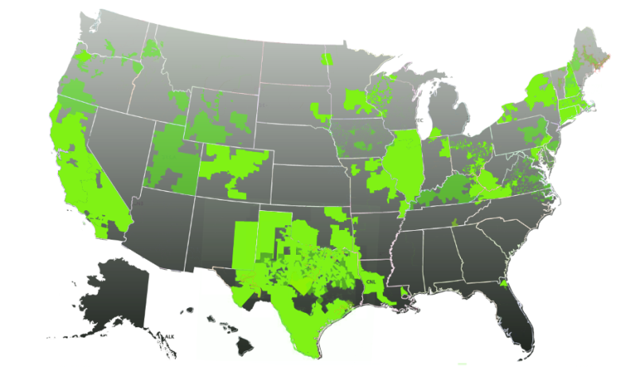
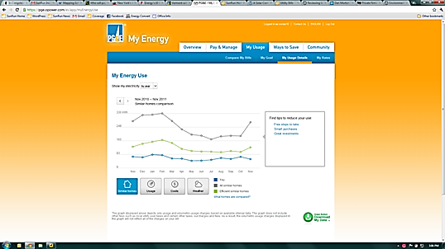


Green Button Across the Nation
Enables electronic consumer access to energy data and supports development of ecosystem (apps)
Available to 60+ million customers in the US and and additional CANADA: 2.6 million+
Result of collaboration among White House, NIST, DOE, state regulators, utilities, vendors, SGIP, and North American Energy Standards Board
Green Button Download My Data and Green Button Connect My Data
Map of US Green Button Commitments

Slide 5
Green Button Evolution
White House Call to Action
Connect My Data Beta Deployments
American Energy Data Challenge
Green Button
CMD Certifications
9/2011
NAESB ESPI Standard Ratified
12/2012
11/2013
4Q 2014
HEY Update w/Green Button
Presidential Memorandum to Federal Agencies
10/2011
First DMD
Available
1/2012
DMD Certifications
Green Button CMD Rollouts
Nationally
DOE Apps for Energy
4/2013
12/2013
2H/2014
5/2012
1H/2015
2011
2012
2014
2013
2015
0 Customers
(Download My Data)
12 Million Customer Accounts*
26 Million Customer
Accounts*
42 Million Customer
Accounts*
* Represents Customer Accounts with Access to Green Button Data – Primarily DMD; Actual Customer download numbers are not available
Notes:
1 – DoE Energy-Apps
a) SDG&E and PG&E released their Green Button support within 90 days of the Call to Action
b) DoE sponsored an Apps for Energy challenge to stimulate ecosystem growth
2 – EPA PM Upgrade: EPA release of API moved Portfolio manager to an Open API platform and set the stage for future Green Button support,
the details of which will be reflected in the EPA portion of the agenda (not wanting to steal their thunder.

