Slide 1
HyGen
Brian, August, Thomas
05/4/2026

Slide 2
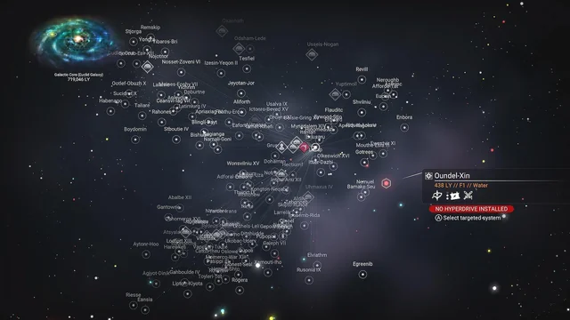
Project Motivation
Many modern games need large worlds for players to explore
Manually crafting maps can time consuming and difficult
Impossible for game with infinite maps (Minecraft, No Man’s Sky)
There are over 18 quintillion procedurally generated planets to be explored in No Man’s Sky

Slide 3
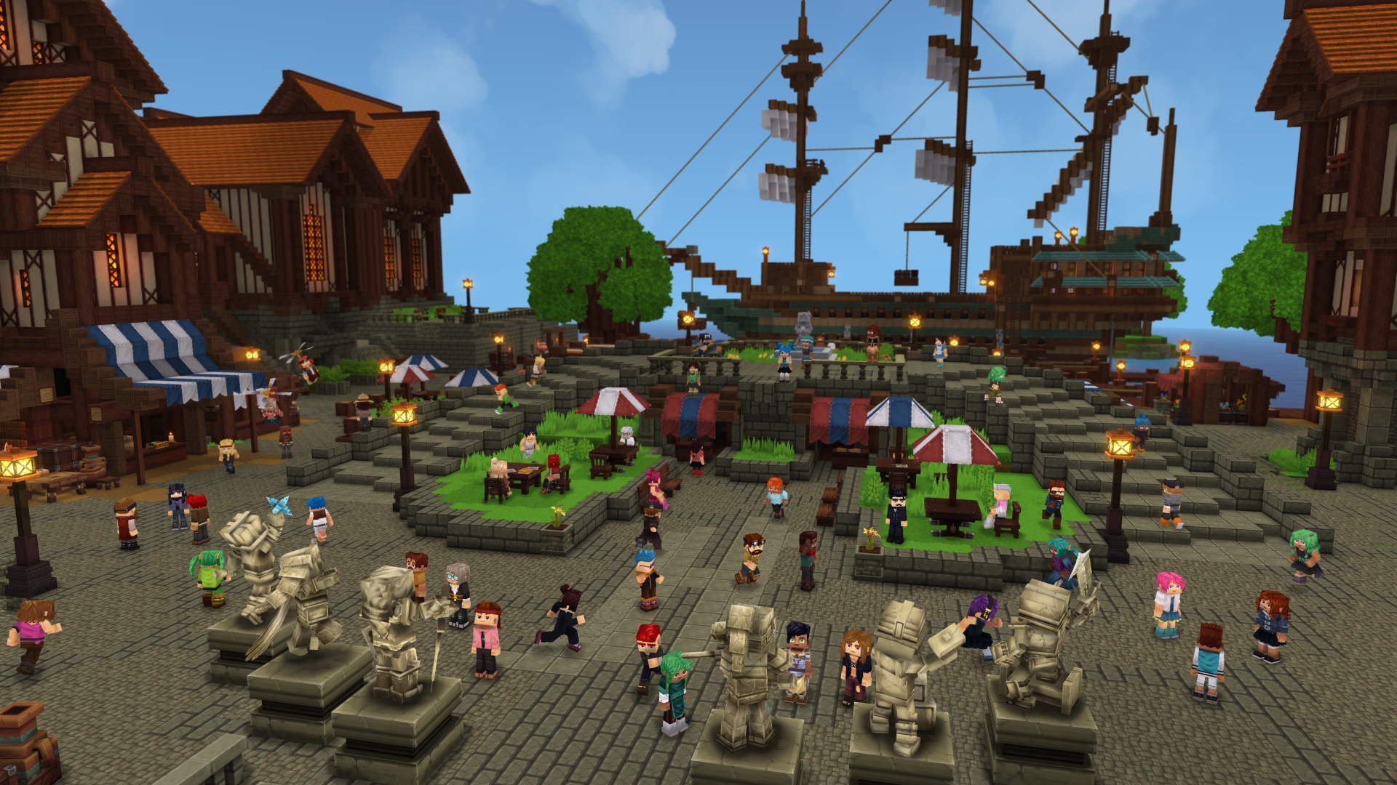
Hytale
Hytale is a fantasy sandbox RPG that has recently gained popularity
Hytale has strong built in tools for animation, modeling, and scripting
  Allowing it be highly accessible for modding and custom content creation
Image from the game Hytale

Slide 4
Project Overview
Project Goal: Create a learned generative model that can automatically generate map layouts for the game Hytale
Ensure that maps are playable and interesting
Models will be trained to generate sub-regions of larger maps
  This will allow our models to be used as a tool to generate diverse custom maps
Example Use Case: “Generate a map with a canyon in the middle”

Slide 5
First Approach

Slide 6
Dataset
Had to build our own - since we could find no existing datasets
Rule-based procedural generation
Generate 64x64 maps with some random variation
Maps were generated from 7 unique archetypes
Important Note:
Currently generating a height map
  2D grid where each value represents the terrain height

Slide 7
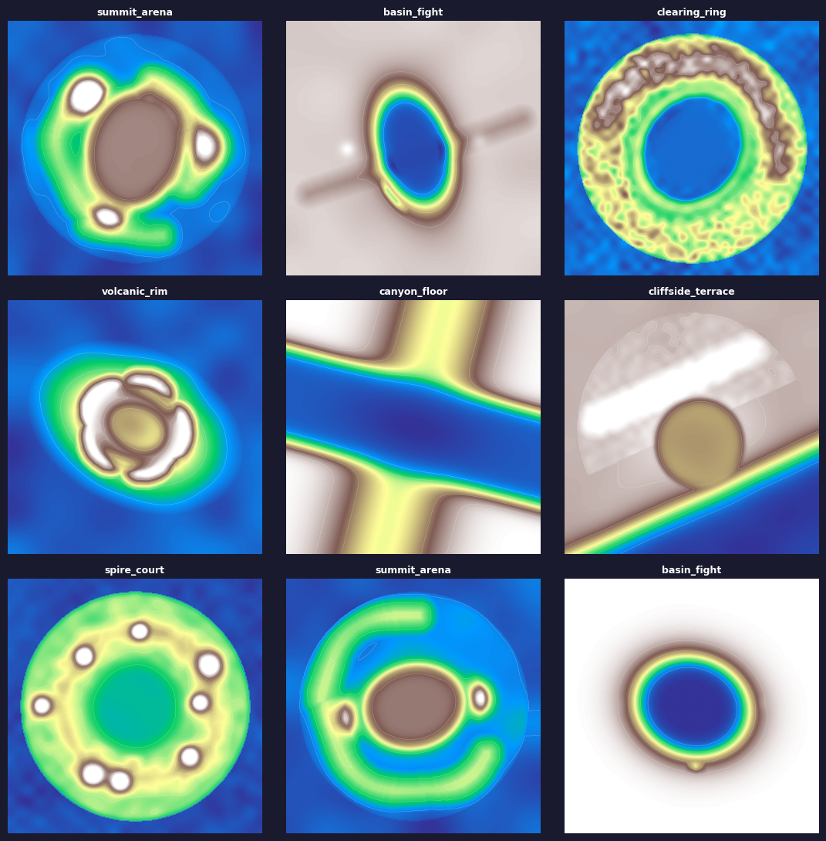
Rule-based Generation Dataset

Slide 8
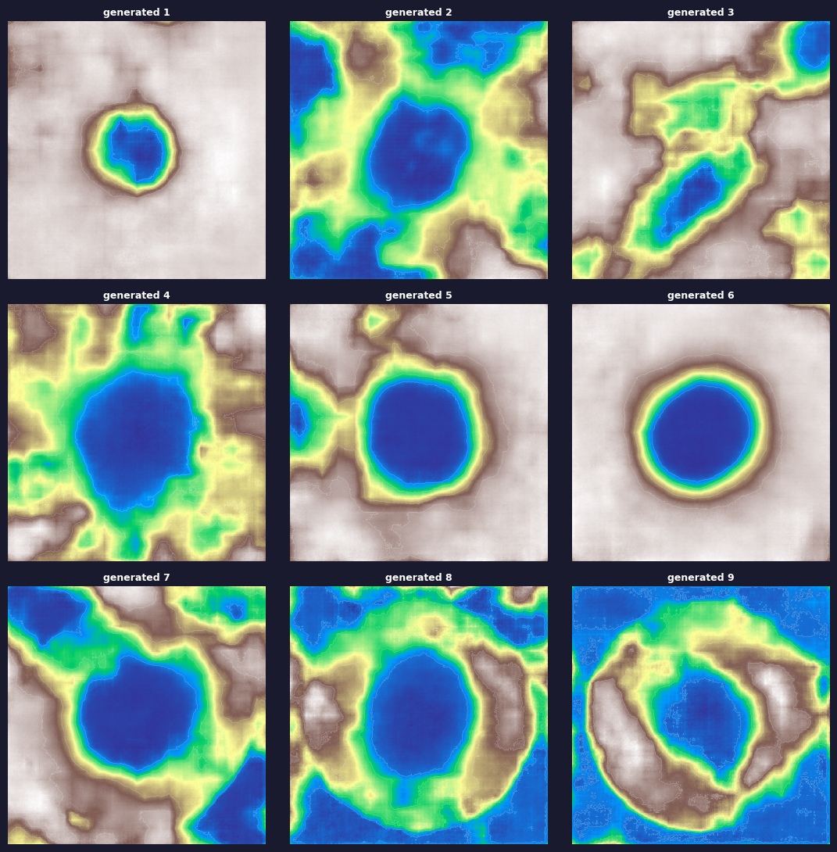
VAE Generated Maps

Slide 9
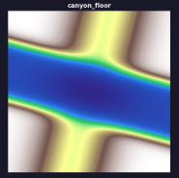
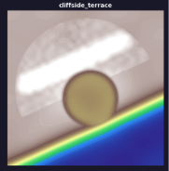
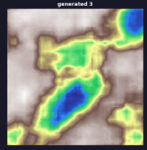
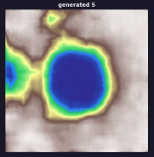
VAE Challenges
Images are blurry
Surfaces that should be flat have noise, reducing playability
Struggled to capture certain archetypes
  Likely due to several archetypes being similar, leading to class imbalance
Dataset
VAE
Generated
VAE struggled with Canyon Floor and Cliffside Terrace

Slide 10
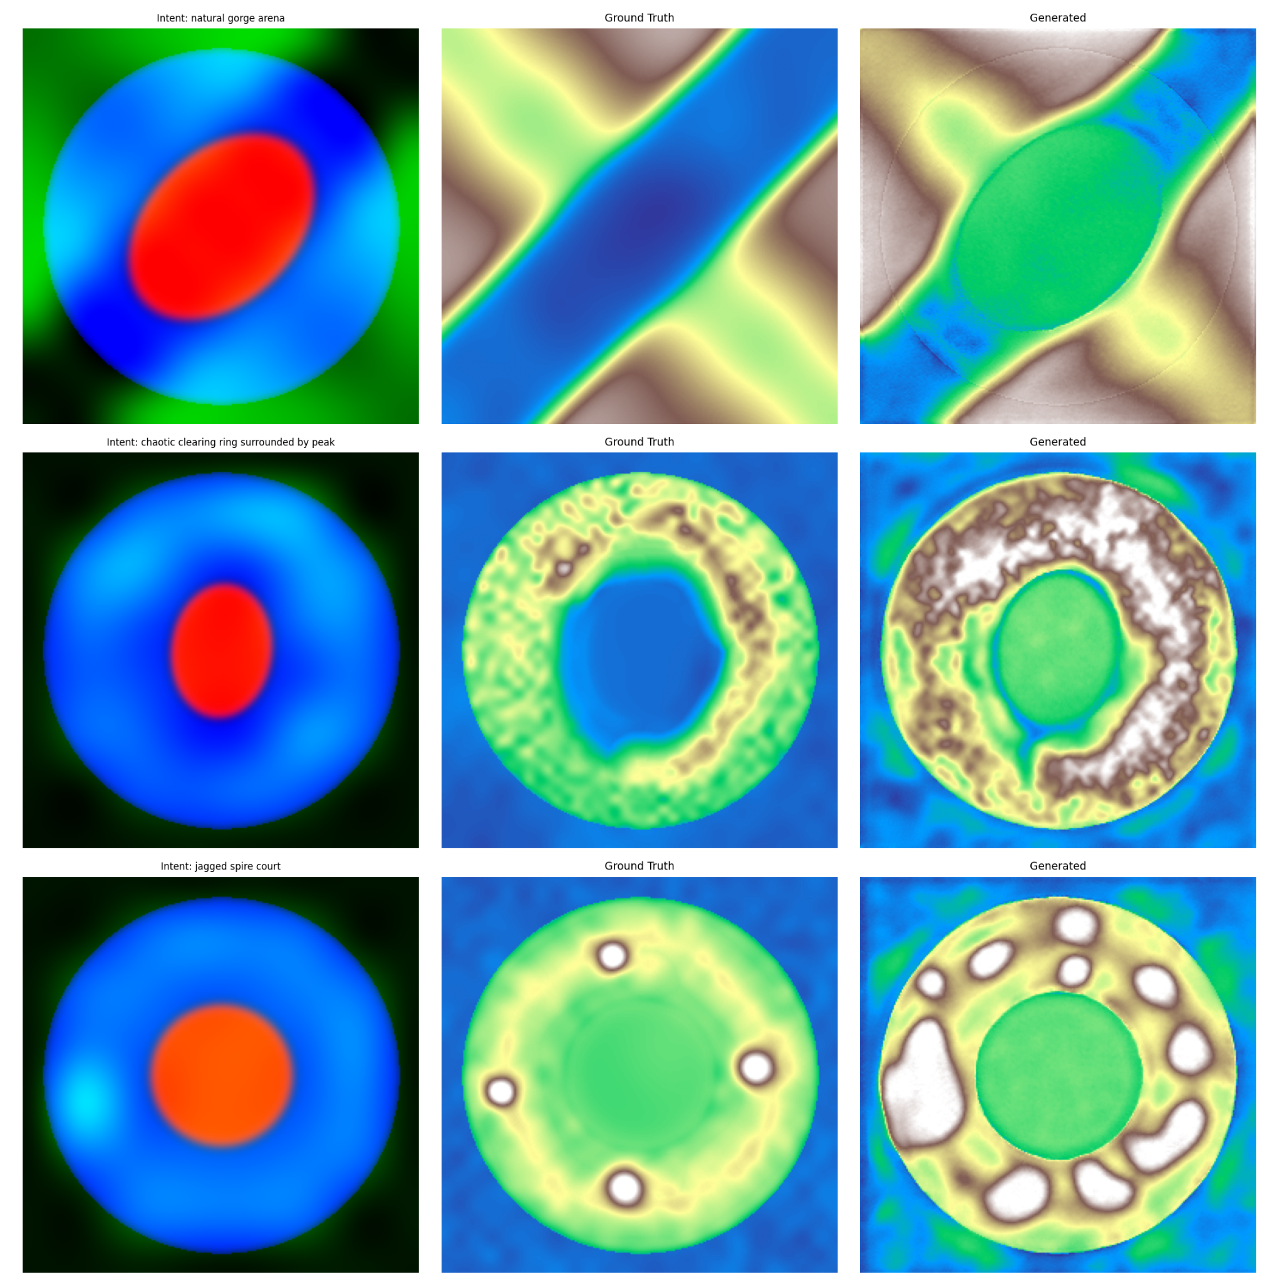
Diffusion Generated Maps

Slide 11
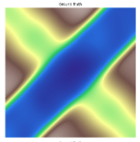
Diffusion Results
Images are less blurry
Better at capturing the difficult archetypes than the VAE
Images still contained noise
  Seen in the flat terrain
Left to right: Dataset, VAE, Diffusion Model

Slide 12
Second Approach

Slide 13
Dataset
Scraped Data from minecraft with Tectonic mod
  Generate a random map generated with a random seed
  Extract all blocks within a 100 chunk radius (1 chunk = 16 blocks)
  Remove trees, grass, structures
  Chunk up into several 256 by 256 blocks
  Convert to heightmap
  Extract biome data
  Get labels from the biome data
Increased size of the maps
Better variation of terrain features
More realistic and playable training examples

Slide 14
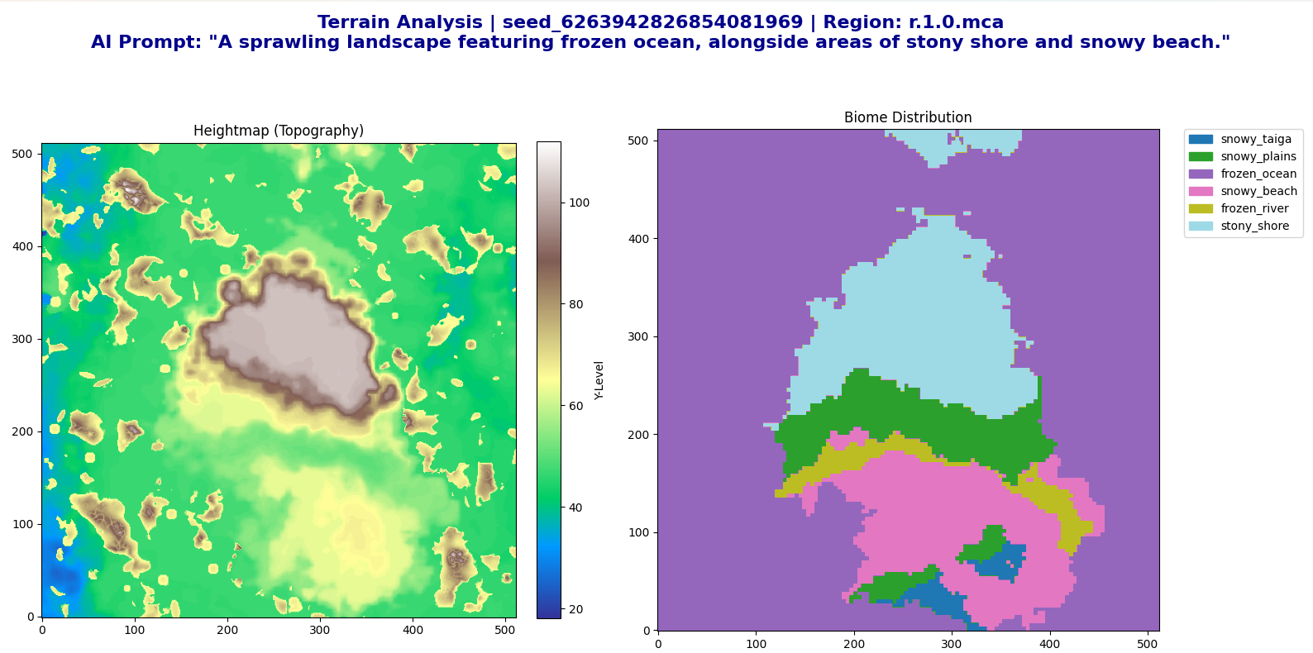
Scraped
Dataset Images

Slide 15
Model Components
VAE
Encodes terrain heightmaps into smaller latent embedding
Converts from 256x256 chunks to 64x64
Makes diffusion faster and cheaper
Decodes final latent output back into terrain heightmaps

Slide 16
Model Components
U-Net
Main diffusion model that generates the terrain
Inputs:
  Noised VAE embedding
  timestep embedding
  Terrain label embedding
  ControlNet border residuals
Learns to remove noise adding in more fine-grain grained terrain details

Slide 17
Model Components
Control Net
Injects border-conditioning into the U-Net
Ensures neighboring chunks are aligned
Prevents cliffs and visible seams at chuck boundaries
Helps to continue rivers, canyons, mountains, etc., across chunks

Slide 18
Model Generation
Generate a high-level terrain map procedurally
  Parse user input to determine what large scale features to add (mountains, rivers)
Encode image to a smaller latent dimension using a VAE
Add noise to the latent representation
Use T5 Text Encoder to convert the user prompt into an embedding
U-Net + ControlNet work together to refine chunks
Use cosine crossfade to remove seams between chunks
Apply terrain validation and add in artifacts based on biomes

Slide 19
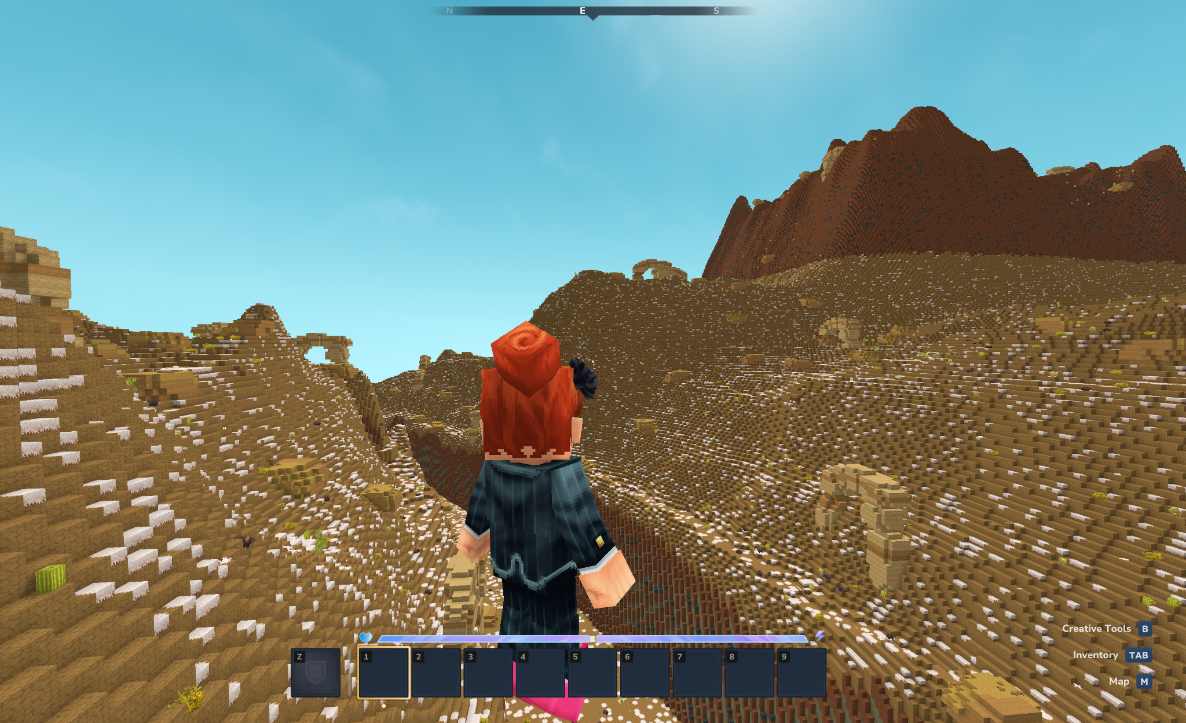
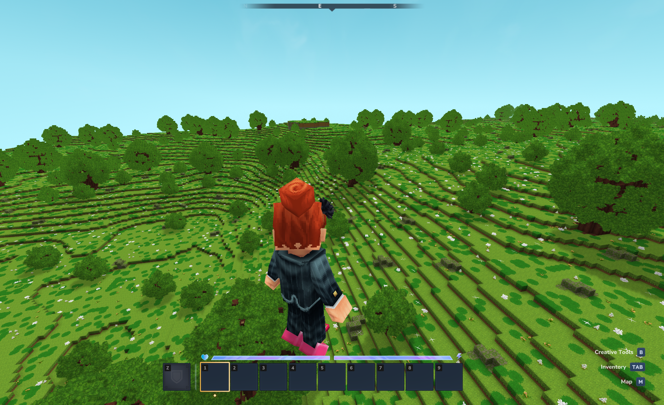
Results
“Desert Canyon”
“Great Plains with Trees”

Slide 20
Demonstration

Slide 21
Image Credits
https://www.reddit.com/r/NoMansSkyTheGame/comments/113am8f/since_nobody_else_i_know_would_understand_this/
https://hytale.com/news/2018/12/simon-and-rezzus

Slide 22
Thank you!

