Slide 1


PlastizymeFinder: a pipeline for the discovery of putative plastic-degrading enzymes in metagenomic datasets
Hongo Koffi Anderson
PhD student - University Nangui Abrogoua

Slide 2


Table of contents
01 - Why plastizymes
02 - Pipeline architecture
03 - Built the Nextflow way
04 - From reads to a 3D fold
05 - Validation on real data
06 - What running it taught us
07 - Status and roadmap
08 - Team

Slide 3

Why plastizymes
The problem, and the gap this pipeline fills
A rare clean route
Enzymatic depolymerisation is one of the few PET-waste routes that is both selective and runs near ambient temperature.
Mechanical recycling shortens the polymer at every cycle. An enzyme does not.
Very few known enzymes
The PETases we know were mostly found by chance. The enzyme space sitting in environmental metagenomes is largely unexplored.
The curated PET_DB screened here holds 158 non-redundant sequences - that is the whole of what is well characterised.
No end-to-end workflow
Mining a metagenome for them means chaining about twenty tools — and existing workflows stop at functional annotation. None carry a candidate through to a predicted structure.

Slide 4
Pipeline architecture
Nine subworkflows, each independently skippable
1-3 · Reads to contigs
FastQC → fastp → Bowtie2 host removal
Kraken2 + MetaPhlAn4 profiling
MEGAHIT → QUAST → Prodigal
4-6 · Contigs to MAGs
MetaBAT2 binning on Bowtie2 coverage
QUAST + CheckM2 + dRep dereplication
Prokka · CD-HIT · GTDB-Tk
eggNOG · dbCAN · KofamScan, in parallel
7-9 · MAGs to a fold
MeTarEnz against a curated PET_DB
RPS-BLAST vs CDD ‖ ColabFold
TM-align against PETase 6EQE
MultiQC and per-run figures

Slide 5
Built the Nextflow way
DSL2 throughout, portable, and resumable by design
Strict DSL2
52 files pass nextflow lint under NXF_SYNTAX_PARSER=v2.
nf-core module conventions end to end; every module carries a stub block, so CI exercises the whole DAG without pulling a single container.
Nothing to install by hand
Nine reference databases auto-download behind storeDir caching.
Or point --kraken2_db, --gtdbtk_db, --checkm_db and the rest at copies you already have, and the pipeline fetches nothing at all.
Resumable, and it mattered
A full sample runs in 3 h 20 on 8 cores — 139 CPU-hours.
-resume carried that run across four separate Docker Desktop restarts without recomputing a finished stage.

Slide 6
From reads to a 3D fold
Stages 7 and 8 — the part specific to this pipeline
Dereplicated, non-redundant proteins from the assembled bins — plus the contigs MetaBAT2 left unbinned, so nothing is lost — are screened by MeTarEnz against a curated database of PET-active enzymes, at the study's minimum bit-score of 250.
Whatever passes goes two ways at once: RPS-BLAST against pre-formatted NCBI CDD profiles for conserved domains, and ColabFold for the fold. ColabFold takes its MSA from a public MMseqs2 server, so stage 8 needs no local structure database — that is what makes it runnable on a workstation. TM-align then scores each model against a reference PETase, 6EQE by default.
Already have candidate sequences? --candidates_fasta enters the pipeline here, skipping stages 1-6 entirely.
MeTarEnz is a published tool by Foroozandeh Shahraki et al., Nat. Prod. Bioprospect. 2024 (doi:10.1007/s13659-023-00426-8). We wrap it in a Nextflow module that handles its relative paths and its silent zero-hit exit.

Slide 7
From raw FASTQ, with no manual step, the pipeline recovered a published PET hydrolase at 99.68 % identity.

Slide 8
Validation on real data
One complete sample, Bietry_1, from raw reads to a scored structure
1 753 → 7 bins
MetaBAT2 produced 1,753 bins from the full assembly.
CheckM2 feeding dRep --genomeInfo, at the study's own 50 % completeness and 10 % contamination thresholds, kept 7.
99.68 % identity
MeTarEnz returned a single candidate, bit-score 389.
315 aa, one residue from BietPETase1 — a PET hydrolase published from this very sample, and recovered here without being looked for.
TM 0.923 · RMSD 1.45 Å
ColabFold and TM-align against 6EQE reproduce the published 0.922 and 1.40 Å.
Same answer, fully independent route: assembly instead of the original MAGs.

Slide 9
What running it taught us
Every stage we had never actually executed was broken
Containers lie by omission
kraken2's image ships no rsync. metabat2's ships no python3. dbCAN 5's ships no hmmpress.
Three modules that read fine and could never have run. None of it is visible without executing the command.
Silent success is worse
dRep exited 0 having produced nothing at all.
storeDir published three 0-byte eggNOG files, which the next run would have reused as a finished database.
-resume reused a stub run's empty directory as a real Kraken2 index.
Scale changes the failure
GTDB-Tk fit in 10.7 GB on the toy dataset.
On seven real genomes, pplacer asked for an 89 GB reference tree and the kernel killed it at 29 GB. --scratch_dir fixed it — but only the real run could find it.

Slide 10
Where it stands
Done, and what comes next
Done
All nine stages run on real data, no stage skipped.
CheckM2 enforces the published quality thresholds again.
The MeTarEnz image is public on GHCR — an anonymous docker pull works.
CI green on four checks, merged to main.
--candidates_fasta screens sequences you already have.
Next
The four remaining samples, end to end.
A second binner plus DAS Tool, the gap to nf-core/mag.
Submit TM-align, RPS-BLAST and ColabFold to nf-core/modules — none of the three exists upstream today.
MeTarEnz needs a Bioconda recipe before it can follow.

Slide 11
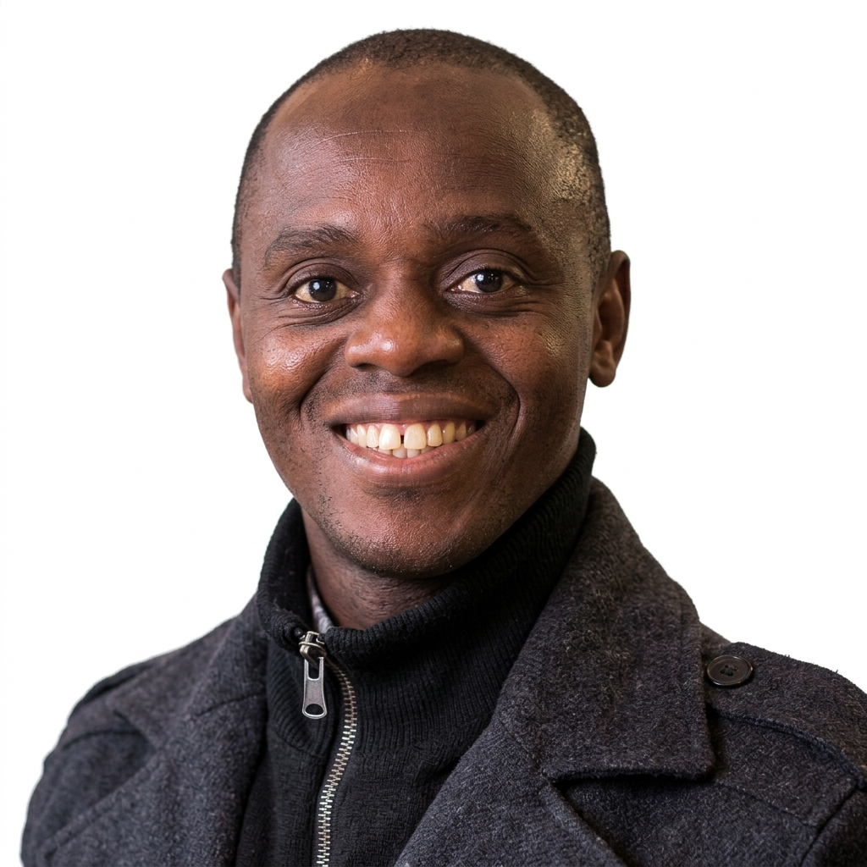

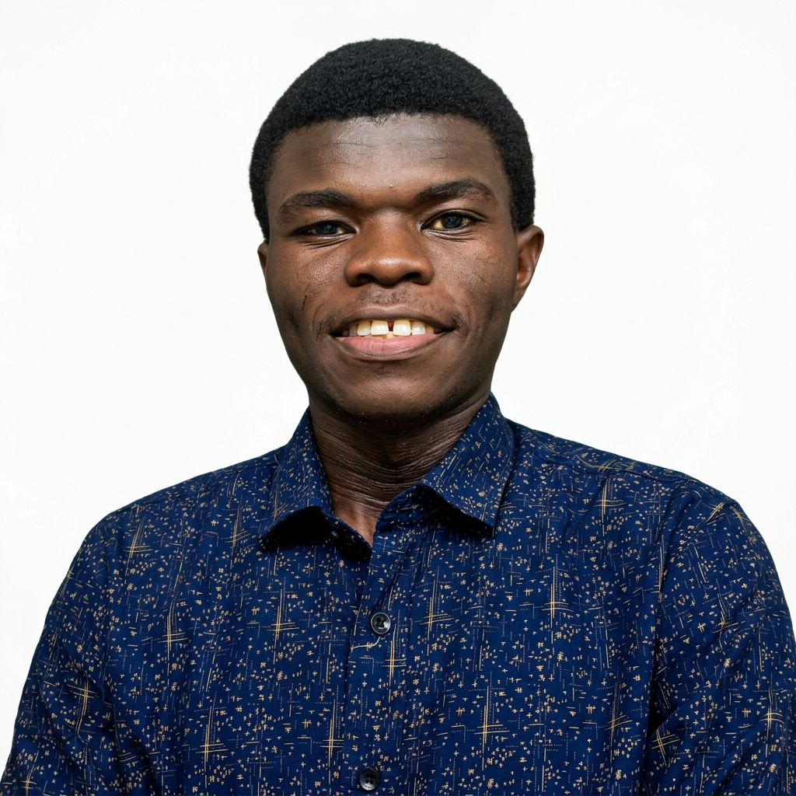
Team
Hongo Koffi Anderson
Ouattara Koffi Nouho
Kouadio Attahoua Ines E.
PhD student, Nangui Abrogoua University
Doctor, Nangui Abrogoua University
PhD student, Nangui Abrogoua University

Slide 12
Thank You
github.com/Bboy010/PlastizymeFinder

