Slide 1
BWOS / BLUE PHOENIX OS
CURRENT TRUTH
Five editions. One platform.
Home: BOOT_PASS_DESKTOP / desktop confirmed
Thunder God: BOOT_PASS_BOOTLOADER_ONLY
Home is the only active edition with a visually confirmed desktop. The rest stay blocked until their own boot evidence exists.
Aurelia: BOOT_PASS_BOOTLOADER_ONLY
ARCWYRE: BOOT_PASS_BOOTLOADER_ONLY
Native: research-only / not boot-matrix tracked
RELEASE POSTURE AND SOURCE OF TRUTH
OBSERVED STATE
NEXT GATES
Home has reached the live Plasma desktop in QEMU x86_64 UEFI.
Kernel, initramfs, and display manager are all observed. Clean shutdown is still unverified.
1. Verify clean shutdown on Home.
2. Build Thunder God for arm64.
3. Move PR40 app launch validation into the active matrix.
4. Keep PR41 blocked until telemetry, boot, and app evidence agree.
release_blocked
desktop_passed
shutdown_pending
telemetry_recorded
retired archived
Source of truth: iso/BOOT_MATRIX.md • iso/ARTIFACTS.md • iso/outputs/manifest.json • iso/outputs/vm-boot-matrix.json

Slide 2
ACTIVE LINEUP
The active lineup is intentionally small.
Four shipping editions plus Native as research-only. That keeps the build, boot, telemetry, and release burden survivable.
HOME
THUNDER GOD
AURELIA
Mainstream stable desktop
Flagship performance edition
Elegant creator edition
The baseline: live desktop reached in QEMU x86_64 UEFI.
The premium ARM target. Build and desktop proof still need to be earned.
Cinematic and restrained. Still waiting on kernel reachability in VM.
desktop proven
arm64 next
bootloader only
ARCWYRE
NATIVE
Recovery + technician environment
Research-only sovereign track
Operational tooling and recovery workflows, not a generic desktop clone.
Long-term platform research. It stays labeled research-only until it proves otherwise.
bootloader only
not shipping
Retired concepts — Forge, Revival, Resilient — remain archived only and must never reappear in active build, registry, matrix, or release outputs.

Slide 3
TELEMETRY / BUILD PIPELINE
Long builds are now measurable instead of mystical.
The telemetry model records phase timings, heartbeats, warnings, and artifact emission so the build can explain itself.
CANONICAL BUILD PHASES
HOME BUILD SUMMARY
preflight
manifest
overlay
package
debootstrap
Elapsed: 3,243 s
chroot
initramfs
filesystem
artifact
cleanup
Warnings: 202
Last successful phase: cleanup
Telemetry status: recorded
Build status: completed
build aware
heartbeat visible
artifact registered
failures classified
No fake ETA. No fake percentages. The watcher only reports the current phase, elapsed time, last successful phase, heartbeat count, and the latest real warning or failure class.
release_blocked
desktop confirmed
Latest warning: Debian non-free-firmware repository component warnings. No hard failure. Build completed with a valid artifact hash.

Slide 4
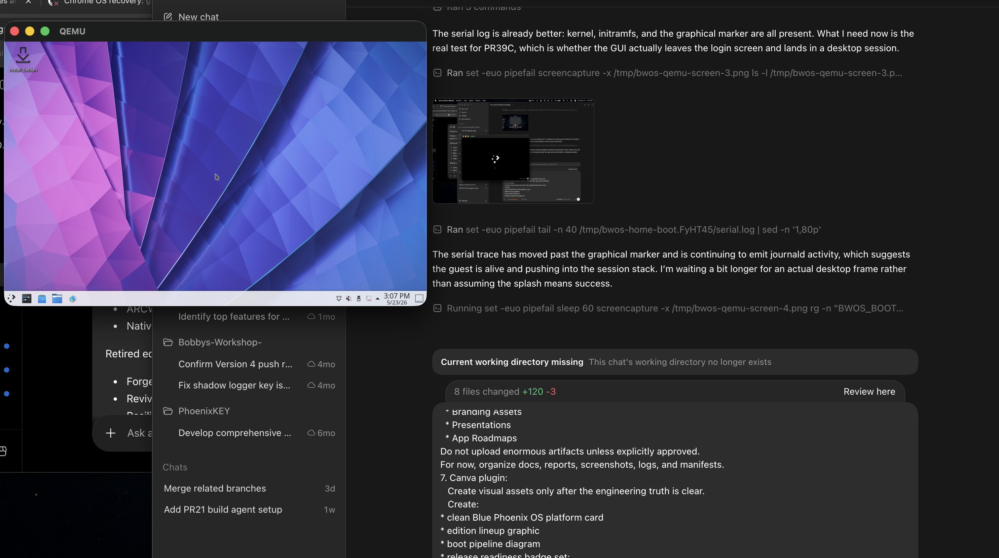
VM BOOT VALIDATION
Home reaches the desktop; the blocker is clean shutdown.
The desktop was visually confirmed in QEMU x86_64 UEFI. The other active editions still stop at bootloader-only states.
OBSERVED EVIDENCE
ACTIVE EDITION BOOT MATRIX
Home
BOOT_PASS_DESKTOP
menu, kernel, initramfs, display manager, desktop all reached
Thunder God
BOOT_PASS_BOOTLOADER_ONLY
GRUB reached; kernel not observed
Aurelia
BOOT_PASS_BOOTLOADER_ONLY
GRUB reached; kernel not observed
ARCWYRE
BOOT_PASS_BOOTLOADER_ONLY
GRUB reached; kernel not observed
Native
NOT_TESTED
research-only; no VM target yet
Evidence: desktop.png / serial.log / console.log
Current classification: BOOT_PASS_DESKTOP. failure_point: shutdown. clean_shutdown_verified: false.

Slide 5
ROADMAP
PR39C is done. PR40 and PR41 are the next gates.
No new edition work until the boot path is stable and the app launch matrix has real evidence behind it.
MILESTONES
RELEASE GATE
Artifact provenance
PR39B
PR39C
Thunder God ARM64
pass
done
done
next
VM boot matrix
partial
GRUB handoff debug pass. Proved the issue was observability and timeout behavior, not missing payloads.
Unattended GRUB handoff, kernel/initramfs reachability, and live desktop confirmation in QEMU.
Build the flagship ARM artifact and record it in the registry and VM matrix.
App launch matrix
pending
Safety validation
pending
PR40
PR41
Release candidate
pending
blocked
blocked
App launch matrix: record actual launch behavior for the active app set.
Release candidate gate. No promotion until registry, boot, telemetry, app launch, and safety evidence agree.
The rule is simple: no boot success claim without observed stage evidence and a specific artifact hash.

