Slide 1
MARCHING MASTERS
Senior Design 2020-2021
Final Term Presentation

Slide 2
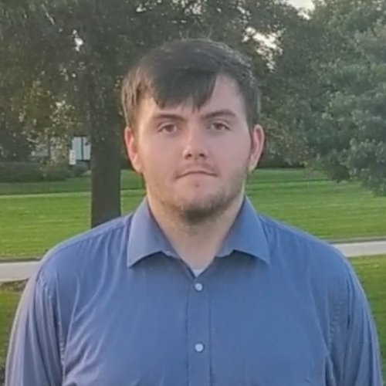



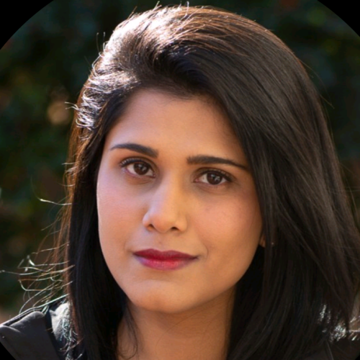

Our Team
Brandin Bulicki
Computer Science Major
Software Development Lead
Siddharth Srinivasan
Computer Science Major
Adam Luong
Computer Science Major
Testing Lead
Tumaresi Yalikun
Computer Science Major
Requirements Engineering Lead
Aparna Mishra
Computer Science Major
Project Planning Lead
Jeffer Zhang
Computer Science Major
System/Software Design Lead
Notes:
Everyone

Slide 3
Our Project
Every summer, marching bands and drum corps all around the world learn drill for their season’s performance. Following this, in the winter, indoor percussion, guard, and wind ensembles, prepare their drill for their seasons. As it stands, the only way to effectively learn the coordinates for the show is to go ‘set-by-set’ and check every performer’s positioning for every drill move. Marching Masters aims to improve these outdated methods.
Marching Masters will increase the effectiveness of drill instruction and the proficiency with which a show is performed. Marching Masters will ultimately be the first marching based program that will allow for tracking of the performers from drill set to drill set. This system will allow staff and performers to track the movements of the performers, analyze for correctness against the written drill, and be able to be reviewed by staff and performers. By obtaining this knowledge, staff will be more equipped to provide instruction and performers will be able to further understand what corrections they must make.
Notes:
Aparna

Slide 4
Application Capabilities
Functional Features
Basic Application Dashboard
Joining a Band
Drill Visualization
Uploading Documents/Events/Assignments
Viewing Documents/Events/Assignments
Application Log-in
Performer Tracking
Instructor Feedback
Notes:
Brandin

Slide 5
Market Research
Conducted Market Research
Market Size
Similar Products (Drill Visualizers):
Pyware 3D Drill Visualizer
Ultimate Drill Book
Notes:
Tumaris

Slide 6





Design
Standard Widgets
User (Instructor)
Instructor Interface
REST Calls
REST Calls
Tracking Sensors
Integration System
Data Storage
REST Calls
Standard Widgets
User (Performer)
Performer Interface
Notes:
Jeffer

Slide 7
System Flow
Notes:
Adam/Jeffer

Slide 8
Technologies Used
Decisions were made on the technologies that would be used in both hardware and software.
Hardware: Bluetooth Beacons, IMU Device
Software: Flutter/Dart, Python/Flask, AWS Lambdas
After working with the Bluetooth beacons, Eddystone is not going to be supported by Google Devices beginning in April, leading us to adjust our approach.
Notes:
Sid
After deciding on a beacon device, we had to change devices due to a change in policy from the original company.

Slide 9
Demo
The Demo has the following features:
Application Log-in
Basic Application Dashboard
Joining a Band
Drill Visualization
Performer Tracking
Uploading Documents/Events/Assignments
Viewing Documents/Events/Assignments
Instructor Feedback
Notes:
Application Log-in -> Sid
Basic Application Dashboard –> Aparna
Joining Band –> Sid
Drill Visualization –> Brandin
Performer Tracking -> Brandin
Doc. Handling –> Tumaris
Instructor Feedback -> Brandin
Server Side –> Jeffer/Adam

Slide 10
Testing/Debugging
System Test Plan
Test Cases
Notes:
Jeffer

