Slide 1
MARCHING MASTERS
Senior Design 2020-2021
Fall Term Presentation
Notes:
Update with Logo

Slide 2
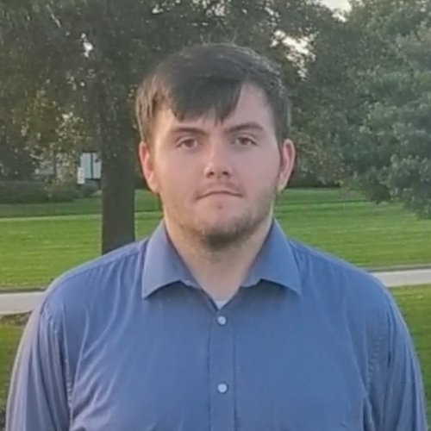
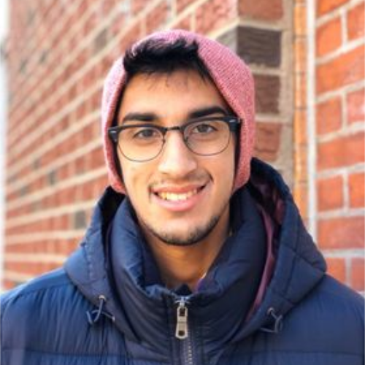
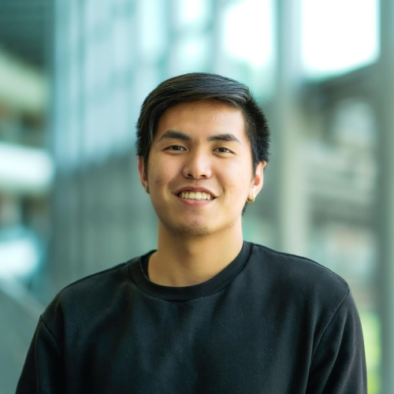


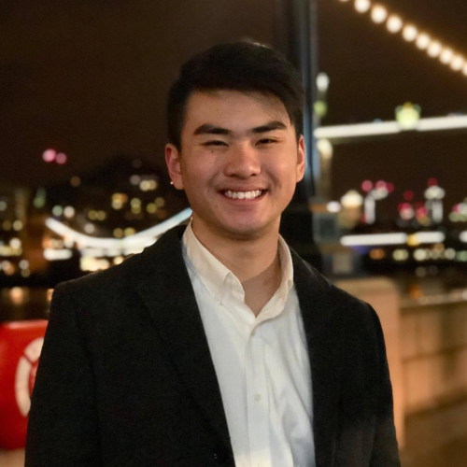
Our Team
Brandin Bulicki
Computer Science Major
System/Software Design Lead
Siddharth Srinivasan
Computer Science Major
Adam Luong
Computer Science Major
Testing Lead
Tumaresi Yalikun
Computer Science Major
Requirements Engineering Lead
Aparna Mishra
Computer Science Major
Project Planning Lead
Jeffer Zhang
Computer Science Major
Software Development Lead

Slide 3
Our Project
Marching Masters is a system which will provide a method of measuring a performer’s accuracy during a field performance by comparing the calculated position to the location written advancing the quality of marching arts programs.
Notes:
Every summer, marching bands and drum corps all around the world learn drill for their season’s performance. Following this, in the winter, indoor percussion, guard, and wind ensembles, prepare their drill for their seasons. As it stands, the only way to effectively learn the coordinates for the show is to go ‘set-by-set’ and check every performer’s positioning for every drill move. Marching Masters aims to improve these outdated methods. Marching Masters will increase the effectiveness of drill instruction and the proficiency with which a show is performed. Marching Masters will ultimately be the first marching based program that will allow for tracking of the performers from drill set to drill set. This system will allow staff and performers to track the movements of the performers, analyze for correctness against the written drill, and be able to be reviewed by staff and performers. By obtaining this knowledge, staff will be more equipped to provide instruction and performers will be able to further understand what corrections they must make.

Slide 4
Features

Slide 5
Functional Requirements
Notes:
Add from SRS & Customer Requirements

Slide 6
Non-Functional Requirements
Notes:
Take from SRS & Customer Requirements

Slide 7
UI Prototype
Early Design

Slide 8
Notes:
Add in UI and add functionality to move from one “screen” to the next

Slide 9
Technical Work Completed
Notes:
Any Development of PoC

Slide 10
Non-Technical Issues Addressed
Notes:
Receiving the Bluetooth Beacons

Slide 11
Technical Issues Addressed
Notes:
Any??

Slide 12
Future Plans
Notes:
Discuss Continuing POC and Future development next term

Slide 13
Open Issues
Notes:
None

