Slide 1
IBK CENTER
Comprehensive Medical Care Services
202121054 Lim Hoe-yeon | | 202020917 Byun Sun-woo | | 202020827 Kim Kyung-min

Slide 2



OUTLINE
Subject
Reason
Goal
Healthcare System Integration Services:
Reduced wait times, reduced use of paper by enabling prescription upload inquiry

Slide 3




USE
Data Management
Language
Server

Slide 4
Function
: The information inquiry page can only be viewed by members who have signed up as hospitals/pharmacies. In this page, we're going to show you a patient's
You can upload and download prescriptions.
a search for a hospital/pharmacy
Information Inquiry
a review of one's visit
: By searching the information of hospitals and pharmacies, you can find information such as location, phone number, and address on the map.
: On the review page of the visit, you can read reviews of people who visited hospitals and pharmacies.
You can write it.
When you click on a map, a page of the hospital or pharmacy you clicked appears on the right.

Slide 5

REQUIRE
Accurate by providing patient information
medical treatment
When visiting by name and resident registration number
Acceptable
Patient (individual) Requirements
Easy to find information about hospitals, pharmacies
Can be prescribed comfortably after treatment
Check guardian information in case of emergency
It's possible.
Check the reviews of visiting hospitals, pharmacies, and
Can be written

Slide 6
REQUIRE
Improve feedback after feedback through reviews
It's possible.
Easily view patient information
License upload required (For information security)
a hospital/pharmacy Requirements
Work place changeable
Prescription upload/searchable
After signing up for membership as a hospital/pharmacy Membership registration is possible as an individual.

Slide 7



REQUIRE
Membership/login function
Prescription Upload / Inquiry Features
Hospital/Pharmacy Inquiry Features
Sign up as a separate member It's possible. To the hospital/pharmacy. License if you sign up for membership. Upload required
logged in as a hospital/pharmacy Only members can access it. DB information when downloading prescriptions Delete
Information can be inquired under the name of the hospital and pharmacy, and related reviews can be read and written.

Slide 8
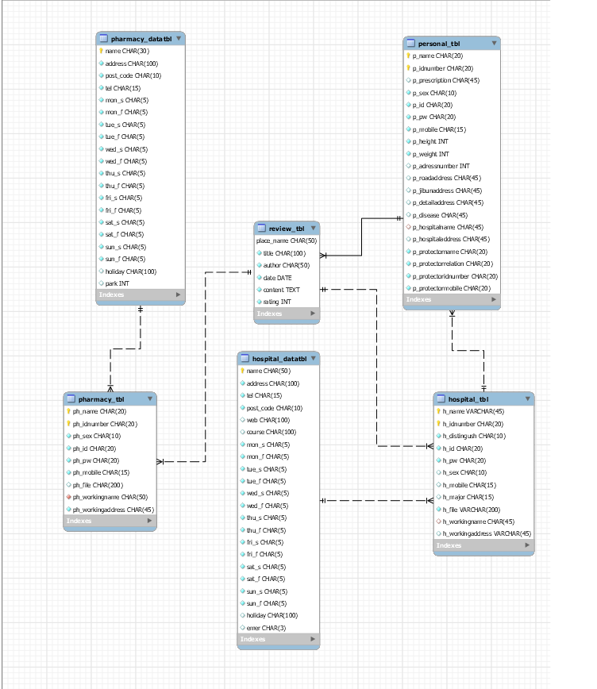
ER MODEL

Slide 9
TABLE
Personal_tbl
Property name | Data Type | Default key | Not_ NULL | UNIQUE
p_name | Char(20) | PK | NN
p_idnumber | Char(20) | PX | NN
p_prescription | Char(45)
p_id | Char(20) |  | NN | UQ
p_pw | Char(20) |  | NN
p_sex | Char(10) |  | NN
p_mobile | Char(15) |  | NN
p_height | Int(5) |  | NN
p_weight | Int(5) |  | NN
p-addressnumber | Int(10) |  | NN
Property name | Data Type | Default key | Not_ NULL | UNIQUE
p_roadaddress | Char(45) |  | NN
p_jibunaddress | Char(45)
p_detailaddress | Char(45)
p_disease | Char(45)
p_hospitalname | Char(45)
p_hospitaladdress | Char(45)
p_protectorname | Char(20) |  | NN
p_protectorrelation | Char(20) |  | NN
p_protectoridnumber | Char(20) |  | NN
p_protectormobile | Char(20) |  | NN

Slide 10
TABLE
Hospital_tbl
Property name | Data Type | Default key | Not_ NULL | UNIQUE
h_name | Char(10) | PK | NN
h_idnumber | Char(20) | PK | NN
h_id | Char(20) |  | NN | UQ
h_pw | Char(20) |  | NN
h_sex | Char(10) |  | NN
h_distinguish | Char(10)
h_mobile | Char(15) |  | NN
h_major | Char(15) |  | NN
h_file | char(200) |  | NN | UQ
h_workingname | Char(45) |  | NN
h_workingaddress | char(45) |  | NN

Slide 11
TABLE
Pharmacy_tbl
Property name | Data Type | Default key | Not_ NULL | UNIQUE
ph_name | Char(20) | PK | NN
ph_idnumber | Char(20) | PK | NN
ph_file | Char(100) |  | NN | UQ
ph_id | Char(20) |  | NN | UQ
ph_pw | Char(20) |  | NN
ph_mobile | Char(15)
ph_sex | Char(10)
ph_workingname | Char(45) |  | NN
ph_workingaddress | Char(45) |  | NN

Slide 12
TABLE
Hospital_datatbl
Property name | Data Type | Default key | Not_ NULL | UNIQUE
name | Char(50) | PK | NN
address | Char(100) |  | NN
post_code | Char(10) |  | NN
tel | Char(15) |  | NN
web | Char(100)
mon_s | Char(5)
mon_f | Char(5)
tue_s | Char(5)
tue_f | Char(5)
wed_s | Char(5)
wed_f | Char(5)
Property name | Data Type | Default key | Not_ NULL | UNIQUE
thu_s | Char(5)
thu_f | Char(5)
fri_s | Char(5)
fri_f | Char(5)
sat_s | Char(5)
sat_f | Char(5)
sun_s | Char(5)
sun_f | Char(5)
holiday | Char(100)
park | Int(3)
emer | Char(3)

Slide 13
TABLE
Pharmacy_datatbl
Property name | Data Type | Default key | Not_ NULL | UNIQUE
name | Char(50) | PK | NN
address | Char(100) |  | NN
post_code | Char(10) |  | NN
tel | Char(15) |  | NN
mon_s | Char(5)
mon_f | Char(5)
tue_s | Char(5)
tue_f | Char(5)
wed_s | Char(5)
wed_f | Char(5)
Property name | Data Type | Default key | Not_ NULL | UNIQUE
thu_s | Char(5)
thu_f | Char(5)
fri_s | Char(5)
fri_f | Char(5)
sat_s | Char(5)
sat_f | Char(5)
sun_s | Char(5)
sun_f | Char(5)
holiday | Char(100)
park | Int(3)

Slide 14
TABLE
Review_tbl
Property name | Data Type | Default key | Not_ NULL | UNIQUE
Place_name | Char(50) | PK | NN
Title | Char(100) | PK | NN
Author | Char(50) |  | NN
Date | date |  | NN
Content | text |  | NN
Rating | Int(1) |  | NN

Slide 15
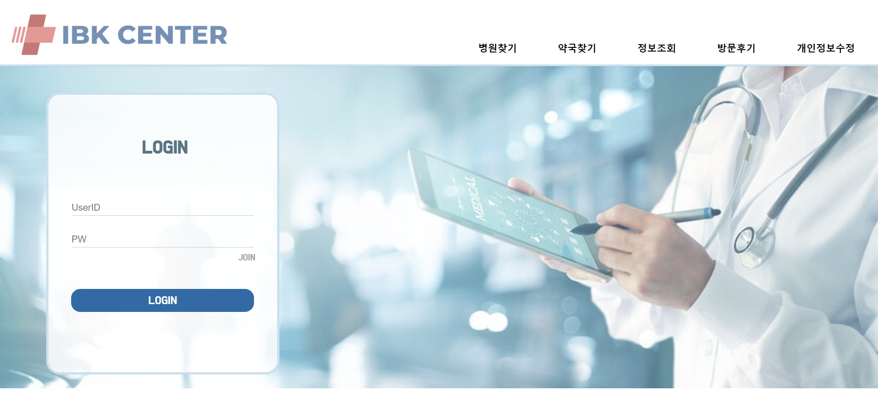

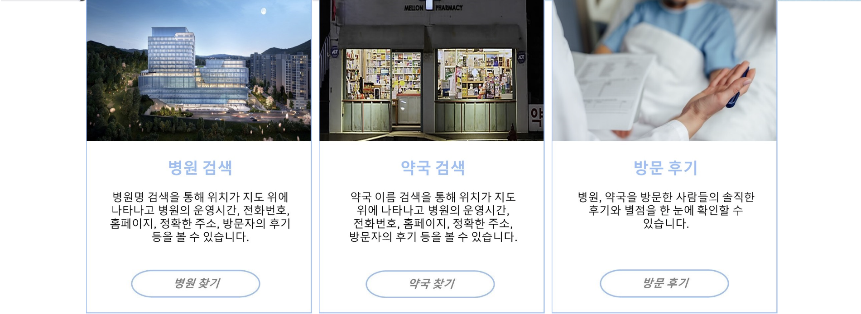
DETAILS
Main page
: Click on the menu bar to move the page
You can sign up for membership through JOIN below login

Slide 16
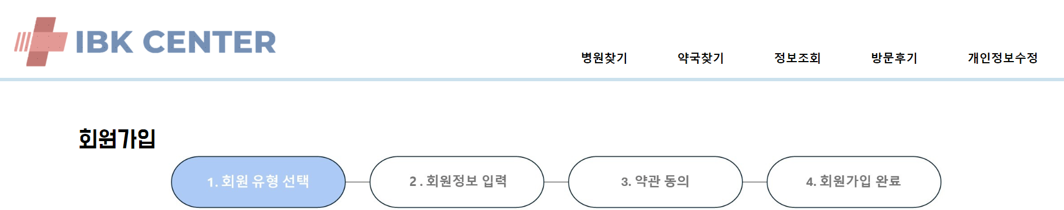
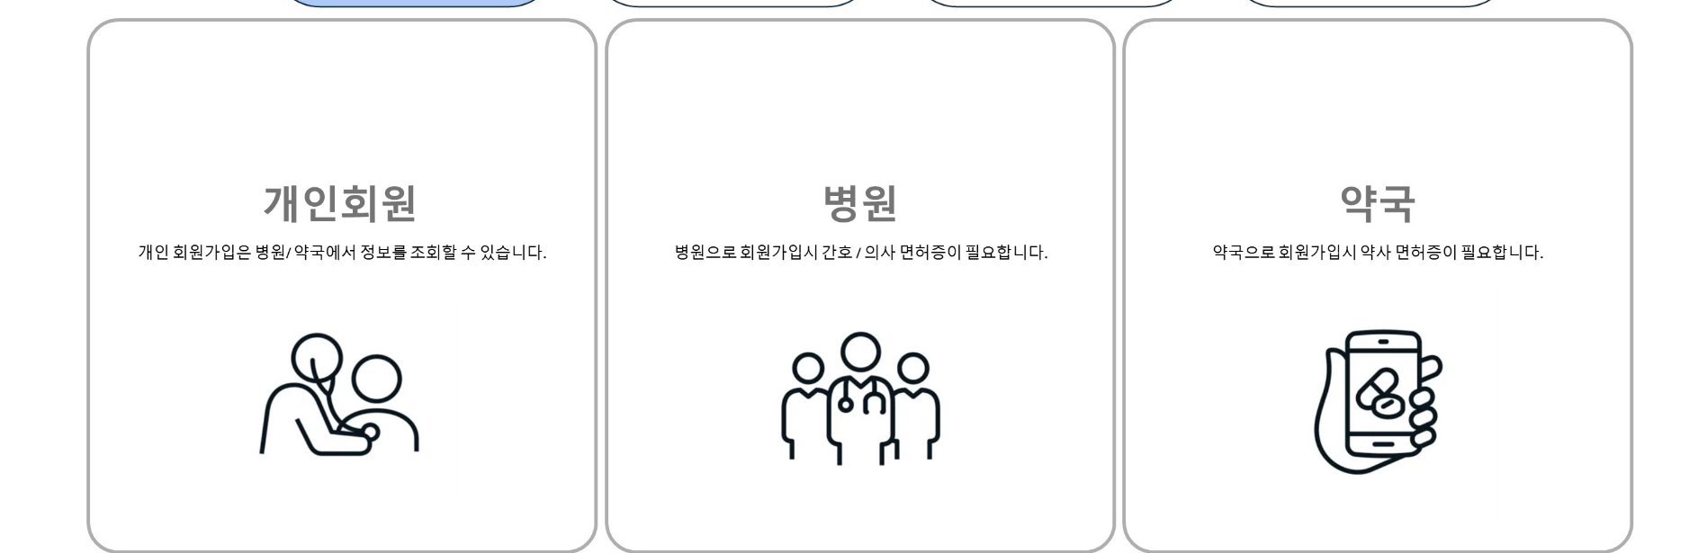
Membership registration
: Membership registration is possible for each member.
Save information to different DATA TBLs
DETAILS

Slide 17

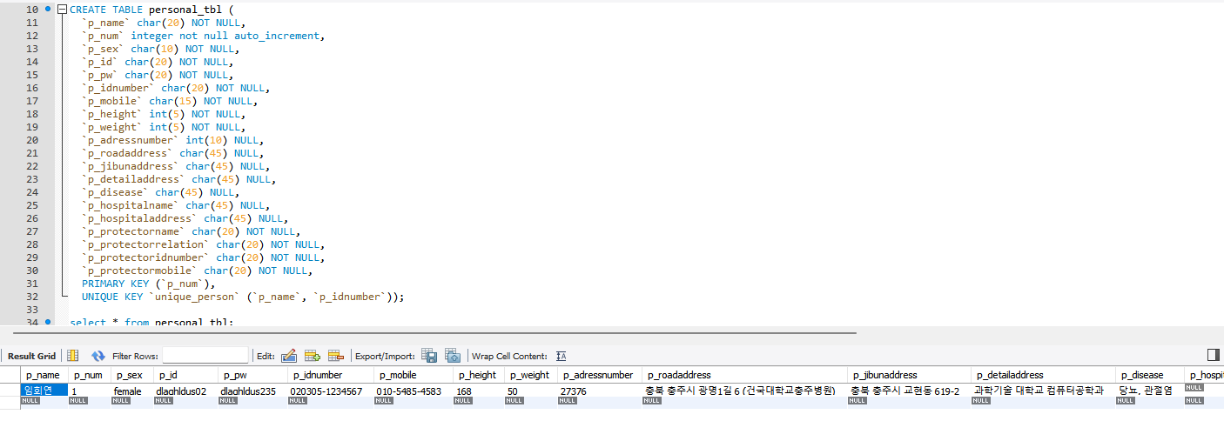
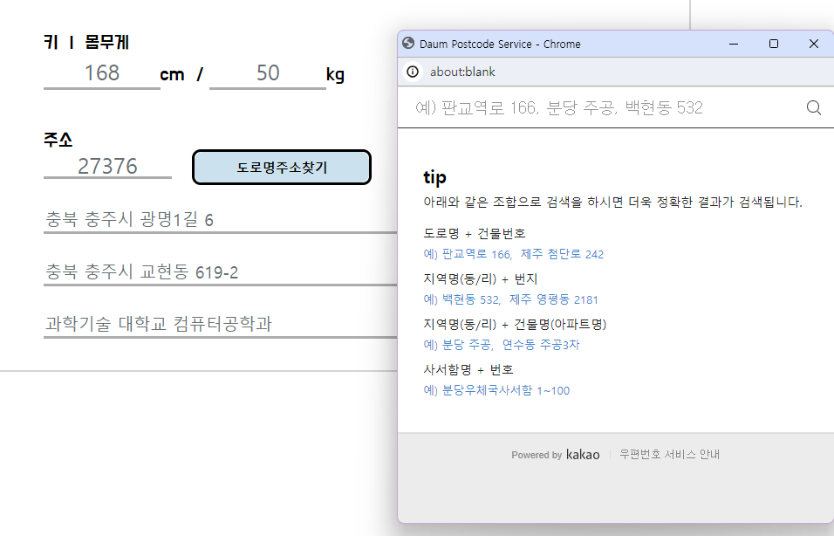
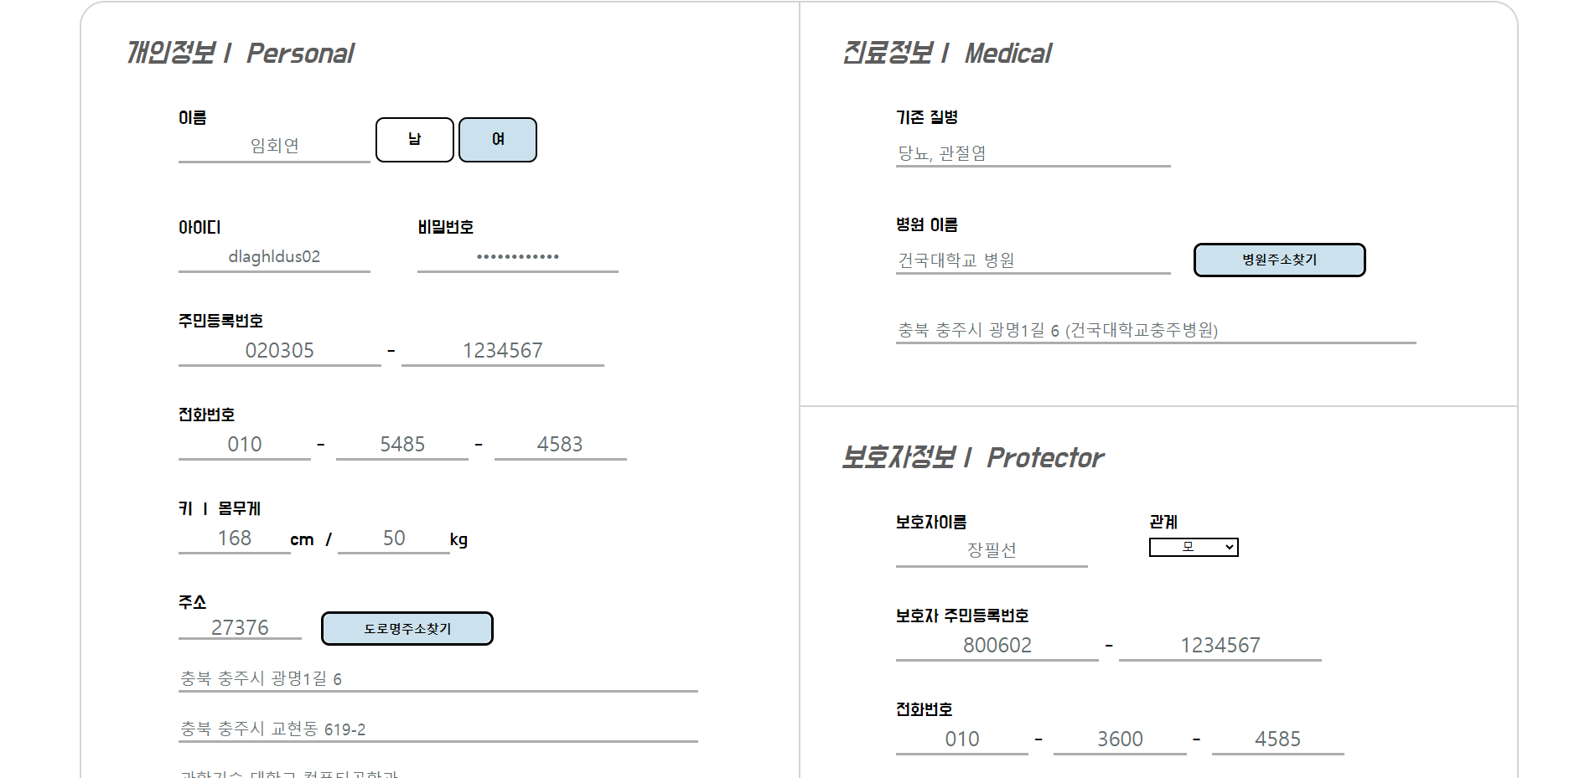

individual membership
: Save information in "personal_tbl" when entering information
DETAILS

Slide 18
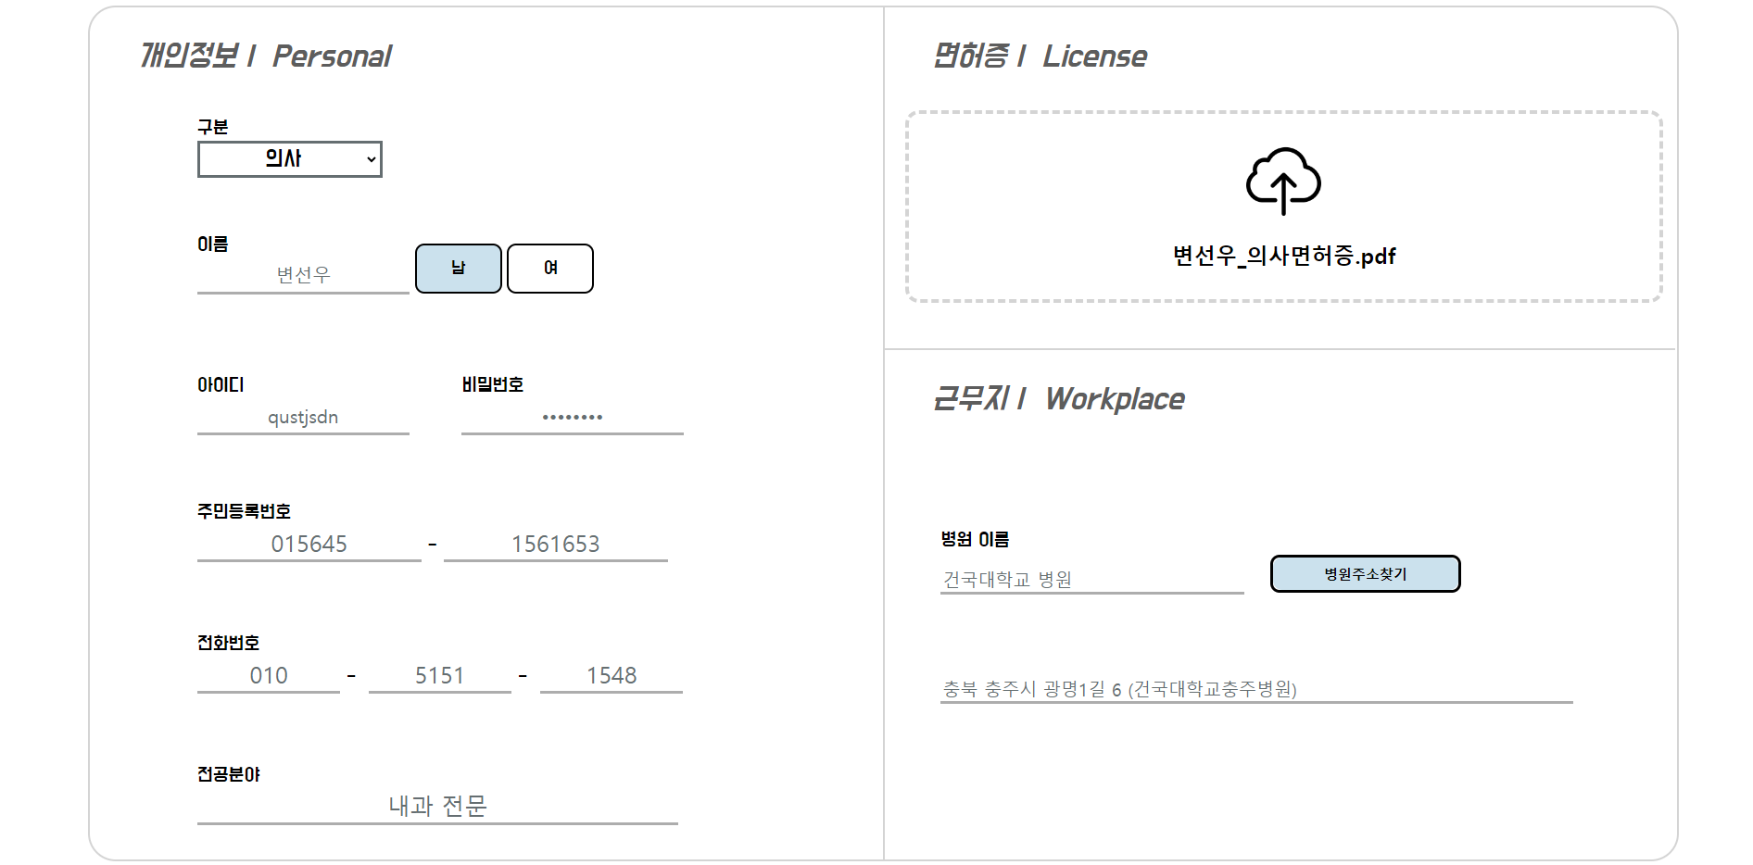
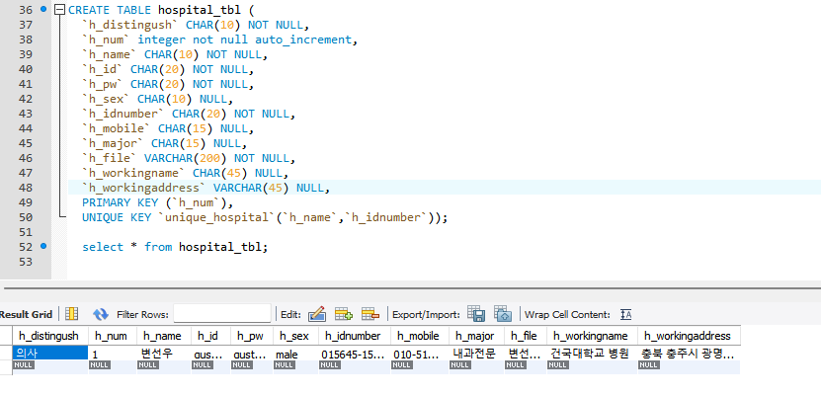
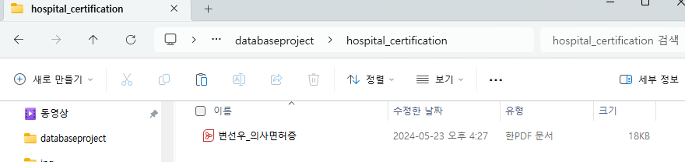
Hospital membership
: Save information to "hospital_tbl" when entering information
DETAILS

Slide 19
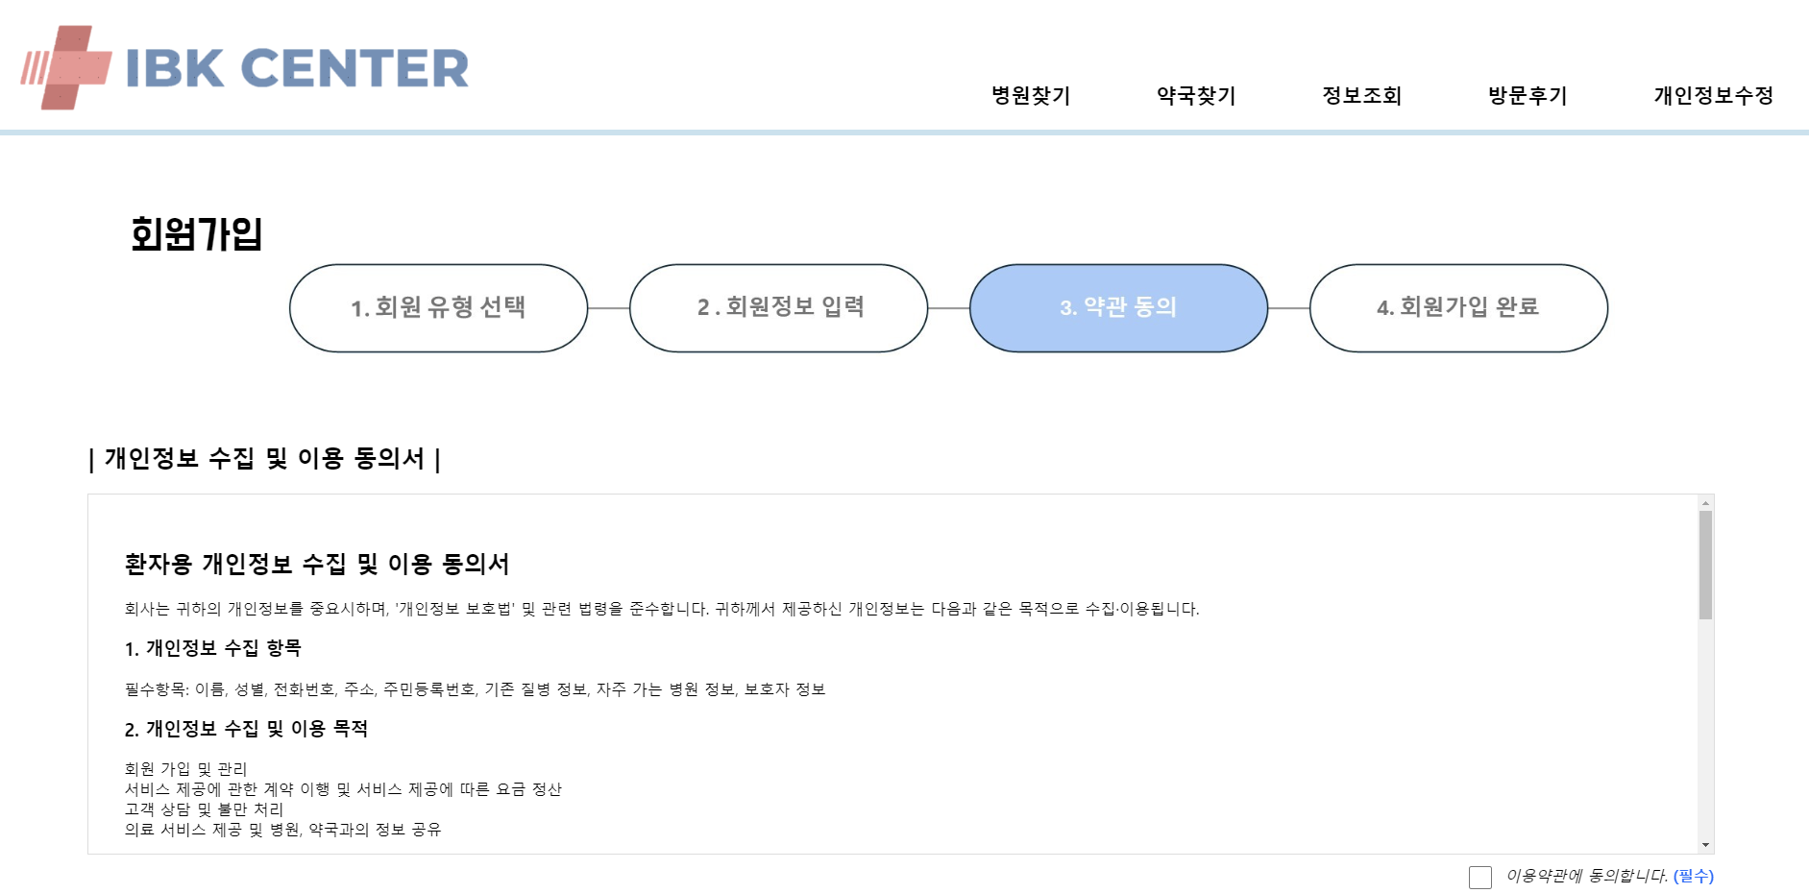
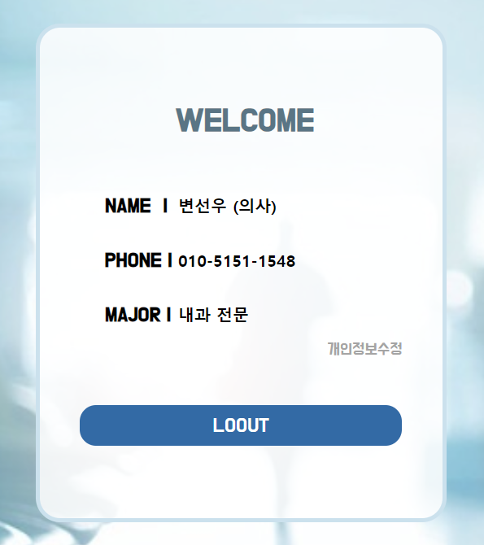
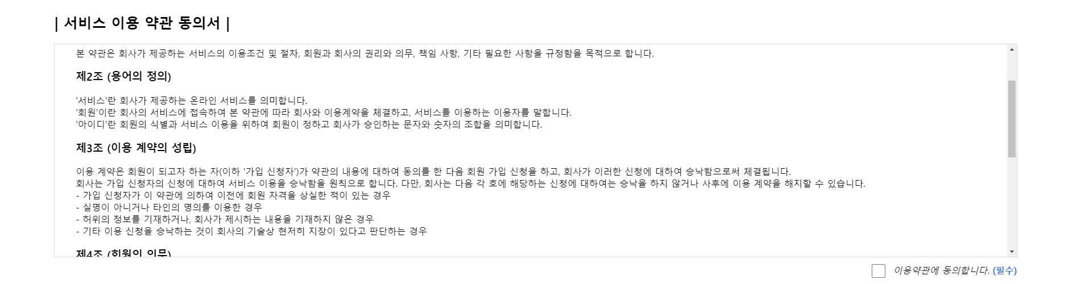
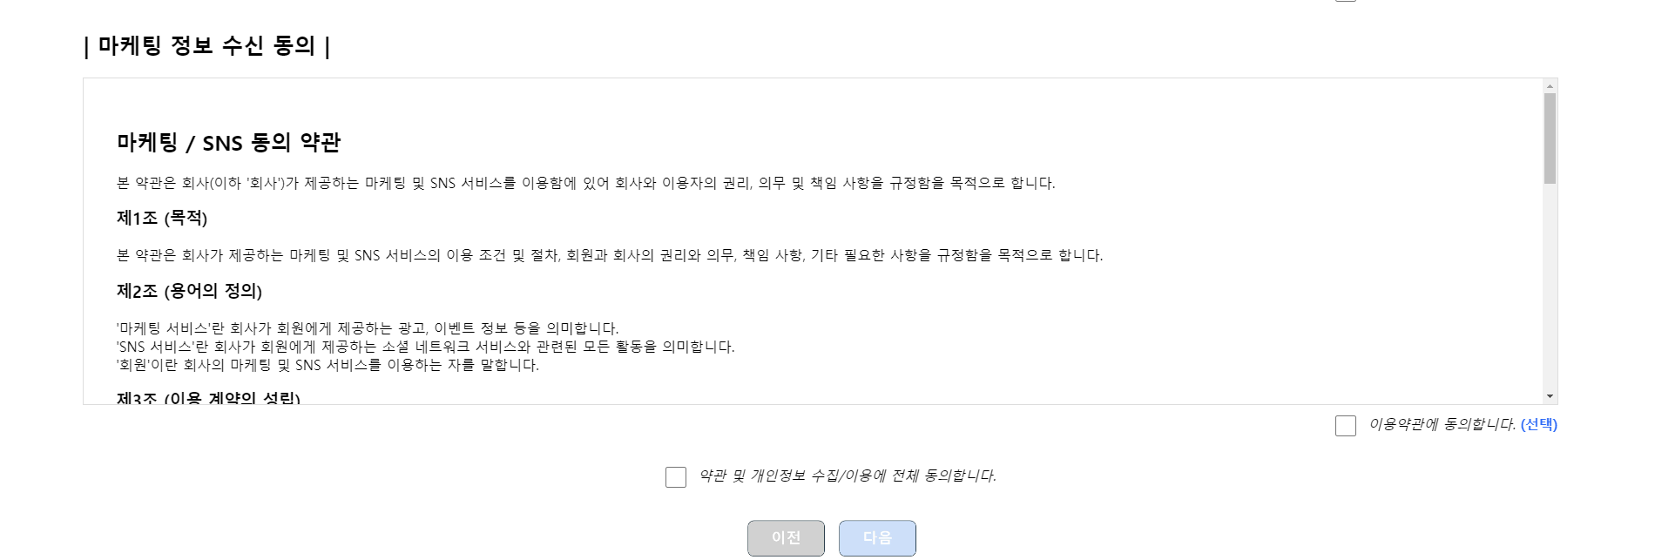
DETAILS

Slide 20
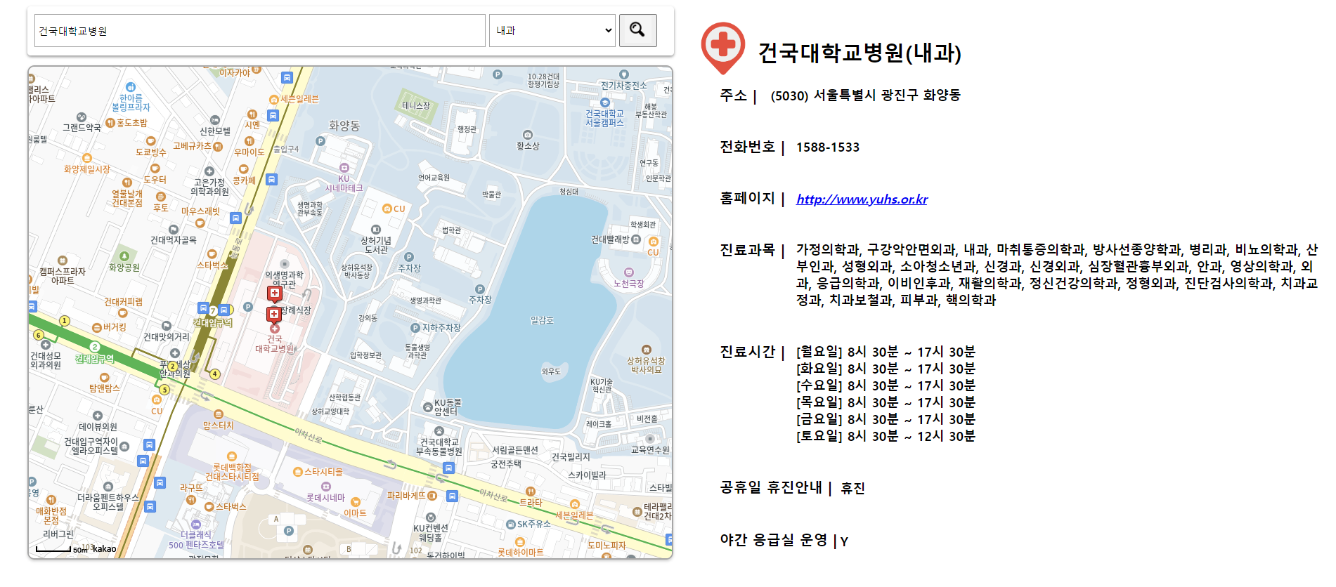
Finding a Hospital
: Location and information appear when searching for a hospital
DETAILS

Slide 21
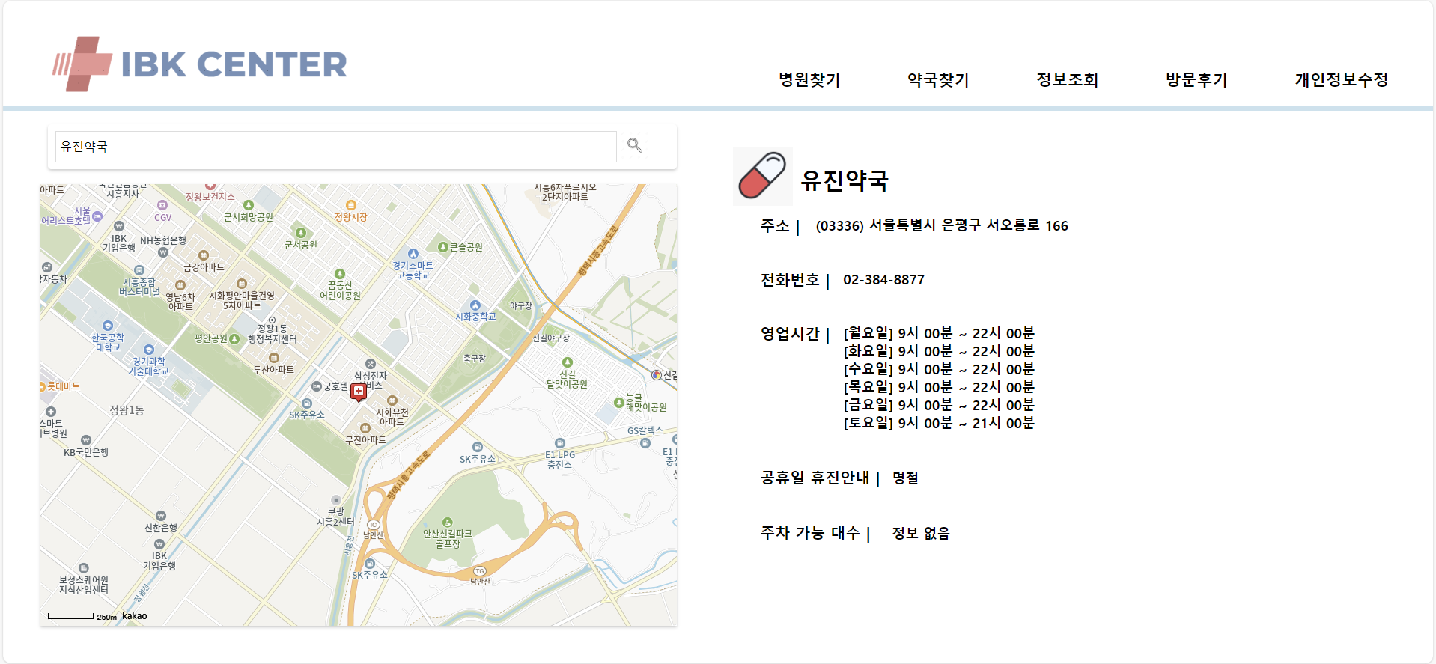
Finding a pharmacy
: Location and information appear when searching for pharmacies
DETAILS

Slide 22
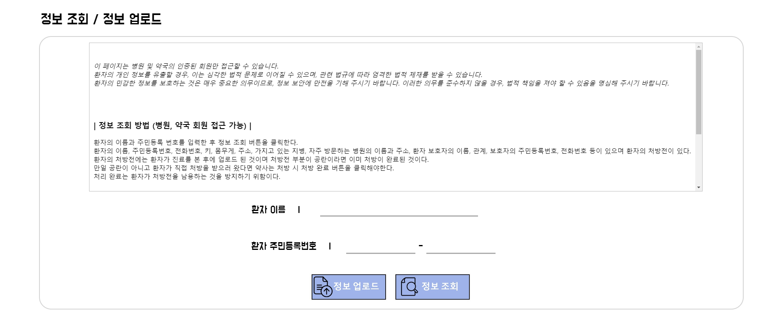
Information Inquiry / Uploading Information
: Patients' information can be viewed and prescriptions can be uploaded and downloaded.
DETAILS

Slide 23
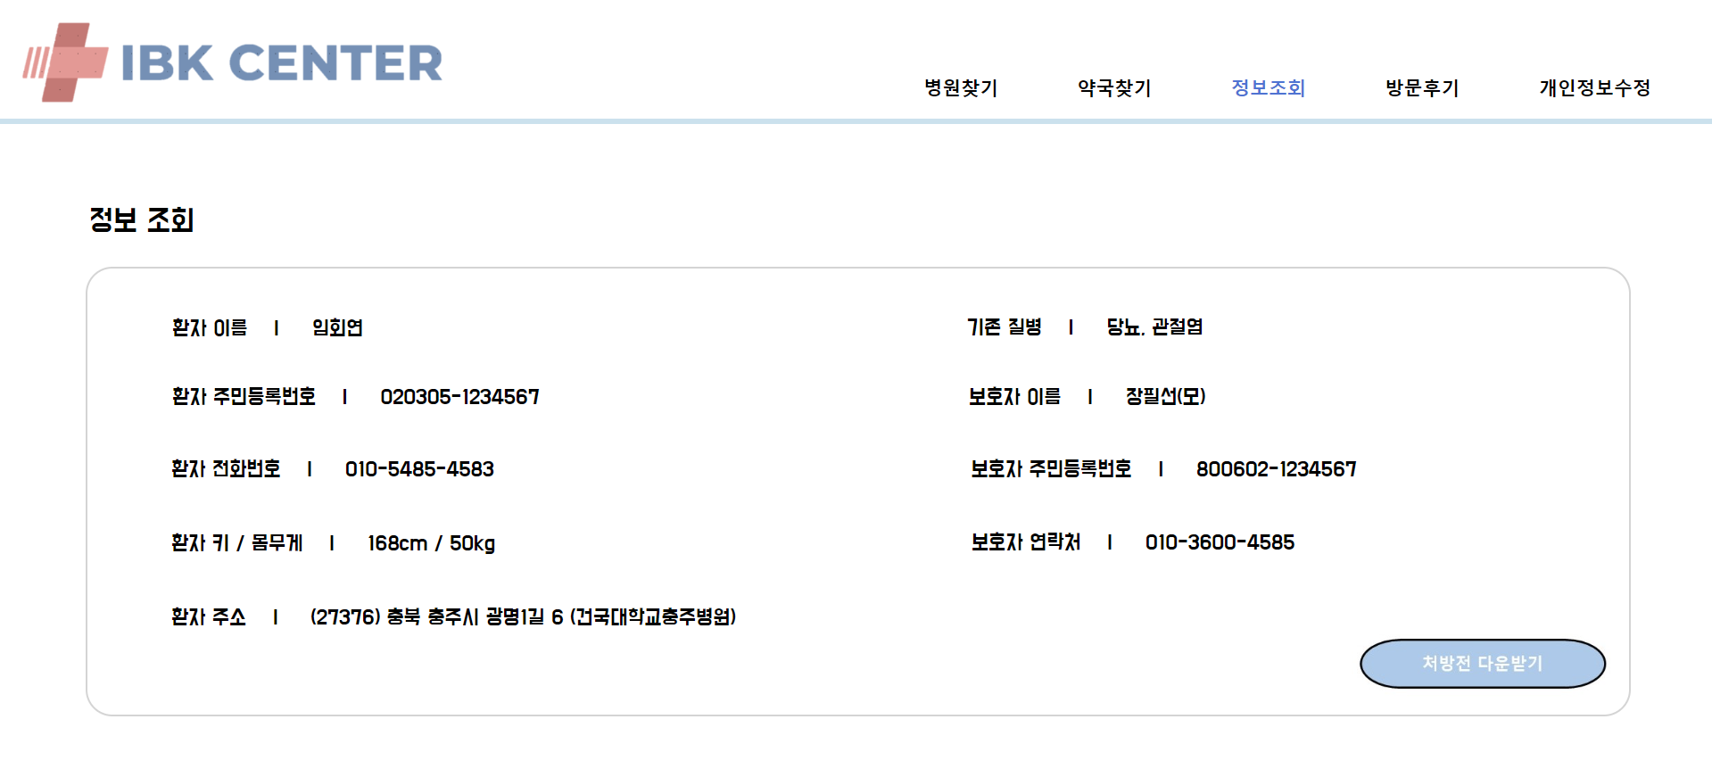
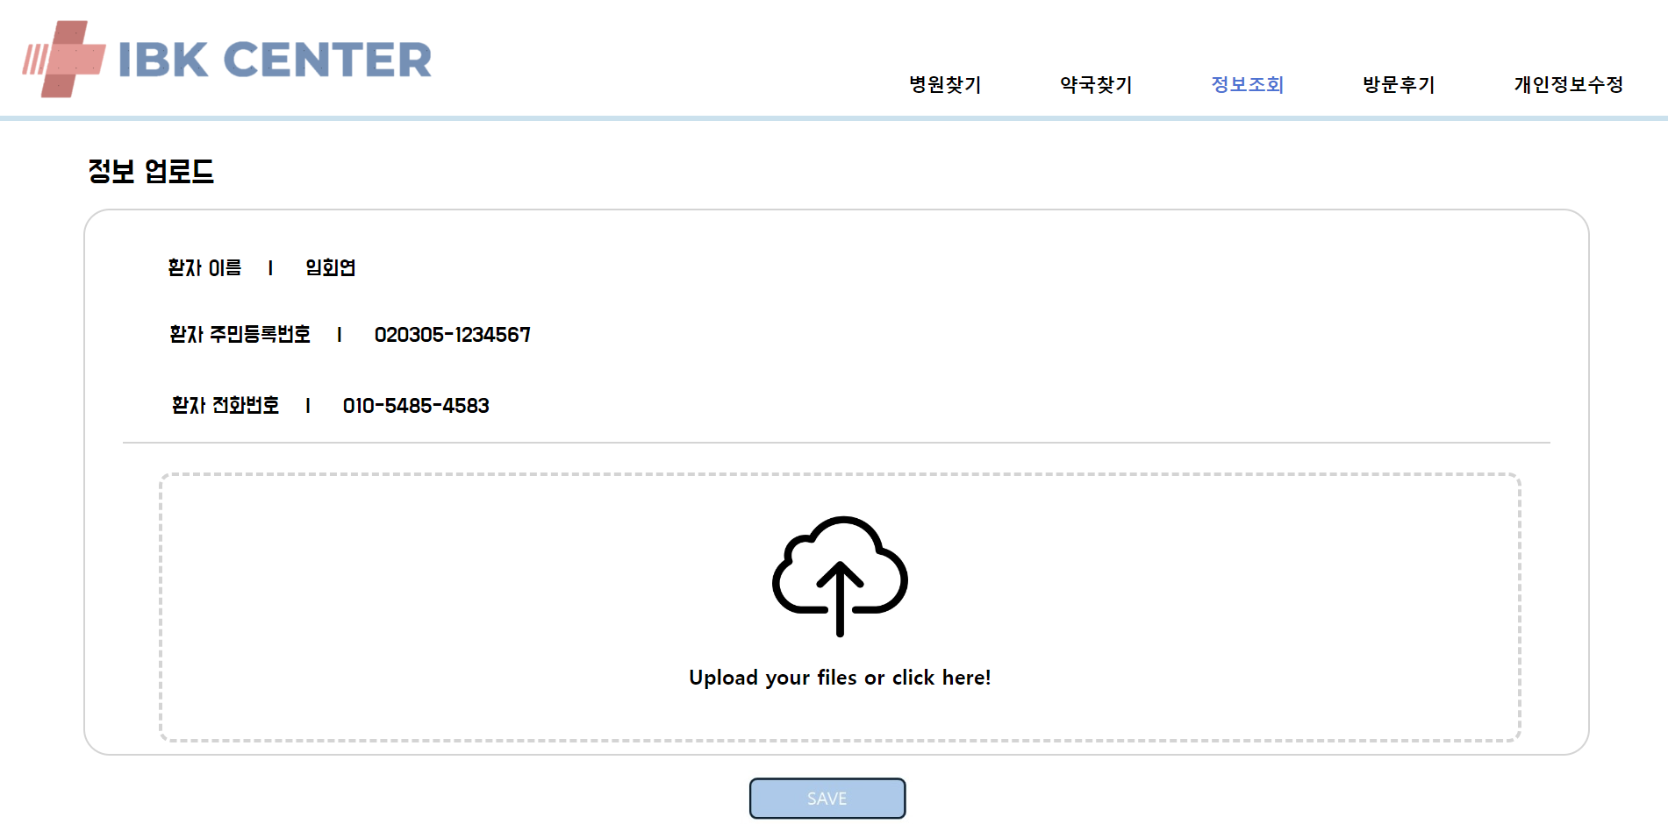
DETAILS

Slide 24
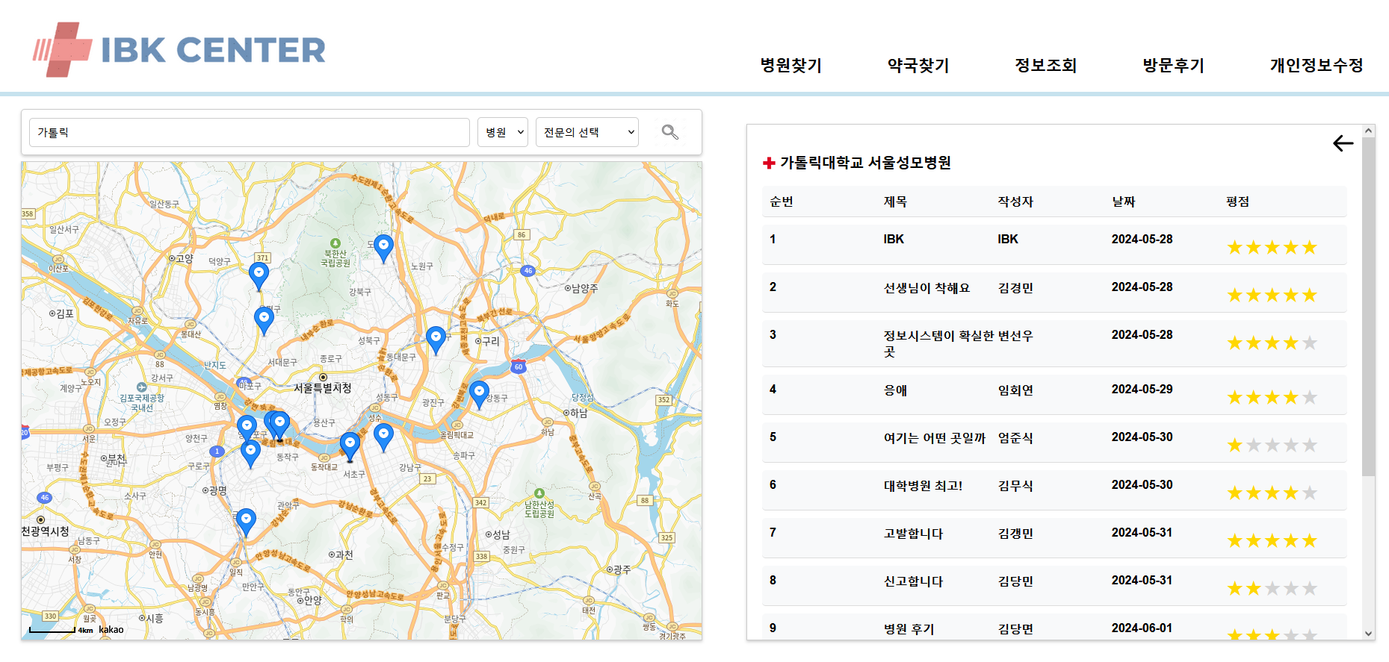
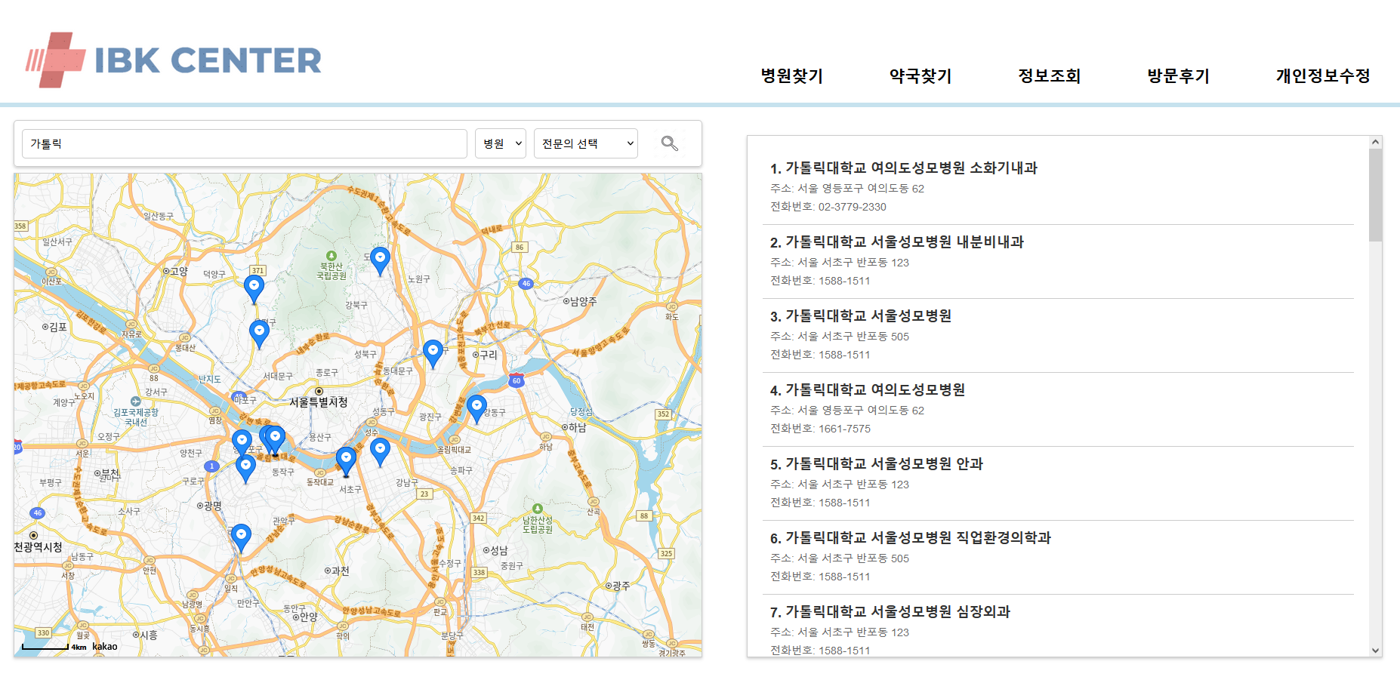
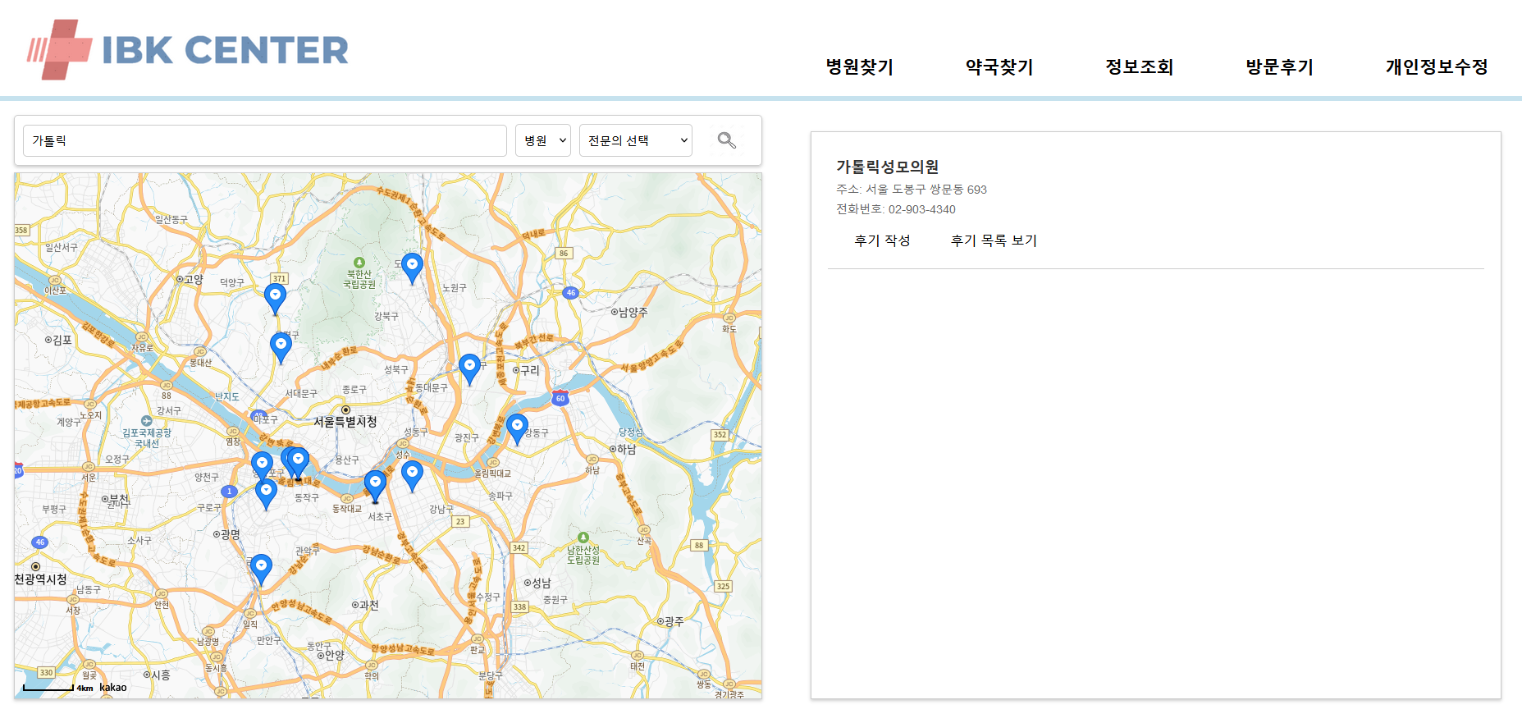
Write a review of the visit
: You can write reviews of hospitals/pharmacies or inquire about them.
DETAILS

Slide 25
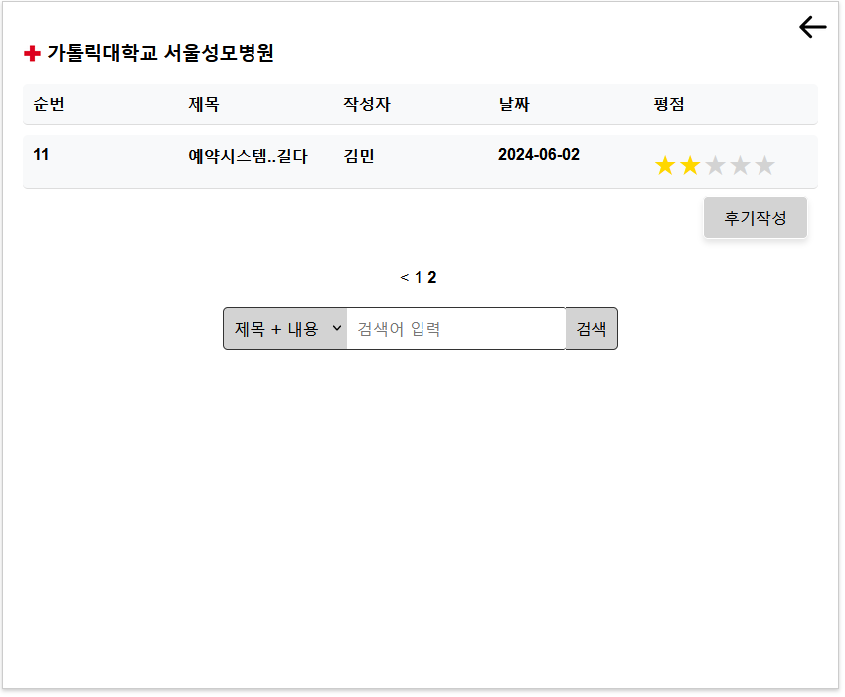
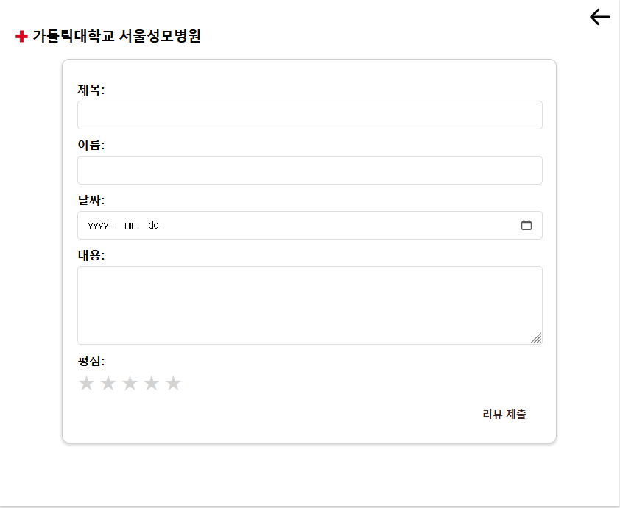
DETAILS

Slide 26
Q & A

Slide 27
Thank you!

