Slide 1

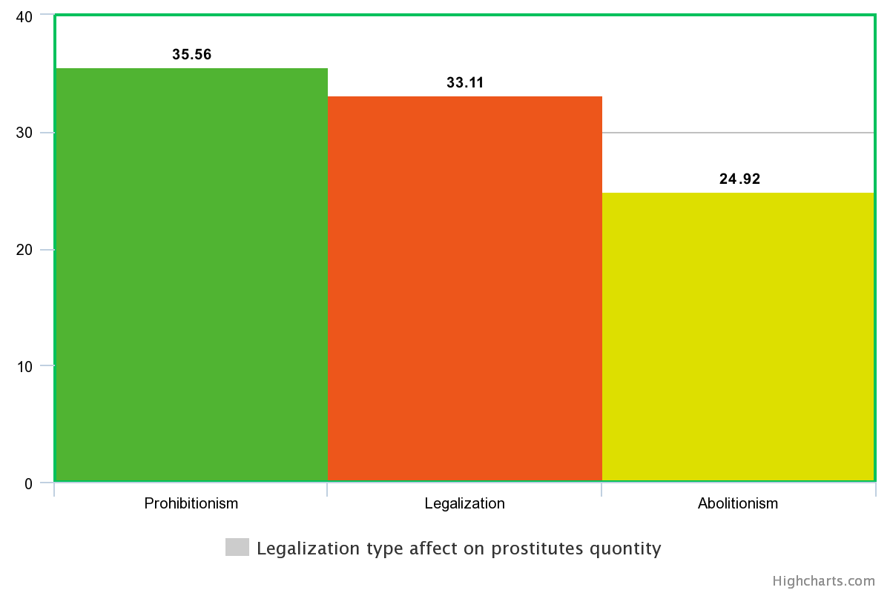
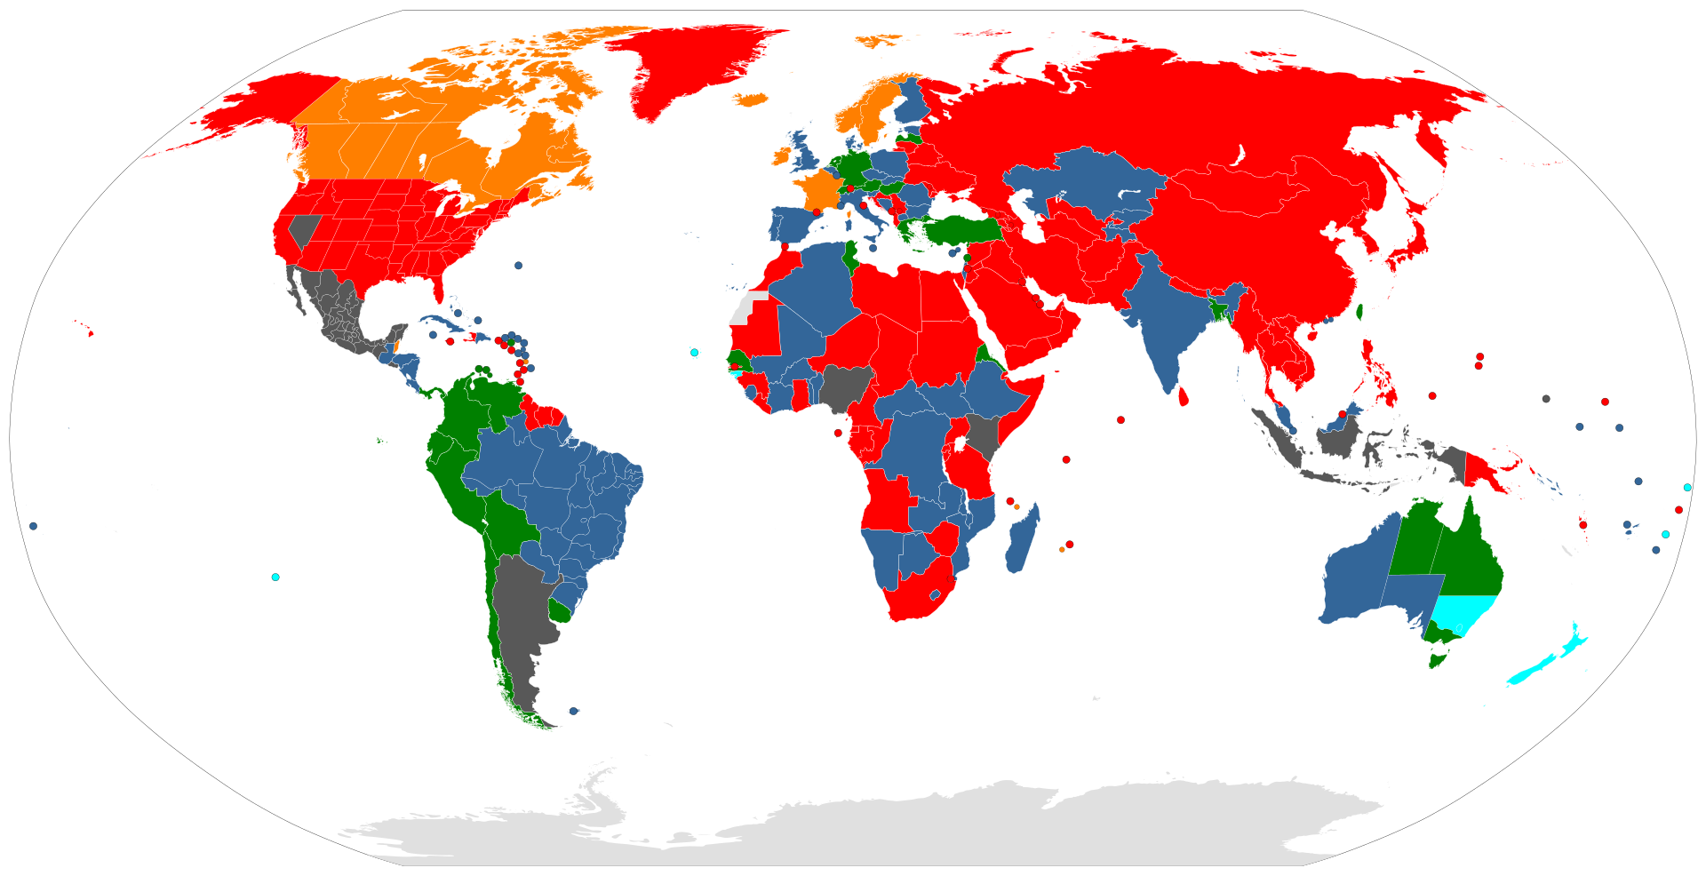
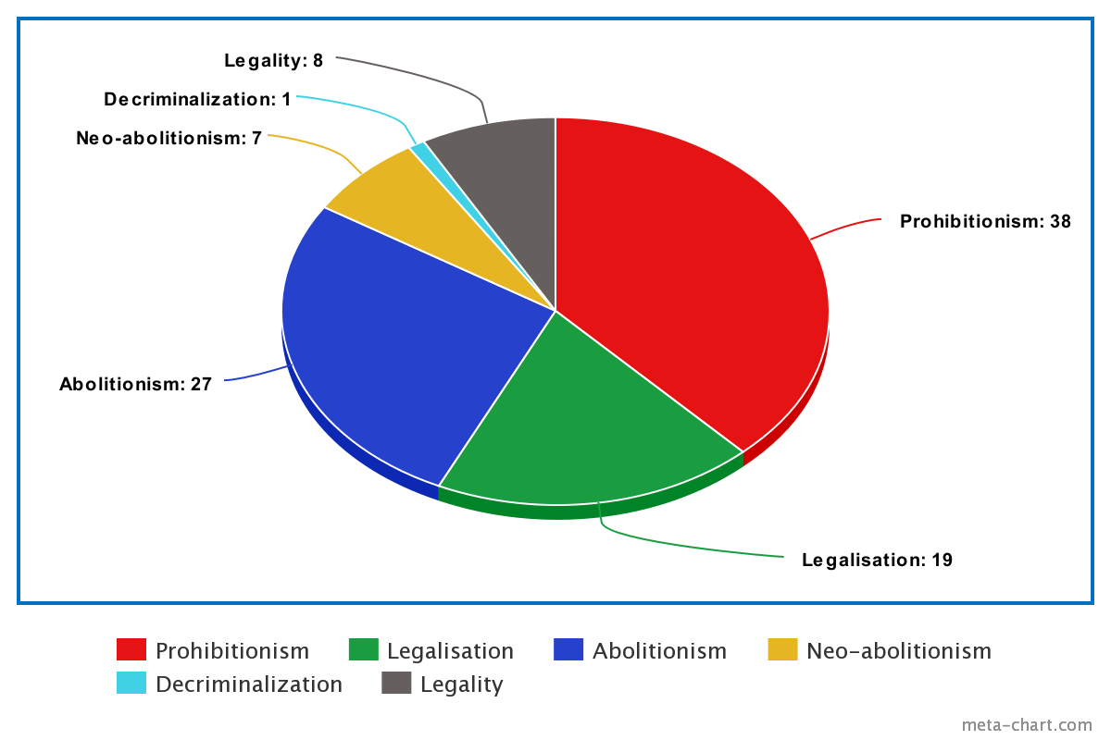
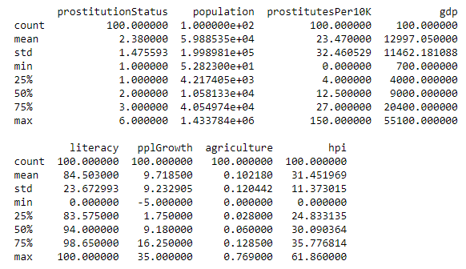

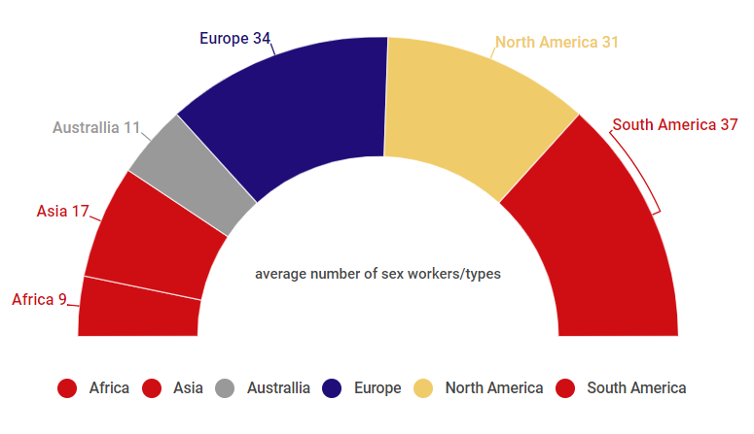


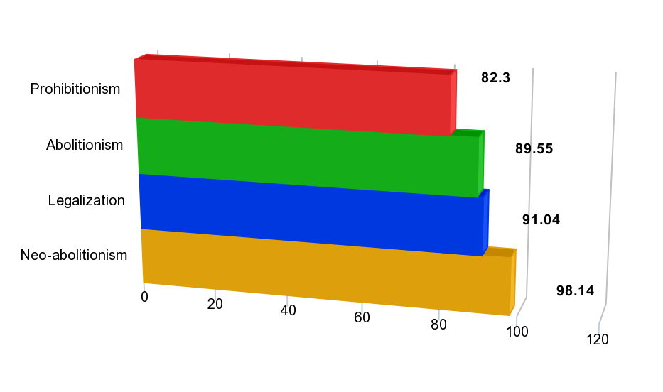
Consequences of legalizing prostitution
B. Darmits
Introduction
1
Methodology
2
The debates about prostitution legalization have been going on since immemorial times. Considering that in thousands of years, we have not been able to completely eradicate it or come up with an ideal model of existence - this is one of the hottest topics today. People have thoroughly examined the impact of prostitution on crime rates and other negative aspects. But what if there were some interesting positives to legalization that few thought about?
Legalization type effect on prostitutes quantity
The methodology implies the use of statistical tools for hypothesis testing and data processing approaches:
1st : Search, collect, rebuild and group data for further analysis
2nd: Analyze data about GDP, literacy, HPI level, etc. of different countries and tell how it is affected by models of sex work law
Legalization
Prohibition
Abolutionism
Experiment Setup
3
The experiment setup involves:
Data from more than 100 countries about prostitution legality and number of prostitutes per 10000 citizens
Decriminalization Legalization Abolitionism Neo-abolitionism (Swedish Model) Prohibitionism Legality
General county identification data
Analyzing influence of prostitution law model on people life
Analyzing influence of prostitution law model on country overall
Analyzing influence of prostitution law model on number of sex workers
The purpose of the experiment is to identify the impact of prostitution on different life spheres using real world data and to investigate all law models. Find and try to explain the reasons for experiment results. If possible, draw and analyze parallels with Ukraine where the issue of prostitution is very urgent topic .
Legalization models usage by countries
By average number of sex workers, countries were divided on 3 groups ( 1st - <15, 2nd - 15 – 30, 3rd - 30<) per 10k of population. This part of analysis showed the following:
Highest GDP level – 1st group
Highest Literacy – 3rd group
Highest Agriculture level – 1st group
Highest HPI level – 2nd group
Highest population growth – 2nd group
US independent organization World Population Review data. World Factbook
Results
4
Conclusions
5
Countries who totally ban sex work, have lower level of Literacy
Agrarian countries have lower number of sex workers on average
People in countries where prostitution is fully legal are happier then others
Prohibition and Legalization models involve the highest level of sex workers
The results were compiled into an imaginary table and ranked from 1 to 6. After summation, the lowest and the best score was shown by full legality – 9. Abolutionism and Prohibitionism – 16 both.
These results cannot be used to judge which type is best. But by adding lots of other country data to the table and grouping in a similar way, we can try to build a bets model of prostitution for each country, including Ukraine. But, we can say for sure that the model of illegal prostitution, as it is in Ukraine, is not the best way out.
Estimated parameter values of the turbine governor
Conclusions
Literacy level effect on legalization
Applied Sciences Faculty, Ukrainian Catholic University, Lviv, Ukraine (darmits@ucu.edu.ua)

