Slide 1

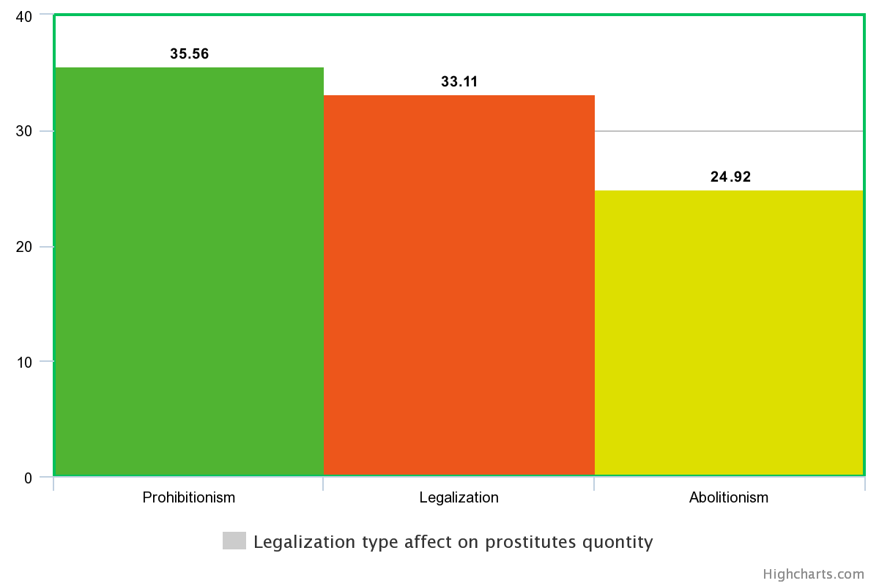
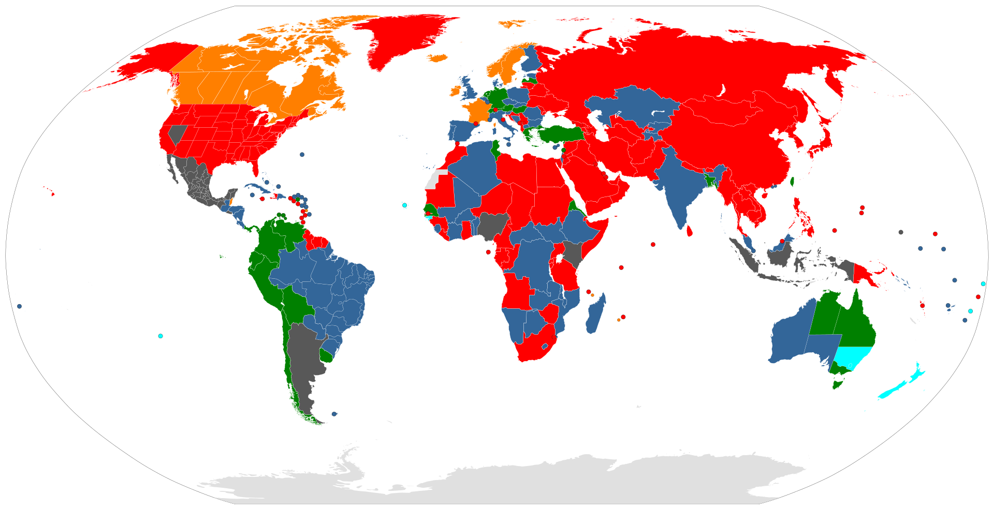

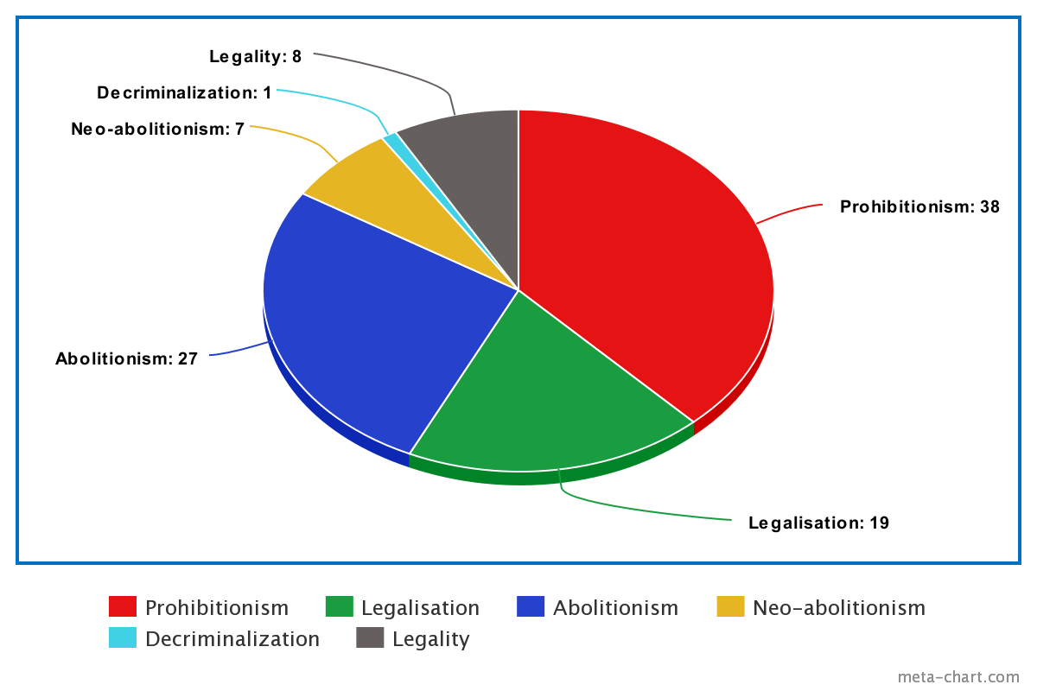


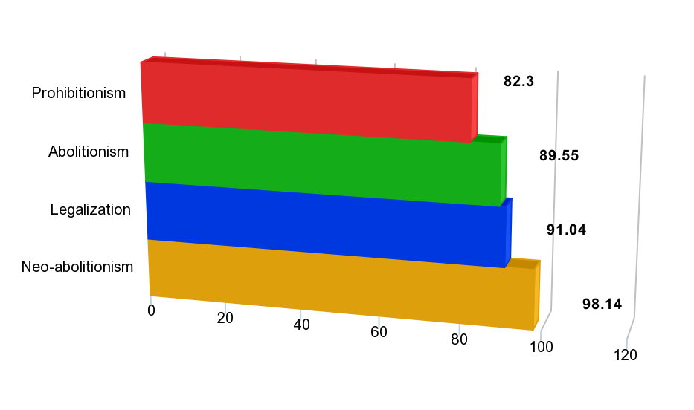
Consequences of legalizing prostitution
B. Darmits
Introduction
1
Methodology
2
The debates about prostitution legalization have been going on since immemorial times. Considering that in thousands of years, we have not been able to completely eradicate it or come up with an ideal model of existence - this is one of the hottest topics today. People have thoroughly examined the impact of prostitution on crime rates and other negative aspects. But what if there were some interesting positives to legalization that few thought about?
Legalization type effect on prostitutes quantity
The methodology implies the use of statistical tools for hypothesis testing and data processing approaches:
1st : Search, collect, rebuild and group data for further analysis
2nd: Analyze data about GDP, literacy, HPI level, etc. of different countries and tell how it is affected by models of sex work law
Legalization
Prohibition
Abolutionism
Experiment Setup
3
The experiment setup involves:
Data from more than 100 countries about prostitution legality and number of prostitutes per 10000 citizens
General county identification data
Analyzing influence of prostitution law model on people life
Analyzing influence of prostitution law model on country overall
Analyzing influence of prostitution law model on number of sex workers
The purpose of the experiment is to identify the impact of prostitution on different life spheres using real world data and to investigate all law models. Find and try to explain the reasons for experiment results. If possible, draw and analyze parallels with Ukraine where the issue of prostitution is very urgent topic .
Decriminalization Legalization Abolitionism Neo-abolitionism (Swedish Model) Prohibitionism Legality
In the particular case, the prostitutes rates and legalization data is collected by US independent organization World Population Review based on World Factbook made by organization ProCon in 2019. Data about regions, GDP, literacy, population growth, agriculture part in GDP of the country is public domain from US government. Data about HPI level taken from official website of the organization counting this index. Also a huge amount of additional information was gathered from different sources to improve research and analysis.
The research includes analysis of dependencies between the country data described above and the forms and levels of prostitution for example: “Prostitution type influence on Literacy”, “Prostitution level influence on Literacy” etc.
Legalization models usage by countries
Results
4
Conclusions
5
Estimated parameter values of the turbine governor
From results of search I can say that, besides the fact that legalization of prostitution has a variety of cons, it also gives a huge contribution to the treasury, partly removes this industry from shade.
This results show us that legalization can help our country to dear with many problems, but we are not ready for this yet. Also it partly explains why its not legalized already.
Countries who totally ban sex work, have lower level of Literacy
Agrarian countries have lower number of sex workers on average
People in countries where prostitution is fully legal are happier then others
Prohibition and Legalization models involve the highest level of sex workers
Conclusions
Literacy level effect on legalization
Applied Sciences Faculty, Ukrainian Catholic University, Lviv, Ukraine (darmits@ucu.edu.ua)

