Slide 1
ENGI 301 Project 1: IcyHot Proposal
October 4, 2020
Brian Dinh

Slide 2


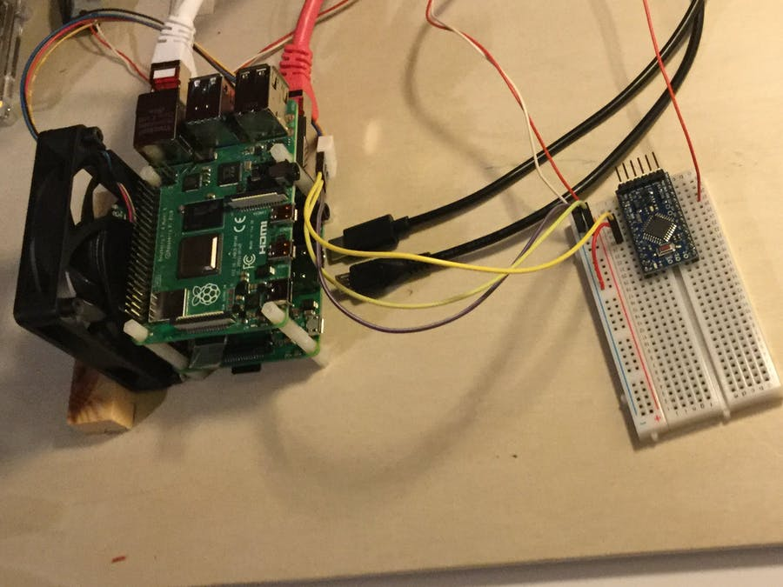
Background Information
What is being proposed?
Automatic thermometer and fan combination
Inspired by current living conditions:
Nonventilated room without a thermometer
Often uncomfortable in own room
Design criteria: needs to know and read current temperature and able to activate the fan if necessary
Links to existing projects / libraries
https://www.hackster.io/moreirarobotics/how-to-make-a-thermometer-with-arduino-and-the-lm35-sensor-d1f65f
https://www.hackster.io/Monstermotte/make-a-fan-controller-with-arduino-b5436d
What improvements / additions over existing project
The fan controller requires a physical input while this project activates the fan depending on T_{environment} (software)
The thermometer outputs a digital value on a screen; the existing thermometer outputs an analog using LEDS (software&hardware)
Software on Cloud9 IDE instead of Arduino IDE

Slide 3
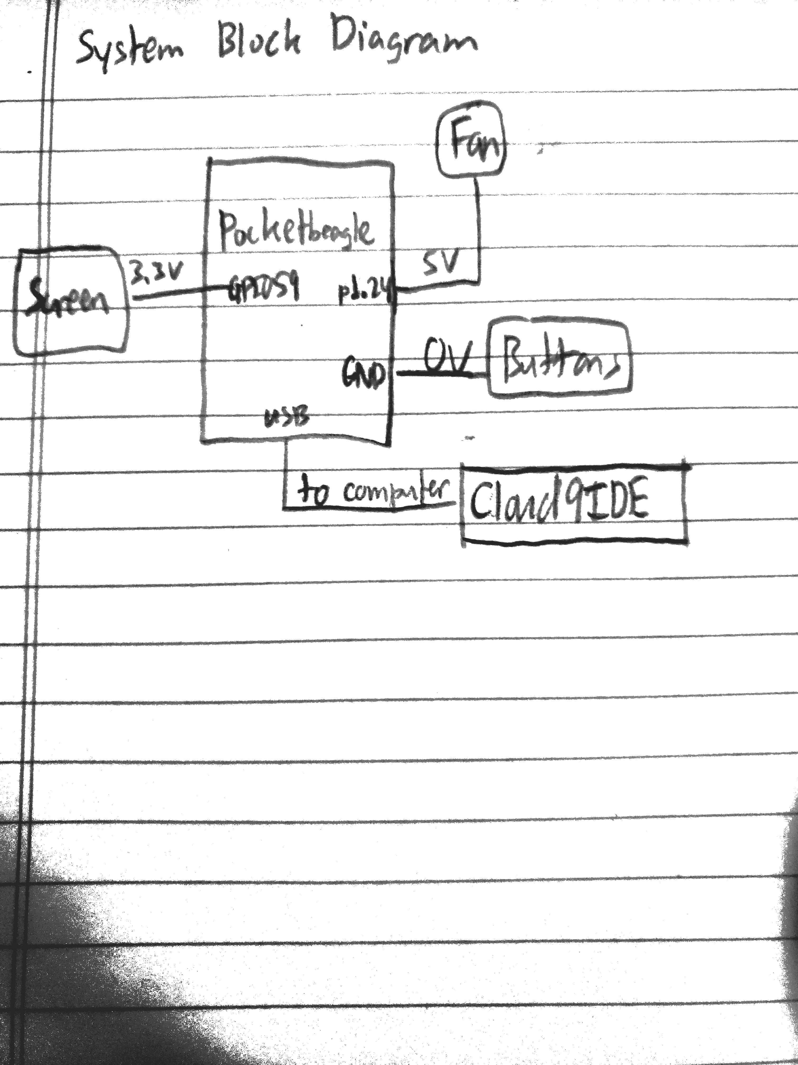
System Block Diagram

Slide 4
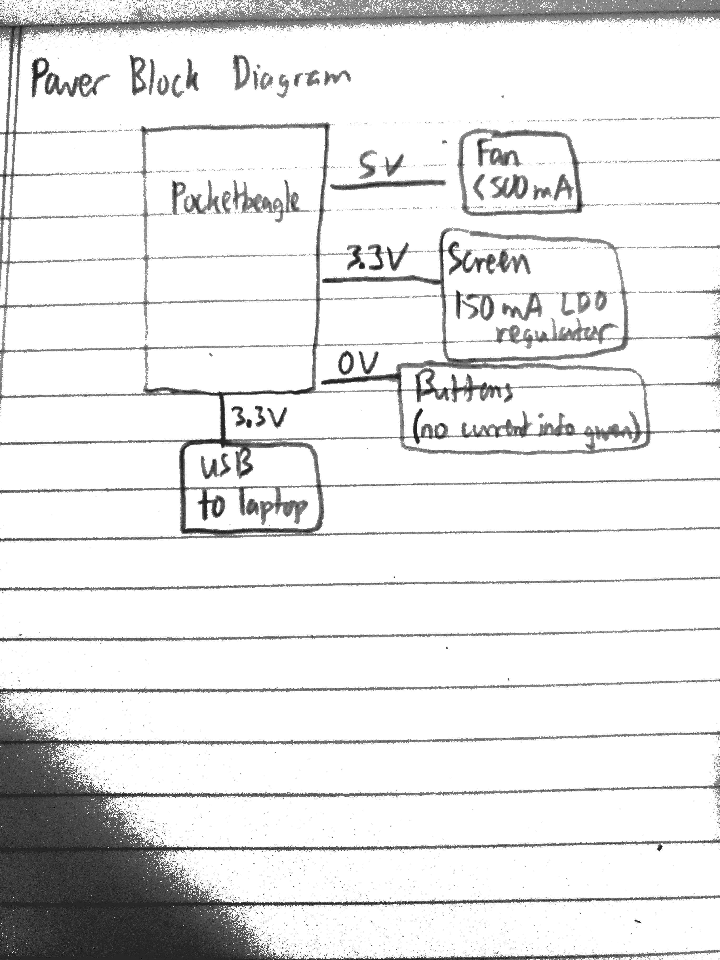
Power Block Diagram

Slide 5
Components / Budget
Component | Need to Buy | Cost (USD)
Noctua NF-A4x20 5V PWM, Premium Quiet Fan, 4-Pin, 5V Version (40x20mm, Brown) | X2 | 29.90
1.8" Color TFT LCD display with MicroSD Card Breakout - ST7735R | X2 | 39.90
Jumper wires | OEDK | 0.00
Set of 10 buttons (digi-key part number 1528-2204-ND) | X1 | 2.50
Total | N/A | 72.30

