Slide 1
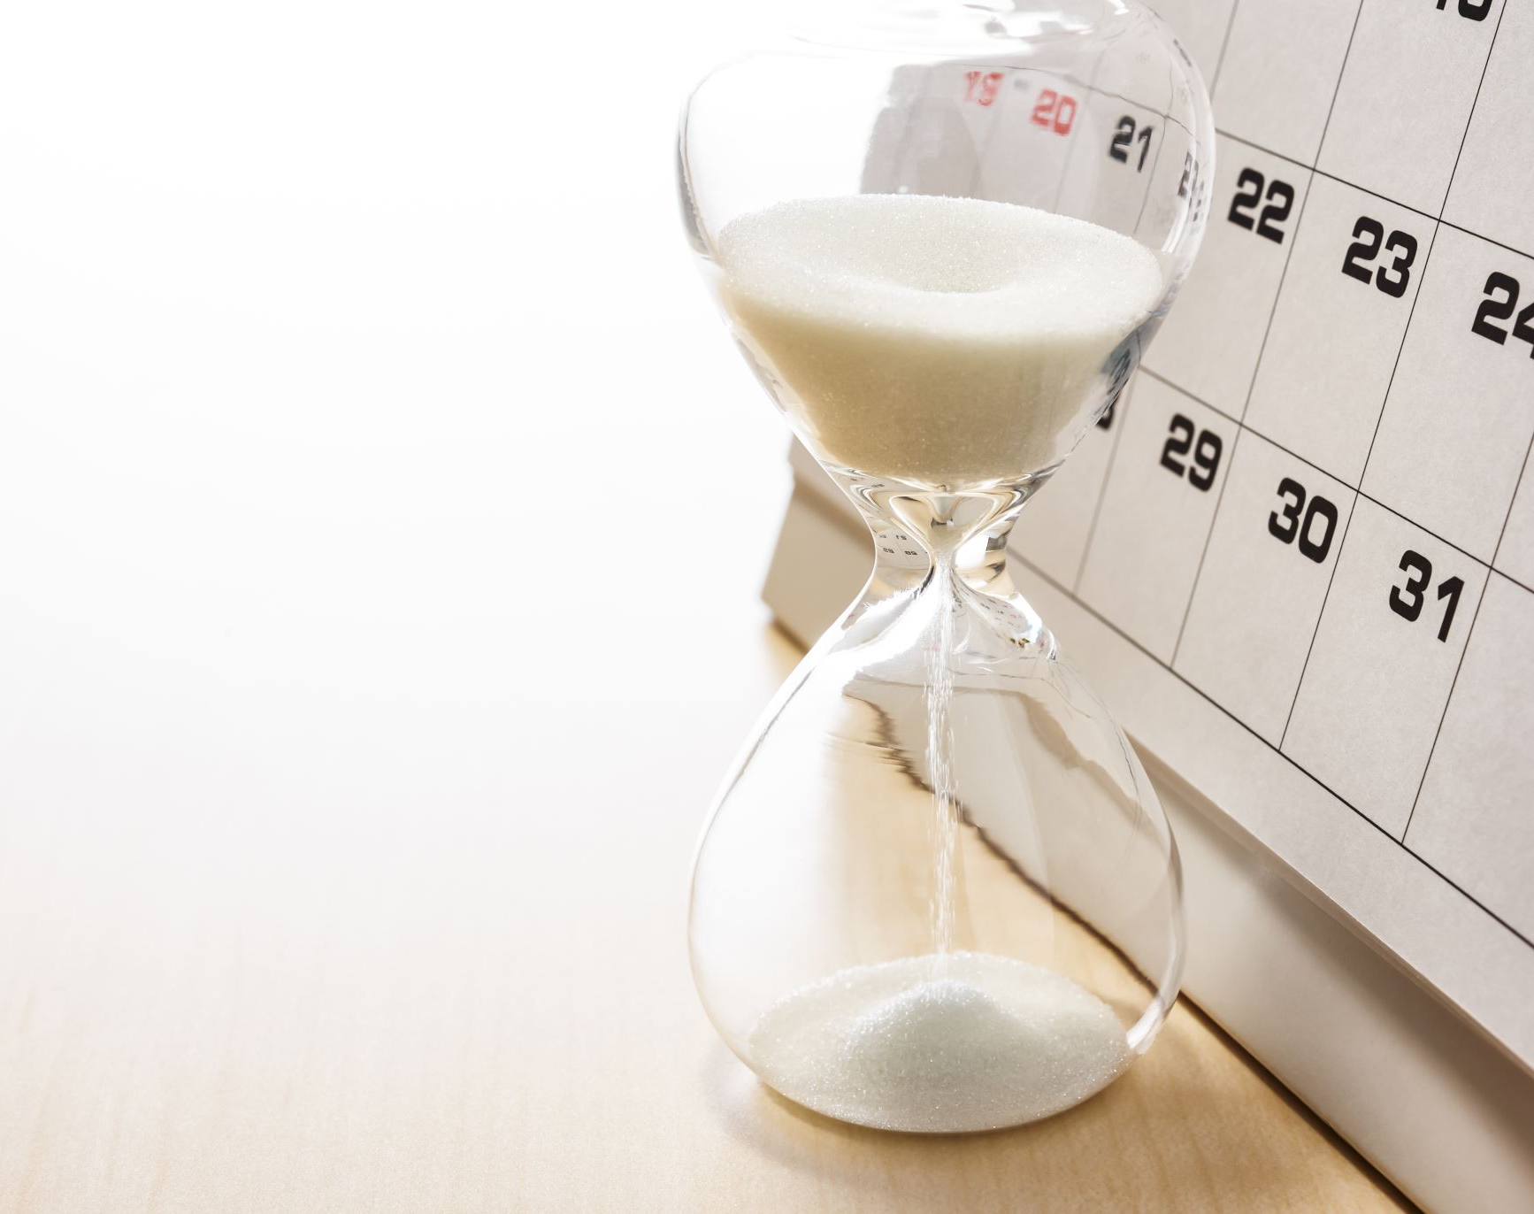
Project Update #2
Geog 498 – Benjamin Kelly

Slide 2
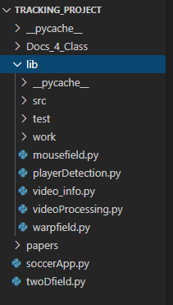
Refactoring
Updated the structure of how the files are laid out
Cleaned up my repository so that everything is easier to locate
Made calling out function much easier

Slide 3
Additional Features
Added a field object so that the field can be updated more easily
This field object also makes it easier to add new features in the future
Add video warping, and corner indentation so that only the field will be pull in to the image processing.
Currently this code requires a whole field to be in view so that the warping function can be used.

Slide 4
New Methods Used
cv.getPerspectiveTransform()
cv.warpPerspective()
cv.setMouseCallback()
The Warp, and Perspective transformation help me to build a better video for the image processing/blob detection
Where as setMouseCallback mainly has to do with building the parameters of the field so that it can be processed.

Slide 5
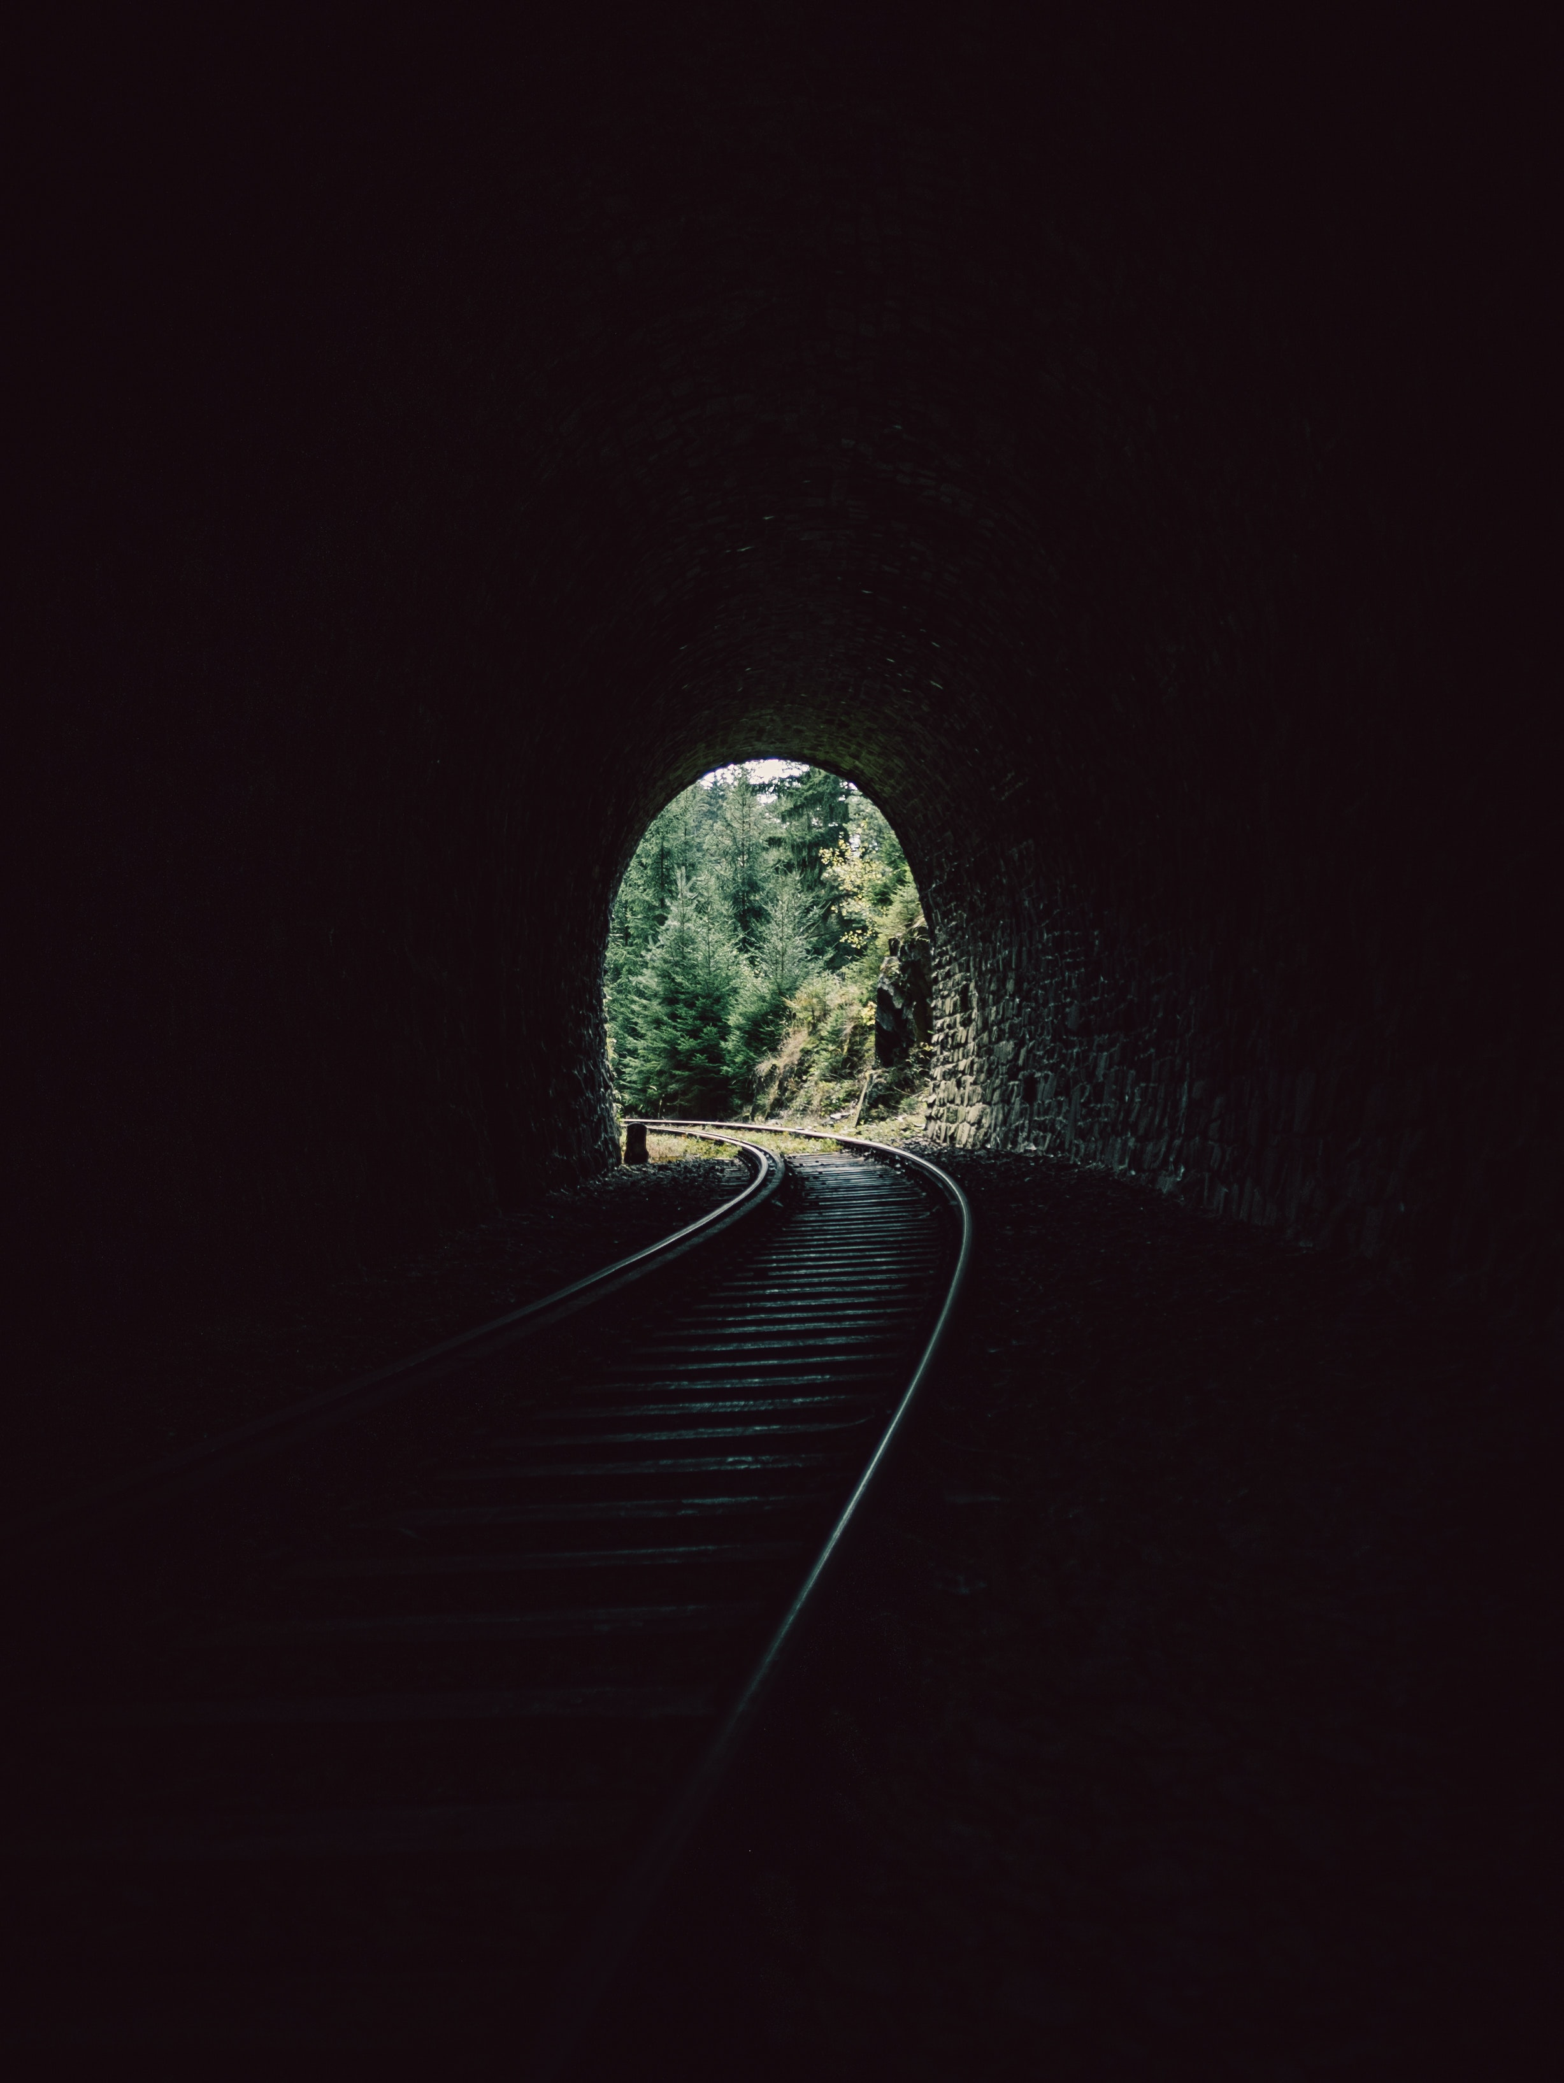
The Future, and Putting it all together
My main goals for the rest of the semester is to refine the blob detection parameter, and adding additional error catching, and finally adding a more user friendly interface.

Slide 6
Time for a demonstration

