Slide 1

592_ITCS424 WIRELESS AND MOBILE COMPUTING
INFORMATION AND COMMUNICATION TECHNOLOGY
SEMESTER 2/ 2016
TAPPO
IONIC PROJECT

Slide 2

MEMBERS
Lalita Junjoewong 5688052
Supatsara Sangnapachai 5688135
Ariya Promdeerach 5688285
Thanatorn Boonnak 5788035
Kittanan Jamnonkrit 5788053

Slide 3
TOPICS
DESCRIPTION
SYSTEM ACHITECTURE
MODULE
DEMO

Slide 4
1.Description

Slide 5


DESCRIPTION
A simple game mobile application
Just a fingertip to enjoy
Tap as much as possible in limited time

Slide 6
2.System Architecture

Slide 7


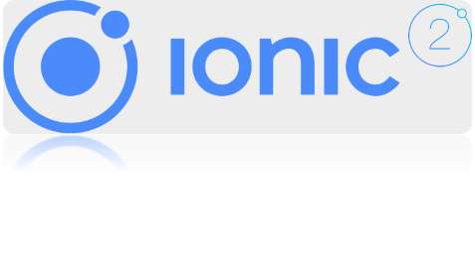
TOOL AND IMPEMENTATION
TOOL: Visual Studio Code
IMPLEMENTATION:
  Install IONIC2 with NODE.JS
  Typescript
  Database: PouchDB with SQLlite

Slide 8

POUCH DB
We use Database to collect the result each game individually and to sort from highest score to lowest score

Slide 9


3.Module

Slide 10
FUNCTIONS
Home page
Menu page: Player can select the functions such as play game, setting, etc.
Player page: Player can should the number of player is one or two players.
Register page: Player can input name which will be kept in the database.
Limitation page: They can select limited time to be the aim of the competition.

Slide 11
FUNCTIONS(2)
Playing page: The timer starts, and the player taps the button.
Ranking page: Afterward, their name and score will be collected and ranked following highest score
Setting page: A player is able to select language, music and sound effect, that they prefers.

Slide 12

4. DEMO

Slide 13

Question and Answer

Slide 14
