Slide 1
GRAPHICAL SECRET KEY VERIFICATION SYSTEM
DOMAIN: SECURITY
GUIDE MEMBERS
Mrs.A.KANCHANA ,ME., DHARSHINI.S – 2018PECCS125
JOSEPHINE BENITA.T – 2018PECCS145
BATCH NO: A-19 KAMALI.B - 2018PECCS146

Slide 2
SYSTEM ARCHITECTURE

Slide 3
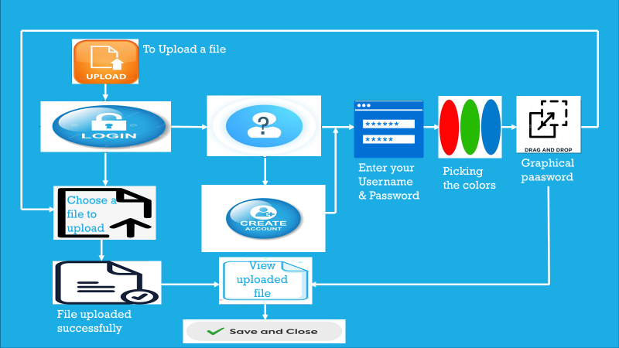
To Upload file
Are you logged in?
Do you have account?
Enter your username &password
Picking the colors
Graphical password
No
Yes
Yes
No
Choose a file to upload
Create an account
File uploaded successfully
View the uploaded file
Save & close

Slide 4
SYSTEM DESIGN
E-R DIAGRAM

Slide 5
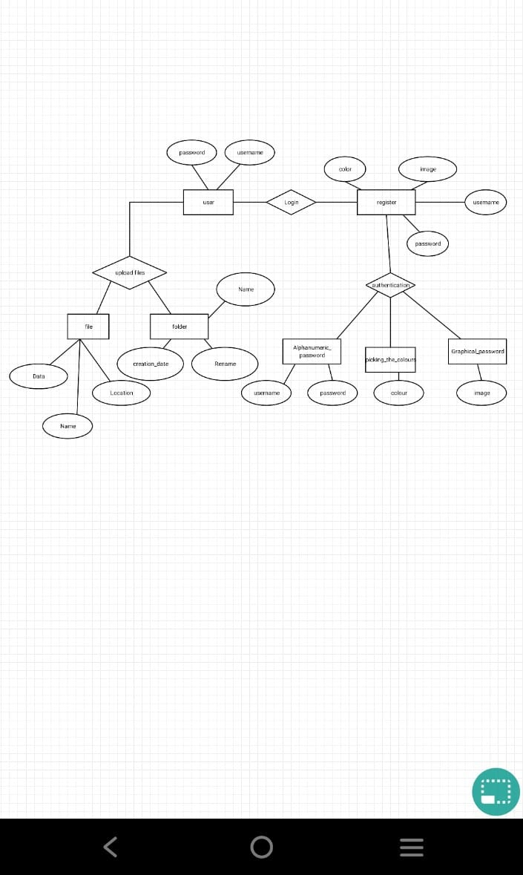

Slide 6
SYSTEM DESIGN
UML DIAGRAMS

Slide 7
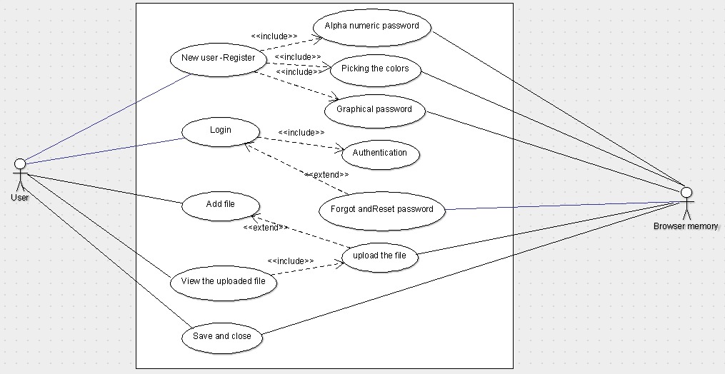
USE CASE DIAGRAM

Slide 8
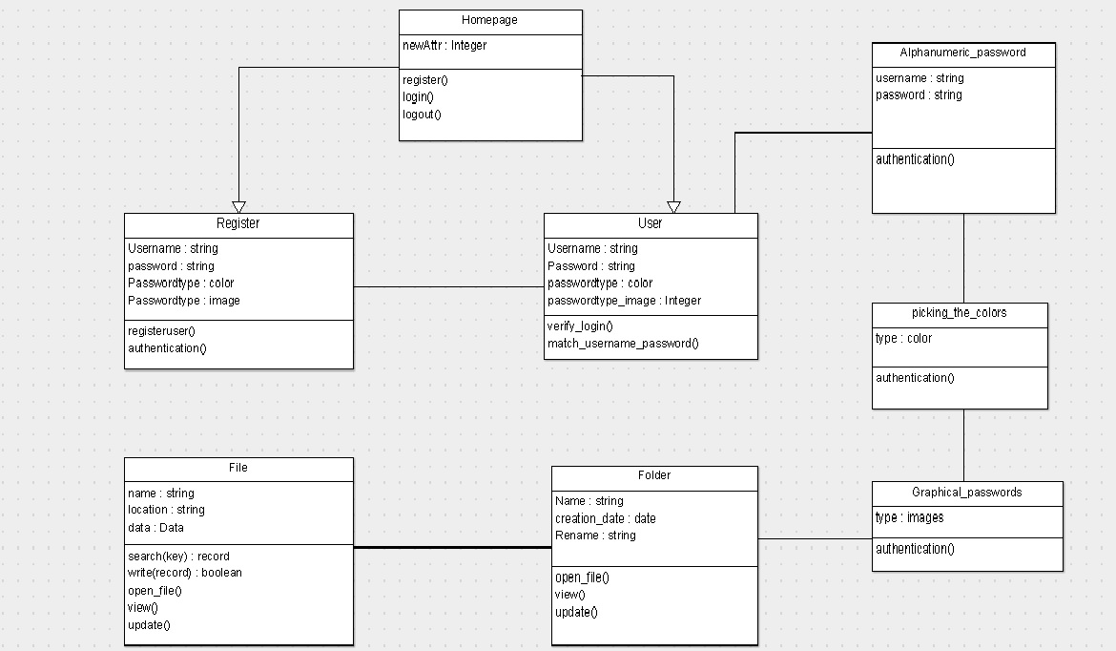
CLASS DIAGRAM

Slide 9
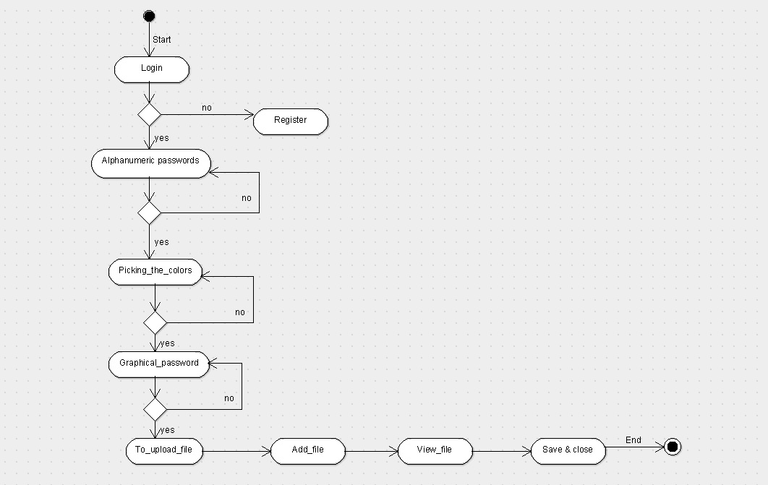
ACTIVITY DIAGRAM

Slide 10
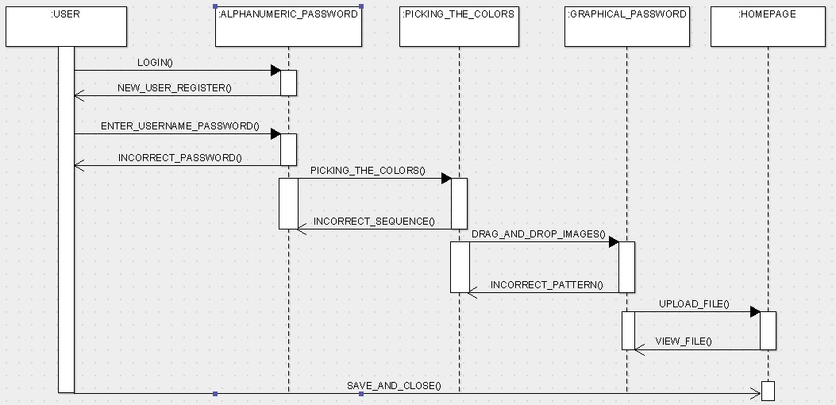
SEQUENCE DIAGRAM

Slide 11
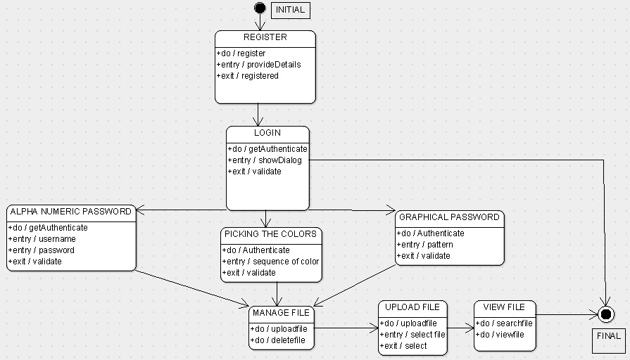
STATE CHART DIAGRAM

Slide 12
DATA DICTIONARY
FIELD NAME | DESCRIPTION | DATA TYPE | DATA SIZE
USER NAME | USER ID | STRING | VARCHAR(20)
PASSWORD | PASSWORD CREATED BY THE USER | STRING | VARCHAR(10)
PICKING THE COLORS | PICK THE CORRECT SEQUENCE OF COLOR | COLORS | 30 BYTES
DRAG &DROP THE IMAGES | DRAG & DROP THE IMAGES IN A CORRECT PATTERN | IMAGES | 12 BYTES
FILES | UPLOAD & STORE THE FILES SAFELY | STRING | 128 GB

Slide 13
INPUT DESIGN

Slide 14
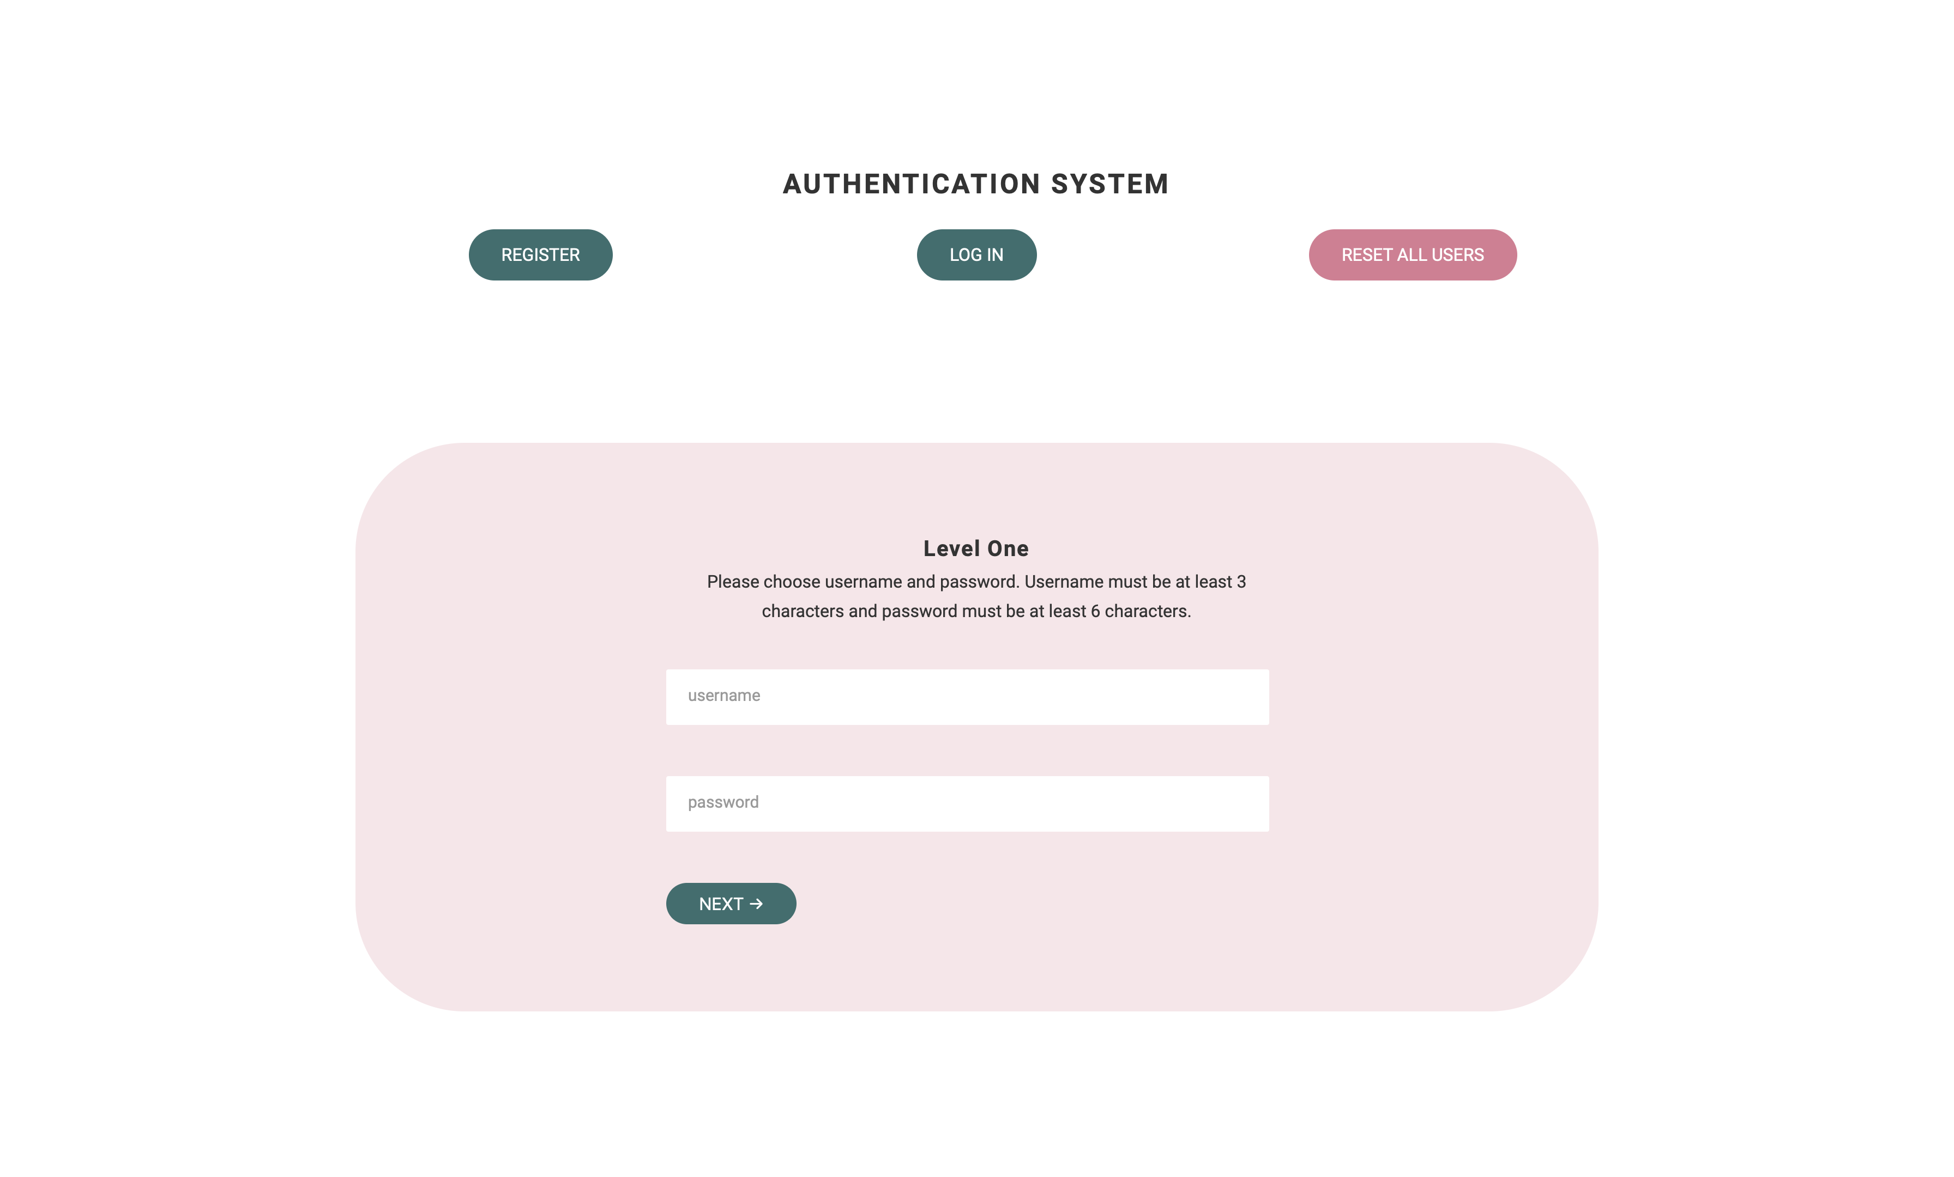
LEVEL ONE

Slide 15
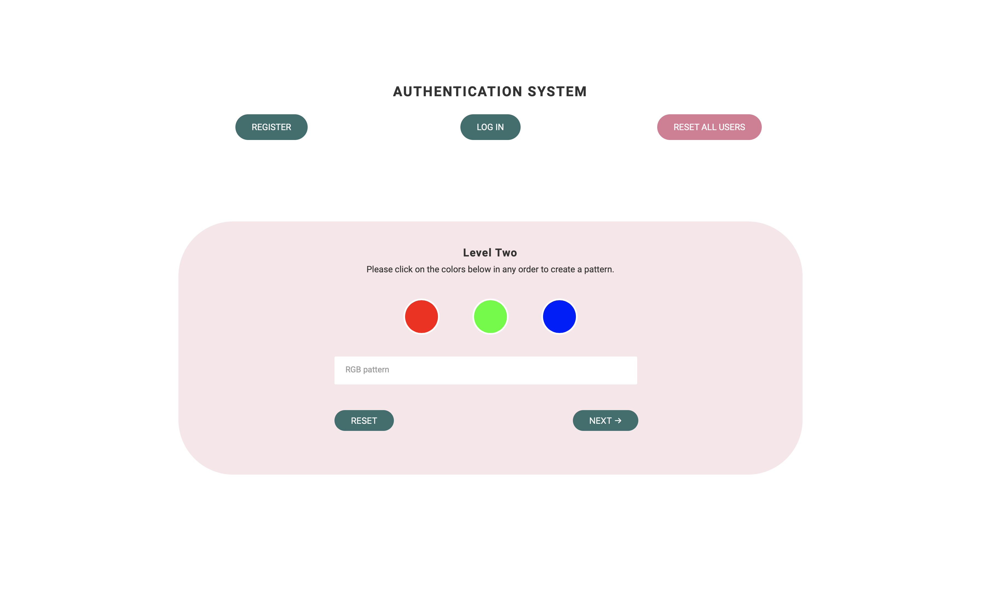
LEVEL TWO

Slide 16
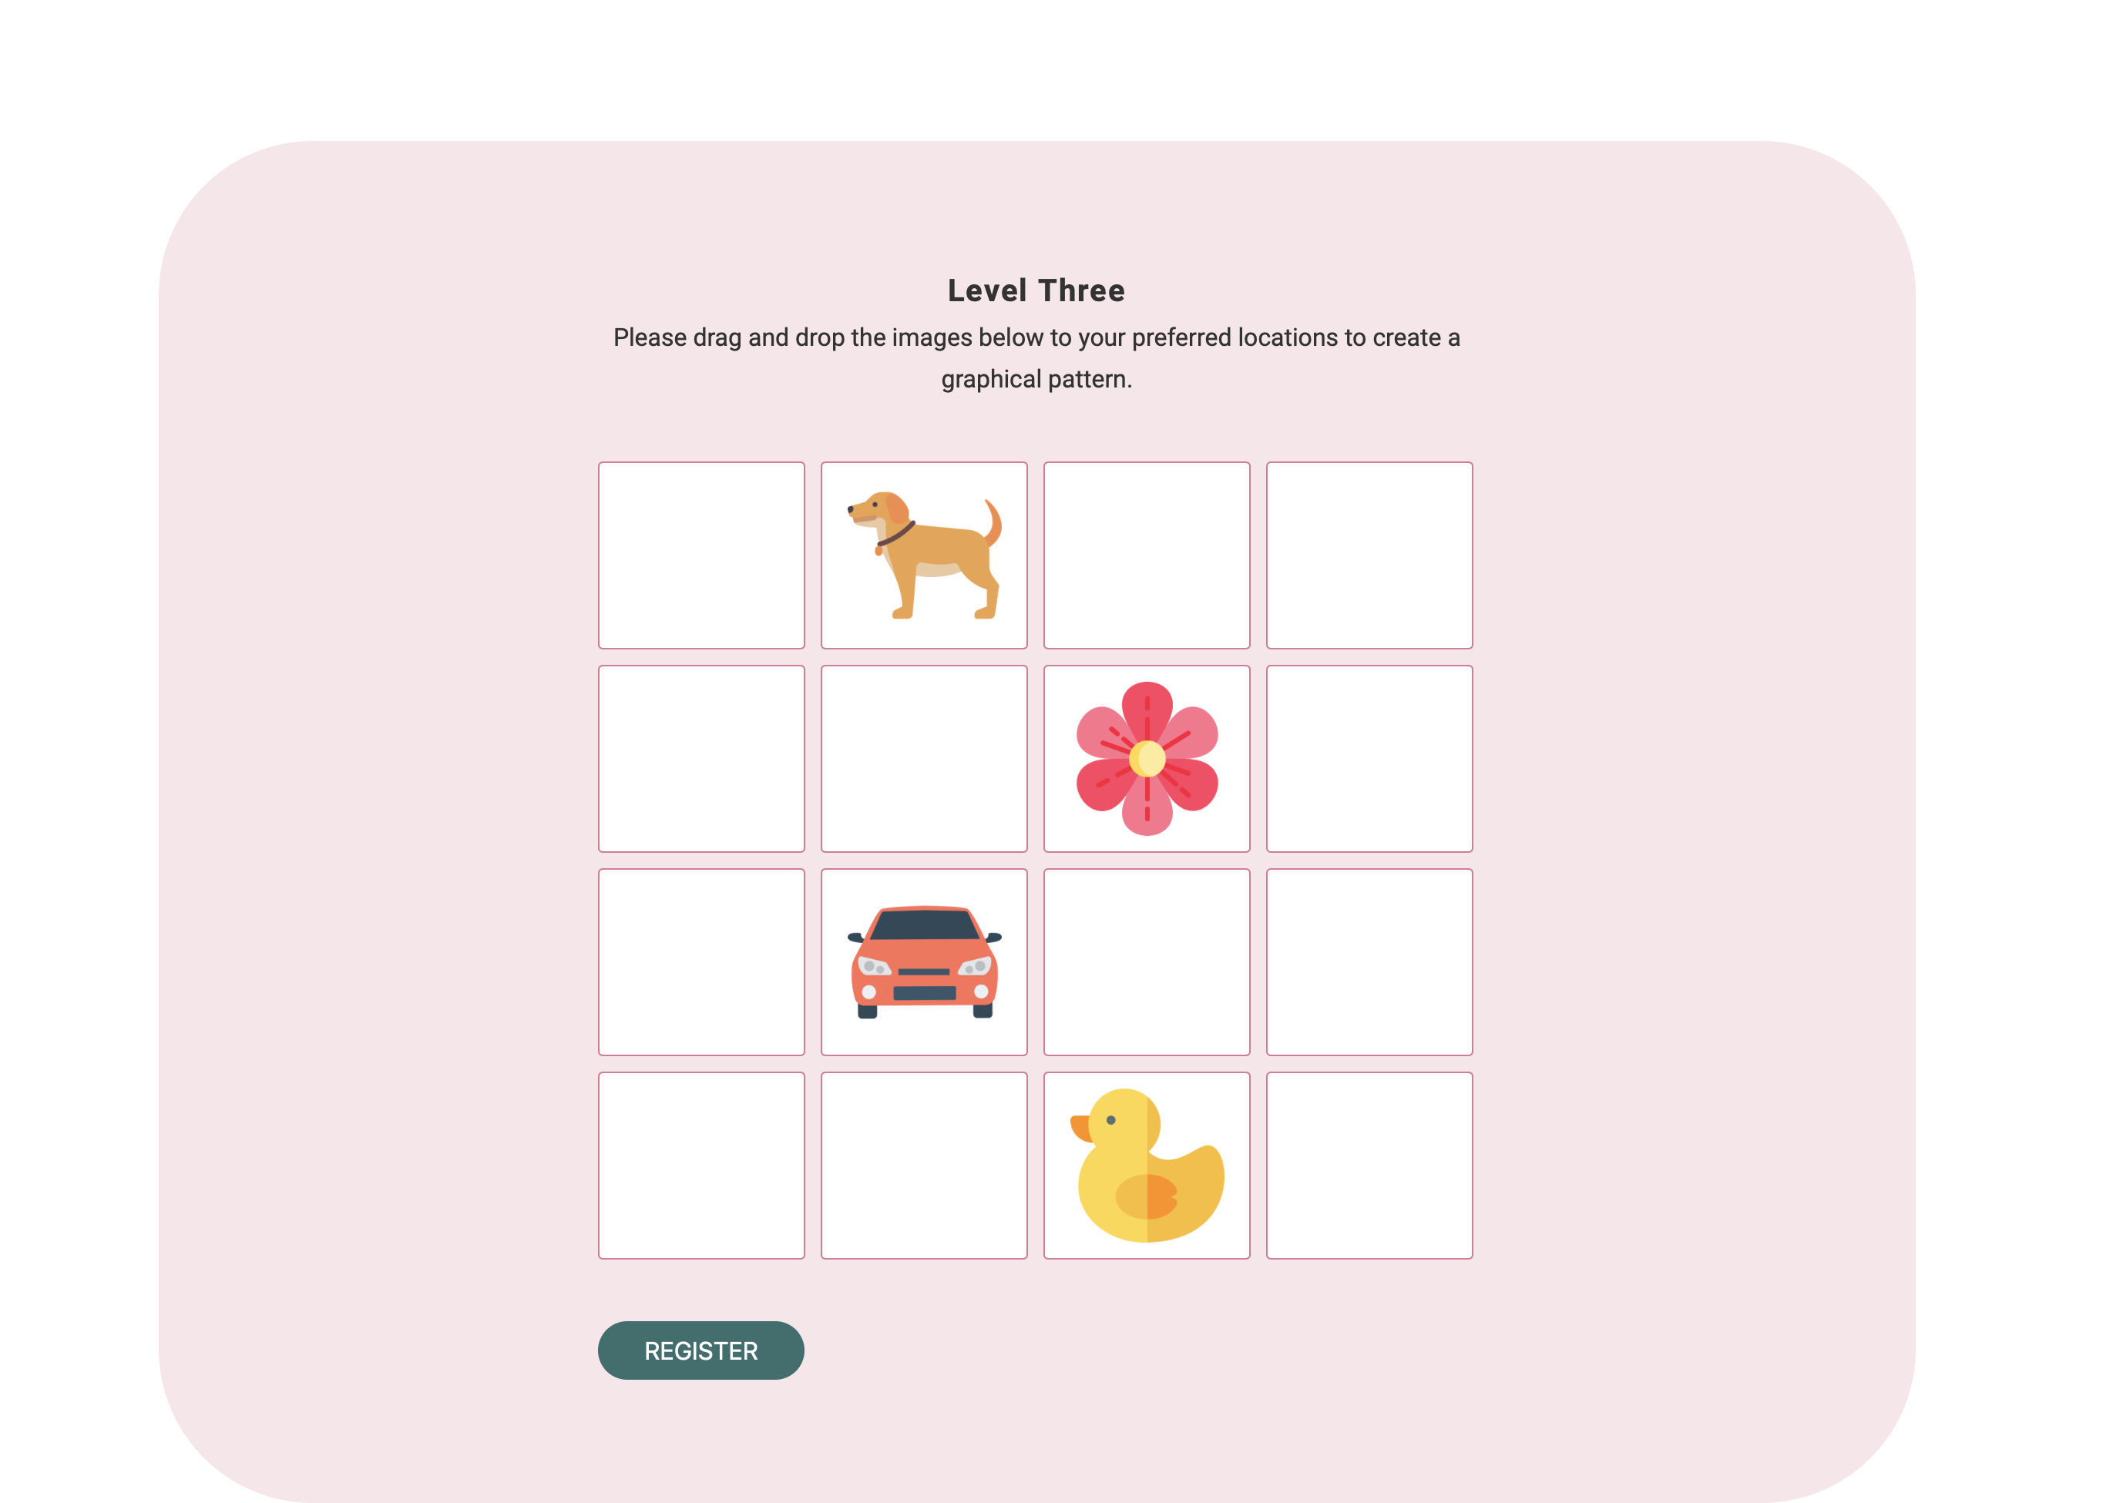
LEVEL THREE

Slide 17
MODULES
Users tend to pick password that can be easily guessed.
So ,here we are using three step authentication system ,in order to keep our information highly secure.
The three step verification systems are as follows:
Alpha numerical user name and password.
Picking the colors in the correct sequence.
Drag and drop the image in grid(pattern).

Slide 18
REGISTRATION MODULE
In this module, the user will get registered in a particular website. It will be formed like a structure where the user details will be filled.
It will have the three fields of authentication.
Alpha numerical user name and password.
Picking the colours in the correct sequence.
Drag and drop the image in grid(pattern).
As this module is present online, the user can register from anywhere they have access to the internet.

Slide 19
LOGIN MODULE
A user reaches a login page on a website they have previously created an account with.
Enables registered users to log in to a site using credentials
The user provides their unique ID and key to verify their identity.
users input their credentials on the website's login form. That information is then sent to the authentication server where the information is compared with all the user credentials on file.
When a match is found, the system will authenticate users and grant them access to their accounts.

Slide 20
THREE LEVEL AUTHENTICATION MODULE
1.Alpha numerical user name and password.
The first level of authentication will be a normal authentication
After entering our details, click on the next button.
2.Picking the colors in the correct sequence.
Next the level two of authentication will be to create a pattern of colors by selecting it so quickly.
If we want to select green ,red ,blue then my color pattern will be green, red, blue for authentication .
3.Drag and drop the image in grid(pattern).
Next the level three of authentication is ,where we have to drag and drop the images to create a pattern of colors.

Slide 21
FILE SYSTEM MODULE
After login, the user can upload their files and also he/she can able to view it after uploading.
The File-System module contains a number of interfaces that let you perform standard file management operations on files already resident on the filesystem.
You can rename, copy, or delete any file, and you can set any available properties for the file.

Slide 22
THANK YOU

