Slide 1
GRAPHICAL SECRET KEY VERIFICATION SYSTEM
DOMAIN: SECURITY
GUIDE MEMBERS
A.KANCHANA.,M.E., DHARSHINI.S – 211418104050
JOSEPHINE BENITA.T – 211418104103
BATCH NO: A-19 KAMALI.B - 211418104108

Slide 2
INTRODUCTION
Computer security depends largely on passwords to authenticate human users from attackers.
The most common computer authentication method is to use alphanumerical usernames and password.
Users tend to pick password that can be easily guessed.
So ,here we are using three step authentication system ,in order to keep our information highly secure.
The three step verification systems are as follows:
Alpha numerical user name and password.
Picking the colors in the correct sequence.
Drag and drop the image in grid(pattern).
After undergoing the above levels ,the user can able to upload their files and keep it in a secure manner.

Slide 3
LITERATURE SURVEY:
S.NO | SOURCE | TITLE OF THE PAPER | METHODOLOGY | FINDINGS
1. | Author: Yuan Zhang, Chunxiang Xu, Hongwei Li, Kan Yang, Nan Cheng, Xuemin Shen, Year: 2021,Journal name: IEEE | Efficient Password-Based Threshold Single-Sign-On Authentication for Mobile Users against Perpetual Leakage. | single-sign-on authentication scheme | Reduces the load of memorizing several passwords
2. | Author: Pawel Szalachowski, Year: 2021,Journal name: IEEE | Password-Authenticated Decentralized Identities. | Decentralized Identity Management | Users control what data to share, Mobile phones act as digital identity devices
3. | Author: Shah zaman nizamani , Syed raheel hassan , Riaz ahmed shaikh 2 , Ehab atif abozinadah, and Rashid mehmood , (senior member, ieee),Year: 2021,Journal name: IEEE | A Novel Hybrid Textual-Graphical Authentication Scheme With Better Security, Memorability, and Usability. | Password security, Textual Password, Graphical password, Observations: | Graphical password schemes provide a way of making more human-friendly passwords.
4. | Author: Simone Raponi, Roberto Di Pietro,Year: 2020,Journal name: IEEE,. | A Longitudinal Study on Web-Sites Password Management (in)Security: Evidence and Remedies. | Secret sharing algorithm, Email based authentication | Can be universally used. User friendly experience.
5. | Author: Masoud Alajmi, Ibrahim Elashry Hala ,S. El-Sayed ,Osama S. Faragallah, Year: 2020, Journal name: IEEE, | A Password-Based Authentication System Based on the CAPTCHA AI Problem. | The brute force attack and the replay attack , 6 CAPTCHA AI | protect against abusive bot traffic.

Slide 4
S.NO | SOURCE | TITLE OF THE PAPER | METHODOLOGY | FINDINGS
6. | Author: Waqas wazir , Hasan ali khattak , (senior member, ieee), Ahmad almogren , (senior member, ieee), Mudassar ali khan and Ikram ud din , (senior member, ieee),Year: 2019,Journal name: IEEE. | Doodle-Based Authentication Technique Using Augmented Reality. | Augmented reality, gesture recognition, password, doodle-based authentication, usable security. | It is based on simple rules and very famous among the users.
7. | Author: Saiful azad1, Noor elya afiqah che nordin , Nur nadhirah ab rasul , Mufti mahmud, (senior member, ieee), Kamal z. zamli1 , (senior member, ieee),Year: 2019,Journal name: IEEE. | A Secure Hybrid Authentication Scheme using PassPoints and Press Touch Code. | Authentication schemes, Graphical authentication schemes, hybrid authentication schemes, Locimetric schemes, Passpoints, Press touch code. | Users select the pre selected faces from a grid.
8. | Author: Abhilash M Joshi, Balachandra Muniyal. Year: 2018,Journal name: IEEE. | Authentication using text and graphical password. | Token Based Authentication Knowledge based authentication Biometric based authentication. | Images in this matrix will be shuffled within, to avoid eavesdropping and shoulder surfing. The shuffle feature of this graphical password will stand against various attacks.
9. | Author: Gi-Chul Yang, Year: 2017,Journal name: IEEE. | A Secure and User-Friendly Graphical Password Scheme. | A mixture of recognition and recall based method | It’s a combination of recognition and recall based technique, hence provides flexibility.
10. | Author: 7 Danilo E. Vieira1 , Tonny L. Mesquita Abreu1 , Max E. Vizcarra Melgar1 , Luz A. M. Santander2 ,Year: 2017,Journal name: IEEE. | A Cued-Recall and Emotion Classification Graphical Password Authentication Scheme | Captcha security method. Recognition-Based method. Recognition of emotional images. Cued-Recall security layer | highly usable and could improve the security level on ATM machines. perception of security is enhanced using human emotions

Slide 5
PROBLEM STATEMENT:
As more and more things go online, the risk of cybercrime and data breaches rises.
Passwords are essential for keeping your data safe on both online and offline platforms. Passwords are the most common means of gaining access to our accounts .Today providing security is considered as a major problem in several areas which may include internet banking and in some areas where high level of security to preserved confidentiality of users data.
Using static passwords alone makes it easy for the hackers to hack the users account. So, using just single level authentication factors is not sufficient to ensure security. In this, an idea is to implement three levels of security for authenticating for true users.
The authentication process happens when information is entered into the login system with a database. Then, the system checks whether the information entered matches the database information. If it matches, the user can access the system. Social environment factors such as parents, friends, work colleagues, social media, and government policies play a vital role.
Alphanumeric passwords are either easy to guess or difficult to remember when using classic username-password authentication. Users also tend to use the same password for all of their accounts because remembering several passwords is tough. To alleviate the challenges associated with the typical username-password authentication methodology, other authentication methods such as color graphical passwords and drag-and-drop graphical passwords are utilized.

Slide 6
DEVELOPMENT ENVIRONMENT:
1. HARDWARE ENVIRONMENT:
Processor - I5
Speed - 3 GHz
RAM - 8 GB (min)
Hard Disk - 100 GB
Monitor - LCD
2. SOFTWARE ENVIRONMENT:
Operating System : Windows 7/10/11
Server : NPM, Mysql ,FireBase API.
Front End : HTML, CSS, Node.JS
Server-side Script : Python, JavaScript.

Slide 7
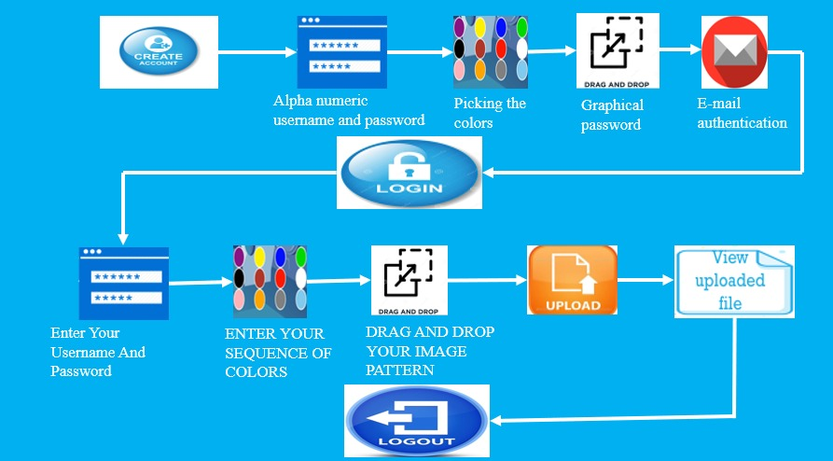
SYSTEM ARCHITECTURE

Slide 8
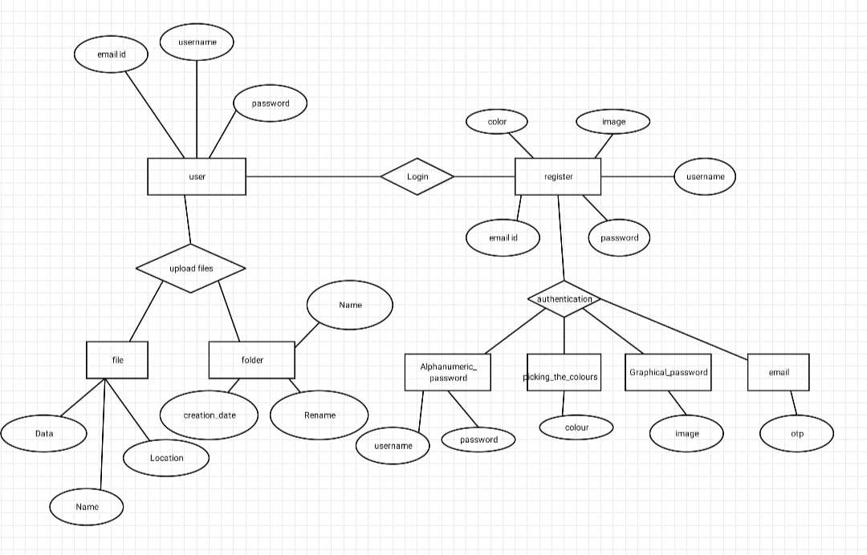
SYSTEM DESIGN-ER DIAGRAM

Slide 9
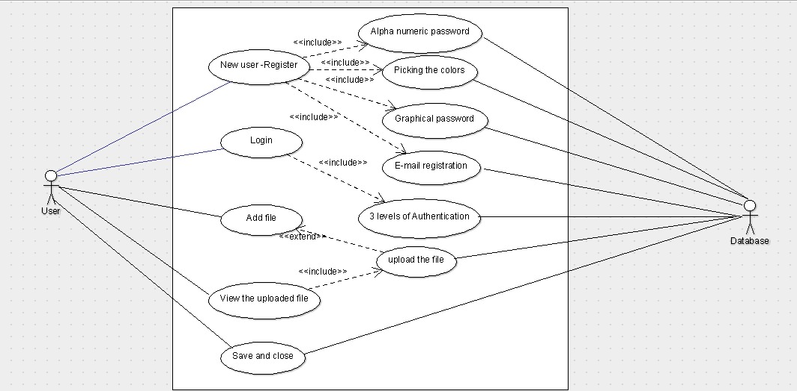
USE CASE DIAGRAM

Slide 10
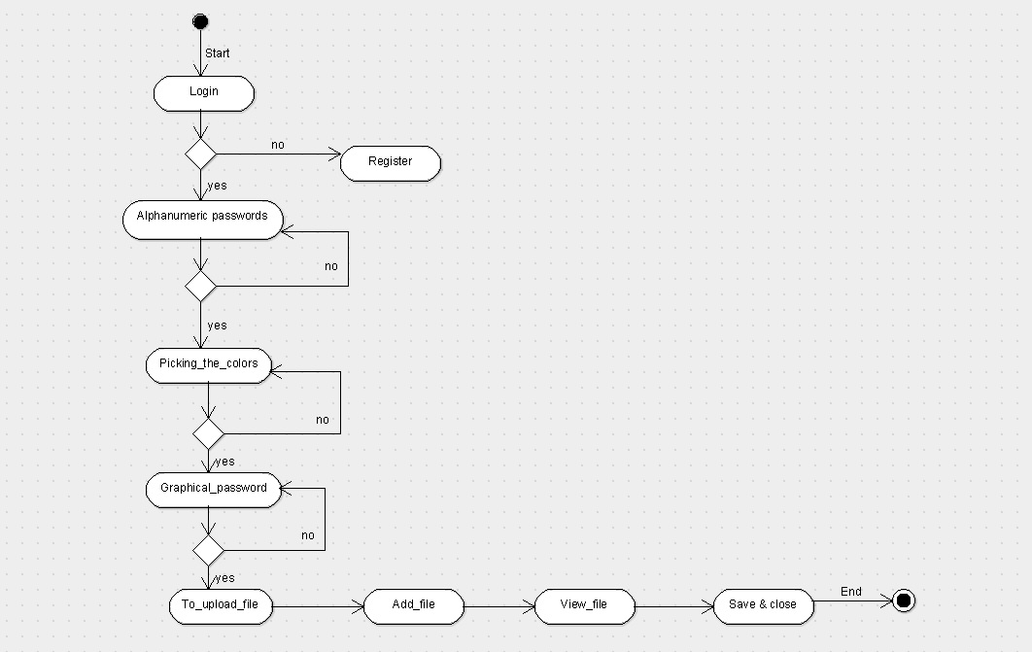
ACTIVITY DIAGRAM

Slide 11
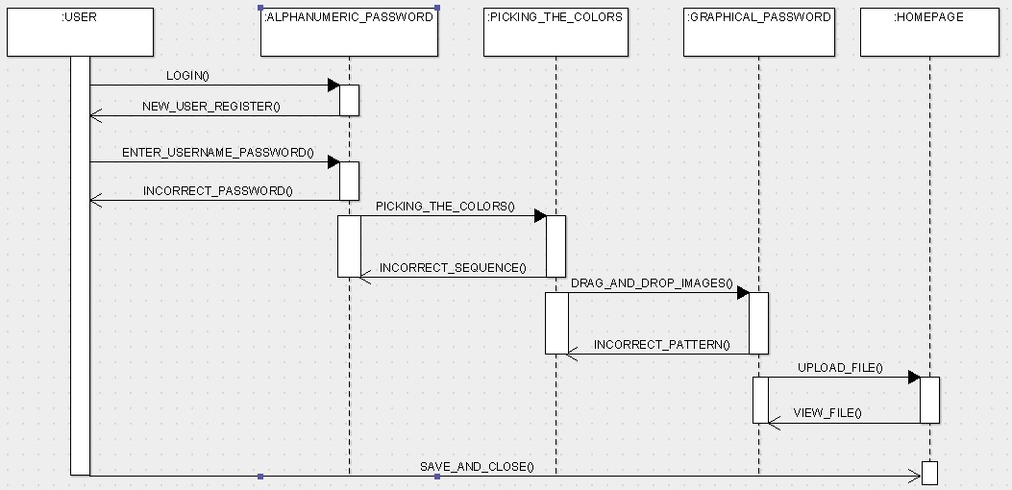
SEQUENCE DIAGRAM

Slide 12
MODULES:
1. REGISTRATION MODULE:
In this module, the user will get registered in a particular website. it will be formed like a structure where the user details will be filled.
It will have the three fields of authentication.
Alpha numerical user name and password.
Picking the colors in the correct sequence.
Drag and drop the image in grid(pattern).
After the graphical level ,the user will redirect to the email authentication level,where the user will receive an OTP.
Finally it will shows that “Registration is successful”.
As this module is present online, the user can register from anywhere they have access to the internet.

Slide 13
2.LOGIN MODULE:
A user reaches a login page on a website they have previously created an account with.
Enables registered users to log in to a site using credentials
The user provides their unique ID and key to verify their identity.
users input their credentials on the website's login form. That information is then sent to the authentication server where the information is compared with all the user credentials on file.
When a match is found, the system will authenticate users and grant them access to their accounts.

Slide 14
3.THREE LEVEL AUTHENTICATION MODULE:
1.Alpha numerical user name and password.
The first level of authentication will be a normal authentication
After entering our details, click on the next button.
2.Picking the colors in the correct sequence.
Next the level two of authentication will be to create a pattern of colors by selecting it so quickly.
If we want to select green ,red ,blue then my color pattern will be green, red, blue for authentication .
3.Drag and drop the image in grid(pattern).
Next the level three of authentication is, where we have to drag and drop the images to create a pattern of colors.

Slide 15
4. FILE SYSTEM MODULE:
After login, the user can upload their files and also he/she can able to view it after uploading.
The File-System module contains a number of interfaces that let you perform standard file management operations on files already resident on the filesystem.
You can rename, copy, or delete any file, and you can set any available properties for the file.
And also we can upload any format of files like audio ,video ,pdf ,image ,etc :-

Slide 16
TESTING/RESULT:
S.NO | FUNCTIONAL TEST CASES | TYPE-POSITIVE/NEGATIVE TEST CASES
1. | Verify if a user will be able to login with a valid user name and valid password | positive
2. | Verify if a user cannot login with a valid username and invalid password. | Negative
3. | Verify the message for invalid login. | positive
4. | Verify if the “Enter key” of the keyboard is working correctly on the login page. | positive
5. | Verify if the font ,text color and color coding of the login page is as per the standard. | UI testing & positive
S.NO | SECURITY TEST CASES | TYPE-POSITIVE/NEGATIVE
1. | Verify if the users cannot enter the characters more than / less than the specified range(user name & password) | Positive
2. | Verify the login page by pressing “Back button” of the browser. It should not allow you to enter into the system once u logout. | positive
3. | Verify if the user should be able to login with the same credentials in different browsers at the same time | Positive

Slide 17
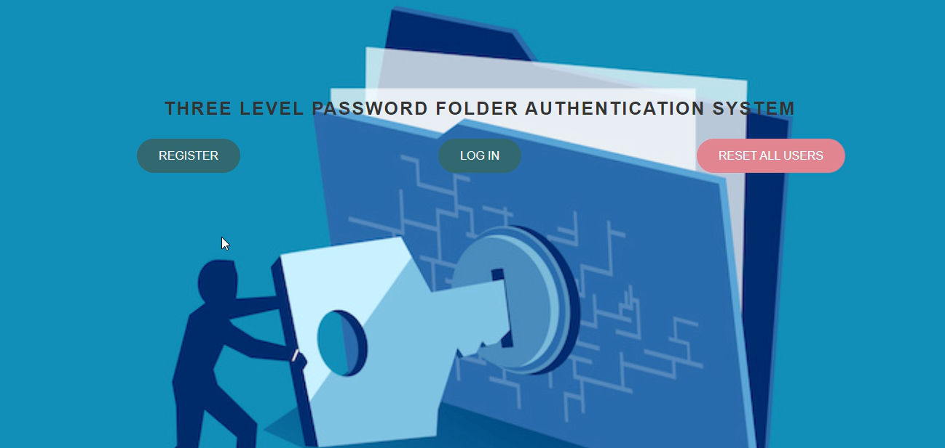
SAMPLE SCREEN SHOTS:
1.

Slide 18
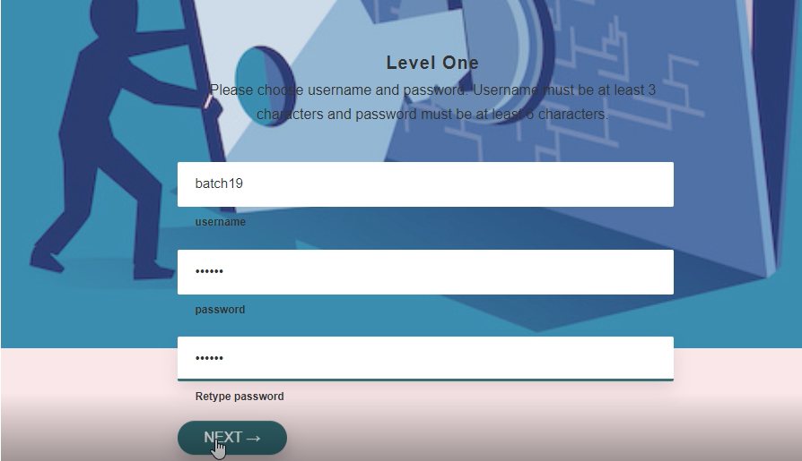
3.

Slide 19
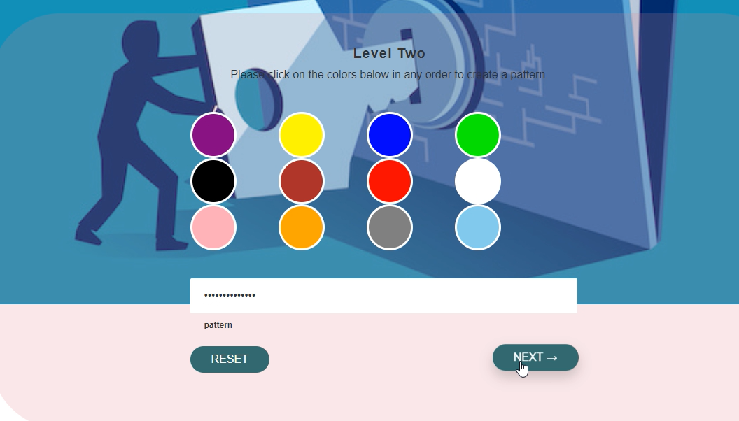
4.

Slide 20
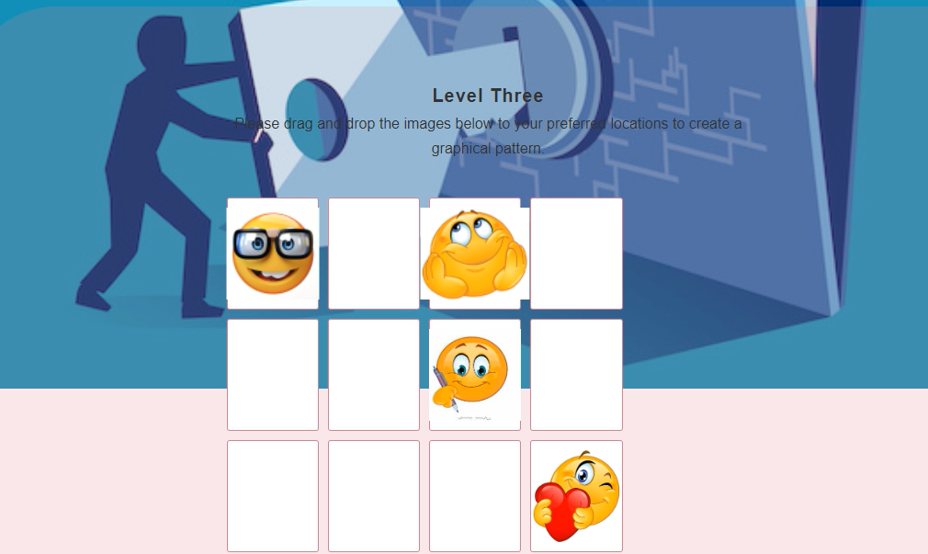
5.

Slide 21
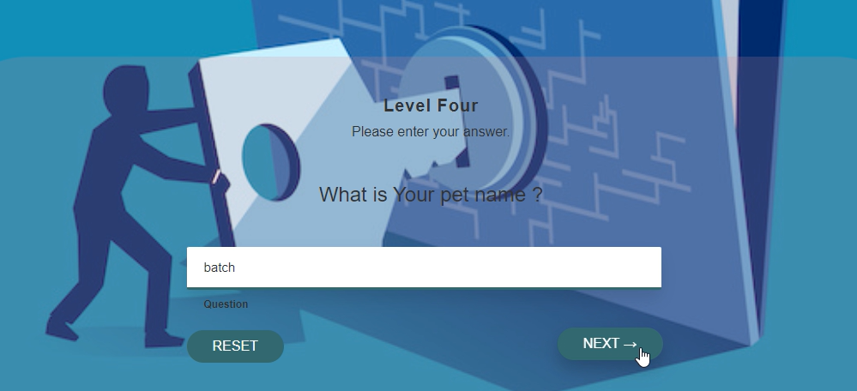
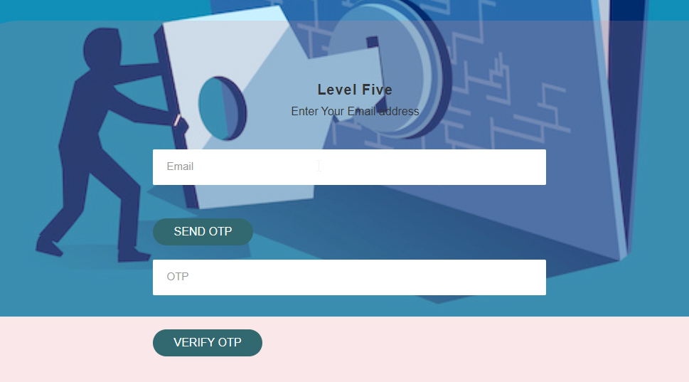
6.
7.

Slide 22
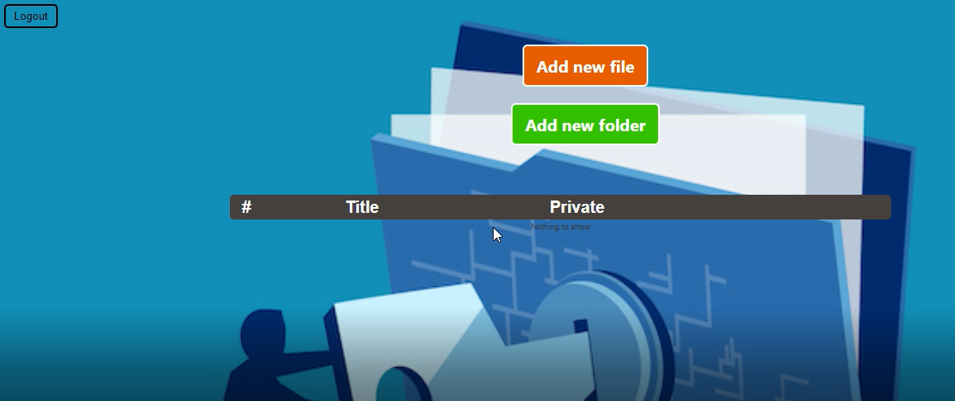
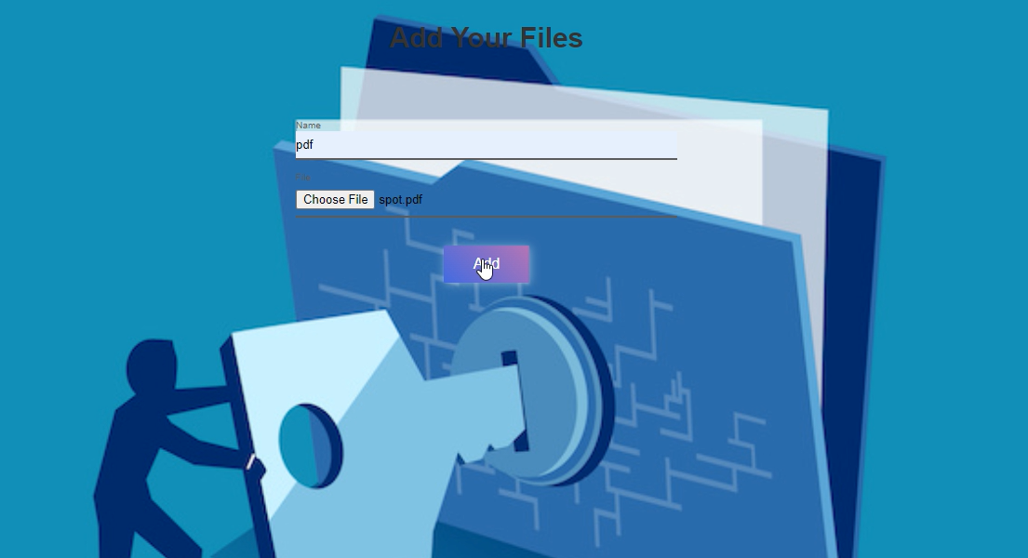
8.
9.

Slide 23
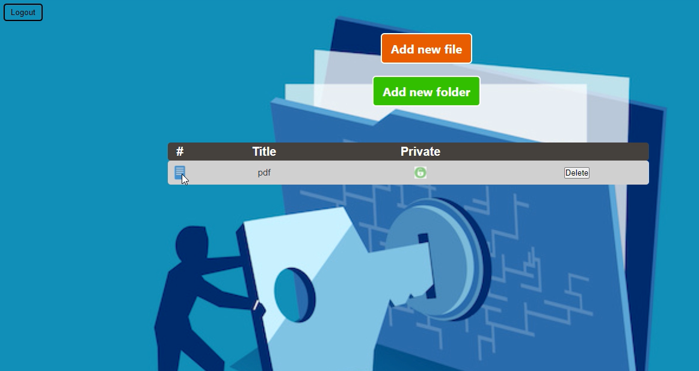
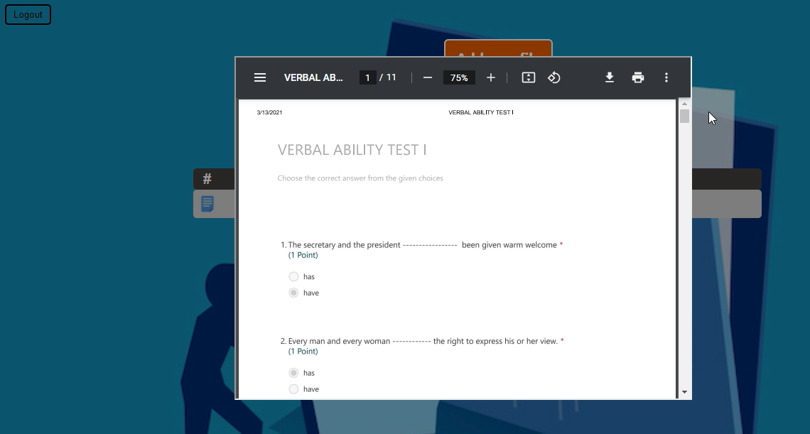
10.

Slide 24
CONCLUSION
Here ,we are trying to make our authentication system more user friendly and also we have tried to implement mature & fast Shoulder Surfing Resistant Mechanism. We have considered both methods: text based and graphical based systems and tried to reduce the efforts required by end-user to remember passwords. A look at the advancement in technology over the past few years tells us that the next era will have system security at its core. Thus Graphical Password may be adapted in future as a major authentication system. Our system is a combination of recognition and recall based approach. It is more usable and secure as compare to previous graphical password authentication systems. As password space is very large it provides the security against brute force attack. It is easy to use. Passwords can be created and memorized easily Randomization in both the authentication steps provides strong security against shoulder surfing. Overall our system is resistant to all other possible attacks also. This system can be used for highly secure systems.

Slide 25
REFERENCES
REFERENCES:
[1] A. H. Lashkari, S. Farmand, D. Zakaria, O. Bin, and D. Saleh, Year 2009,“Shoulder surfing attack in graphical passwordauthentication”,” International Journal of Computer Science and Information Security”, Volume . 6, Page. 145-154.
[2] M. V. Ruiz-Blondet, Z. Jin, and S. Laszlo, Year 2016 , “Cerebre: A novel method for very high accuracy event-related potential biometric identification”,” IEEE Transactions on Information Forensics and Security”, Volume . 11, no. 7, Page 1618–1629,.
[3] J. M. Mandler and G. H. Ritchey, Year: 1977 “Long-term memory for pictures”,” Journal of Experimental Psychology: Human Learning and Memory”, Volume. 3, no. 4, Page 386.
[4] J. Yan, A. Blackwell, R. Anderson and A. Grant, Year 2004,“Password Memorability and Security: Empirical Results,” in Proceedings of IEEE Security & Privacy, Volume . 2, Page. 25–31.
[5]Bin B. Zhu, Jeff Yan, Guanbo Bao, Maowei Yang, and Ning Xu, Year 2014,“Captcha as Graphical Passwords A New Security Primitive Based on Hard AI Problems,” in Proceedings of the IEEE Transactions on Information Forensics and Security”, Volume. 9, Page. 891–904.

Slide 26
THANK YOU

