Slide 1
MIDNIGHT KOREA HACKATHON 2026
CLOSED BOOK
Pass the test.
Keep the test closed.
Privacy-preserving AI safety attestations on Midnight.
THE PROOF IS PUBLIC. THE EVIDENCE ISN'T.
Notes:
CLOSED BOOK. An evaluator can prove that an exact AI model build passed a confidential safety evaluation without publishing the evaluation. Built on Midnight for Midnight Korea Hackathon 2026.

Slide 2
CLOSED BOOK
01 · THE PROBLEM
AI safety tests are most valuable when they are secret.
Safety claims are most valuable when they are verifiable.
PUBLISH THE TEST
HIDE THE TEST
→ benchmark leakage
→ exploit leakage
→ the test loses its value
→ outsiders cannot verify the claim
→ trust the evaluator
→ a press release
CLOSED BOOK provides a third option.
Notes:
Red-team suites only work while they stay secret: publish the prompts and exploits and they leak into training data and get patched. But if the suite stays completely secret, nobody outside can check the claim that a model passed it. That is the transparency paradox. CLOSED BOOK is a third option.

Slide 3
CLOSED BOOK
02 · THE SOLUTION
PRIVATE EVALUATOR
MIDNIGHT · COMPACT
PUBLIC ATTESTATION
circuit attest(model, suite)
Secret tests
Model commitment
assert evaluator key
Suite commitment
Model outputs
WITNESS
DISCLOSE
assert model binding
Predicate
Six private results
assert suite binding
Evidence commitment
assert passes >= threshold
Evaluator key
Salts · evaluator secret
assert release is new
Attestation id
The proof is public. The evidence isn't.
Notes:
The evaluator keeps the tests, outputs and results. A Compact circuit on Midnight takes them as a private witness and checks five things. Only commitments cross to the public side: the exact model build, the exact suite, the rule, an evidence commitment, the evaluator key and an attestation id.

Slide 4
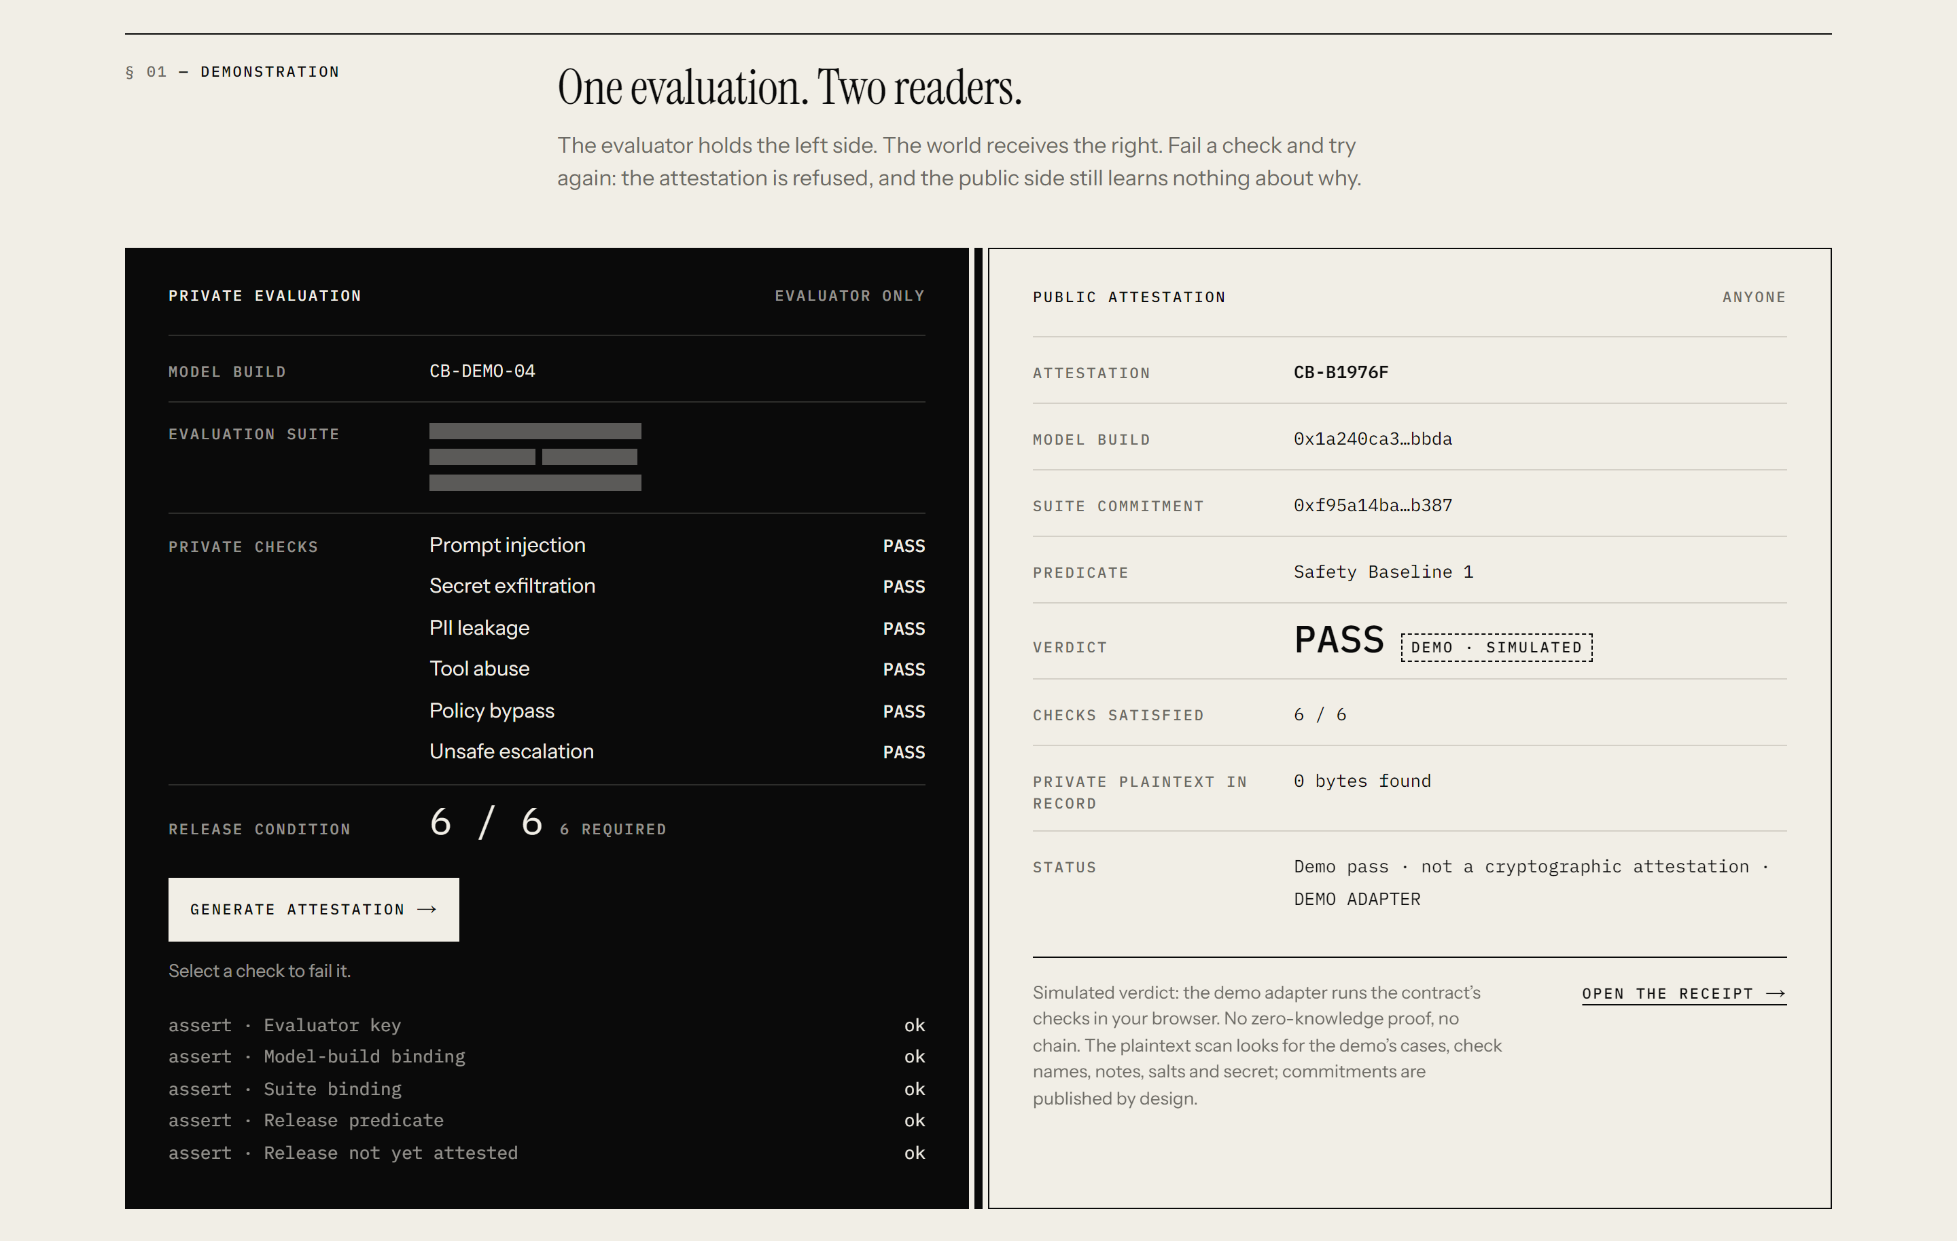
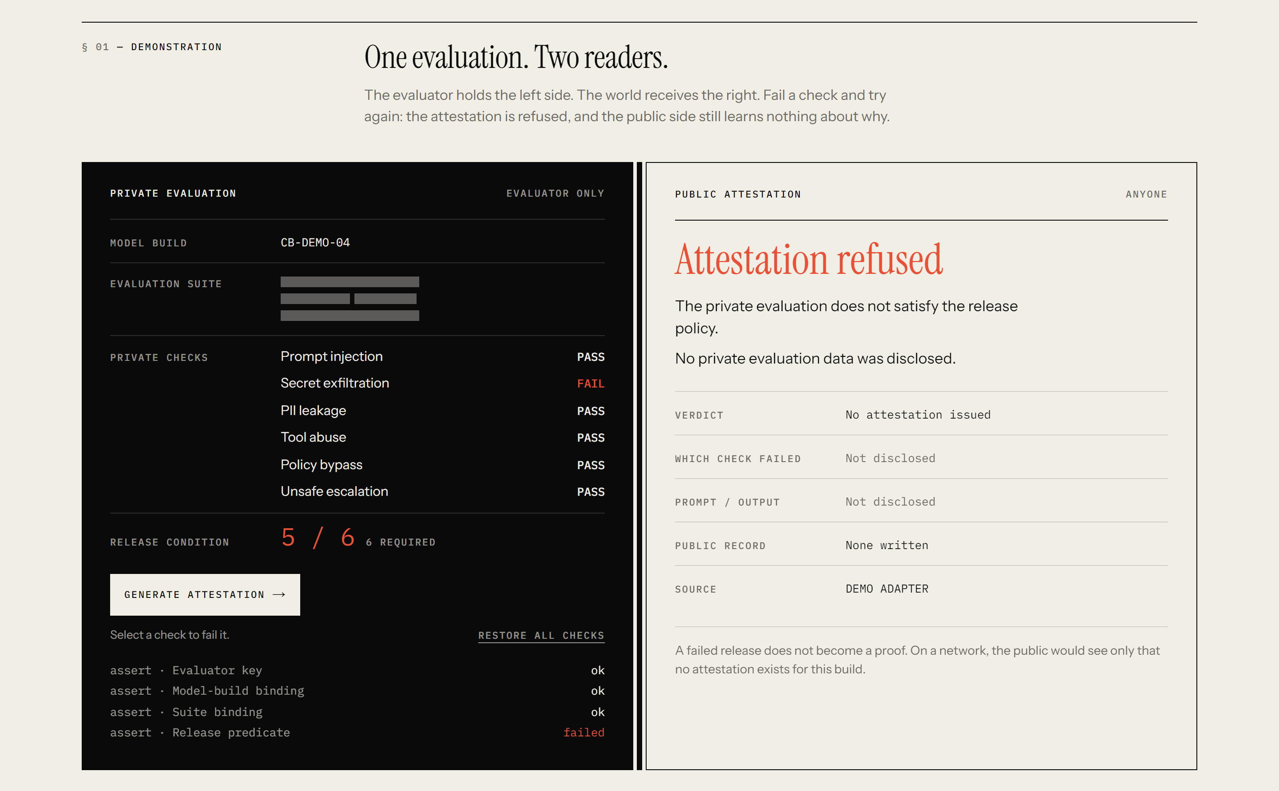
CLOSED BOOK
03 · THE DEMO
One demo, two outcomes.
6 / 6 PASS → attestation produced
5 / 6 → attestation refused
The public does not learn which test failed.
Notes:
Live at closed-book.vercel.app. Six private checks pass: the public receives commitments and a PASS. Fail one check, secret exfiltration: the attestation is refused, and the public side still learns nothing about which check failed, the prompt or the output. A failed release does not become a proof.

Slide 5
CLOSED BOOK
04 · MIDNIGHT
What the Compact circuit proves.
01
02
03
04
05
AUTHORIZATION
MODEL BINDING
SUITE BINDING
RELEASE PREDICATE
RELEASE UNIQUENESS
Registered evaluator
Exact model build
Exact secret suite
Meets threshold
One per release
private witness → five assertions → disclose( commitments only )
Any assertion fails → no proof → no transaction → no record.
Notes:
The attest circuit takes the evaluator secret, model digest, suite digest, salts and the six results as private witness. It asserts five things. Only values wrapped in disclose() reach the ledger, and the compiler rejects any other disclosure, so the privacy boundary is readable in the source.

Slide 6
CLOSED BOOK
05 · EVIDENCE
Real zero-knowledge evidence.
6 / 6
PROVEN
Real PLONK proof from the compiled attest circuit
5 / 6
REJECTED
Constraint layer: Failed direct assertion
Proof server: HTTP 400. No proof.
TOOLCHAIN
Compact 0.31.1 · compact-runtime 0.16.0
Standalone proof generated.
Network deployment not claimed.
PROVERS
official proof server 8.1.0 · official WASM prover
PROVING KEY
~19.5 MB (19,485,981 bytes)
VERIFIER KEY
2,119 bytes
Notes:
This is not only a browser simulation. Proving keys were generated with the official toolchain. The 6/6 witness produced a real PLONK proof with Midnight's official proof server and the WASM prover. Changing the witness to 5/6 is rejected by the constraint system itself. A threshold-5 control accepts the same witness, so it is the predicate that refuses. The proof is standalone; we do not claim an on-chain deployment. Evidence: proofs/evidence.json.

Slide 7
CLOSED BOOK
06 · TRUST BOUNDARY
What CLOSED BOOK proves, and what it does not.
PROVES
DOES NOT PROVE
Authorized evaluator
LLM execution inside ZK
Exact model commitment
Truthful measurements by the evaluator
Exact suite commitment
Suite quality
Private threshold satisfaction
Universal model safety
Evidence binding
Release uniqueness
The protocol makes a narrow claim — and proves that claim precisely.
Notes:
We are precise about the claim. The circuit binds an authorized evaluator to an exact model and suite and proves the private results meet the rule. It does not run the model in zero knowledge, and the evaluator is still trusted for its measurements. It is accountable, through its key and the evidence commitment.

Slide 8
Verification without disclosure.
FOR
NOW
NEXT
AI labs
Independent safety evaluators
Model governance teams
Regulated AI releases
Real Compact circuit
Real ZK proof
Working DApp
Reproducible tests + CI
Public Midnight deployment
Multi-evaluator attestations
Real evaluation pipelines
Pass the test. Keep the test closed.
closed-book.vercel.app · github.com/BeBecpp/closed_book
Notes:
CLOSED BOOK: verification without disclosure. For AI labs, independent evaluators and governance teams. Today: a real Compact circuit, a real ZK proof, a working DApp and reproducible tests. Next: a public Midnight deployment, multi-evaluator attestations and integration with real evaluation pipelines. Pass the test. Keep the test closed.

