Slide 1
Sage 300 2018.0 Web SDK Overview
John Thomas (JT)
July 2017

Slide 2
Samples
Sync global files to current 2018.0 versions
Upgrade Accpac .NET references to 6.5.0.0
Updated Docs
Defect with JQuery.validator.format resolved
New Import/Export Engine implemented in 1 sample

Slide 3
Documentation
Upgrade Instructions for 2017.2 to 2018.0
New Pagination CVIEW Document
Updated WebApi Endpoint Reference
Updated a few endpoints, but no breaking changes
Updated Wizard Documents

Slide 4
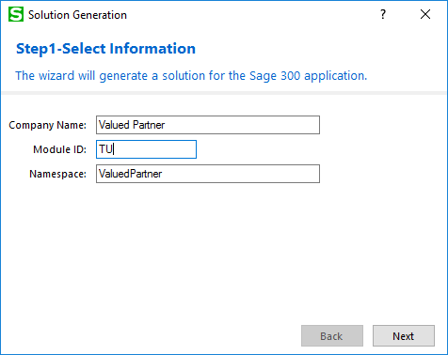
Solution Wizard
Global Files Updated to 2018.0
XML Documentation Checkbox now selected by default
Updated User Interface

Slide 5
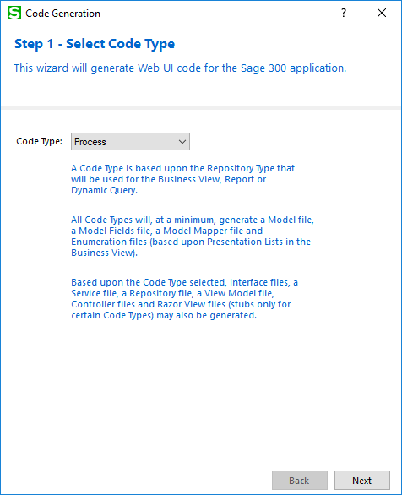
Code Generation Wizard
Global Files Updated to 2018.0
Updated AccpacDotNet.props file to 6.5.0.0
Import/Export Changes for default code
Pagination TODO Comments for manual implementation
Updated User Interface

Slide 6
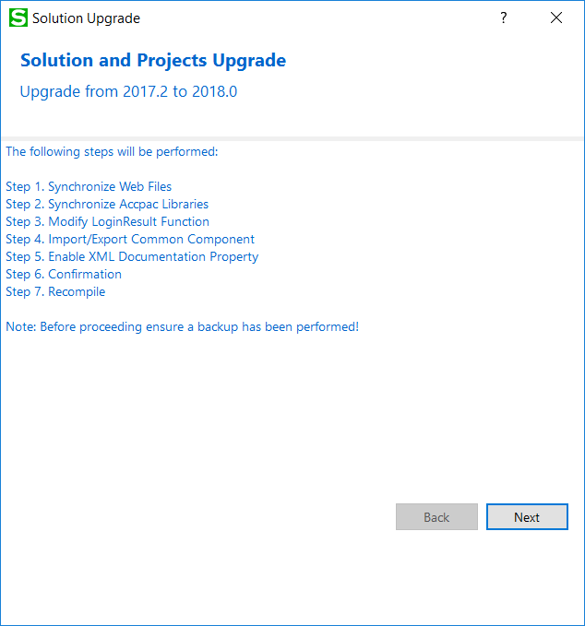
Upgrade Wizard
Upgrades Projects and Solution
Upgrade files from 2017.2 to 2018.0
Turn on XML Documentation
Update .props file
Search for invalid JQuery.validator.Format signature
Manual correction required, if found
Import/Export changes
Manual steps in document as automation not possible
Pagination TODO Comments
Updated User Interface

Slide 7
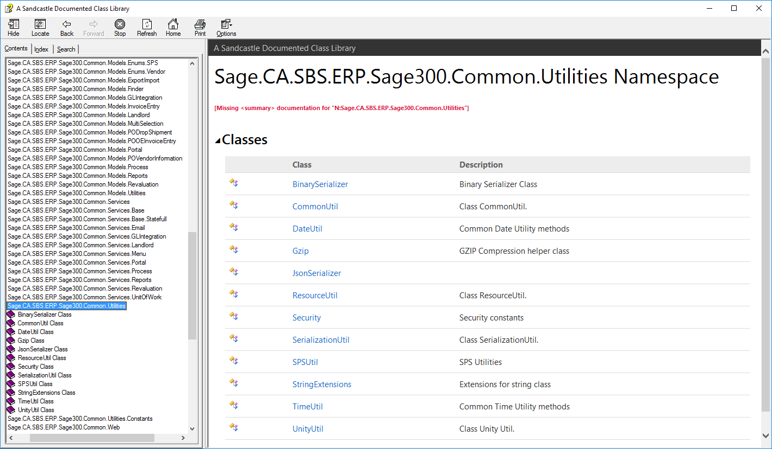
Help File
CommonCore.chm
Updated content
More to be done
Note: Still a work in progress!

Slide 8
Partner Menu Defects and Enhancement
Defects
Partner Menus with three columns not displaying correctly
Breadcrumbs missing from partner menu

Slide 9
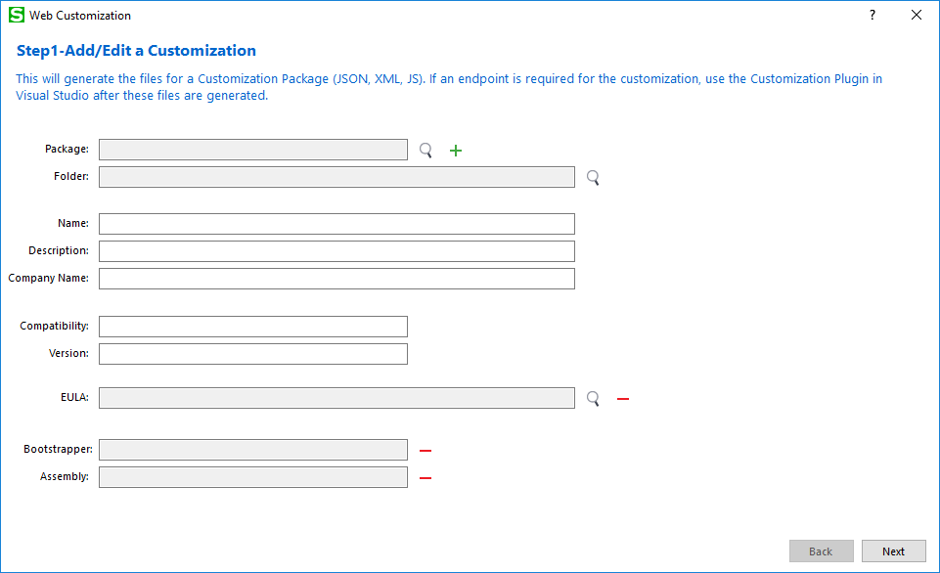
Customization Wizard Enhancement
Split into two wizards
First wizard (standalone) is outside of Visual Studio for customizations not requiring an endpoint
Generates Manifest, XML, and JavaScript
Inputs for Manifest and XML via WYSWYG editor
Second wizard (plug-in)is inside of Visual Studio and accepts JSON Manifest as input

Slide 10
PDB Files for Common and Core Components
Delivery of PDB files for Common and Core components
Ability to debug into Sage components
Available via DPP Download

Slide 11
GitHub Repository
Open Source
https://github.com/SageNADev/Sage300-SDK
2018.0 is available in the “master” branch
2017.2 is available in the “release-2017.2” branch (archive)
2017.1 is available in the “release-2017.1” branch (archive)
2017 is available in the “release-2017” branch (archive)
2018.1 is available in the “develop” branch (in-progress)

