Slide 1
Sage 300 2018.1 Web SDK Overview
John Thomas (JT)
October 2017

Slide 2
Defects Corrected
The module name for a partner’s menu item is not being localized when displayed in the window manager
Resolved in LocalizeMenuItems of the HomeController

Slide 3
Documentation
Upgrade Instructions for 2018.0 to 2018.1

Slide 4
Solution Wizard
Global Files Updated to 2018.1

Slide 5
Code Generation Wizard
Global Files Updated to 2018.1

Slide 6
Upgrade Wizard
Upgrades Projects and Solution
Upgrade files from 2018.0 to 2018.1

Slide 7
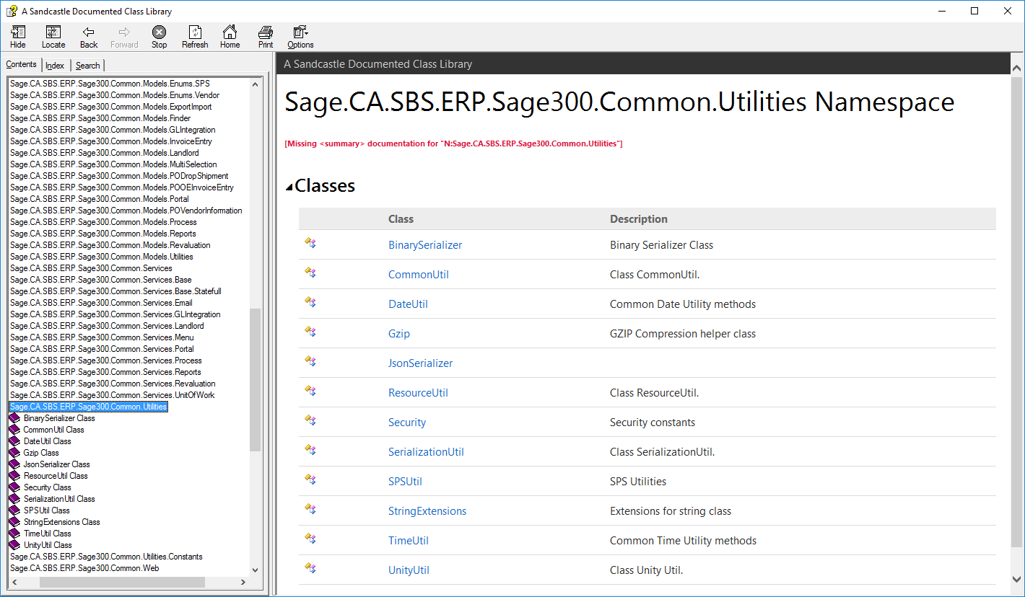
Help File
CommonCore.chm
Updated content
More to be done
Note: Still a work in progress!

Slide 8
Customization Wizard
Global Files Updated to 2018.1

Slide 9
GitHub Repository
Open Source
https://github.com/SageNADev/Sage300-SDK
2018.1 is available in the “master” branch
2018.0 is available in the “release-2018” branch (archive)
2017.2 is available in the “release-2017.2” branch (archive)
2017.1 is available in the “release-2017.1” branch (archive)
2017 is available in the “release-2017” branch (archive)
2018.2 is available in the “develop” branch (in-progress)

