Slide 1
Prediction of housing price
Yuhao Wu yuw121@pitt.edu
Yuling Chen yuc104@pitt.edu

Slide 2
Four Steps
Analyze problem
Data preprocessing
Training models
Comparison of performance

Slide 3
Analyze problem
There are 79 explanatory variables from different aspects that decide how much about the house price, we need to find the most related features then using them to predict the sales prices for each house

Slide 4
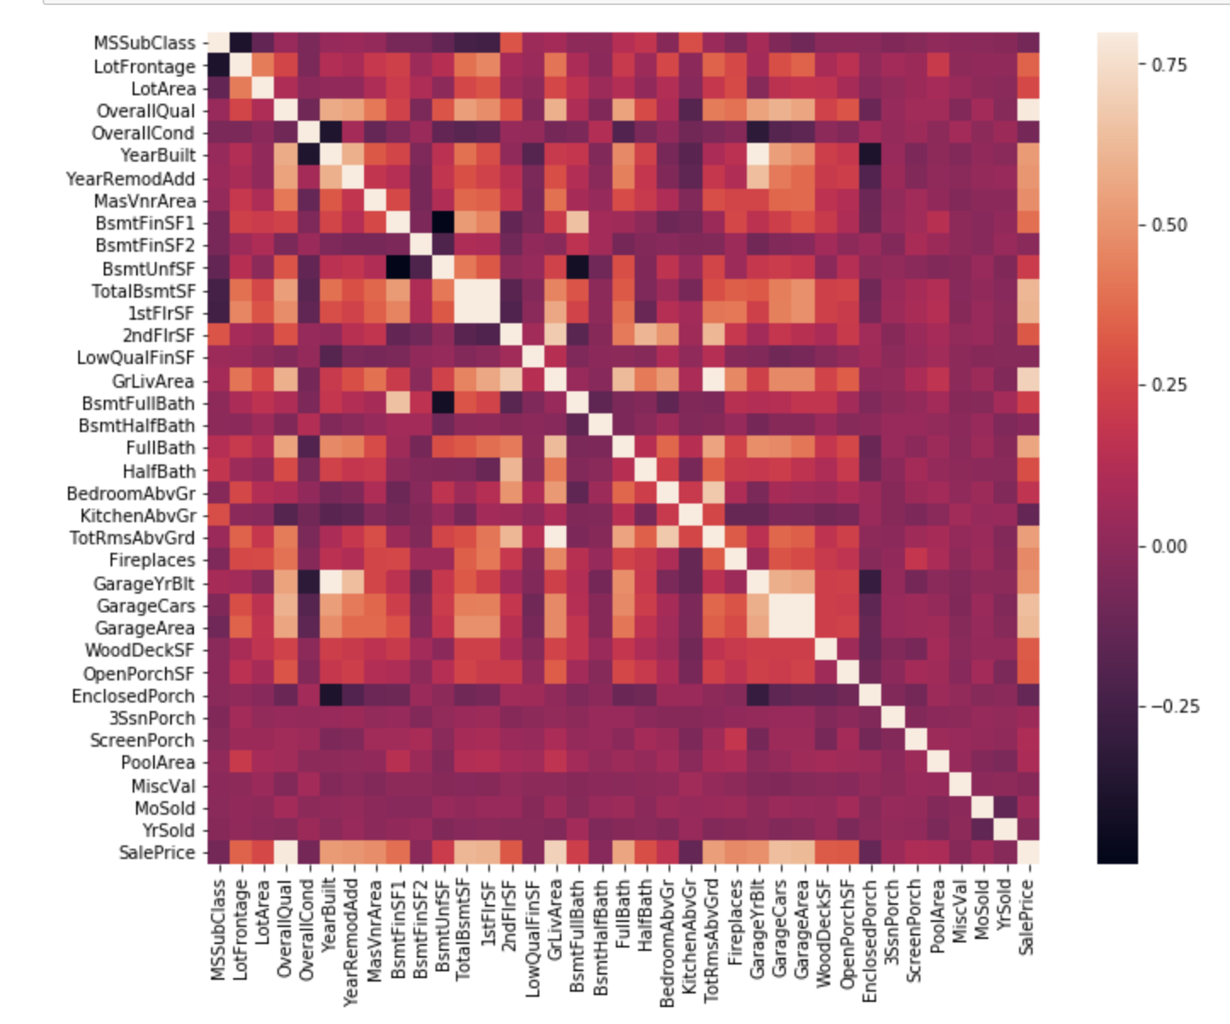
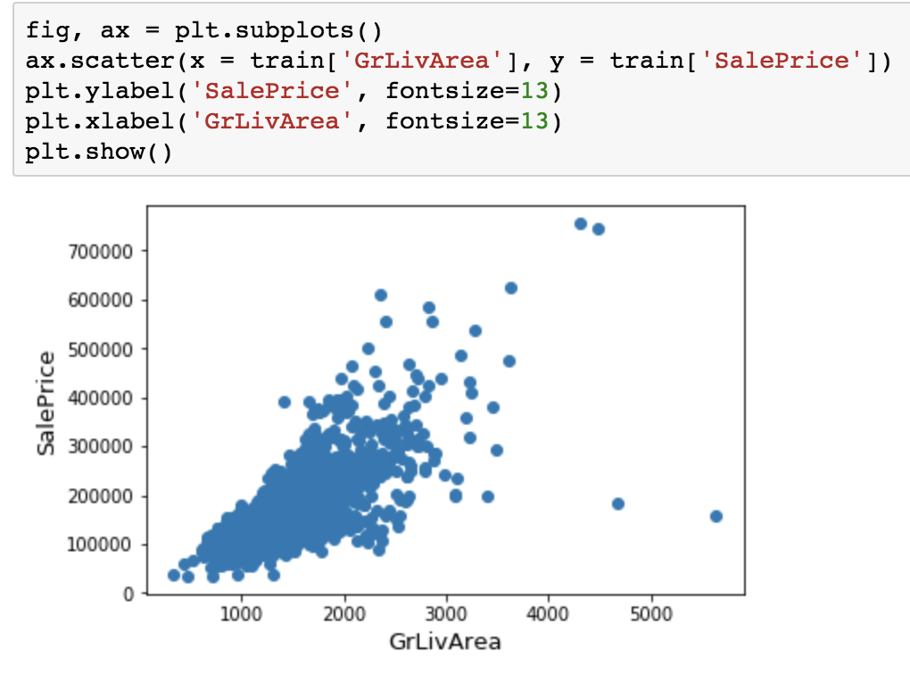
Data preprocessing (1)
Choose one feature randomly from dataset for testing.
Almost Linear regression!

Slide 5
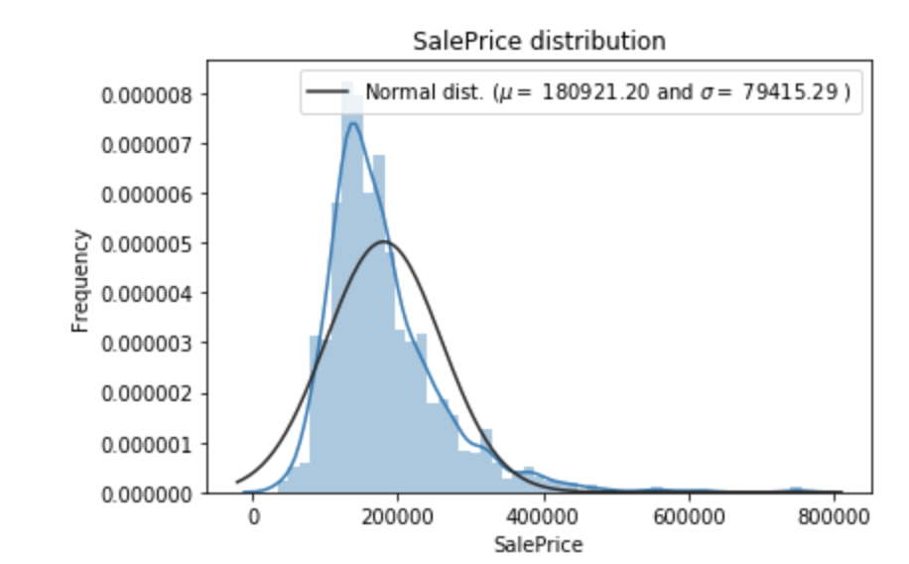
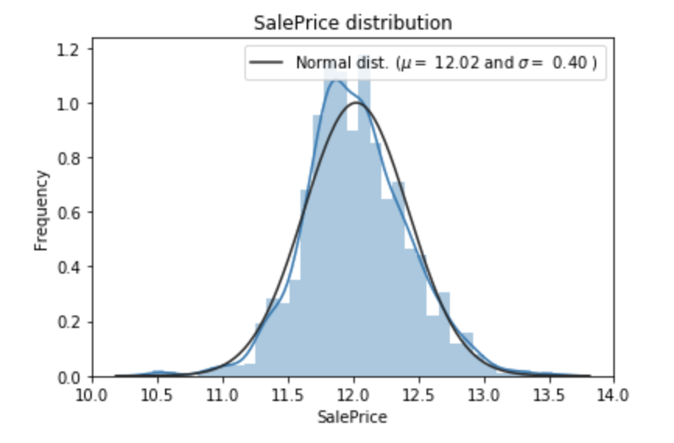
Data preprocessing (1)
2. Plot the distribution diagram
Applying log(1+x) function to saleprice and numeric variables for changing to the Normal distribution

Slide 6
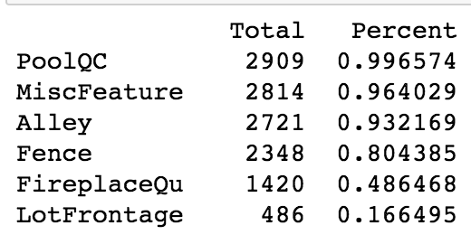
Data preprocessing (2)
Feature selection: checking the missing value, drop some features that has more than 10% data missing
2. Replacing missing data of categorical variables with None
Replacing missing data of numeric variables with 0
3. Analyzing data and decide how to deal with some of the features.
(filling with the common values or remove them)
Split dataset to train set and test set
then using StandardScaler for processing data

Slide 7
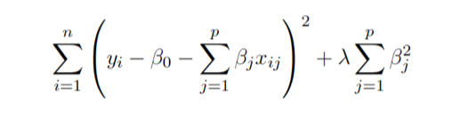
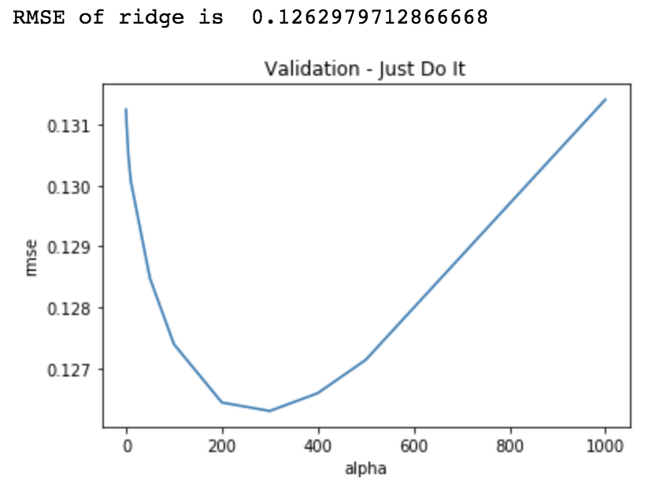
Training models
(Using 10-fold cross validation)
1. Ridge regression
Reduce variances( when features is too much)
Training models with different alpha value:
Alpha close to zero---least square estimates
Alpha is too large ---coefficients shrink to zero
Through this figure, we achieves the good bias-variance tradeoff in this point!

Slide 8
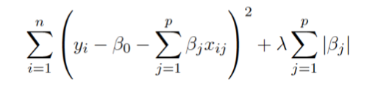
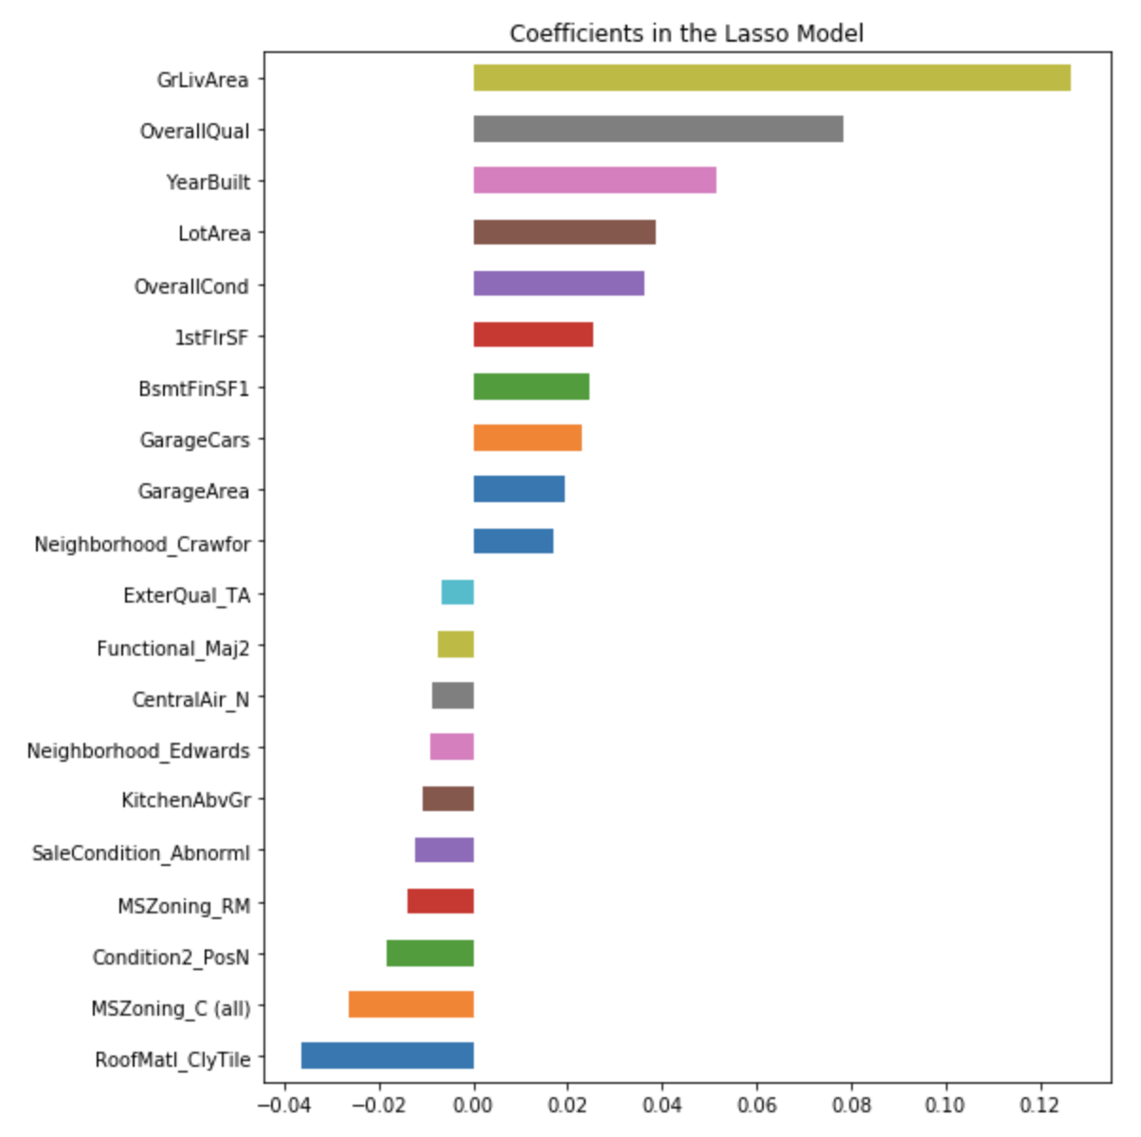

2. Lasso regression
Training models with different alpha value:
When alpha is too large, some coefficients will be force to zero, like feature selection, which will remove some irrelevant features that may affect the performance.
Result: (keep 86 variables and remove other 190 variables)

Slide 9
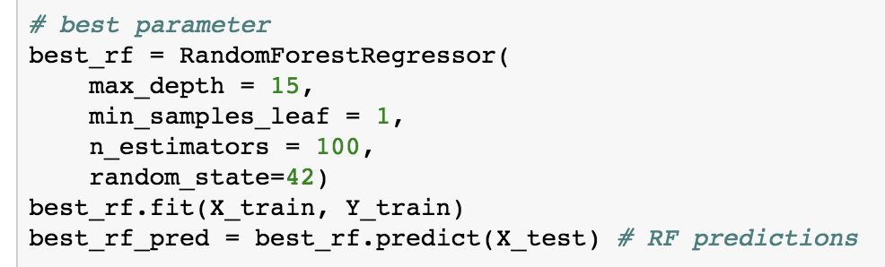
3. Random forests
It have better performance when there are many features included
Use cross validation to find the best parameters (import package– GirdSearchCV)
Result:

Slide 10
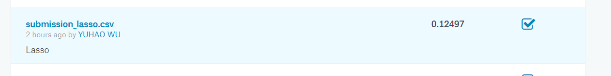
Comparison of performance
Random Forest
Lasso
Ridge
Random forest maybe overfitting, so the lasso is the best in the Kaggle.

