Slide 1
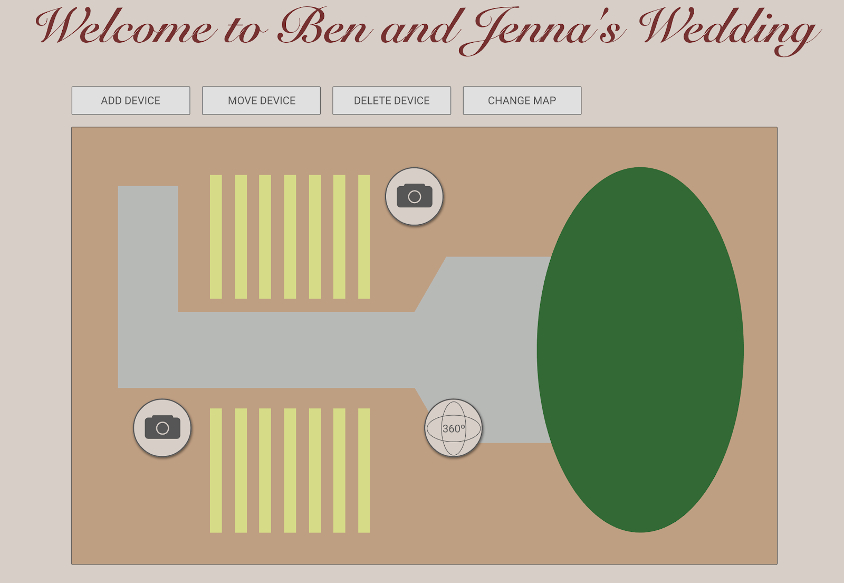
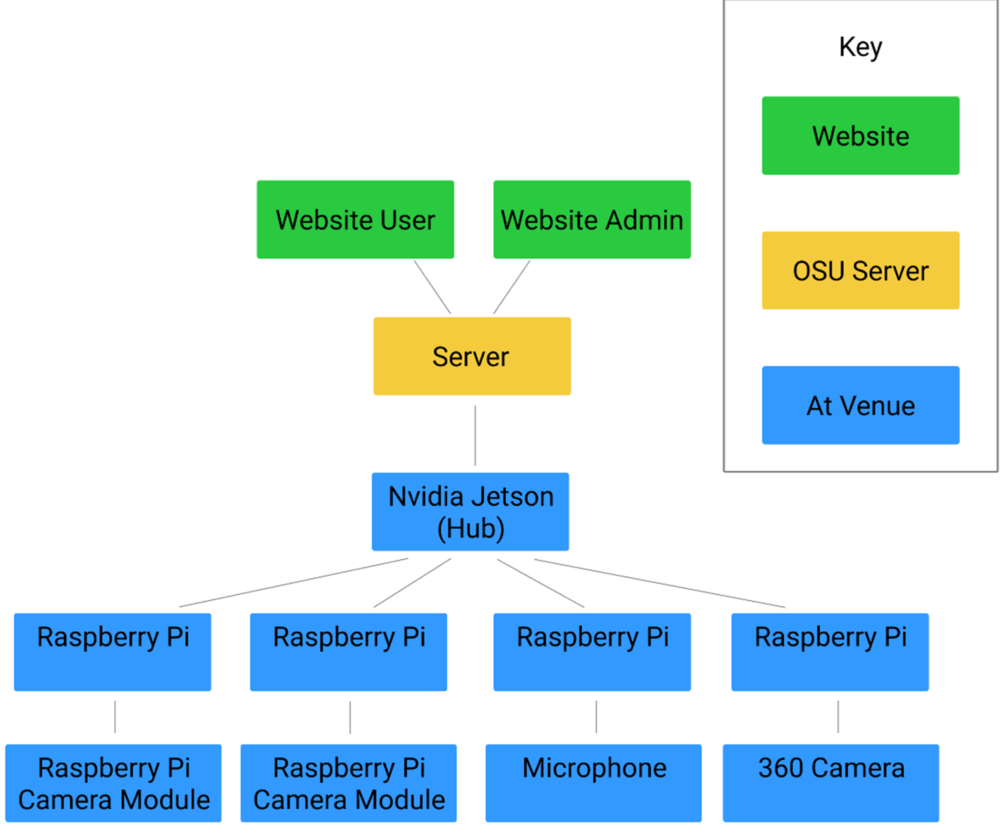
###
BACKGROUND
A-FRAME LIVESTREAM PORTAL
Supreme Court decision to uphold the travel ban preventing families from attending important events.
Our sponsor is getting married and their family is unable to attend because of the travel ban.
Nexusphere is dedicated to bringing families together through experiences that they might have otherwise missed. Catch the moment.
Server Architecture
LAMP (Linux, Apache, MySQL, and PHP)
The Raspberry Pis at the venue will connect on an ad hoc network to another device which will stream all of the video to the web server.
Ut volore secuptio es rem rerati volor atem lic te voloria qui simporest doluptat etur? Alignit volorae venimai onsequame odipitatur sequosa ntiste ea id que ipsam, omniaed et offictus moluptiis et ius.
Ut volore secuptio es rem rerati volor atem lic te voloria qui simporest doluptat etur? Alignit volorae venimai onsequame odipitatur sequosa ntiste ea id que ipsam, omniaed et offictus moluptiis et ius.
DESCRIPTION
The project will include an interactive web portal for family members to view our sponsor’s wedding
Lightweight and portable devices will be custom made and used for streaming.
The admin can edit the camera locations, add and delete devices, and change the current, viewable map.
There is no hard limit on the number of devices that can be added.
Viewers can select any camera to see and hear the wedding ceremony live.
ABOUT US
Louis C Duvoisin: duvoisl@oregonstate.edu
Meghan Mowery: mowerym@oregonstate.edu
Sarahi Pelayo: pelayos@oregonstate.edu
360º CAMERA
AD HOC NETWORK
System Overview
360 degree video camera was made using an iPhone camera attachment and a raspberry pi.
The camera module will be modified to fit onto the raspberry pi using a case created with a 3D printer.
The video will be recorded in 30 second segments, “unwrapped” so it is viewable, and then sent to the web portal to be viewed by the client’s family.
Four devices will be connected in an ad hoc network to a central hub microprocessor by NVidia called the Jetson tx2.
Two subsystems of raspberry pi 3 connected to a normal camera model.
One raspberry 3 pi connected to a 360 camera.
One raspberry 3 pi connected to a microphone

