Slide 1
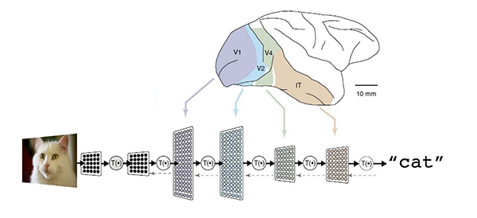
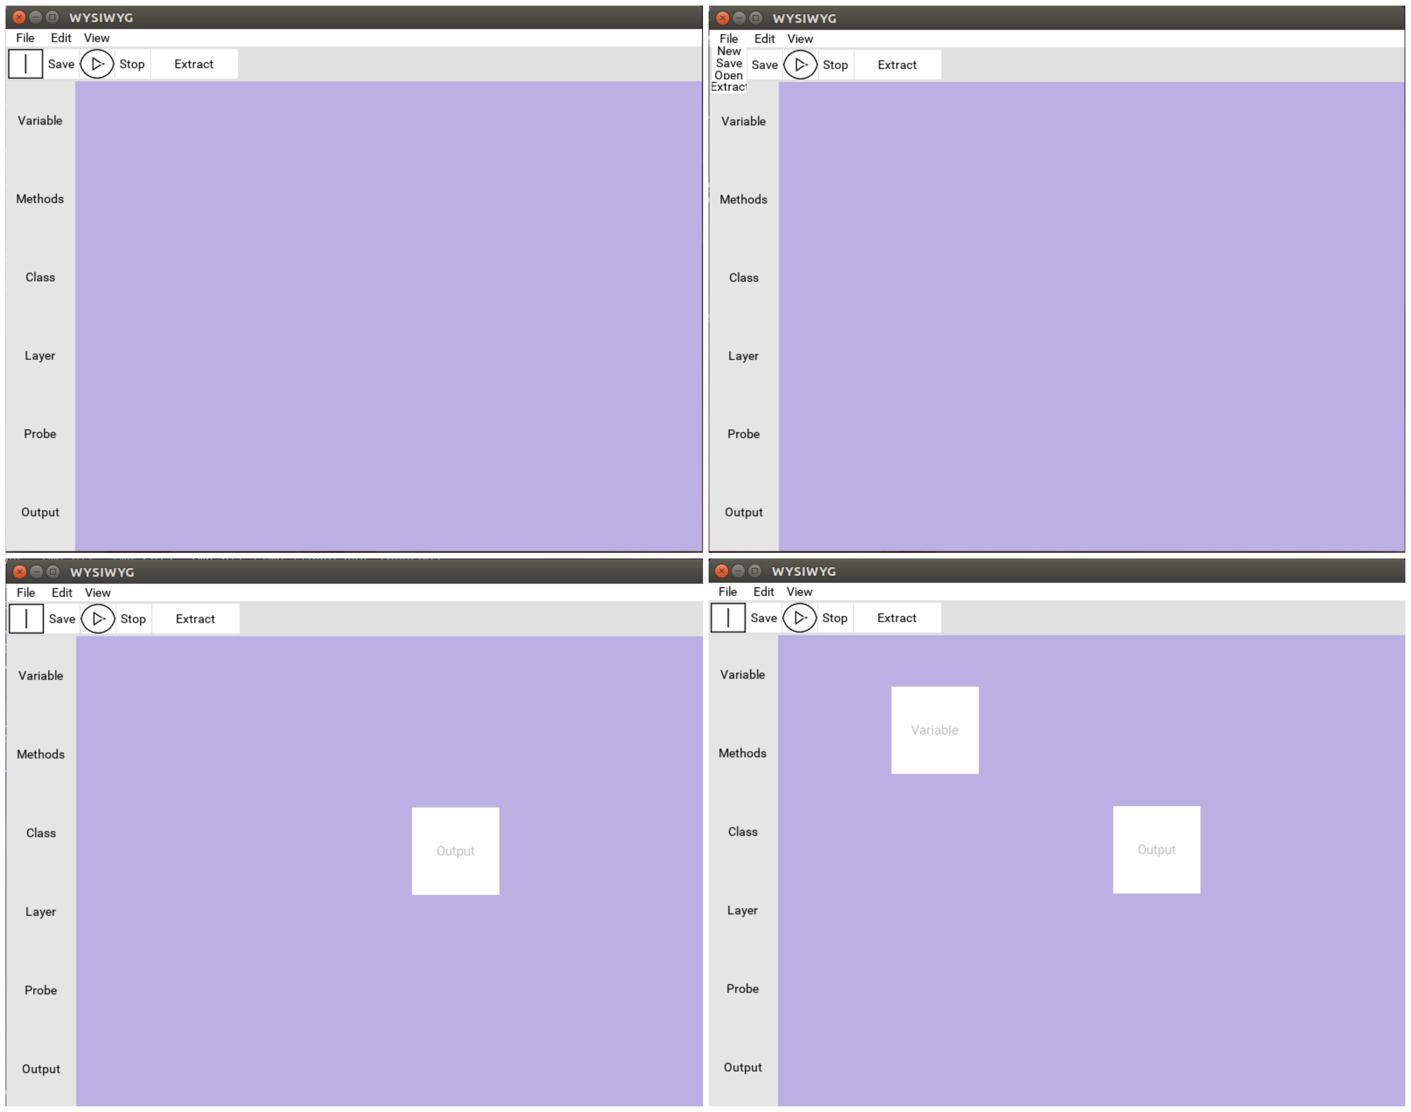
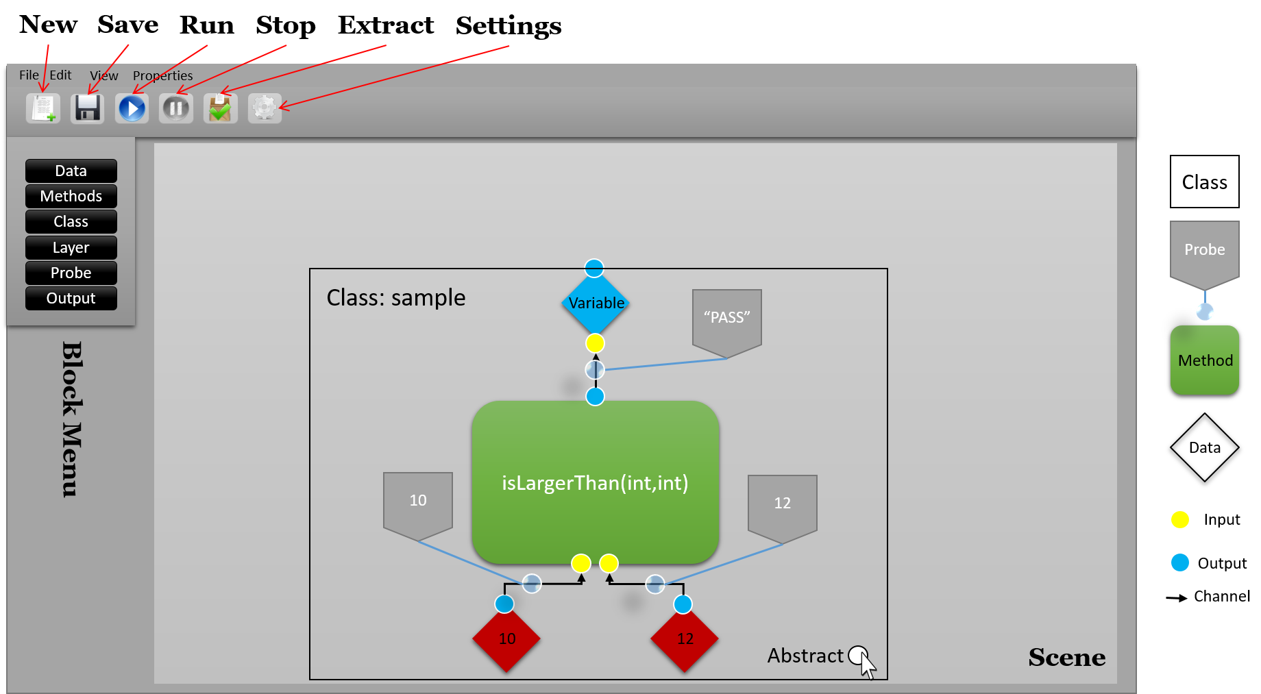


Tensorflow wysiWyg graphical User-Interface
Meet the team!
Make Deep Learning Easier
Current State
Project Prototype
Figure 1: A diagram showing how a deep learning algorithm works. (Dean, 2015)
What is Deep Learning?
Deep Learning is a field of study related to Artificial Intelligence which allows us to estimate the probability of occurrence of a certain pattern given the data of an event.
In other words, Deep Learning allows computers to study given information to make a calculated estimate or educated guess that allows them to perform tasks like decision making from large sets of data like images or other gathered sensory information
Team Members:
Connor Sedwick
Applied Computer Science
(sedwickc@oregonstate.edu)
Behnam Saeedi
Computer Science Systems
(saeedib@oregonstate.edu)
Collin Dorsett
Computer Science Systems
(dorsettc@oregonstate.edu)
Client:
Professor Fuxin Li
Oregon State University
References:
Dean, Jeff. "Large-scale deep learning for intelligent computer systems." BayLearn keynote speech (2015).
Figure 2: Our early prototype mock-up
Figure 3: Our current GUI showing the flow of an algorithm
How are we trying to solve the issue?
We are trying to implement a new way of programming. We are trying to abstract away the text-based programming environment to shift the attention of the programmer from syntax to development of functionality, making it easier for them to focus on studying their design.
Learn more about our project at our website here:
What are we making?
We are making a Graphical user interface-based programming environment. The task of this tool is to convert a program design generated by the user using our interface into Python code.
Our proposed solution is to use the Python scripting language to develop a software that grants developers the ability to visualize the control flow of their program using a flowchart style design.
The idea behind this comes from the analogy of a factory pipeline where each and every module (or in this case function) performs a task on the output of the previous module or function in order to generate the desired product. At each module the data is scrutinized and filtered to the next until the final module completes the pipeline and outputs the desired or expected value.
What problem are we trying solve?
Software that allows individuals to visualize the step-by-step process of computer programming has greatly assisted aspiring programmers and experienced professionals.
Tools that aid individuals in programming software exist for both educational and commercial purposes, but there is a lack of visualization software targeted specifically at the subject of machine learning.
We want to create a software that supports TensorFlow to aid developers, researchers, and students with deep learning algorithm design.
Notes:
If tri-fold mounting at SMS – make sure no text or image is in-between the two vertical guide lines; this space will be cut away. To view the vertical guide lines: Select “View” from the main menu, select “Guides” from the pull down menu, and lastly select “Static Guides”.

