Slide 1

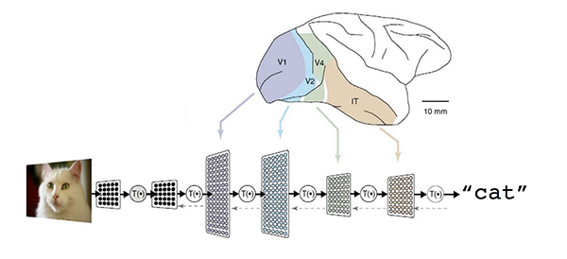
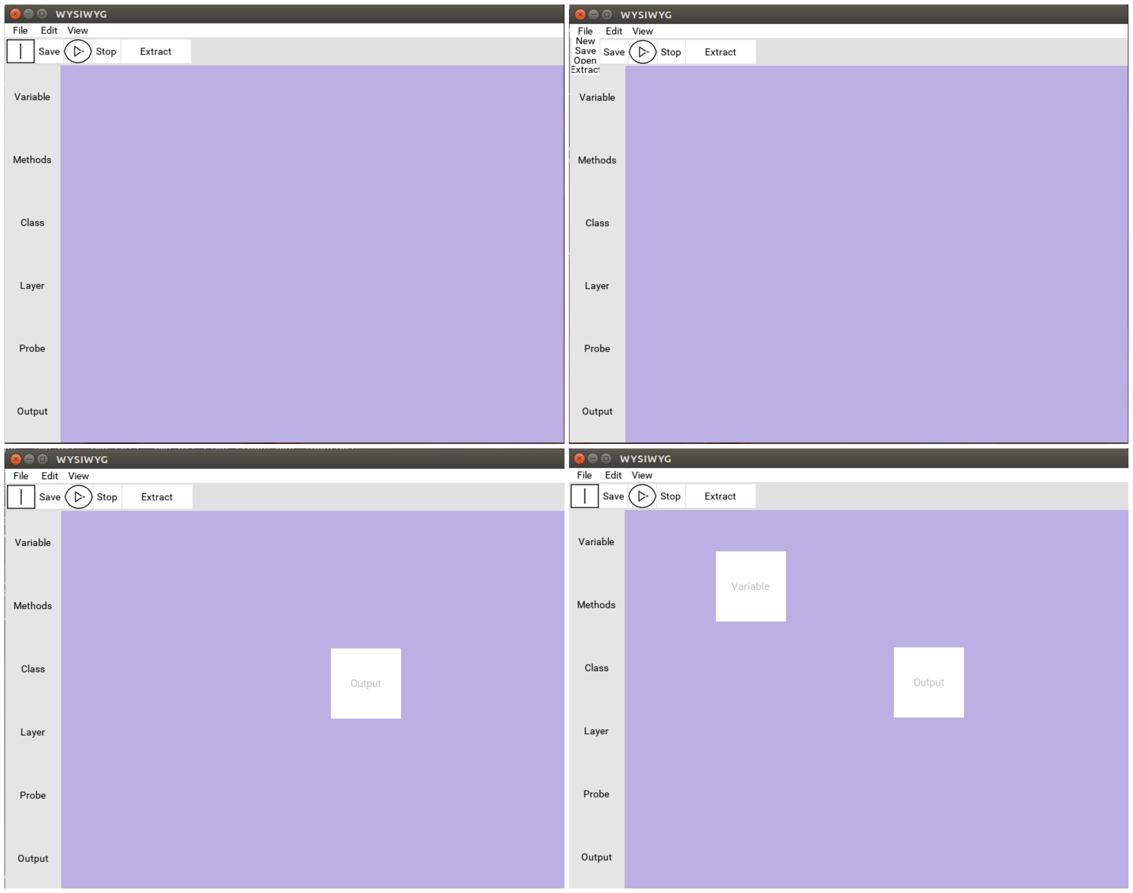

Tensorflow wysiWyg graphical User-Interface CS Capstone Project
Meet the team!
Project Goal
Problem
Software that allows individuals to visualize the step-by-step process of computer programming has greatly assisted aspiring programmers and experienced professionals.
Tools that aid individuals in programming software exist for both educational and commercial purposes, but there is a lack of visualization software targeted specifically at the subject of machine learning.
TensorFlow is a machine learning API (Application Program Interface) developed by Google in order to provide an optimized machine learning toolset for developers.
Despite TensorFlow having useful applications and a rich manual it does not have an eloquent way to interact with visualization of the software for its users.
Proposed Solution
Our proposed solution is to use the Python scripting language to develop a software that grants developers the ability to graphically visualize the control flow of their program using a flowchart style design.
Make Deep Learning Easier
Design (cont.):
Probes can also assert certain values causing the execution to stop if a certain assertion is violated.
Represent outputs as blocks. This block represents the final outcome. This block also ends the program execution.
Extract function outputs the corresponding Python file based on the designed system.
Blocks menu window. This window contains a list of all blocks including layers, classes, methods, variables and probes.
Drag and drop functionality. The user should be able to drag and drop blocks from the block menu to the Scene.
Dean, Jeff. "Large-scale deep learning for intelligent computer systems." BayLearn keynote speech (2015).
Team Members:
Connor Sedwick
Applied Computer Science
(sedwickc@oregonstate.edu)
Behnam Saeedi
Computer Science Systems
(saeedib@oregonstate.edu)
Collin Dorsett
Computer Science Systems
(dorsettc@oregonstate.edu)
Client:
Professor Fuxin Li
Oregon State University
The Design:
Display the build space in a graphical user interface. This display is called the Scene.
Represent variables as blocks. These blocks contain data.
Represent methods as blocks. These blocks can be rotated in order to help with readability. Furthermore, you can adjust the visual size of this block.
Represent classes as blocks. Classes can contain multiple method and variable blocks and could be abstracted away. when a class is abstracted, it is represented as a new block that hides its members.
Represent layers as pages. Layers can contain multiple classes, however, each layer is independent of other layers.
Represent channels as vectors. A channel is a connection between an input and an output that describes how data flows between method blocks.
Probe blocks that display what is being passed through channels. This probe can modify the data that is going through a channel while the program is running.
Notes:
If tri-fold mounting at SMS – make sure no text or image is in-between the two vertical guide lines; this space will be cut away. To view the vertical guide lines: Select “View” from the main menu, select “Guides” from the pull down menu, and lastly select “Static Guides”.

