Slide 1
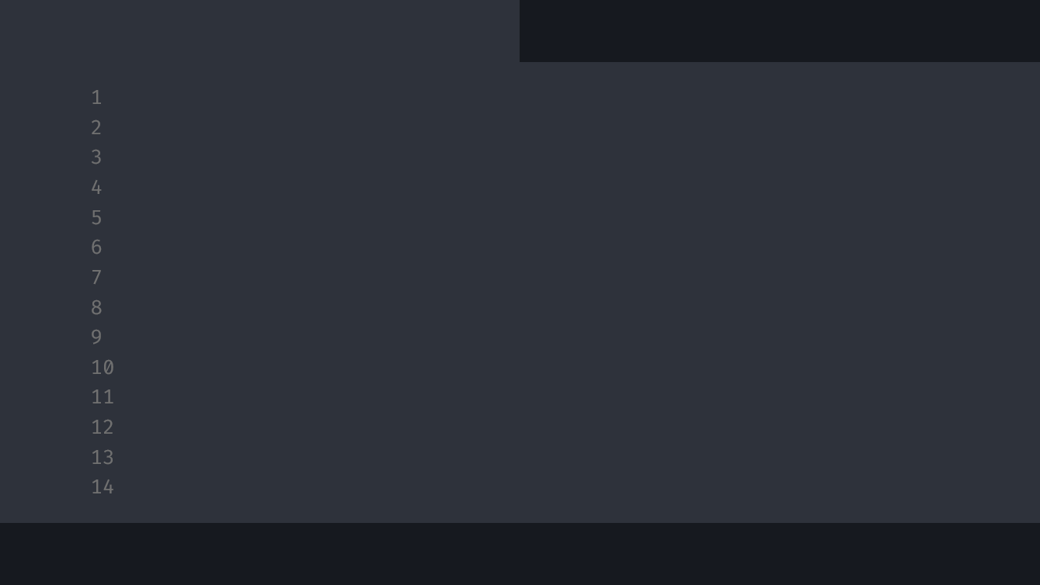
def Business Card Recognition:
title.py
content.py
#With Csup_team
Le Minh Hoang = 21522089
Bui Thanh Quang = 21522507
Nguyen Thanh Tuan = 21521635
Truong Quang Nghia = 21522376
CS406

Slide 2
Class Table Of Contents:
01
02
03
title.py
content.py
def Purpose
< About why we chose this topic?>
def Idea
< About what we think and going to do?>
def Progress
CS406

Slide 3
01
Purpose()
title.py
content.py
CS406

Slide 4
“””Concepts < /1 >
title.py
content.py
Business cards are a common tool for exchanging contact information between individuals and businesses
“””
“””Concepts < /2 >
Identifying characters on a business card makes it easier for people to store information effortlessly
“””
CS406

Slide 5
02
Idea()
title.py
content.py
CS406

Slide 6
plt.imshow(‘idea’)
title.py
content.py
< Build a web app that can read and save all information on a business card >
CS406

Slide 7

cv2.imshow(‘sample1’)
title.py
content.py
CS406

Slide 8
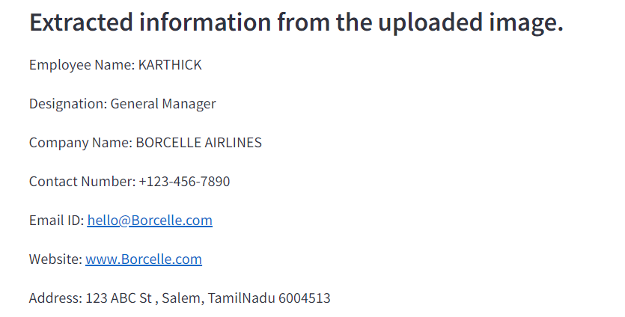
cv2.imshow(‘sample2’)
title.py
content.py
CS406

Slide 9
03
Progress()
title.py
content.py
CS406

Slide 10
for i in range 4:
title.py
content.py
Step 01
Find out all the related issues
Step 02
Build a sample program
Step 03
Checking effectiveness
Step 04
Build a complete app/web
CS406

Slide 11
plt.imshow(‘resouces’)
title.py
content.py
Languages
Python
100%
All we use for this:
EasyOCR to recognize character
Streamlit to build a web app
SQL server to manage data
CS406

Slide 12
“””Readme
title.py
content.py
EasyOCR
EasyOCR is a free and open-source library used to recognize text from images. EasyOCR supports more than 70 languages, including Vietnamese.
Streamlit
Streamlit is a Python-based web application framework for visualizing data and analyzing results more efficiently and flexibly.
SQL server
It is designed to store and retrieve data in a structured and secure manner.
“””
CS406

Slide 13
print(“Thank you for listening”)
title.py
content.py
CS406

