Slide 1
Comparator
Jetpack Composable Android App

Slide 2
Doelstelling
Interface: Compose
ApiCall
Webshop
Details + Home

Slide 3
Composables
Expressieve Syntax
Herbruikbaar
Kotlin
Reactief

Slide 4
State, StateFlow en MutableStateFlow
State
Actuele status
StateFlow
Constante dataflow
MutableStateFlow
Stateflow variabel

Slide 5

Retrofit en APICalls

Slide 6
models
Data models
Interafecen API
Ui-state models
Status Views

Slide 7
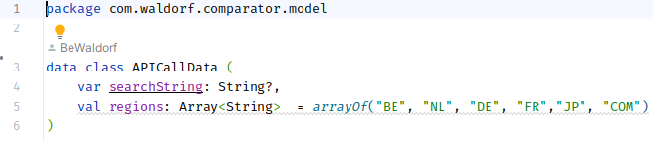
APICallData

Slide 8
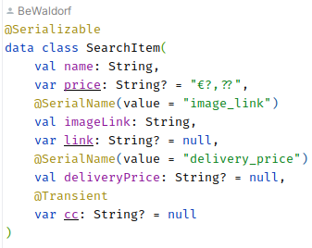
SearchItem

Slide 9
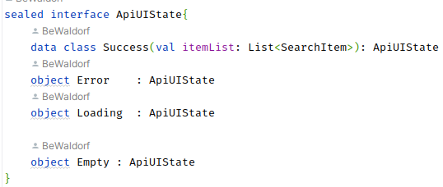
API UI State

Slide 10
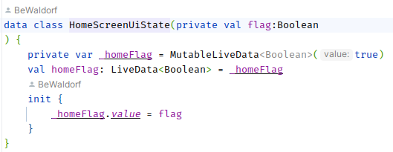
Home UI State

Slide 11
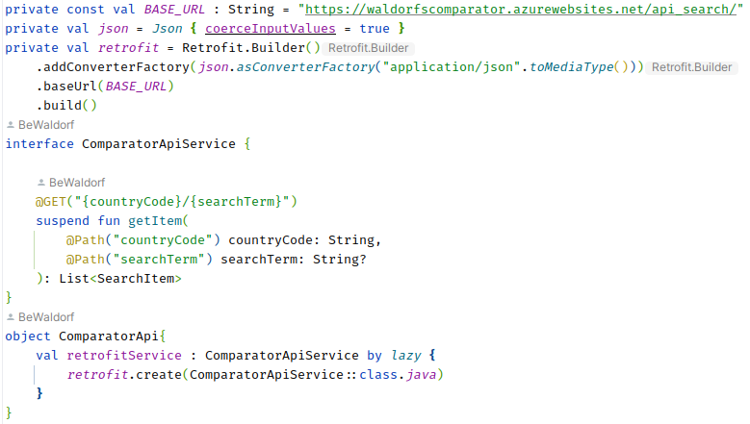
Network service

Slide 12
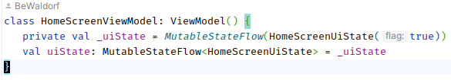
ViewModels

Slide 13
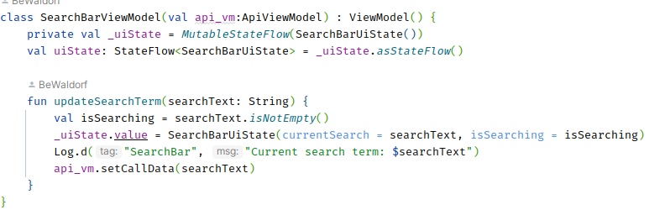
viewModels

Slide 14
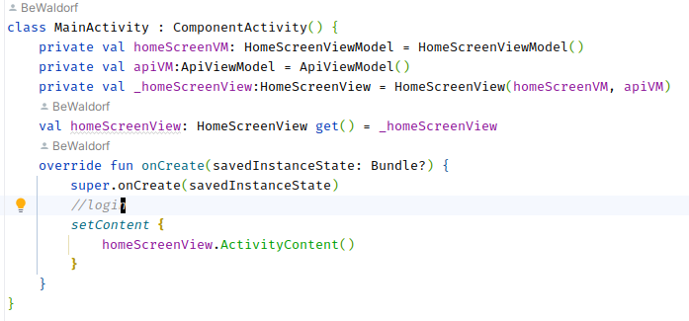
Views

Slide 15
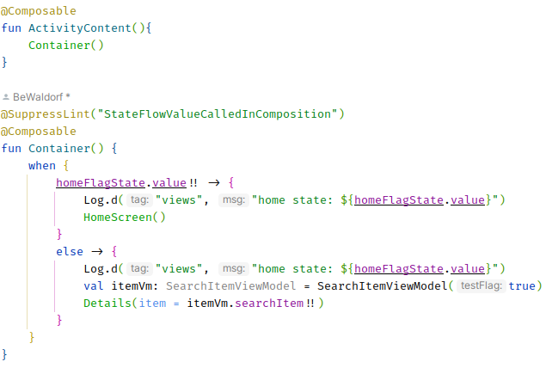
Views

Slide 16
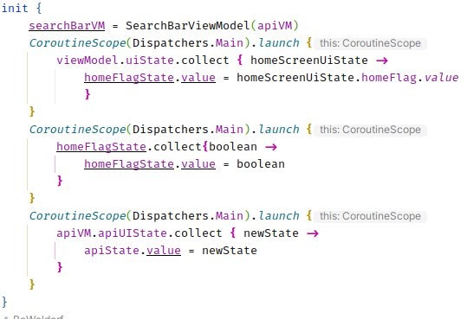
Views

Slide 17
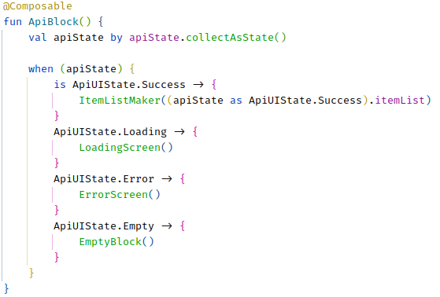
Views

Slide 18
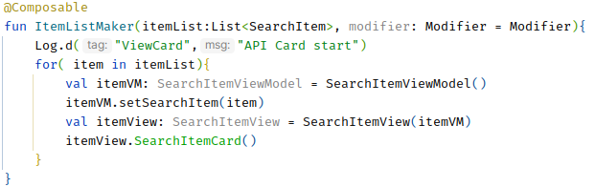
Views

Slide 19
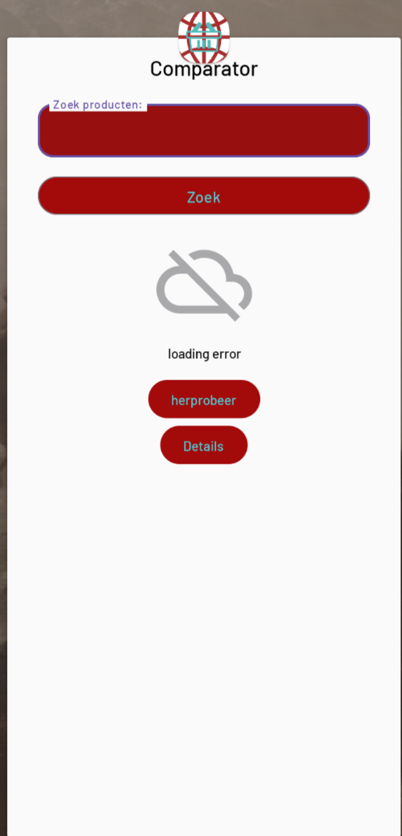
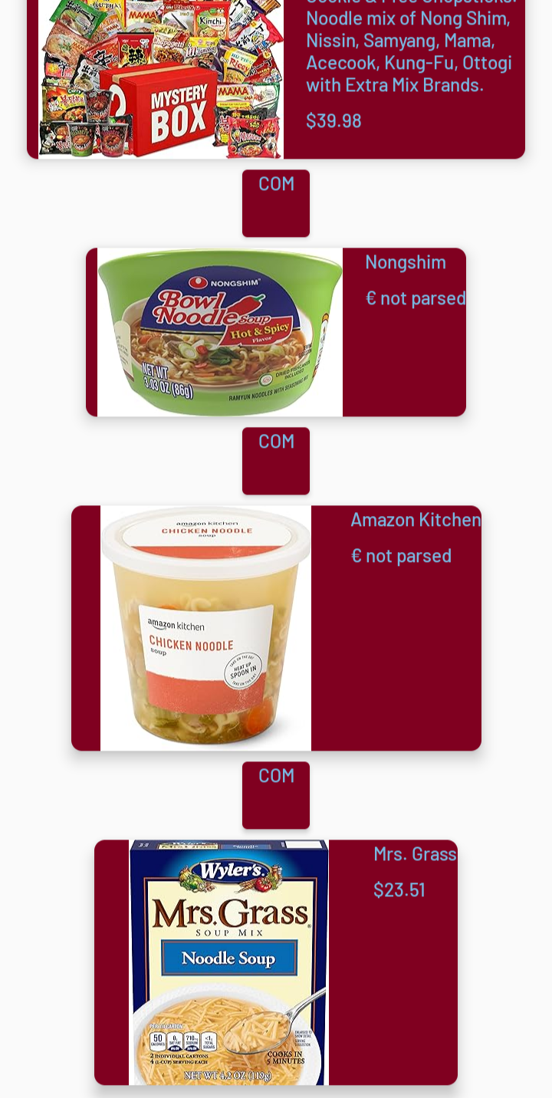
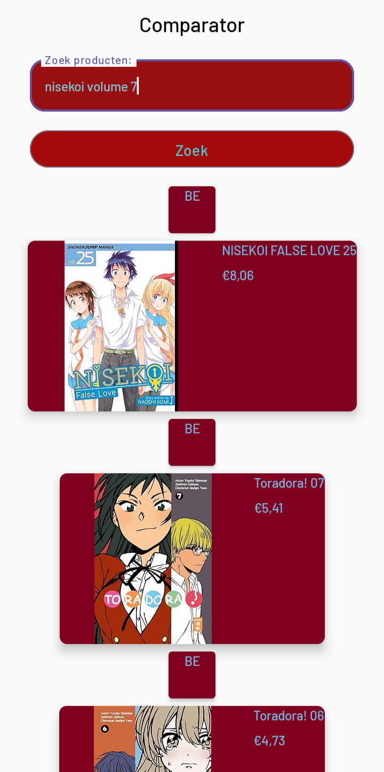
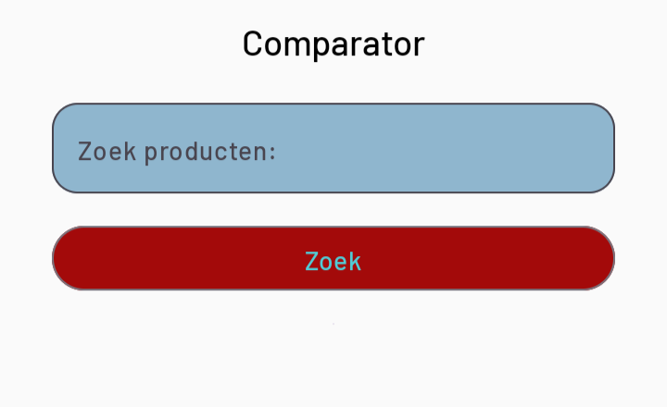
Views

Slide 20
