Slide 1
Welcome aboard ResearchEd’s PDP Toolkit
Open any web browser and go to https://github.com/BeaLeydier/researched-pdp-toolkit
This takes you to the github repository (or repo) where the toolkit is stored
What is github?
Github is a website that makes code sharing easy, and where a lot of projects that use code (no matter the language : Stata, R, Python, JavaScript, etc.) are shared publicly
What is a repo?
A repo or repository is the name used on github to call a project
What is a toolkit?
A toolkit can take many forms, but in this case it takes the form of a series of code scripts that you can download and run with your own data to generate analyses of interest
For this toolkit, all the scripts are in Stata, and we refer to them as scripts or dofiles interchangeably
The toolkit also contains a README document, which is a document that you have to read (like its name suggest) when you first use the toolkit, as well as an example Report document that showcases the type of analyses produced by this toolkit

Slide 2
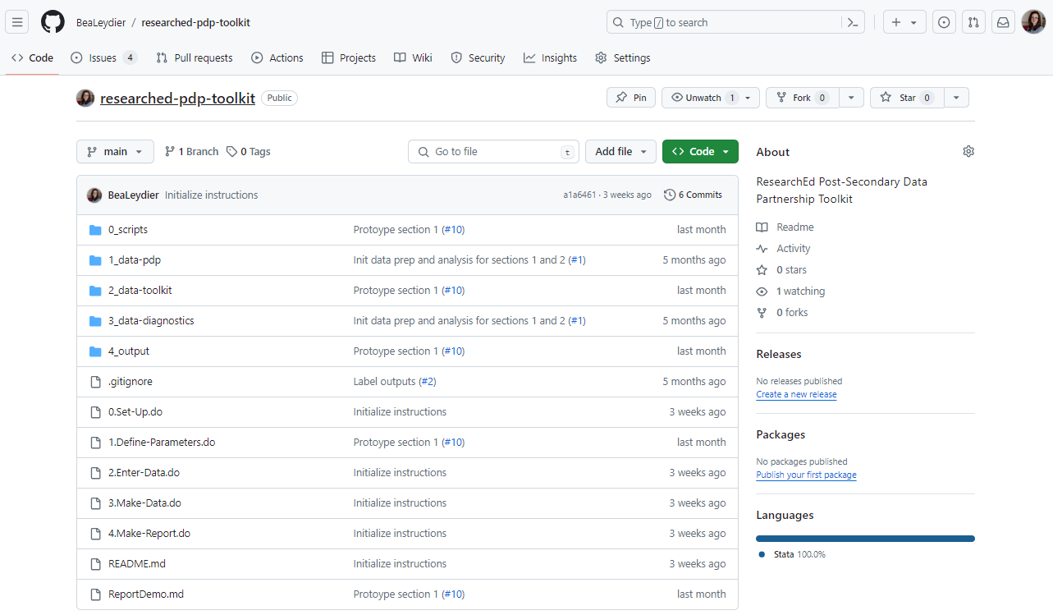
What am I looking at?

Slide 3
You have landed at the root of the repository, which contains files. Ignore everything else!

Slide 4
You have landed at the root of the repository, which contains files. Ignore everything else!
Repository owner / Repository name : this repository is owned by the github user BeaLeydier and called researched-pdp-toolkit, because developed by ResearchEd, and contains a toolkit to use on your PDP data.
Repository files : Like files on your computer, the repo files can be organized in folders and subfolders. When you open the repo page on github, you arrive at the root of the repository. In this particular repository, there are scripts (dofiles ending in .do) at the root of the repository, as well as folders which contain other files, including scripts, images, and other files.
You can navigate the repository on github directly. You can click on a folder to open it and display its contents. You can click on a file to read it. If it is a script (or a text file, a pdf document, or a csv file for example), the file will usually be displayed (or rendered) directly on that web page. If it is an image file or a data file, it will usually not be rendered online, but the option will be given for you to download that file, and then open it on your computer.

Slide 5
Ok, there are a few more things you can look at on the repo landing page.
About: tells you what the repo is about! (unsurprisingly)
Languages: tells you what languages are used in the repo, taking into account all the script files of the repo. This repository is 100% Stata.

Slide 6
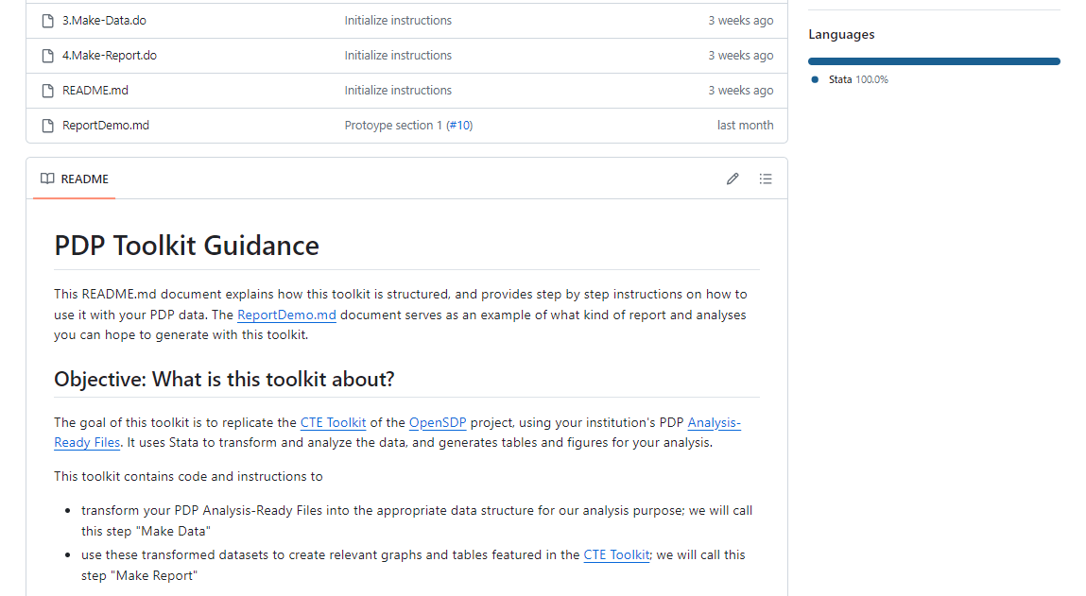
On most github repos, there will be a README document that is rendered automatically at the root of the repo, and displayed on the repo landing page on github. You can scroll down and know what the repo is about from the README.

Slide 7
How to get these files on your computer?
Click on the green <> Code button

Slide 8
Option 1 : Download
You will download the files onto your computer, and then never have to visit github ever again
You will have used github like a cloud you get files from
INSERT download screenshot

Slide 9
Option 1 will download a .zip file in your chosen location on your own computer
A .zip file is a compressed folder
It is a folder, meaning that it is an object on your computer that contains other files and subfolders
It is compressed, meaning that it takes less space on your computer
You need to unzip or uncompress it
Right click
HowTo
This creates a regular folder on your computer
That folder is now your toolkit! It contains all the files you saw on the github page, with the same folder structure (some scripts at the root, some subfolders and files in them)

Slide 10
Option 2 : Fork and Clone
This is only if you already know github and want to keep using github to work on your repo
Fork so you have writing access
Clone – remember, not in a cloud synced folder
Note : .gitignore
Data files always local, never tracked with git, and never pushed to github

Slide 11
Who should have access to the toolkit files?
Anyone who wants to work with your PDP AR data using this toolkit
Inside the toolkit folder, you will add your PDP Analysis Ready files
Make sure your toolkit folder isn’t saved somewhere your PDP AR files shouldn’t be
How to work and collaborate on the toolkit
Each person who works on the toolkit can download the files from github to their own machine, copy the AR files in the dedicated toolkit subfolder (1_data-pdp) and run the toolkit this way
You can use a cloud system (Google Drive, Box, Dropbox, OneDrive, etc) to have one toolkit folder on the drive shared with everyone who will work on the toolkit
One person downloads the files from github, saves them in your cloud system, adds the AR files to the dedicated toolkit subfolder (1_data-pdp) and shares the cloud folder withrelevant colleagues
Or you can use the forked github repo and collaborate on it
Each person cloning the repo will need to also add the AR files locally
The gitignore ensures that the AR files are never uploaded onto github
For example, if you use an online cloud system for your files, you shouldn’t save your toolkit folder inside a shared folder that is also shared with people who can’t access the PDP AR files

Slide 12
Will my PDP AR files be shared with anyone if I use this toolkit?
Short answer : No
Whether you download or clone the toolkit from github, the toolkit code runs locally on your own machine, and none of the contents of the 1_data-pdp, 2_data-toolkit and 3_data-diagnostic subfolders are shared with anyone or anything
Even if you clone the repo and work on it with github, the contents of these folders are not tracked by git and not pushed to github (thanks to the .gitignore)
For the toolkit to run, you need to copy your AR files in the 1_data-pdp subfolder of the toolkit on your machine, wherever you saved your toolkit
The toolkit itself doesn’t read any file outside of what’s in the toolkit folder
The toolkit doesn’t share any file that is under the 1_data-pdp, 2_data-toolkit and 3_data-diagnostic subfolders of the toolkit
It is important for you to save the toolkit in a location where it is safe to add the AR files (e.g. not on a public cloud folder)

Slide 13
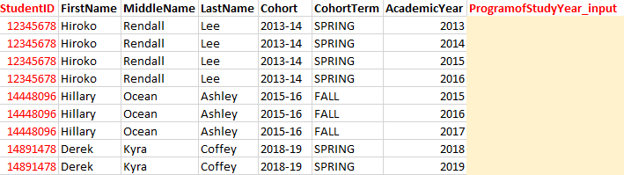
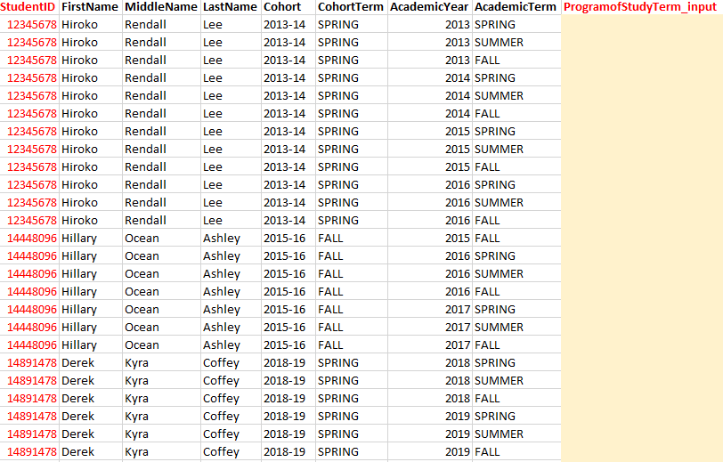
How do I enter student pathway data?
Template at the term level
Template at the year level

Slide 14
todo

Slide 15
Check folders 1_ 2_ and 3_ are in gitignore
Everything ignore EXCEPT for templates in 2_ and images in 3_
Add section 0 code/example
Clean up Report.MD
Clean up sequence between parameters and add data
Parameters
Add the number of credits as a parameter for section4
Add the pathway code to look into as a parameter for section2/3
Add a comment about how INSTRUCTIONS is where you have to change things in the code
Add in readme presentation of section2 the fact that term by term is also an option
Update the screenshots for pathway template with correct academic term format
Run quietly the add data + define parameters dofiles at the top of each make data file
Add the ado file path at the top of every exporting dofile

Slide 16
archives

Slide 17
On the github repo: what I am looking at?
Repository name
Repository owner
This repository is called researched-pdp-toolkit, because it was developed by ResearchEd, and contains a toolkit to use on your PDP data.
Repository files
Like files on your computer, the repo files can be organized in folders and subfolders. When you open the repo page on github, you arrive at the root of the repository. In this repository, there are scripts (dofiles ending in .do) at the root of the repository, as well as folders which contain other files.
You can navigate the repository on github directly. You can click on a file to read it. If it is a script, a text file or a pdf document, the file will be displayed (or “rendered”) directly. If it is an image file or a data file, it will not be rendered online, but the option will be given to you to download it and open it on your computer.

