Slide 1
Instantons and Monte Carlo Methods in Quantum Mechanics ---------------------------------------------- T. SchÄfer
Beatrice Magni – 1103483
Pietro Ghedini - 1087345

Slide 2
OUTLINE OF THE PRESENTATION
INTRODUCTION
EXACT DIAGONALIZATION
MONTE CARLO SIMULATIONS
MONTE CARLO COOLING
MONTE CARLO ADIABATIC SWITCHING
INSTANTON – ANTI-INSTANTON CONTENT

Slide 3
INTRODUCTION

Slide 4
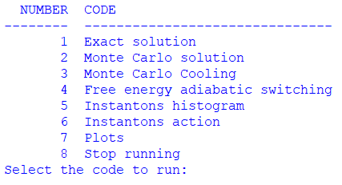
STRUCTURE OF THE CODE: MAIN
In the Main.py file we create a table visualizing the possible things that can be done using our code. To each input corresponds the execution of a code or the appearance of the table showing the possible plots. Everytime a program is executed, the corresponding table reappears.
from tabulate import tabulate
https://github.com/BeaMagni/IstantonProject

Slide 5


STRUCTURE OF THE CODE: GENERAL FUNCTIONS
In the General_functions.py file we define all the functions that will be used in the different programs, to make the file more readable.
We use the pathlib library to build a function creating the directory in which the data files will be stored.
We use, where is possible, the @njit command from numba library to speed up the functions, so to speed up the code.

Slide 6
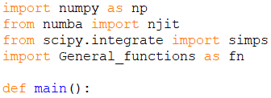
STRUCTURE OF THE CODE: PROGRAMs
Exact_solution.py
Monte_Carlo.py
MC_cooling.py
In each of these file.py, the internal structure is the same.
Free_energy_as.py
Instanton_hist.py
Instanton_action_density.py
Firstly, we import all the necessary libraries, among which we always have the file General_functions.py.
Then, we define an additional function and we call it main. This function is the one that will be called in Main.py to obtain the requested results.

Slide 7
STRUCTURE OF THE CODE: Plots
potential_eigenvalues
energy_eigenvalues_variation
ground_state_hist
correlation_functions
log_correlation_functions
correlation_functions_cooling
log_correlation_functions_cooling
euclidean_path
free_energy
instanton_distribution
instanton_density
instanton_action
These are all the names of the different functions inside the Plots.py file, used in the plots table in the Main.py file.
We use the matplotlib.pyplot library to create the different images.

Slide 8
EXACT DIAGONALIZATION

Slide 9

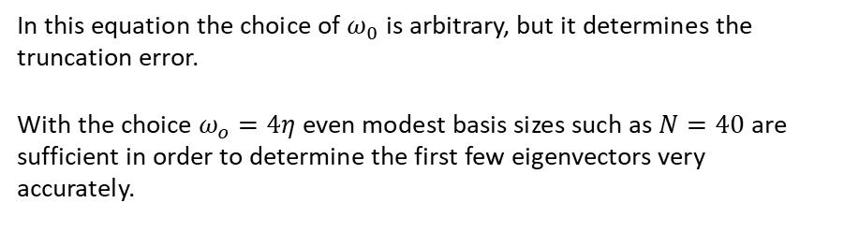

Theoretical background
We consider a non relativistic particle moving in a double-well potential V(x)
$$H= \frac{p^{2} }{2m}+λ{\left(x^{2}−η^{2} \right)}^{2}$$
We can rescale x and t such that $2m = λ = 1$
To perform the exact diagonalization we use, as basis, the harmonic oscillator hamiltonian
$$H_{0}=\frac{p^{2}}{2m}+\frac{1}{2}mω_{0}^{2}x^{2}$$
In this equation the choice of $ω_{0}$ is arbitrary, but it determines the truncation error.
With the choice $ω_{o}=4η$even modest basis sizes such as $N=40$ are sufficient in order to determine the first few eigenvectors very accurately.

Slide 10
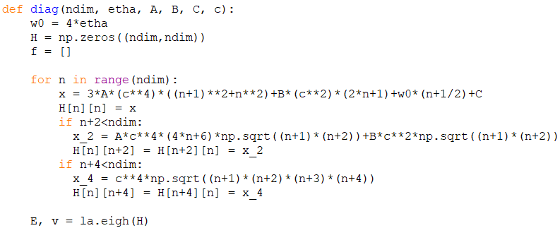

Numerically, the eigenvalues and eigenvectors are obtained with the use of linalg (la, linear algebra) function contained in the numpy library.
The function la.eigh allow us to find the eigenvalues and eigenvectors of a real symmetric matrix, as in our case.
It returns two objects, a 1-D array containing the eigenvalues of H, and a 2-D square array of the corresponding eigenvectors (in columns).
These are the expression for the non-zero elements.
$$A=1$$
$$B=−2η^{2}−\frac{2ω_{0}^{2}}{4}$$
$$C=η^{4}$$
$$c=\frac{1}{\sqrt{ω_{0}}}$$

Slide 11
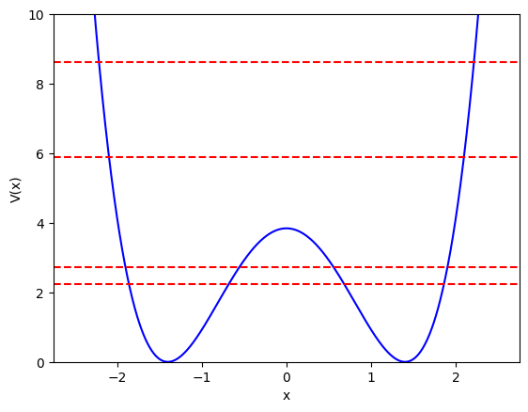


$$V\left(x\right)={\left(x^{2}−η^{2}\right)}^{2}$$
PLOT OF THE POTENTIAL OF THE ANHARMONIC OSCILLATOR. THE DASHED RED LINES REPRESENT THE GROUND STATE AND THE FIRST THREE EXCITED STATES
$$η=1.4 and N=40$$

Slide 12
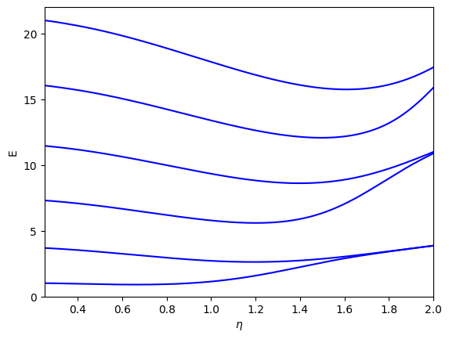
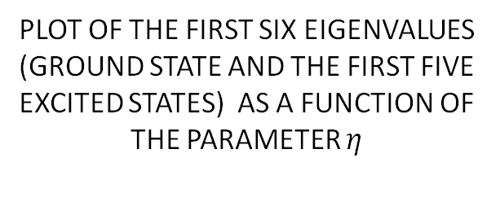
PLOT OF THE FIRST SIX EIGENVALUES (GROUND STATE AND THE FIRST FIVE EXCITED STATES) AS A FUNCTION OF THE PARAMETER $η$

Slide 13
MONTE CARLO SIMULATION

Slide 14
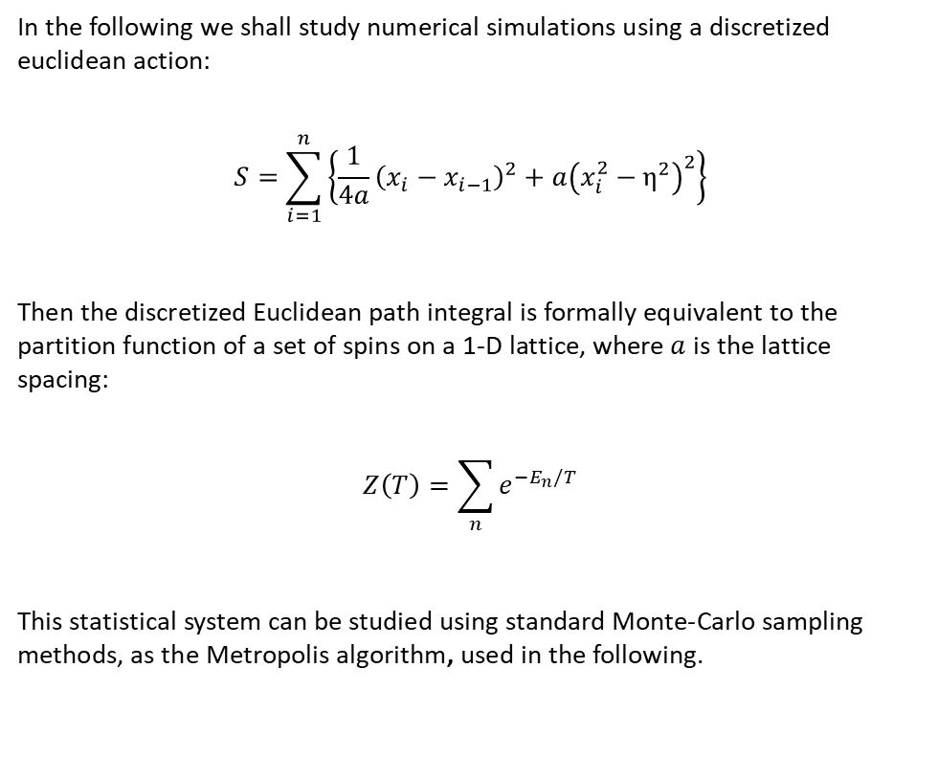
Quantum mechanics on a Euclidean lattice
In the following we shall study numerical simulations using a discretized euclidean action:
$$S=\sum_{i=1}^{n}{\left\{\frac{1}{4a}{\left(x_{i}−x_{i−1}\right)}^{2}+a{\left(x_{i}^{2}−η^{2}\right)}^{2}\right\}}$$
Then the discretized Euclidean path integral is formally equivalent to the partition function of a set of spins on a 1-D lattice, where $a$ is the lattice spacing:
$$Z\left(T\right)=\sum_{n}{e^{−E_{n}/T}}$$
This statistical system can be studied using standard Monte-Carlo sampling methods, as the Metropolis algorithm, used in the following.

Slide 15
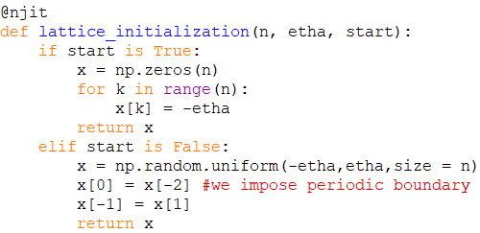

$$η=1.4$$
N = 800
We initialize our lattice with a cold start, in which the initial configuration is at the minimum of the potential, or with a hot start, in which the initial configuration is a random one.
We also impose periodic boundary conditions.
To obtain the results presented in this presentation, we always consider a hot start

Slide 16
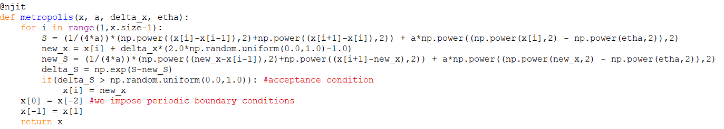
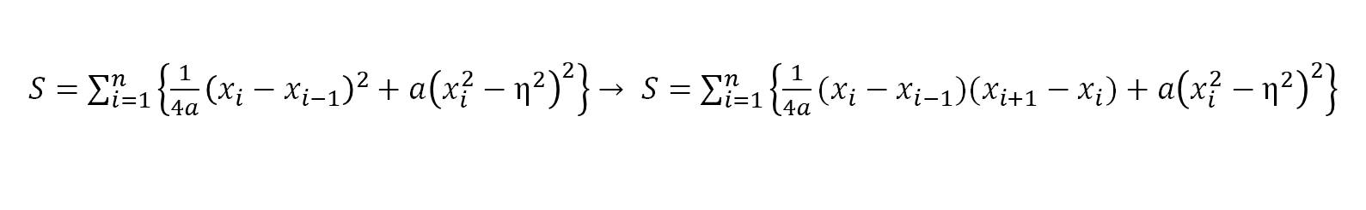

We build the Metropolis algorithm. The action is computed with the symmetrized version of the previous formula:
$S=\sum_{i=1}^{n}{\left\{\frac{1}{4a}{\left(x_{i}−x_{i−1}\right)}^{2}+a{\left(x_{i}^{2}−η^{2}\right)}^{2}\right\}}$ $→ S=\sum_{i=1}^{n}{\left\{\frac{1}{4a}(x_{i}−x_{i−1})(x_{i+1}−x_{i})+a{\left(x_{i}^{2}−η^{2}\right)}^{2}\right\}}$
$$Δx=0.5$$
Generates a new random update from the previous configuration that will be accepted with a 50% probability
a = 0.05

Slide 17
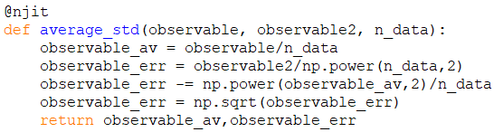

Quantum mechanics averages are computed by averaging the observable over many configuration
$\left\langle O\right\rangle =\lim_{N_{config}→∞}{\frac{1}{N_{config}}\sum_{k}{O^{(k)}}}$
Instead, the error is given by:
$$Δ\left\langle O\right\rangle =\sqrt{\frac{\left\langle O^{2}\right\rangle −{\left\langle O\right\rangle }^{2}}{N_{config}}}$$
This calculation is based on the assumption that the configurations are statistically independents.
To diminish the possible correlation, we save only some configurations, in this case 1 every 50 sweeps

Slide 18
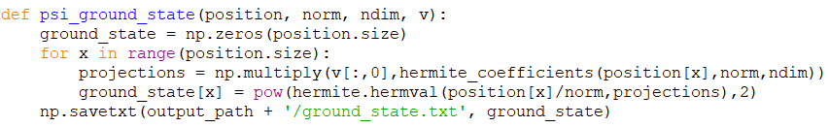
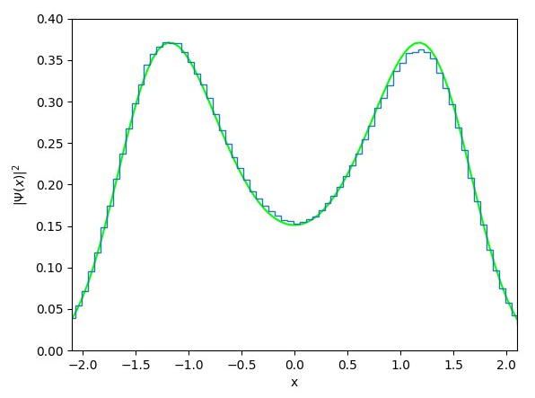
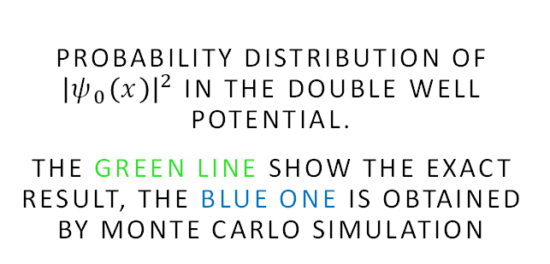
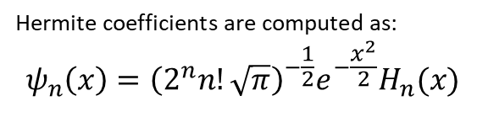
Evaluate an Hermite series at given position and with given coefficients
Hermite coefficients are computed as:
$$ψ_{n}\left(x\right)={\left(2^{n}n!\sqrt{π}\right)}^{−\frac{1}{2}}e^{−\frac{x^{2}}{2}}H_{n}(x)$$
PROBABILITY DISTRIBUTION OF ${\left|ψ_{0}\left(x\right)\right|}^{2}$ IN THE DOUBLE WELL POTENTIAL.
THE GREEN LINE SHOW THE EXACT RESULT, THE BLUE ONE IS OBTAINED BY MONTE CARLO SIMULATION
N = 800, a = 0.05, $η$ = 1.4, n_sweeps = 100000, n_equil = 100, $Δx$ = 0.5, $ω_{o}=4η$

Slide 19
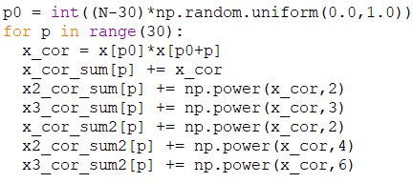
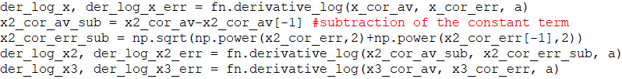
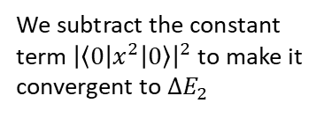
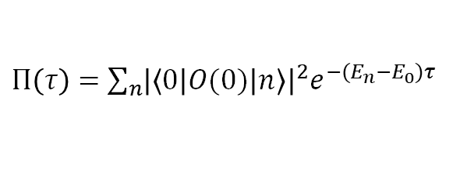
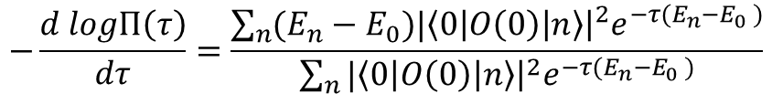
N = 800
We compute here the correlation function as
$Π\left(τ\right)=\sum_{n}{{{\left|\left\langle 0 | O(0) | n\right\rangle \right|}^{2}e}^{−{(E}_{n}−E_{0})τ}}$
evaluated using the expression of the position operator in terms of the ladder operators
$$−\frac{d logΠ\left(τ\right)}{dτ}=\frac{\sum_{n}{(E_{n}−E_{0})|{\left.​\left\langle 0\left|O\left(0\right)\right|n\right\rangle \right|}^{2}e^{−τ(E_{n}−E_{0} )}}}{\sum_{n}{|{\left.​\left\langle 0\left|O\left(0\right)\right|n\right\rangle \right|}^{2}e^{−τ(E_{n}−E_{0} )}}}$$
The logarithmic derivative is performed as
We subtract the constant term ${\left|\left\langle 0 | x^{2} | 0\right\rangle \right|}^{2}$ to make it convergent to $∆E_{2}$

Slide 20
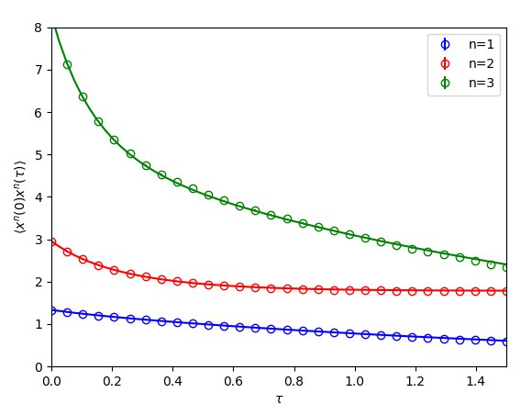
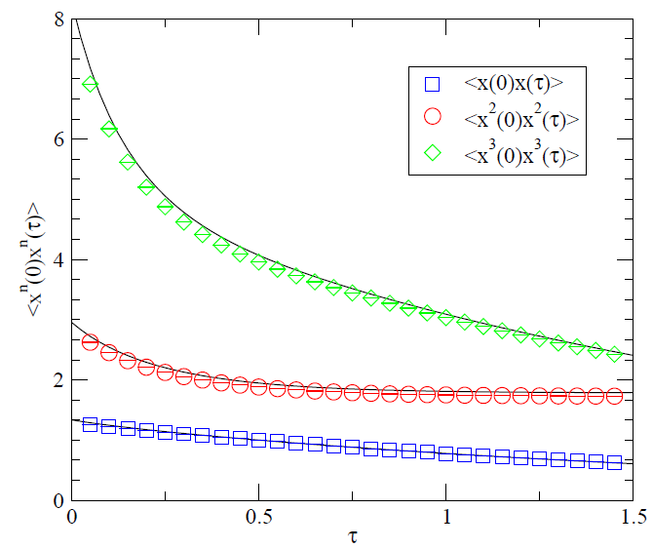
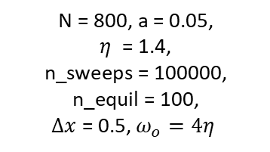
CORRELATION FUNCTIONS OBTAINED WITH THE EXACT DIAGONALIZATION (SOLID LINE) AND WITH MONTE CARLO SIMULATION.
RESULTS OBTAINED IN THE ORIGINAL PAPER
N = 800, a = 0.05,
$η$ = 1.4,
n_sweeps = 100000, n_equil = 100,
$Δx$ = 0.5, $ω_{o}=4η$

Slide 21
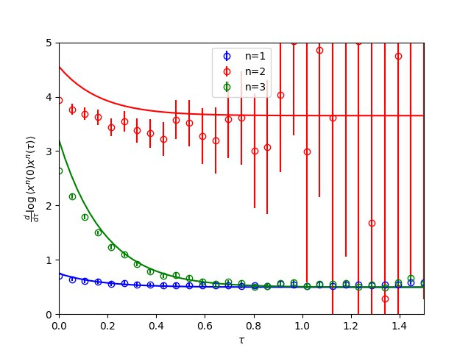
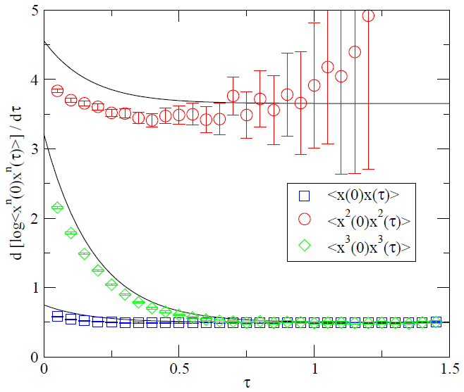
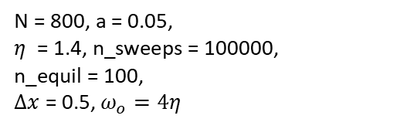
LOGARITHMIC DERIVATIVE OF THE PREVIOUS CORRELATION FUNCTIONS
RESULT PRESENTED IN THE ORIGINAL PAPER.
N = 800, a = 0.05,
$η$ = 1.4, n_sweeps = 100000,
n_equil = 100,
$Δx$ = 0.5, $ω_{o}=4η$

Slide 22
MONTE CARLO cooling

Slide 23
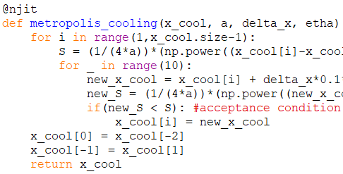
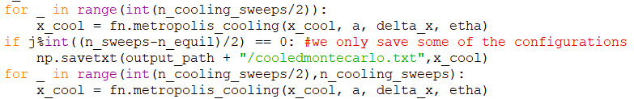
Cooling method
In this case we only accept new configurations that reduce the action.
We firstly use this method to smooth a typical Euclidean path obtained with Monte Carlo simulation.
Then it will be applied to the computation of correlation functions.

Slide 24
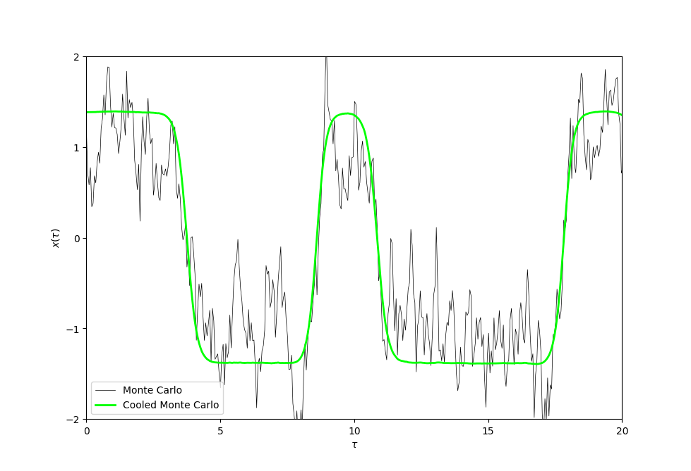
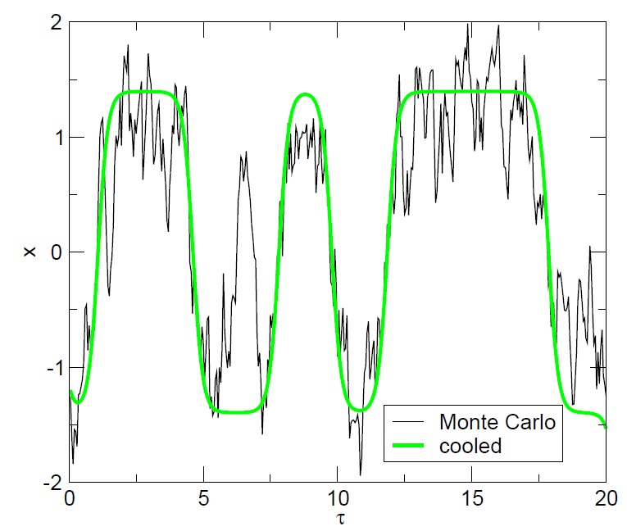
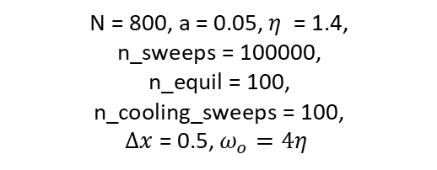
TYPICAL EUCLIDEAN PATH OBTAINED IN A MONTE CARLO SIMULATION OF THE DISCRETIZED EUCLIDEAN ACTION, COMPARED TO THE ONE OBTAINED AFTER 100 COOLING SWEEPS
N = 800, a = 0.05, $η$ = 1.4,
n_sweeps = 100000,
n_equil = 100,
n_cooling_sweeps = 100,
$Δx$ = 0.5, $ω_{o}=4η$

Slide 25
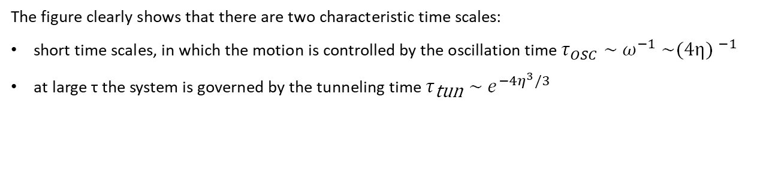
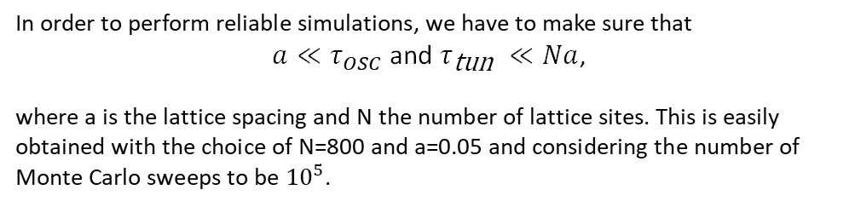
The figure clearly shows that there are two characteristic time scales:
short time scales, in which the motion is controlled by the oscillation time $τ_{OSC}\text{ ∼ }ω^{−1}\text{ ∼}{\text{(4}\text{η}\text{)} }^{−1}$
at large τ the system is governed by the tunneling time$τ_{\text{tun}} \sim e^{−4η^{3}/3}$
In order to perform reliable simulations, we have to make sure that
$a≪τ_{OSC}$ and $τ_{\text{tun} }≪Na$,
where a is the lattice spacing and N the number of lattice sites. This is easily obtained with the choice of N=800 and a=0.05 and considering the number of Monte Carlo sweeps to be ${10}^{5}$.

Slide 26
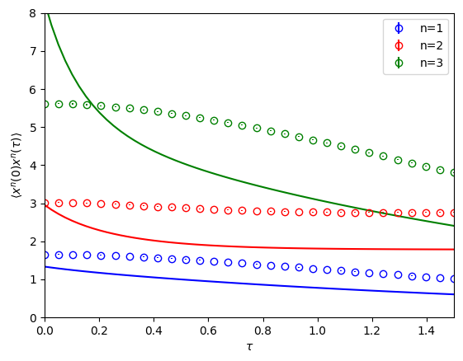
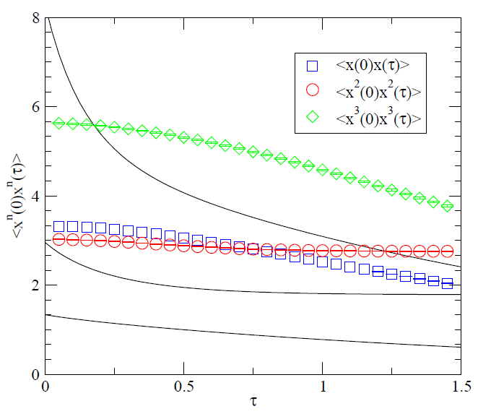
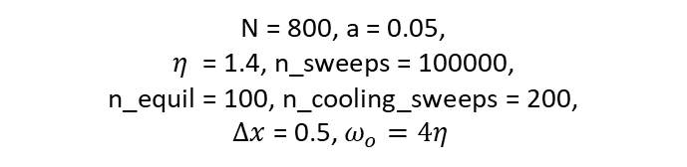
CORRELATION FUNCTIONS OBTAINED WITH THE EXACT DIAGONALIZATION (SOLID LINE) AND WITH MONTE CARLO SIMULATION (COOLING)
RESULTS OBTAINED IN THE ORIGINAL PAPER
N = 800, a = 0.05,
$η$ = 1.4, n_sweeps = 100000,
n_equil = 100, n_cooling_sweeps = 200,
$Δx$ = 0.5, $ω_{o}=4η$
WE NOTICE A MISCALCULATION FOR THE FIRST COOLED CORRELATOR IN THE PAPER

Slide 27
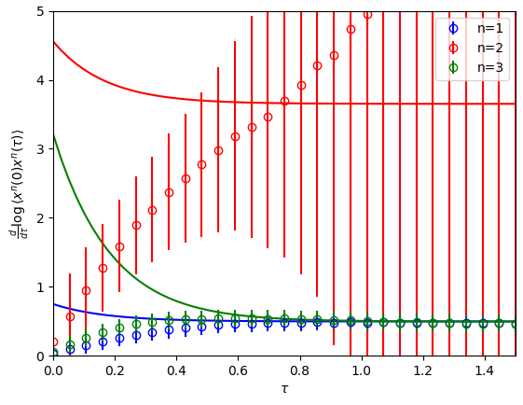
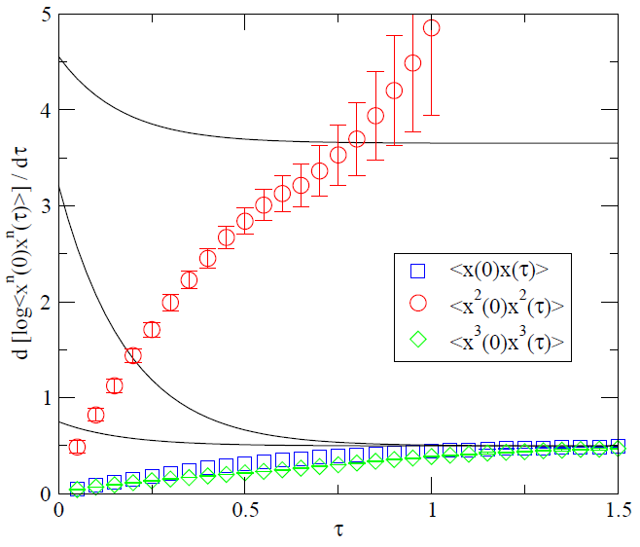
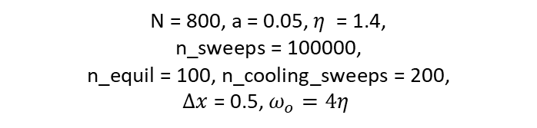
LOGARITHMIC DERIVATIVE OF THE PREVIOUS CORRELATION FUNCTIONS
RESULT PRESENTED IN THE ORIGINAL PAPER
N = 800, a = 0.05, $η$ = 1.4,
n_sweeps = 100000,
n_equil = 100, n_cooling_sweeps = 200,
$Δx$ = 0.5, $ω_{o}=4η$

Slide 28
MONTE CARLO adiabatic switching

Slide 29
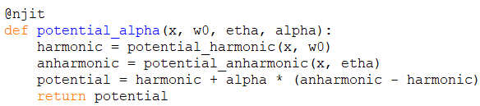
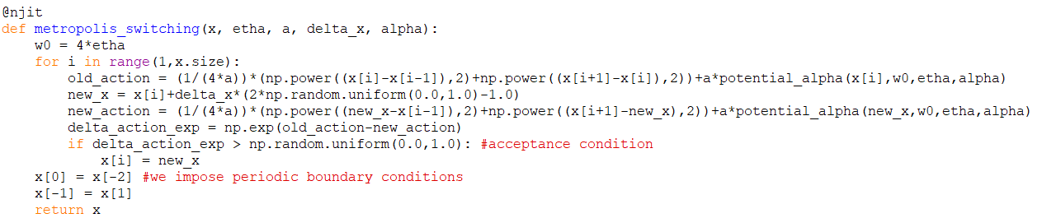
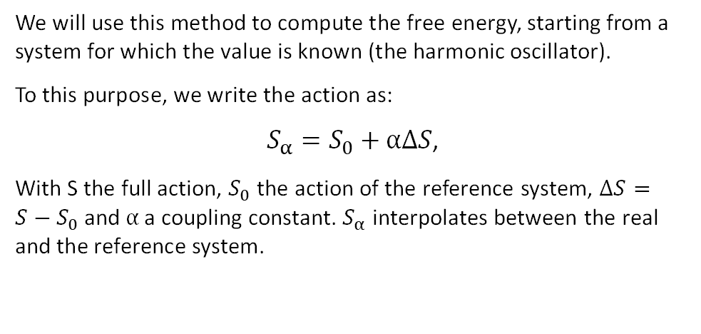
Adiabatic switching technique
We will use this method to compute the free energy, starting from a system for which the value is known (the harmonic oscillator).
To this purpose, we write the action as:
$S_{α}=S_{0}+αΔS$,
With S the full action, $S_{0}$ the action of the reference system, $ΔS=S−S_{0}$ and $α$ a coupling constant. $S_{α}$ interpolates between the real and the reference system.

Slide 30
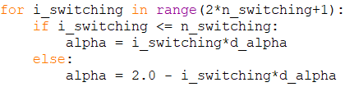
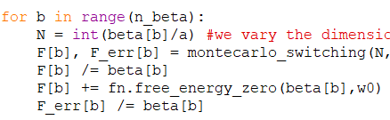
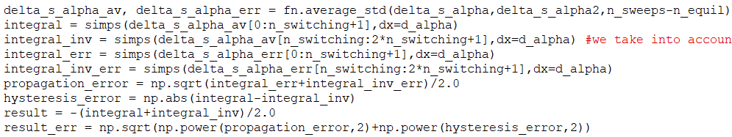

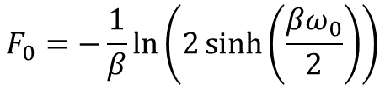
To find the partition function, we integrate $\frac{∂logZ\left(α\right)}{∂α}=−{〈 ∆S〉}_{α}$ and we find
$$log\left(Z\left(α=1\right)\right)=log\left(Z\left(α=0\right)\right)−\int_{0}^{1}{dα^{′}{〈∆S〉}_{α’}}$$
With the harmonic oscillator as reference system, we have $Z\left(α=0\right) =\sum_{n}{e^{−βE_{n}^{0}}=\frac{e^{−βω_{0}^{}/2}}{1−e^{−βω_{0}^{}}}}$
$$F_{0}=−\frac{1}{β}ln\left(2\sinh\left(\frac{βω_{0}}{2}\right)\right)$$
We perform the integration in both ways (0 to 1 and vice versa) to account for possible hysteresis errors
we make use of the Simpson’s integration rule defined in scipy.integrate library.
n_switching = 20

Slide 31
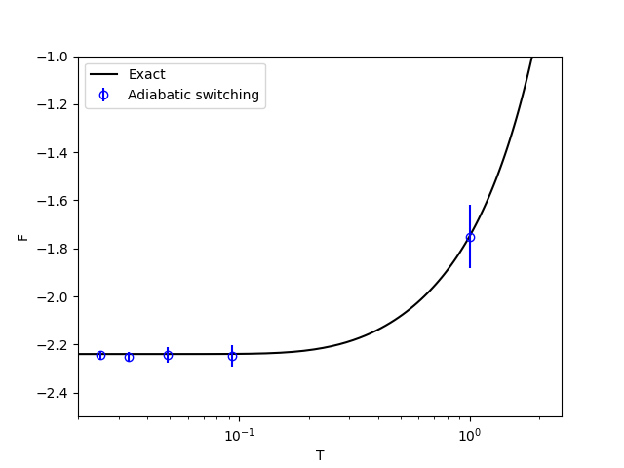


FREE ENERGY: EXACT AND MONTE CARLO USING ADIABATIC SWITCHING
RESULT PRESENTED IN THE ORIGINAL PAPER
n_beta = 5, beta_max = 40,
a = 0.05, $η$ = 1.4,
n_sweeps = 100000,
n_equil = 100, n_switching = 20,
$Δx$ = 0.5, $ω_{o}=4η$
Notes:
Good result limited to a low range of temperature where the main contribution is given by the ground state , at higher temperatures we need to carefully watch the discretization errors

Slide 32
INSTANTON – ANTI-INSTANTON CONTENT

Slide 33






INSTANTON ANTI-INSTANTON CONTENT
In the continuum limit the instanton solution can be found from the classical equation of motion.
The solution which satisfies the boundary condition $x\left(τ→±∞\right)=±η$is given by
$$4η$$
$$m\ddot{x}=V′(x)$$
$$x_{I}\left(τ\right)=−x_{A}\left(τ\right)=ηtanh⁡[\frac{ω}{2}\left(τ−τ_{0}\right)]$$
“location” of
the instanton
The tunneling rate, up to next-to-leading order
in the semi-classical expansion, is given by
$$n_{I+A}=\frac{N_{I+A}}{β}=8η^{5/2}\sqrt{\frac{2}{π}} e^{−S_{0}−\frac{71}{72S_{0}}}$$
$$S_{0}=\frac{4η^{3}}{3}$$
This is studied better considering the cooling method, as it removes short distance fluctuations: since instantons are classical solutions, cooling can be used to study the instanton content of a quantum configuration.

Slide 34


The cooling method can also be used to get an estimate of the total density of instanton and anti-instantons
We use this formula since we work with a discretized system
$N_{I}\left(n_{cool}\right)=N_{osc}e^{−n_{cool}a/τ_{osc}}$+ $N_{tun}e^{−n_{cool}a/τ_{tun}}$
Disappearance of quantum fluctuations
Instanton – anti-instanton annihilation

Slide 35


INSTANTON DENSITY AS A FUNCTION OF THE NUMBER OF COOLING SWEEPS
RESULT PRESENTED IN THE ORIGINAL PAPER
N = 800, a = 0.05, $η$ = 1.4,
n_sweeps = 100000,
n_equil = 100, n_cooling_sweeps = 200,
$Δx$ = 0.5, $ω_{o}=4η$
SOLID LINE = 1-LOOP
DASHED LINE = 2-LOOP

Slide 36


INSTANTON ACTION AS A FUNCTION OF THE NUMBER OF COOLING SWEEPS
RESULT PRESENTED IN THE ORIGINAL PAPER
N = 800, a = 0.05, $η$ = 1.4,
n_sweeps = 100000,
n_equil = 100, n_cooling_sweeps = 200,
$Δx$ = 0.5, $ω_{o}=4η$
SOLID LINE = CLASSICAL ACTION

Slide 37

The histogram of instanton – anti-instanton separations is built considering data obtained by measuring the zero crossing distance after 10 cooling sweeps.

Slide 38



INSTANTON – ANTI-INSTANTON SEPARATION, COMPUTED FROM ZERO CROSSING DISTANCE
RESULT PRESENTED IN THE ORIGINAL PAPER: WE DID NOT CONSIDER THE RANDOM INSTANTON GAS
N = 800, a = 0.05, $η$ = 1.4,
n_sweeps = 100000,
n_equil = 100, n_cooling_sweeps = 10,
$Δx$ = 0.5, $ω_{o}=4η$

Slide 39
THANK YOU FOR THE ATTENTION

