Slide 1
GEO877, Spatial Algorithms
Chatty Maps: Constructing Sound Maps of Urban Areas from Social Media Data
Aiello et al. (2016)
Muriel Geissmann, Lea Stoffel, Guillermo Filgueira Fernandez & Julia Good
30.04.26

Slide 2
Research Questions (Lea)
Can urban soundscapes in Zurich be inferred from geotagged Flickr tags?
According to the Flickr tags, which noise categories are dominant on different road sections in Zurich?
Notes:
For our project we want to replicate this study on a smaller scale for Zurich
For this we defined 4 research questions which are building on each other.
Similar to Aillo et al., we want to examine if soundscapes in Zurich infer with the geotagged Flickr Tags. If Flickr tags are representative, we then want examine which noise categories are dominant on different road sections in Zurich.
Then we want analyse if the Flicker-derived sound patterns correlate wit the official noise pollution dataset. There we want to escpecially focus on road traffic noise.
As a final step we are going to analyse if Flick posts can complement traditional urban sound monitoring.

Slide 3

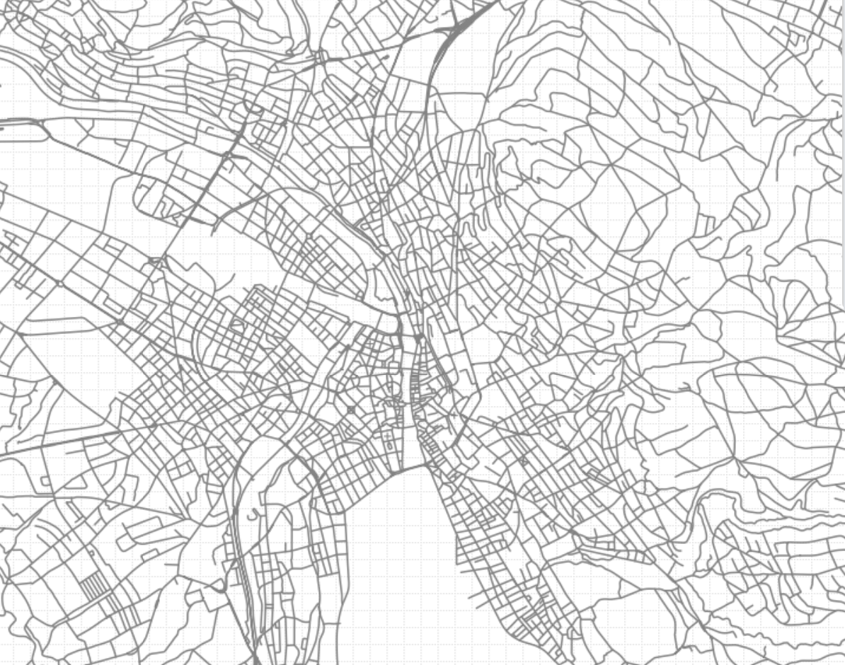

Data Sources (Lea)
Geotagged Photos: Flickr posts
Streets: Official Street Directory of Switzerland
Spatial boundary: Municipal boundary of Zurich
Notes:
For our replication of the study and to answer our formulated research questions we are going to use following four data sources. First we have the Flickr posts, where we will use to extract keywords for the sound classification.
The official street directiory of Zurich is used to locate the flickr posts to the road sections. But to overall define the spatial extend ot zurich, we use the municipal boundary of zurich.
As we also want to compare if the flickr derived categorization correlate with the offcial noise pollution dataset, we also ned the road noise data of zurich. Our municiplity layer are provided by the city of zurich, whereby the streetnet and the noise pollution data we will download from map.geo.admin

Slide 4
Spatial Algorithms (Lea)
Julia: Dividing Street Segments
Muriel: Creating Buffer
Guillermo: Point in Polygon (Buffer)

Slide 5
Preprocessing of Flickr data (Lea)
Typos
Lower-upper case
Languages
Filter for Zurich

Slide 6
Construction of Sound Wheel (Lea)
Take sound wheel from paper and add words

Slide 7
Dividing Streets into segments (Julia)
Streets from Switzerland, filter für zurich, divide for name and then length

Slide 8
Creating Buffer around Street Segments (Muriel)

Slide 9
Points in Polygon (Guillermo)

Slide 10
Challenges at the moment

