Slide 1




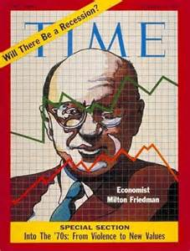



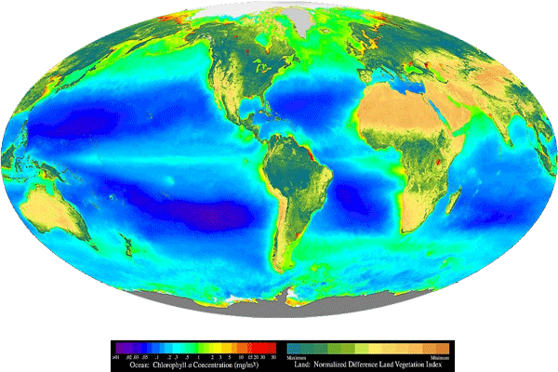











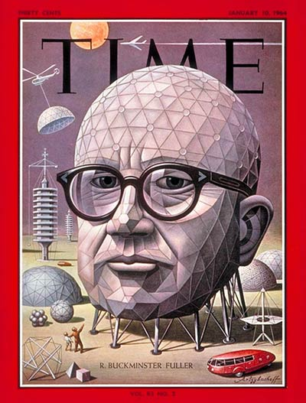

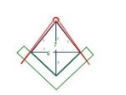
ECO ECON HEARTBEAT
IoT
UTZ
TERRA
TRC
FRIEDMAN’S K% RULE
Earth Intelligence Network
Eco
Incentives
{“URN”}
Commodity Tokens
{“Org_ID”}
Commodity Token Index Fed/World Coin
CHECK
LIST
Heartbeat Flash Message Event Bus
Syntax Lexicon OPSCODE brevity codes
300+ Templates structured data exchange
Firefly
Heartbeat
Sync
Algorithm
Stochastic
Harmonization
STATE META DATA Snapshot
SYNC DELTAS
STAT MEAN INDEX
Time-Space Meter, Metrics, Net Survey
Agile, Adhoc DAO Eco Economic federation
NEO Net Enabled Operations Situation Pulse
NEO
Procedural Template
Sync to
Closest
Heartbeat
USPTO 13/573,002 US SCT Alice compliant
stevenjmcgee@sawconcepts.com
Cell: 732-768-5440
Web: http://sawconcepts.com/index
http://patreon.com/beacon_heart
http://github.com/Beacon-Heart
EVENT
BUS

