Slide 1

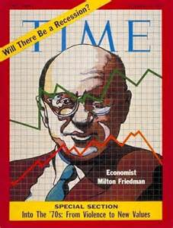
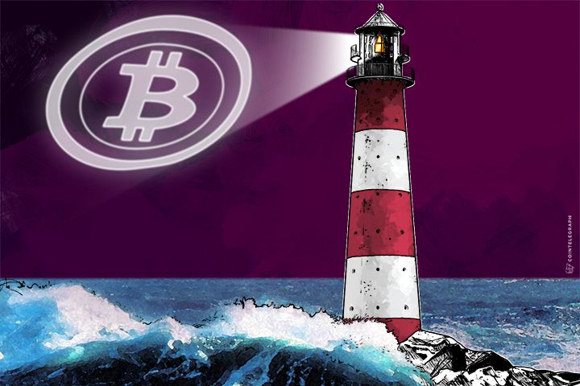
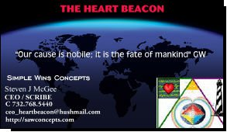


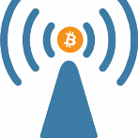

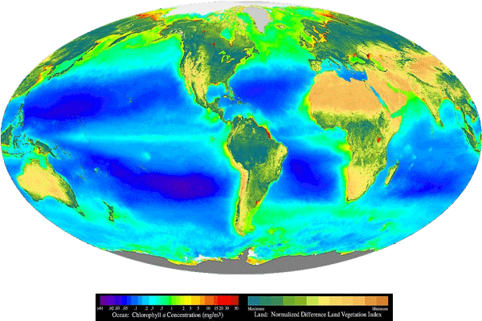

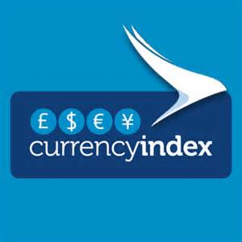



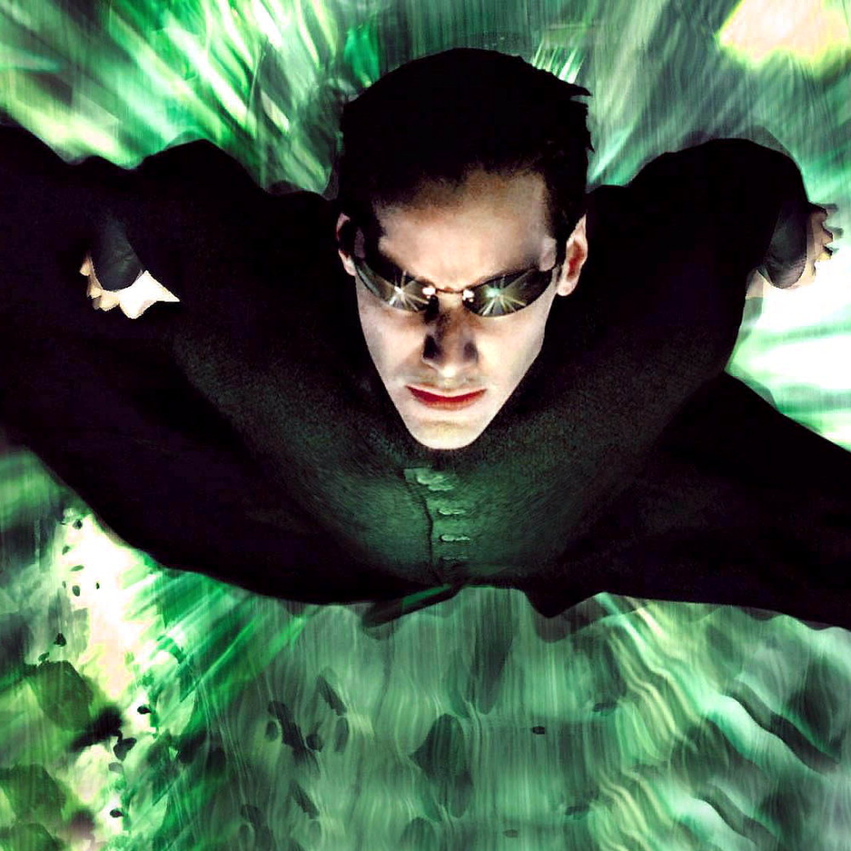


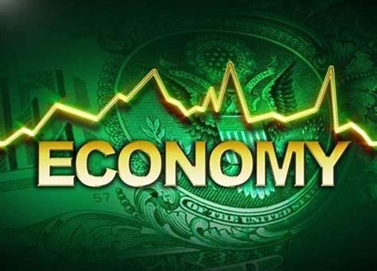








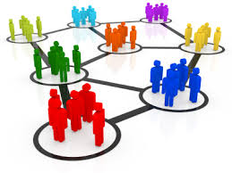

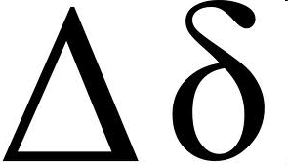
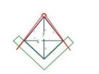
UTZ
STAT MEAN
INDEX
GDP
BLOCK TIME ARBITRAGE
Trade Reference Currency
MICRO
CYCLES
MACRO
CYCLES
SLA
Earth Intelligence Network A.I. EIN
Friedman’s K% Rule
Time-Space Meter-Metrics
Distributed Systems Temporal
Geo-Spatial, Semantic Consensus
NEO Situation Awareness Beacon
Quantum Random Number Beacon
{“URN”}
K% GDP Pulse
{“Org_ID”}
NEO
Heartbeat Flash Message Event Bus
Eco Incentives
Token Economy
NATO
OTAN
UTZ TIME ZONE SYNC
#1421
Steven J. McGee
SYNC TO
OPTEMPO
HEARTBEAT
USPTO 13/573,002 Heart Beacon Cycle
NET SURVEY
Programmable Money, Economy
Eco Economic Epochs – It’s TIME
paypal.me/EcoEconHeartbeat
Stochastic
Harmonization
https://pinterest.com/mcgee3077/
Firefly-
Heartbeat
Sync Algo
Shortest path to
Truth = Nature
Luxor Temple
ecoeconomicepochs@protonmail.com
http://patreon.com/beacon_heart
http://github.com/Beacon-Heart
STATE META Data snapshot
SYNC DELTAS
Adaptive Procedural
Template - Checklist

