Slide 1

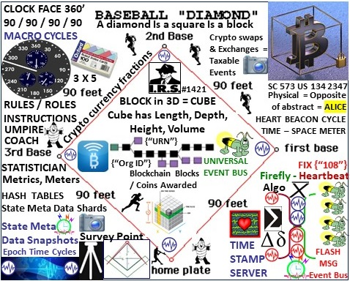
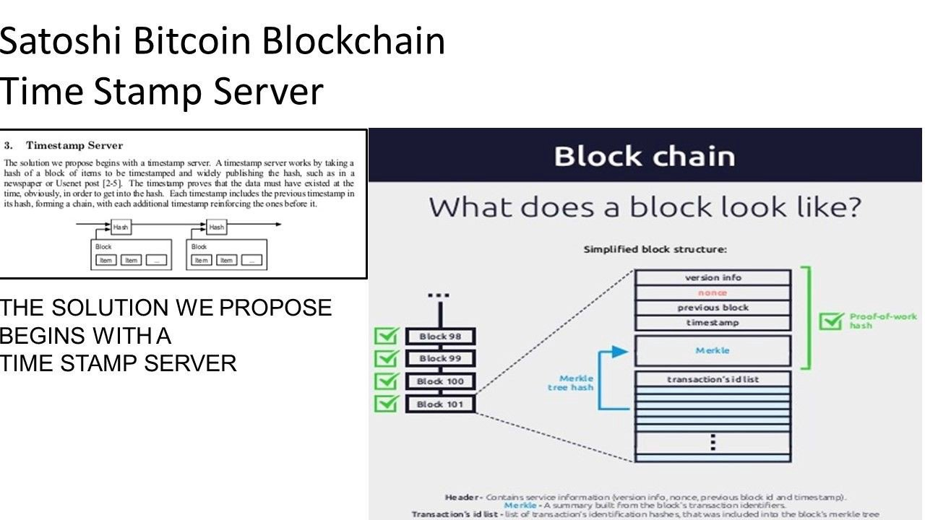



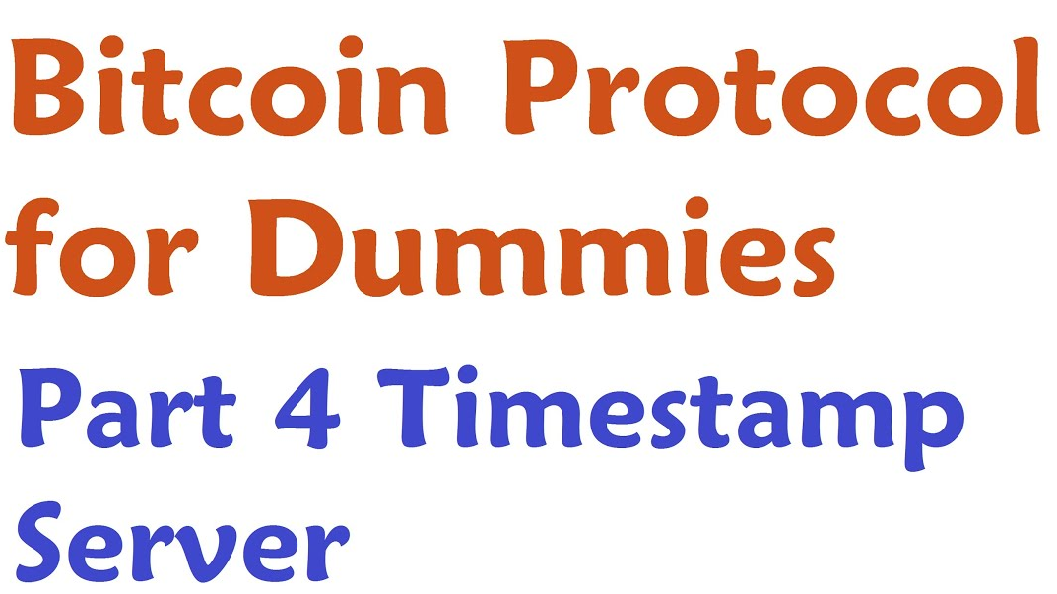
Epoch Time Cycles / Syntax
Key building blocks of the Net / Net of Money

Slide 2

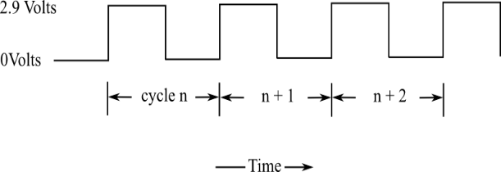

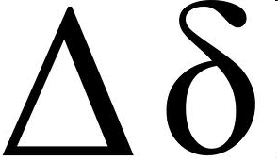
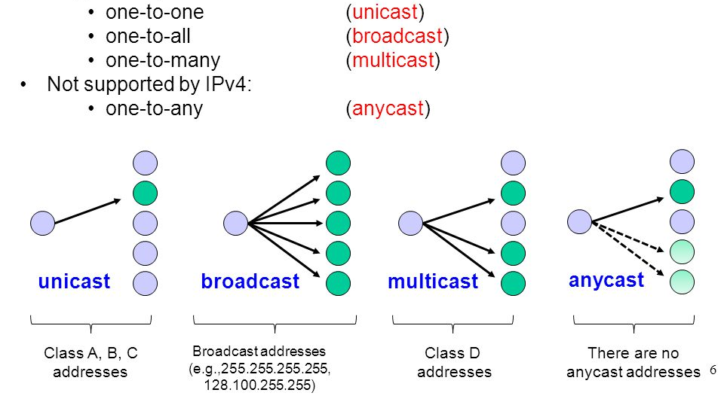

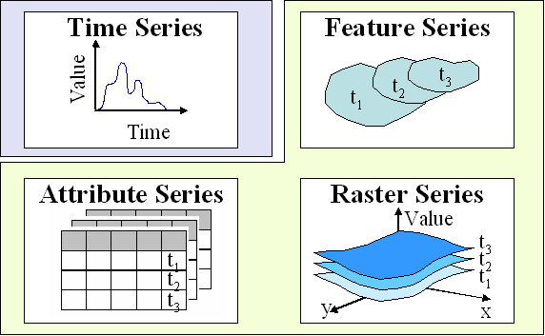
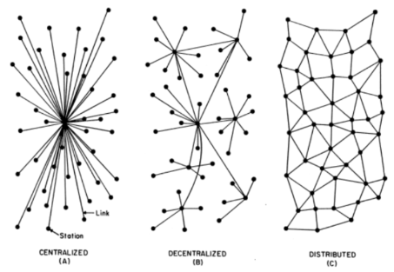
Time Epochs / Syntax:
Crypto Currency
Programmable
Blockchain Money
The Internet: Epoch time cycles / syntax
BLOCKCHAIN Programmable Money CLOCK CYCLES / EPOCHS
UNICAST =
Time Cycles
FILTERS
- Workflow
SYNTAX
Multi / Broad / Any
+ 2
+ 1
0
+ 1
+ 2
All things internet, programmable net of money are formed using:
1) Epoch Time Cycles to 2) process (not) syntax as instructions
- FILTERS
- Workflow

