Slide 1


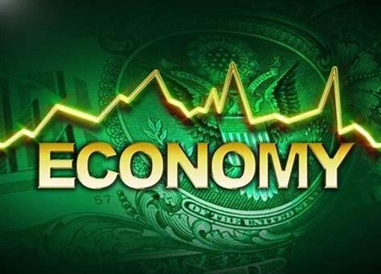


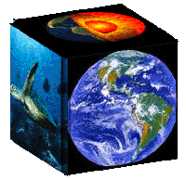
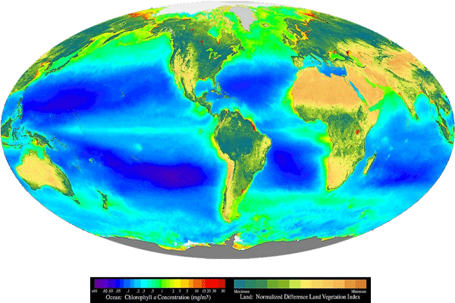









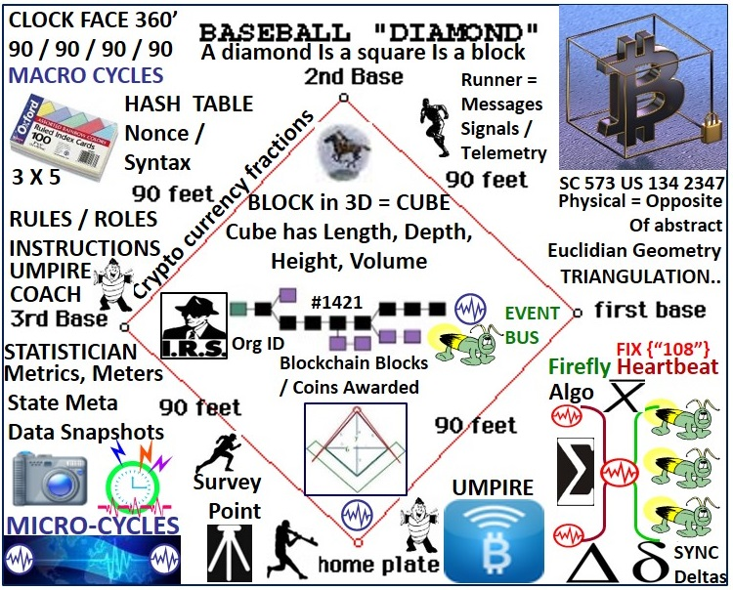
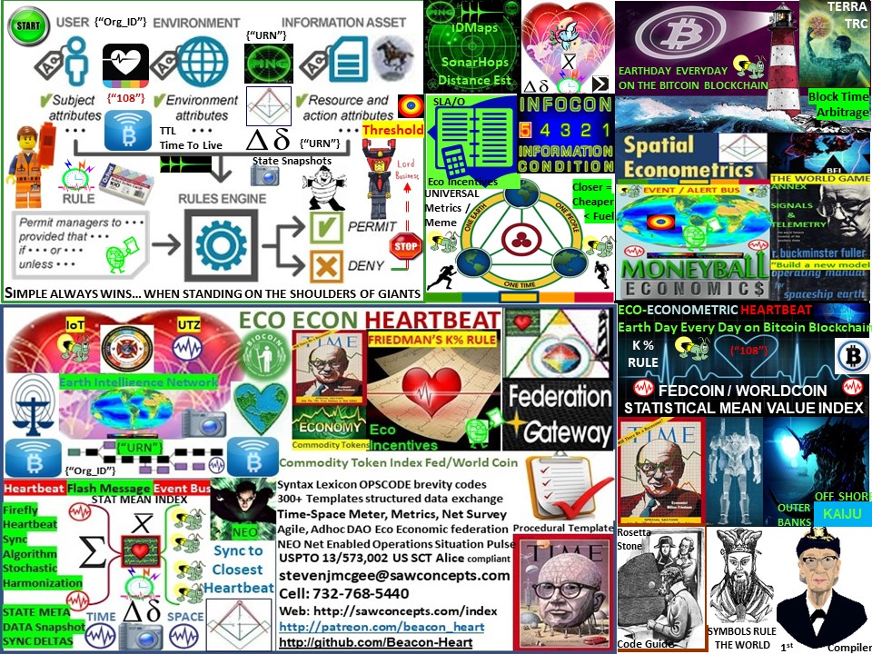






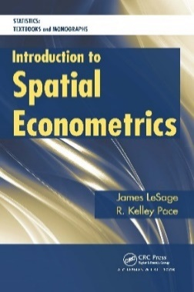


ECO ECONOMIC HEARTBEAT
MILTON FRIEDMAN’S K% RULE
EIN/UTZ
GDP Currency Pulse
FEDCOIN
WORLDCOIN
Eco
Incentives
TIME- SPACE METRICS
METERS
EIN/UTZ
SLA/O
URN
URN
URN
URN
Org_ID
Org_ID
Org_ID
Org_ID
DEMURRAGE FEES
Closer = Cheaper

