Slide 1

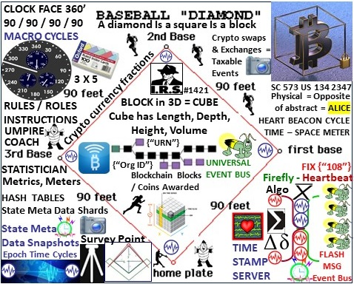
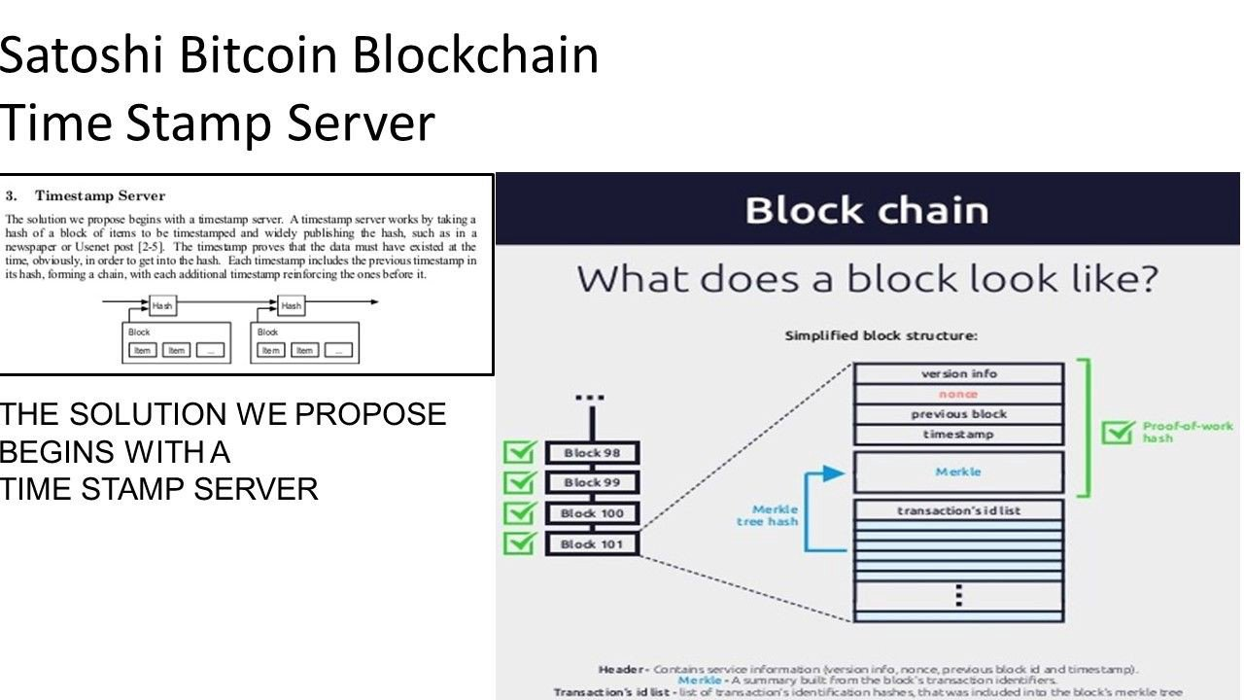



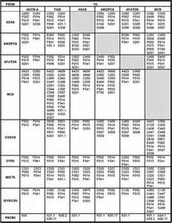

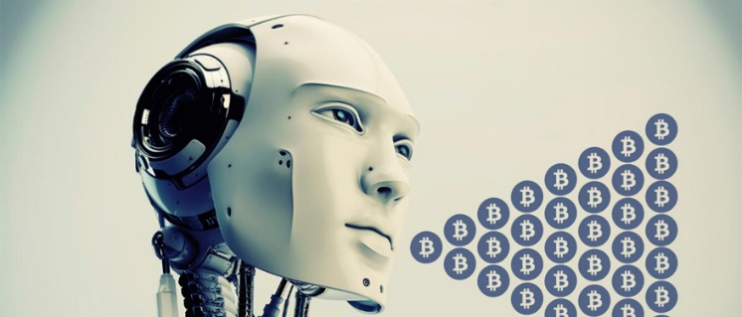
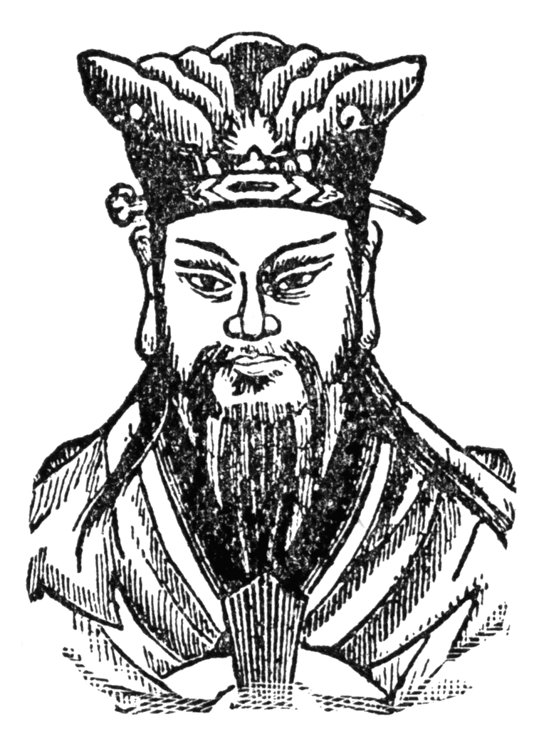
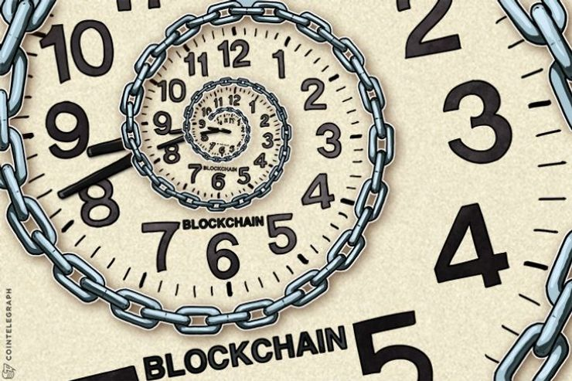
Epoch Time Cycles / Syntax
Internet / Internet of Money building blocks
OPSCODE
Brevity
Codes
Mapped
To
Symbol Sets
Time
Function
AI
GENESIS TIME STAMP / Genesis Block

Slide 2
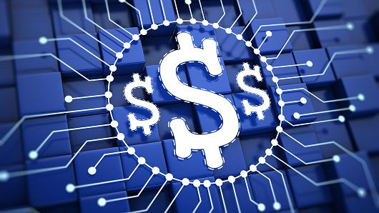


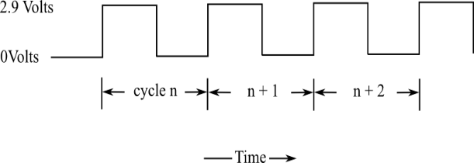

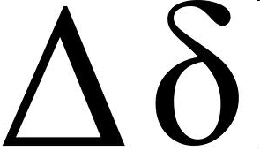
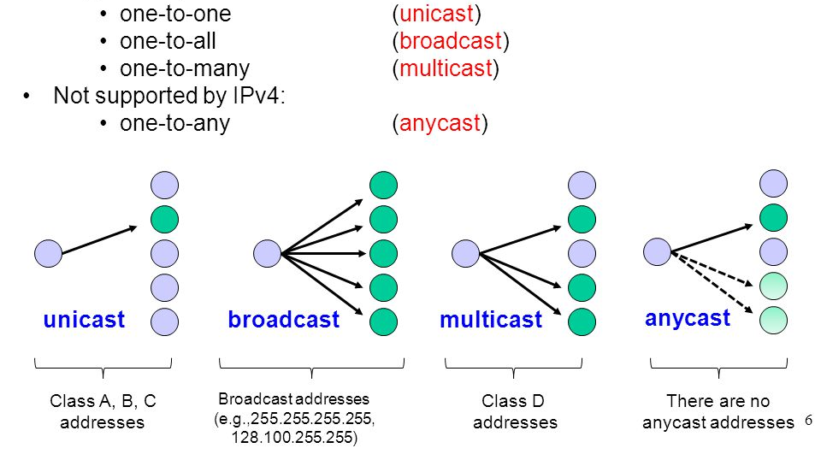

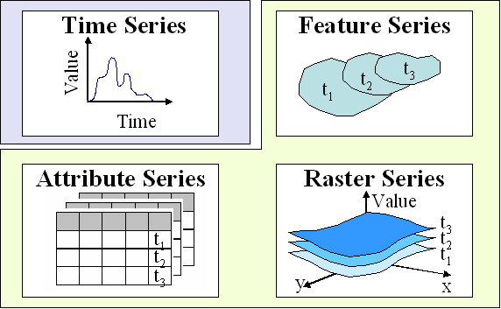
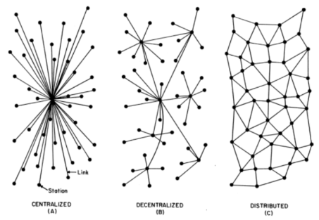
Time Epochs / Syntax:
Crypto Currency
Programmable
Blockchain Money
The Internet: Epoch time cycles / syntax
COMPUTER CLOCK CYCLES / TIME EPOCHS
COMPUTER CLOCK CYCLES / TIME EPOCHS
UNICAST =
Time Cycles
FILTERS
- Workflow
SYNTAX
Multi / Broad / Any
+ 2
0 =
Genesis
Time
Epoch
+ 1
0
+ 1
+ 2
All things internet, programmable net of money are formed using:
1) Epoch Time Cycles to 2) process (not) syntax as instructions

Slide 3
