Slide 1
COMP90041 Programming and Software Development 2020 - Semester 1 Lab 2 - Week 3
Yuhao(Beacon) Song
yuhsong1@unimelb.edu.au

Slide 2
Introduction
Master of Information Technology (Artificial Intelligence), Second Year
Timetable
Tue(11) 14:15-15:15 (Melbourne Time) https://unimelb.zoom.us/j/4631577274
Tue(07) 16:15-17.15 (Melbourne Time) https://unimelb.zoom.us/j/4631577274
Contact
yuhsong1@unimelb.edu.au
Github: https://github.com/Beaconsyh08/COMP90041_Programming_and_Software_Development_Tutorials.git

Slide 3
Outline
Brief Introduction for Zoom
Lab 1 Explanation(optional)
Lecture Review
Exercise & demo

Slide 4

Zoom
Download
https://www.unimelb.edu.au/zoom/home
Basic Function
Yes & No
Raise Hand
Poll
Preparation
Food
Drink

Slide 5
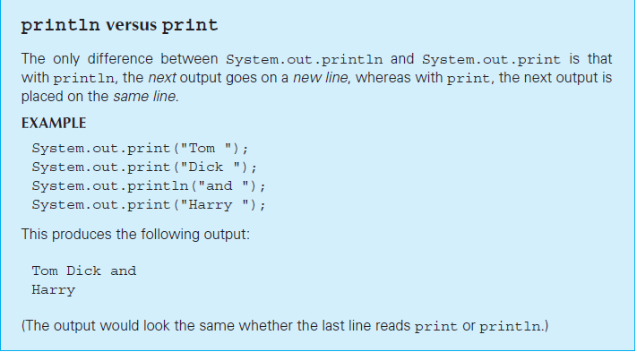
Lecture Review – Print Function

Slide 6
Lecture Review – Scanner
Console Input Using the Scanner Class
• The following line creates an object of the class Scanner and names the object keyboard :
Scanner keyboard = new Scanner(System.in);
• Although a name like keyboard is often used, a Scanner object can be given any name
– For example, the Scanner object is named scannerObject
Scanner s1 = new Scanner(System.in);
s1.nextLine/ nextInt/ Next

Slide 7
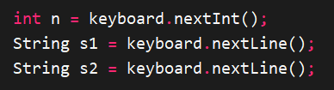

QUIZ
Input Code Output

Slide 8


PITFALL: Dealing with the Line Terminator, '\n'
Expected
Reality

Slide 9
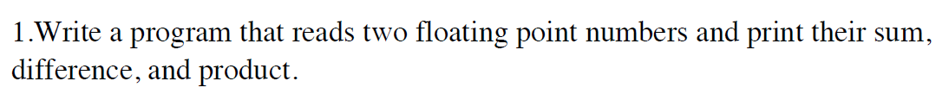
Tutorial Q1

Slide 10
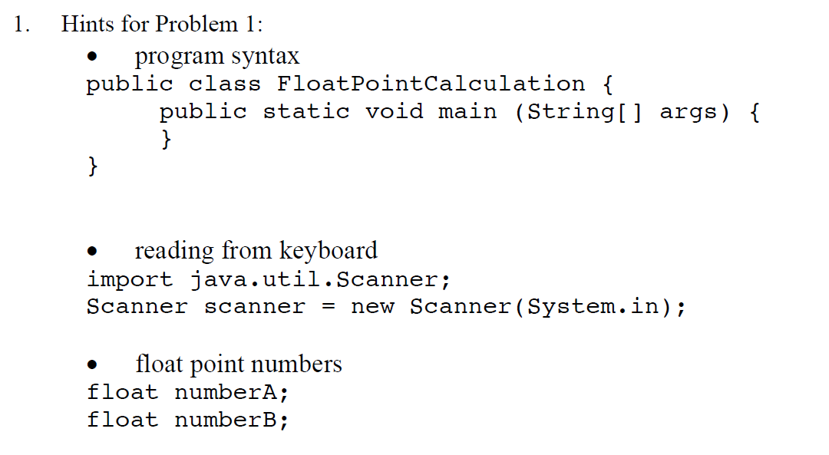

Slide 11
Java string valueOf()
The java string valueOf() method converts different types of values into string.
By the help of string valueOf() method, you can convert int, long, boolean, character, float, double, object and char array to string

Slide 12
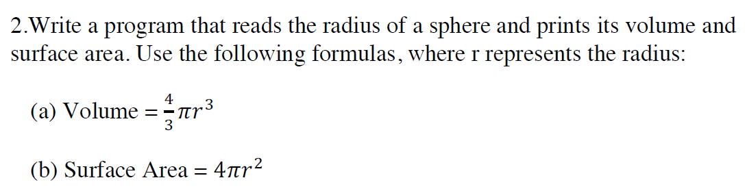
Tutorial Q2

Slide 13
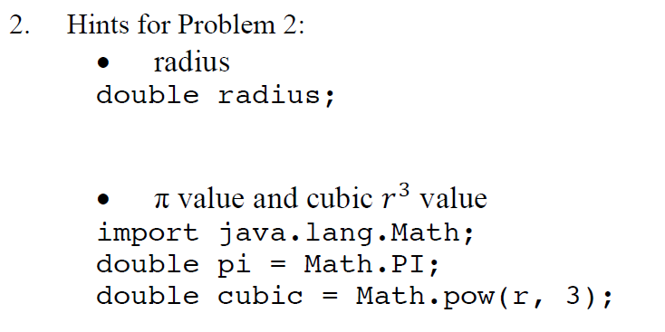

Slide 14
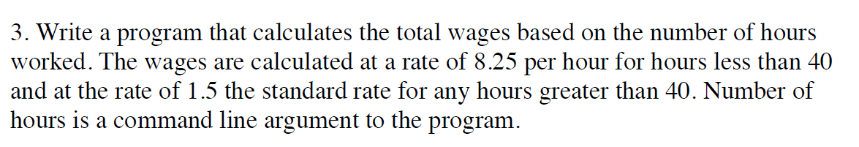
Tutorial Q3

Slide 15
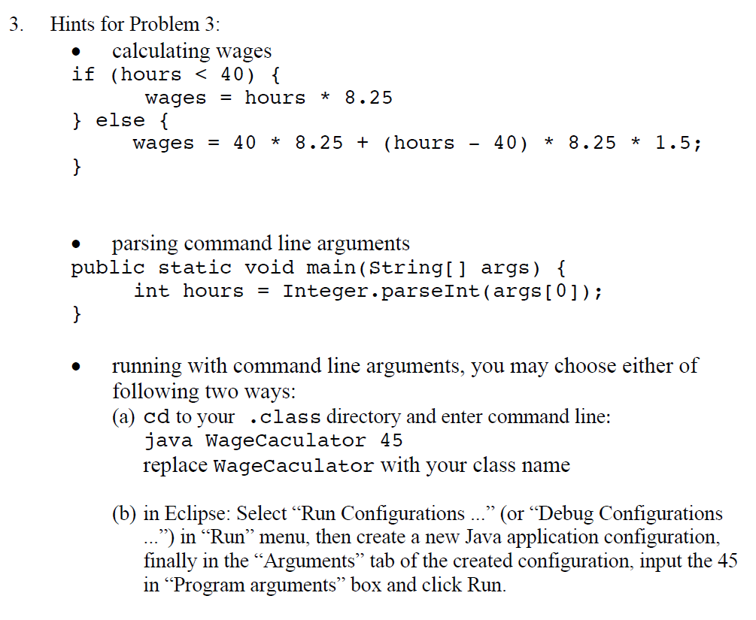

Slide 16
The Conditional Operator
• The conditional operator is a notational variant on certain forms of the if-else statement
– Also called the ternary operator or arithmetic if
– The following examples are equivalent:
if (n1 > n2) max = n1;
else max = n2;
vs.
max = (n1 > n2) ? n1 : n2;
– The expression to the right of the assignment operator is a conditional operator expression
– If the Boolean expression is True → the first expression (n1)
Else If the Boolean expression is False → second expression (n2)

