Slide 1
COMP90041 Programming and Software Development 2020 - Semester 2 Lab 9
Yuhao(Beacon) Song
yuhsong1@unimelb.edu.au
yuhsong@student.unimelb.edu.au

Slide 2
Introduction
Timetable
Tue(18) 16:15-17:15 (Melbourne Time)
https://unimelb.zoom.us/j/94854648719?pwd=WUY0NmR6MkI5UVZBUWhGNWFIU216Zz09
Wed(19) 17:15-18:15 (Melbourne Time)
https://unimelb.zoom.us/j/93723434766?pwd=MGh4QkJuZnhJR21LZ0VqeXhJQU52UT09
GitHub Page (Tutorial Materials, Solutions, Additional Resources)
https://github.com/Beaconsyh08/COMP90041-2020SEM2
PollEv
https://pollev.com/yuhsong

Slide 3
Outline
Assignment 1 Feedback
Lecture Review
Exercise
Assignment 2

Slide 4
Assignment 1 Feedback
Congratulations everyone!
You have done an excellent job in Assignment 1! If you achieved a mark higher than 12 out of 15 (80%), that actually is H1 grade!
Files in your feedback folder. Which are
a) input1 & input2, the tests for marking;
b) output1 & output2, the expected output for tests;
c) mark.txt, the output file showing you the differences using "sdiff";
d) Marking_guide.docx, the feedback file.

Slide 5
Assignment 1 Feedback
a) NimPlayer Instances
You need to create two instances of NimPlayer to finish your task
b) Static method (not more than 3 in this task)
You need to avoid using too many static methods, which is not follow the OOP concept.
c) removeStone()
NimPlayer class should also have a removeStone() method that returns the number of stones the player wants to remove in his/her turn.
d) Bad variable names
The name like k or n are considered as a bad variable name, and you should make them more intuitive, i.e. upperBound, initialStonesNo
e) Lines >100 chars
Too many characters in a single line. Exceed the IDE suggested boundary
Academic Integrity

Slide 6
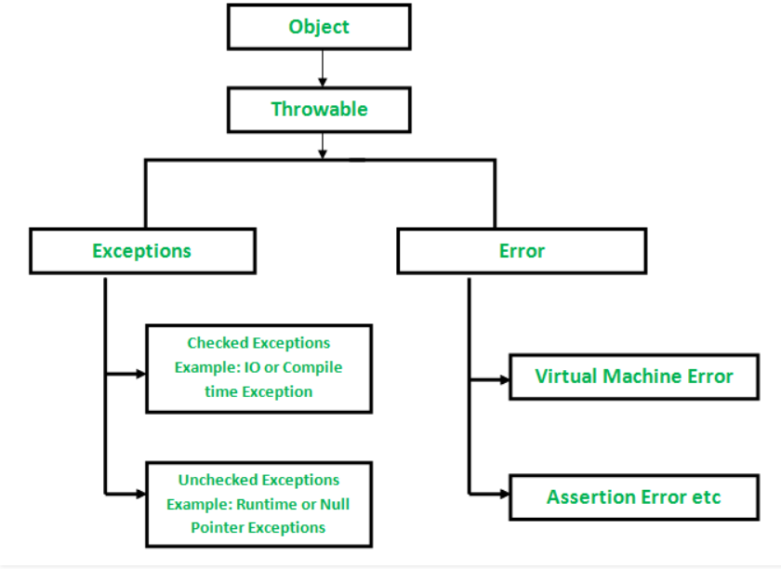
Exception
Checked Exceptions
Must be handled.
Unchecked Exceptions
Could be handled

Slide 7
Exception Throwing & Handling
Throwing an Exception: Java library software (or programmer-defined code) provides a mechanism that signals when something unusual happens
Handling the Exception: In another place in the program, the programmer must provide code that deals with the exceptional case

Slide 8
Five Keywords
Keyword | Description
try | The "try" keyword is used to specify a block where we should place exception code. The try block must be followed by either catch or finally. It means, we can't use try block alone.
catch | The "catch" block is used to handle the exception. It can be followed by finally block later. It must be preceded by try block which means we can't use catch block alone.
finally | The "finally" block is used to execute the important code of the program. It is executed whether an exception is handled or not.
throw | The "throw" keyword is used to throw an exception.
throws | The "throws" keyword is used to declare exceptions. It doesn't throw an exception. It specifies that there may occur an exception in the method. It is always used with method signature.
(Summary using info from https://www.javatpoint.com/exception-handling-in-java)

Slide 9
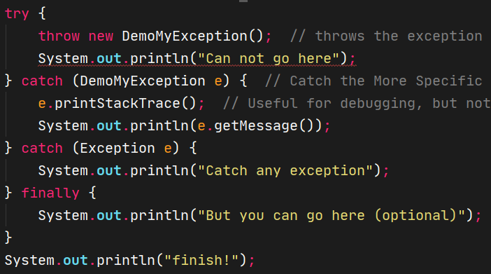
The try-throw-catch Trio

Slide 10
try
Two cases:
No exception is thrown in the try block
try block -- executed to the end of the block
catch block -- skipped
after the catch block -- execution continues
An exception is thrown in the try block and caught in the catch block
try block – skipped after thrown
Control is transferred to a following catch block (in simple cases)
The thrown object is plugged in for the catch block parameter
catch block -- executed
after catch block -- executed (if any)

Slide 11
catch
When an exception is thrown, the catch block begins execution
catch block: only one parameter
exception object thrown: is plugged in for the catch block parameter
catching/handling the exception: the execution of the catch block(exception handler)
Whenever an exception is thrown, it should ultimately be handled/caught by some catch block
catch (myException e) {
ExceptionHandlingCode}
e is called the catch block parameter
specifies the type and provides a name of thrown exception object
The identifier e is often used by convention, but any non-keyword identifier can be used

Slide 12
Exception Handling: Two ways
1. throw -- handles an exception in a catch block
try block: throw an exception ,
catch block: caught the exception within the same method
2. throws -- shift the exception handling responsibility to the method that invoked the exception throwing method
Declared at the start of the method definition by placing the exception class name in a throws clause
The invoking method must handle the exception, unless it shift the responsibility as well
Ultimately, every exception that is thrown must eventually be caught/handled by a catch block in some method that does not just declare the exception class in a throws clause

Slide 13
throw
throw new ExceptionClassName(PossiblySomeArguments);
If exception is thrown, try block stops
Normally, the flow of control is transferred to another portion of code known as the catch block
The value thrown is the argument to the throw operator, and is always an object of some exception class

Slide 14
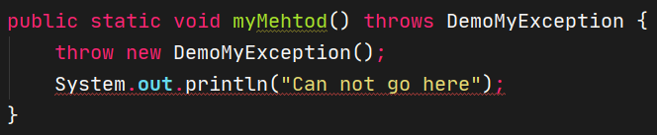
throws
public void aMethod() throws AnException
If a method can throw an exception but does not catch it, it must provide a warning in the heading
throws clause: The Warning
declaring the exception: The process of including an exception class in a throws clause
If a method throws an exception and does not catch it, then the method invocation ends immediately

Slide 15
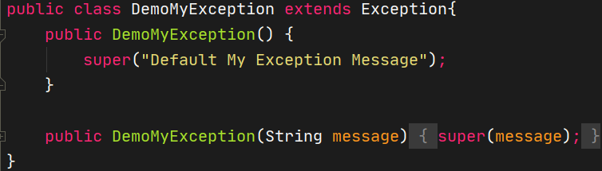
Programmer-Defined Exception Class Guidelines
Must be a derived class of an already existing exception class
At least two constructors should be defined, sometimes more
A no-argument constructor that includes a call to super with a default string as the argument
A constructor that takes a string argument and begins with a call to super, which takes the string argument

Slide 16
Preserve getMessage
The method getMessage is inherited
For all predefined exception classes, getMessage returns the string that is passed to its constructor as an argument
Or it will return a default string if no argument is used with the constructor
This behaviour must be preserved in all programmer defined exception class, two constructors must be included by convention

Slide 17
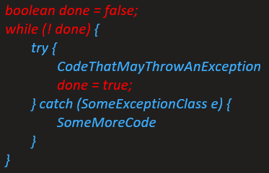
Tip: Exception Controlled Loops
Sometimes it is better to simply loop through an action again when an exception is thrown, as follows:

Slide 18
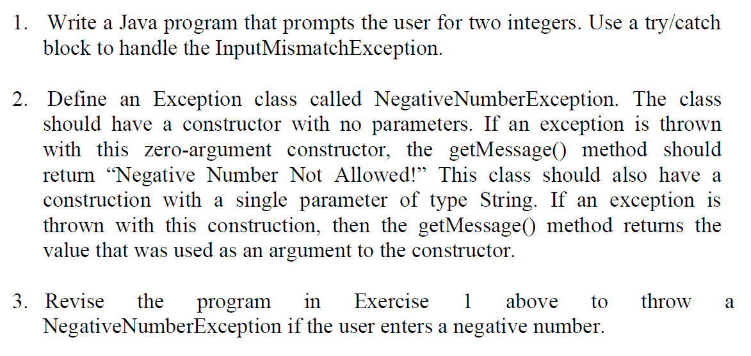
Exception handling Exercise
4. Try to Put it in a while-loop and ask the user input again if exception happen

Slide 19
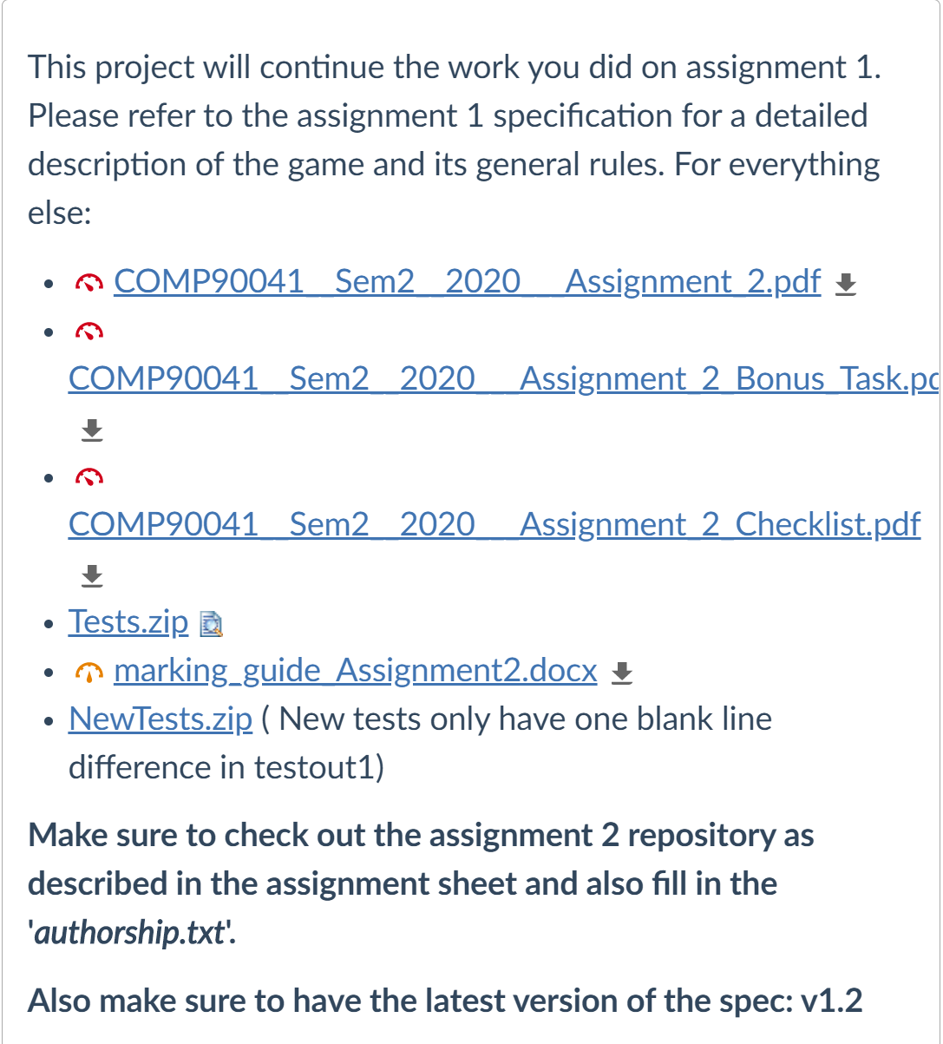
Assignment 2

Slide 20
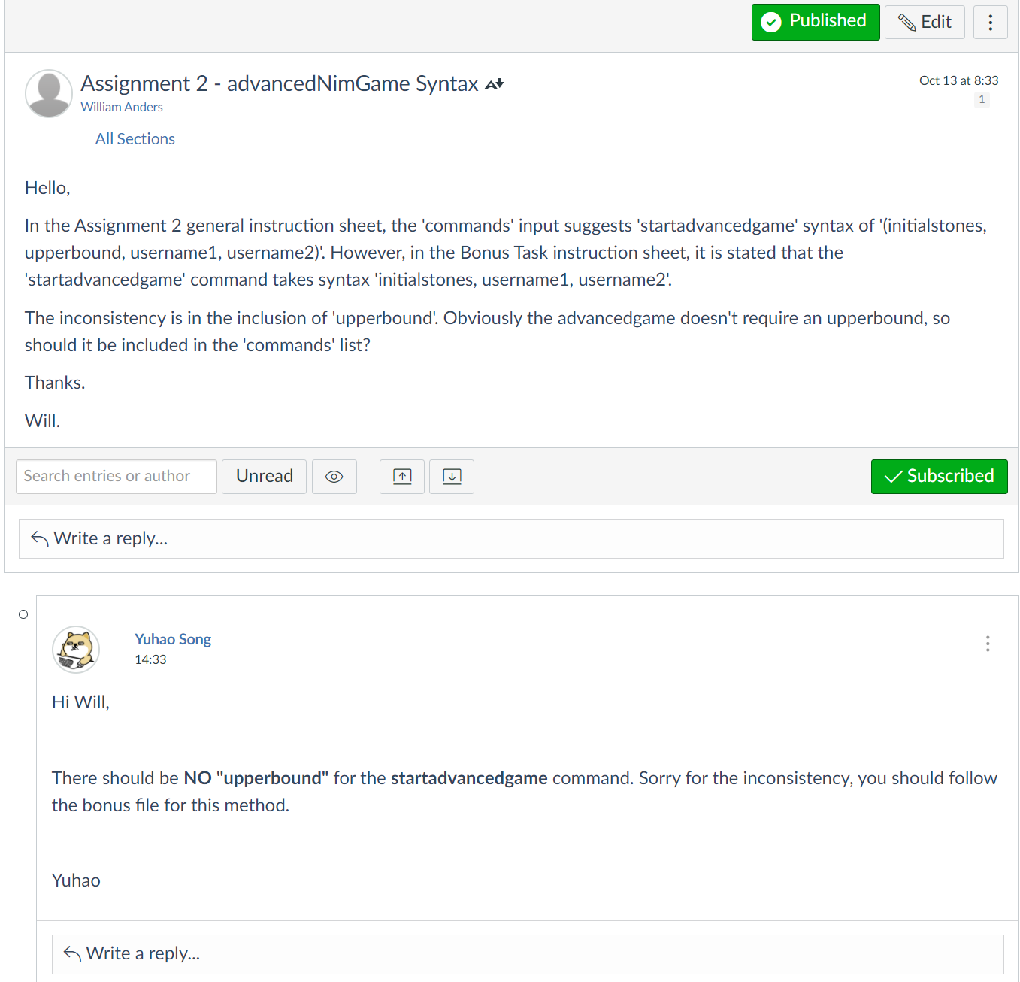
Inconsistency for startadvancedgame
For the advanced game, the method should not include “upperbound”. (Follow the bonus task pdf)
For marking purpose, there will be no deduction if you include the upperbound parameter in your commands list

