Slide 1


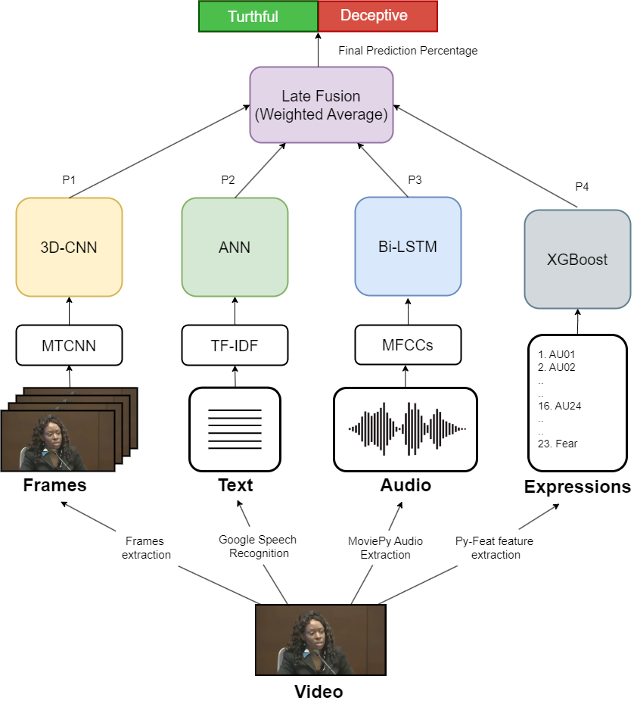

Multimodal Deception Detection
System
By: Doaa Yehia, Medhat Essam, Mena Ashraf,
Mohamed Moawad, Reem Ayman, Rodayna Mohamed
Supervised by: Prof. Dr. Salsabil Amin, TA. Zeina Rayan
Faculty of Computer and Information Sciences - Ain Shams University
Introduction
Deception involves actions intended to mislead, conceal the truth, or promote false beliefs. Detecting deception is critical in security-sensitive areas like police investigations and airport security.
Traditional methods, such as polygraph tests, require skin-contact devices and human expertise, making the impractical and susceptible to human error and bias. Moreover, offenders can employ countermeasures to deceive these methods.
Learning-based approaches using text, speech, and facial expressions have been proposed to address these limitations.
Research indicates that micro expressions —brief, involuntary facial movements— are significant indicators of deception. Modern systems have integrated multiple modalities, combining text, audio, and visual data to enhance detection accuracy.
Our research aims to develop a multimodal deception detection system leveraging video, audio, linguistic features from text, and micro-expressions. This comprehensive
approach addresses the limitations of traditional methods and offers a robust solution for detecting deceptive behavior in critical settings.
Methods
Dataset:
To evaluate our deception detection model, we utilized a real-life deception detection dataset. This dataset comprises 121 video clips of courtroom trials, with 61 clips classified as lies and the remaining 60 classified as truth.
The dataset is also combined with text transcripts for each video, additionally it is annotated with micro-expressions manually, however we chose to extract our own micro expressions to make our system fully automated.
Figure 2: System Architecture
Results
Table 1 summarizes our deception detection system's performance, comparing our best performing unimodal and multimodal approaches. The results highlight the superiority of multimodal methods, especially majority voting, improving accuracy from 87.5% (best unimodal) to 95.8% (best multimodal).
Unimodal Results
Modality | Video |  | Expressions |  | Text | Audio
Model | 3D-CNN |  | XGBoost |  | ANN | Bi-LSTM
Accuracy | 87.5% |  | 75% |  | 79.1% | 79.1%
Multimodal Results
Late Fusion Technique | Weighted average | Majority Voting |  | Weighted average |  | Majority Voting | Majority Voting
Features | A+V+T | A+V+T |  | A+V+T+E |  | A+V+T+E | A+V+T+E
Accuracy | 91.6% | 95.8% |  | 87.5% |  | 91.6% | 91.6%
Figure 1: Dataset screenshots
Implementation:
Video Frames Modality:
Lie detection via video utilizes involuntary facial expressions, eye movements, and body gestures. We used MTCNN for face detection and experimented with CNN-LSTM and 3D CNN architectures, combining spatial and temporal features for classification.
Micro Expressions Modality:
Using Py-Feat, we extracted mean Action Units and emotions from each video and employed machine learning classifiers (SVM, Decision Tree, Random Forest, XGBoost) to detect deceptive cues, as neural networks were prone to overfitting.
Text Modality:
We used TF-IDF to vectorize textual data and employed machine learning algorithms (SVM, SGD, XGBoost) and a basic ANN with two hidden layers to detect deceptive patterns. Complex models like RNNs and Transformers were unsuitable due to overfitting risks with such a small amount of data.
Audio Modality:
MFCCs were used to analyze vocal cues such as pitch, tone, and speech pace. We experimented with RNN-based architectures (GRUs, LSTMs, Bidirectional LSTMs) for classification.
Data Fusion:
Combining information from multiple modalities enhances accuracy and understanding. In the proposed system, we utilized output level fusion (late fusion).
Table 1: Results summary
Conclusions
The multimodal deception detection system we developed shows promising results and significant advancements over traditional methods. By leveraging AI and integrating multiple data modalities, our system provides a more accurate and unbiased means of detecting deception. However, it may not perform as well in real-world scenarios outside courtroom contexts due to being trained on a small dataset of only 121 videos.
Bibliography
[1] Perez-Rosas, V., Abouelenien, M., Mihalcea, R., Burzo, M.: Deception detection using real-life trial data. In: Proceedings of the 2015 ACM on International Conference on Multimodal Interaction, ACM (2015).
̧[2] Sen, M.U., Perez-Rosas, V., Yanikoglu, B., Abouelenien, M., Burzo, M. and Mihalcea, R., 2020. Multimodal deception detection using real-life trial data. IEEE Transactions on Affective Computing, 13(1), pp.306-319.
[3] Ahmed, H.U.D., Bajwa, U.I., Zhang, F. and Anwar, M.W., 2021. Deception detection in videos using the facial action coding system. arXiv preprint arXiv:2105.13659.
[4] Krishnamurthy, G., Majumder, N., Poria, S. and Cambria, E., 2018, March. A deep learning approach for multimodal deception detection. In International Conference on Computational Linguistics and Intelli gent Text Processing (pp. 87-96). Cham: Springer Nature Switzer land.

