Slide 1
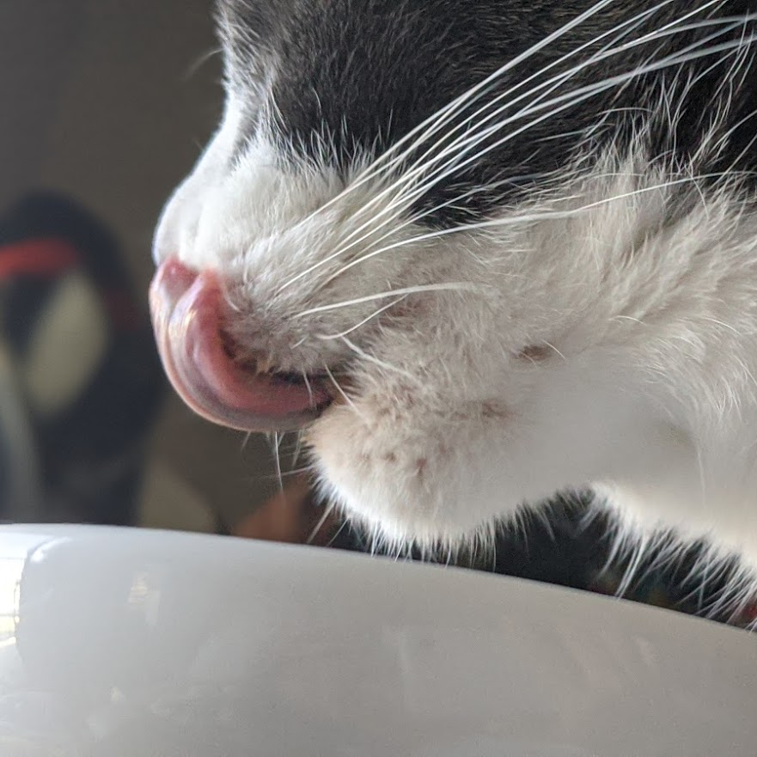
Tiny paw
MET CST 683 Final project
professor :Yuting zhang
Student:Jipeng liu

Slide 2
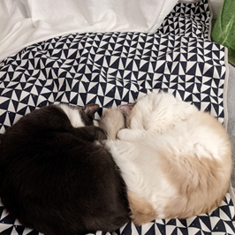
Introduction
Pet management android application
Pet body information
Pet food management
Feeding notes
Calorie intake calculator
Food intake suggestion
Synchronize with cloud

Slide 3
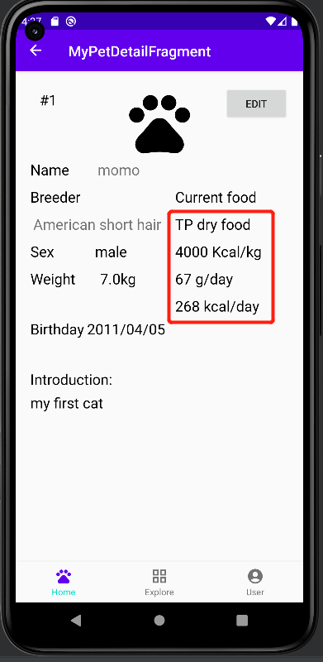
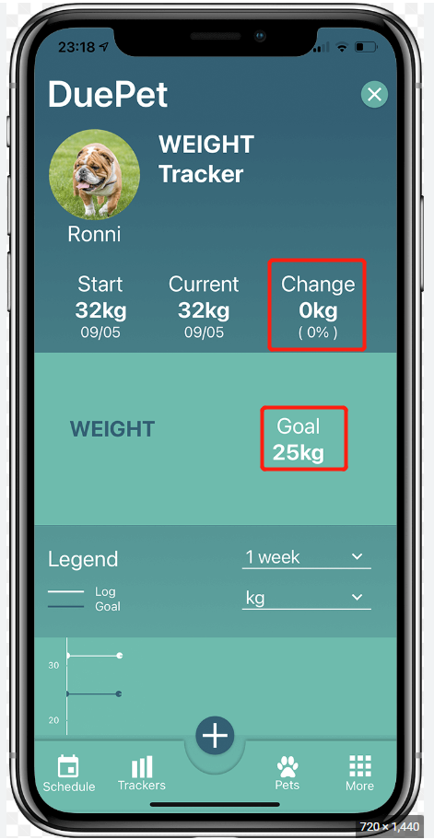
Differences
Tiny Paw
Due Pet

Slide 4
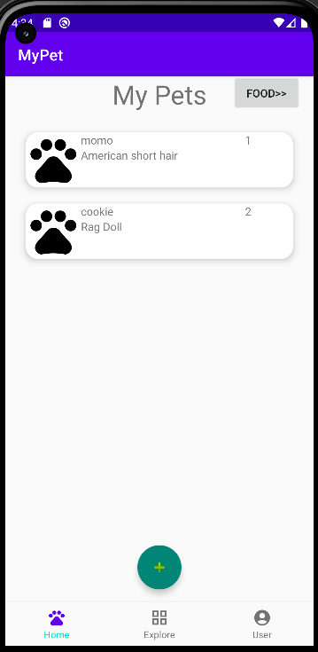
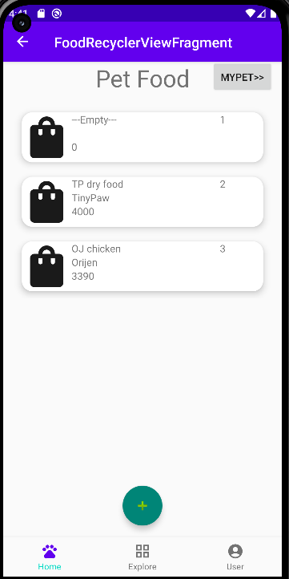
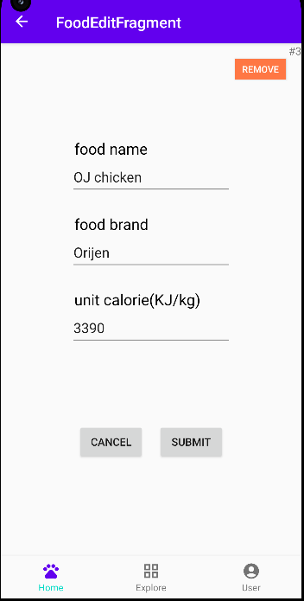
Product – food management
Home page
Multiple food list
Food edit page

Slide 5
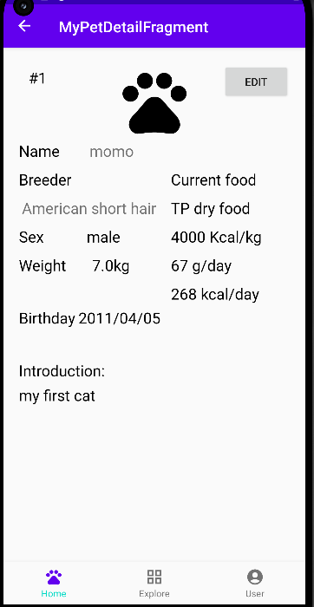
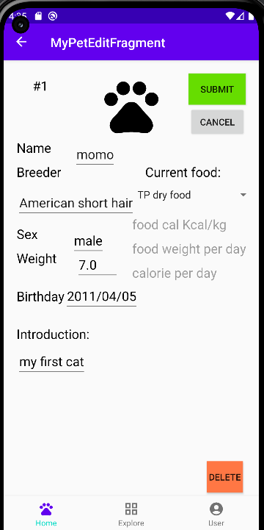
Product - Pet body info
Food
Spinner
Home page
Pet detail page
Pet edit page

Slide 6
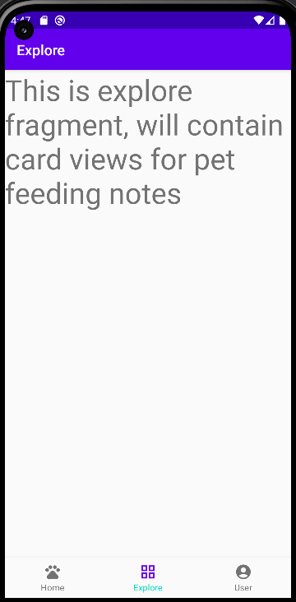
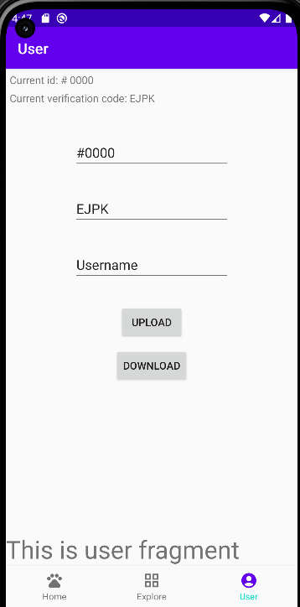
Product – Unfinished
Home page
Notes list
User syn page

Slide 7
Demo
https://youtu.be/grhCP9pN8Ck

Slide 8
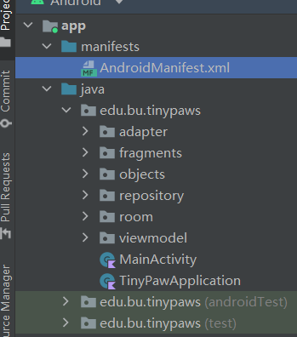
Structure
1 activity class
1 application class
MVVM structure
Room database

Slide 9
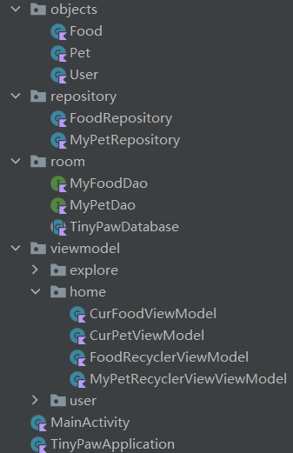
Structure
Objects: data class
Room: Dao & database
LiveData
Repository
Viewmodel

Slide 10
Android feature
Bottom navigation bar
Recycler view
Button
Spinner

Slide 11
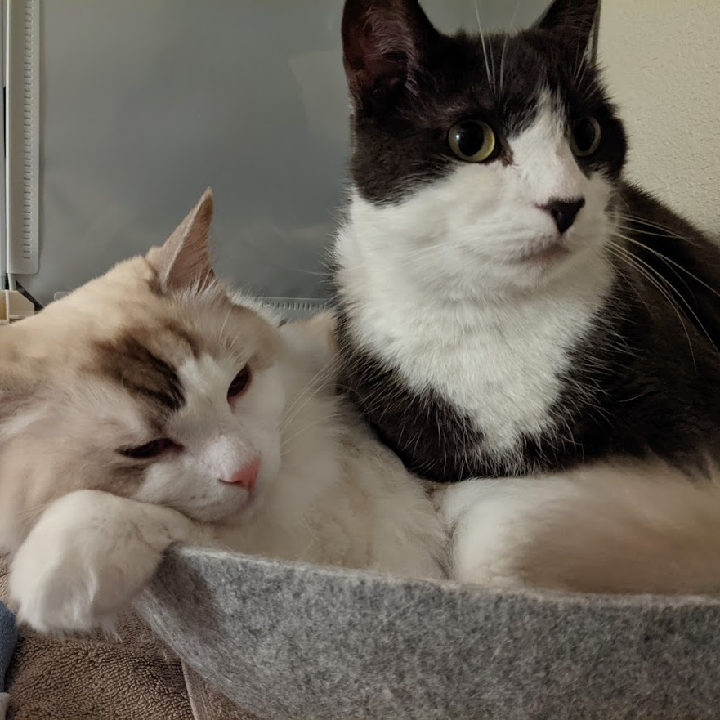
Thank you! Questions?
MET CST 683 Final project
professor : Yuting zhang
Student: Jipeng liu

