Slide 1
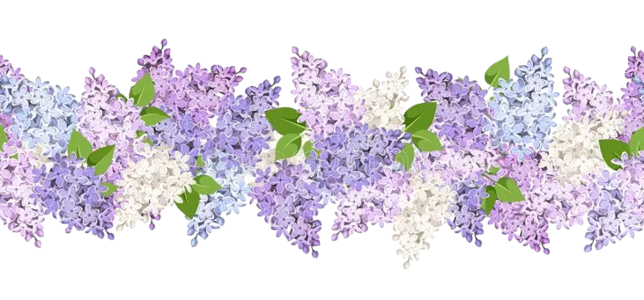
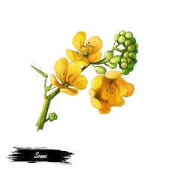

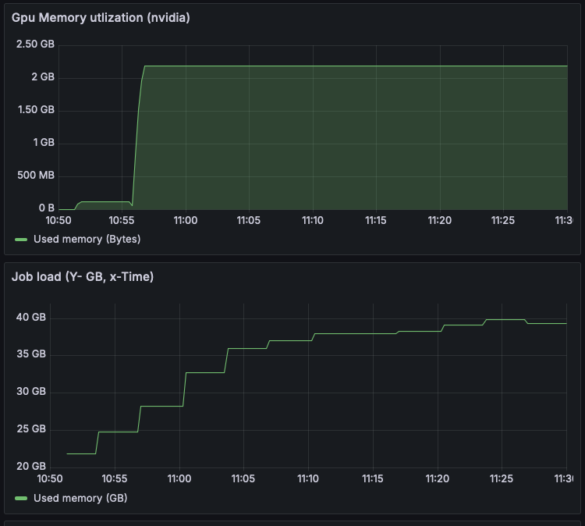
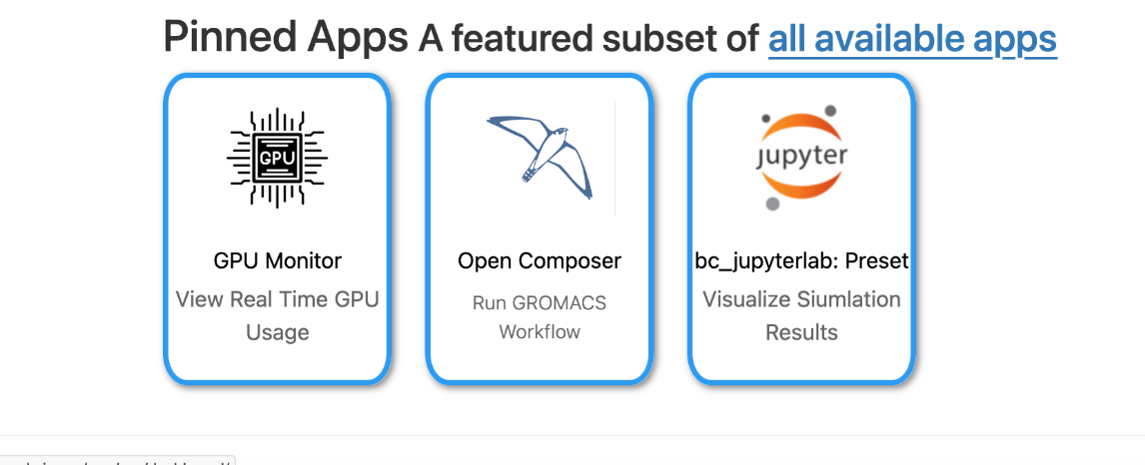
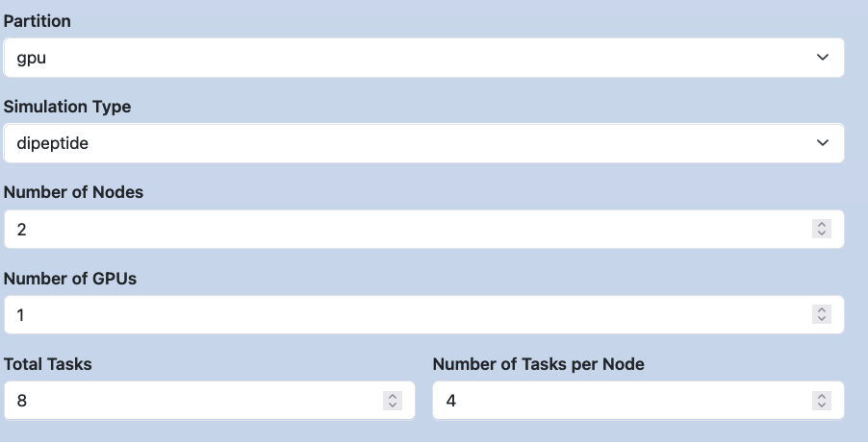


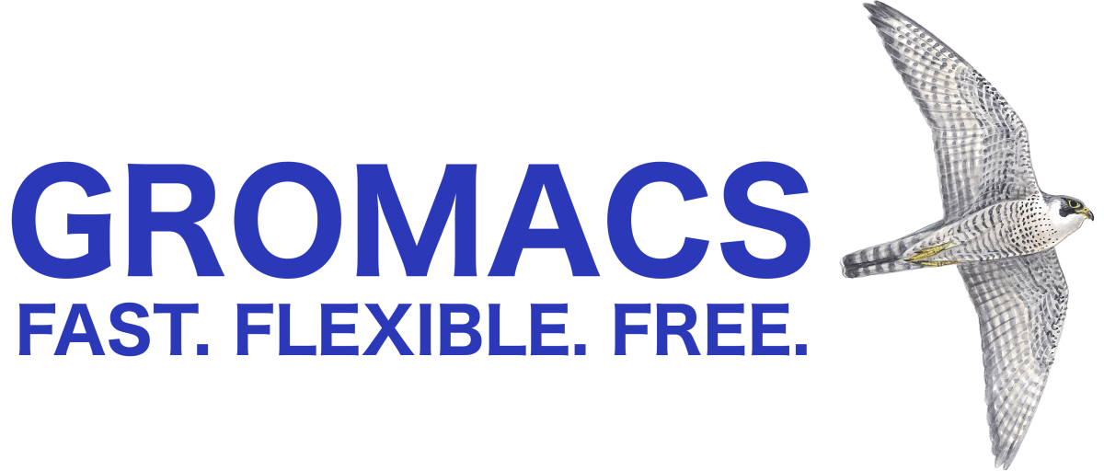

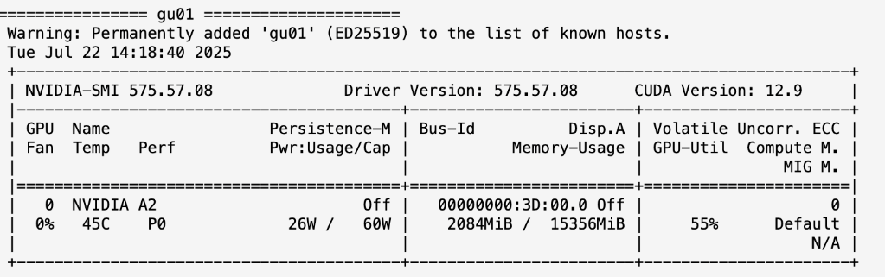
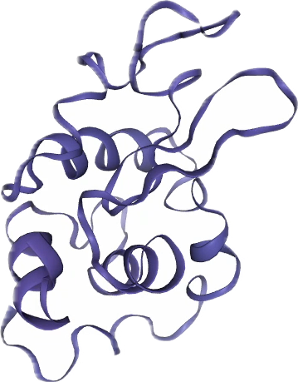
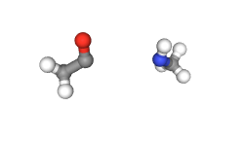






Reducing the Barrier of Entry for GPU Accelerated Workflows using Open OnDemand and Charliecloud Containers in HPC
Abhinav Kotta
Cornell University
abhinavkotta.io@gmail.com
Beamlak Bekele
University of Maryland Baltimore County
bekbeamlak@gmail.com
Kelsey Tirado
Rochester Institute of Technology
kelseytirado3@gmail.com
Mentors:
Jordan Ogas, Hunter Easterday, Angelica Loshak, and Andres Quan
Background
HPC systems enable powerful simulations but require complex command line skills to complete the job.
LANL lacks an accessible framework for integrating scientific workflows.
Time spent learning HPC tools can instead be used to focus on core parts of experiments.
GROMACS GPU Workflow
Monitoring
Starting on the fully customizable dashboard a user can easily navigate to the GROMACS workflow through the custom Open Composer application. The simulation is readily available for use. Select the dipeptide option and the sbatch script is automatically loaded in
Grafana monitoring for allocated resources per active job
Overview
Charliecloud
Slurm script
Grafana
Node exporter
Output script
#SBATCH --ntasks-per-node=4
#SBATCH -N2
#SBATCH --output=/home/admin/output.log
#SBATCH --error=/home/admin/error.log
cd /home/admin/GROMACS_workflow/dipeptide_simulation
PATH=/home/admin/charliecloud/bin:$PATH
cat << 'EOC' > container.sh
export GMX_ENABLE_DIRECT_GPU_COMM=1
export GMX_GPU_PME_DECOMPOSITION=1
export NVSHMEM_BOOTSTRAP=MPI
export GMXLIB=/usr/local/share/GROMACS/top
Slurm exporter
Prometheus
Nvidia exporter
The integration of Open OnDemand, JupyterLab, Charliecloud, GROMACS, and OpenComposer enables an accessible HPC workflow.
Simulations run in Charliecloud containers and are submitted as GPU jobs across two nodes.
Post-processing is done in JupyterLab using Python to visualize molecular trajectories.
Visualization
Once The job is complete the user launches a Jupyter Notebook which visualises the results. All the necessary code is preloaded into the application to allow for visualization of the data
Real time GPU monitoring showing raw logs from the compute nodes that are running an active job
Key Takeaways
Future Works
OOD provides a web-based, non-command line interface to users.
Job Composer provides a complete, sharable, repeatable turnkey simulation campaign for users.
All non-OOD software stack elements containerized and abstracted from users.
Replace Open Composer with a fully custom made application encased in Open OnDemand environment
Offer other scientific softwares through Open Composer
Make the GPU app more interactive
Integrate an automatic job submission functionality for repeatable runs
Trajectory of dipeptide molecules through a solvent
Generated image showing a protein (lysozyme) in a box of water, with ions
LA-UR 25-28155

