Slide 1
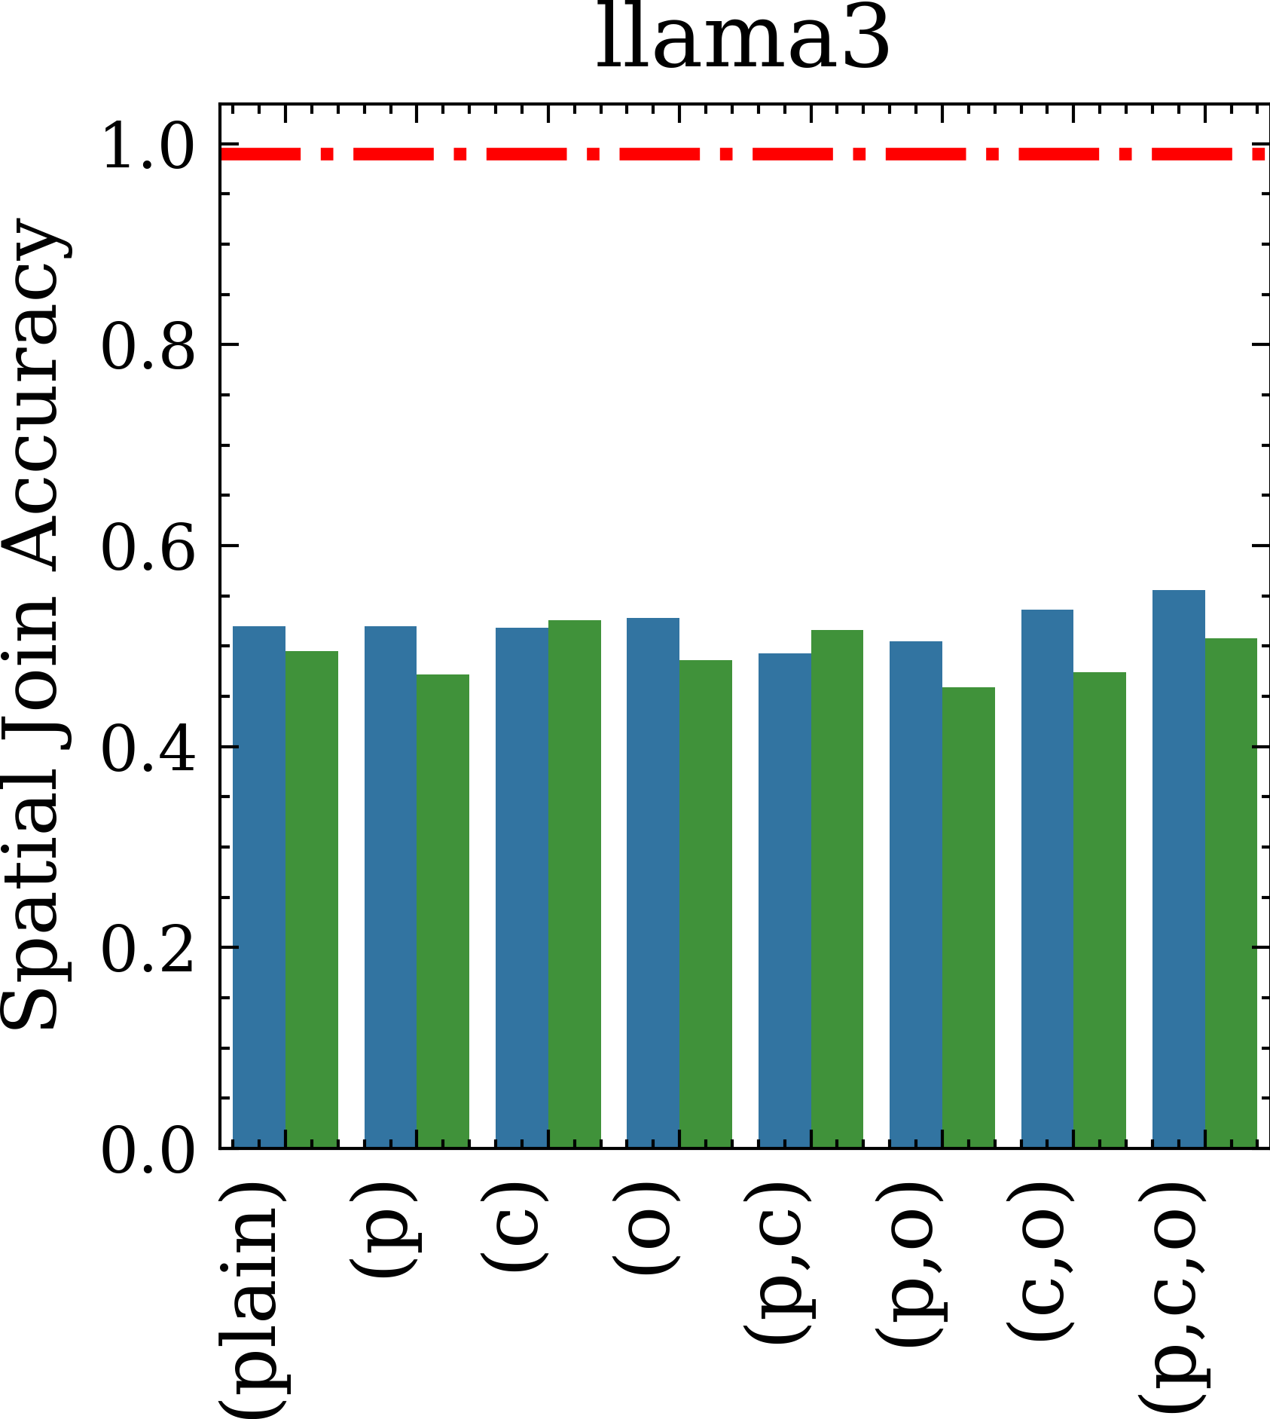
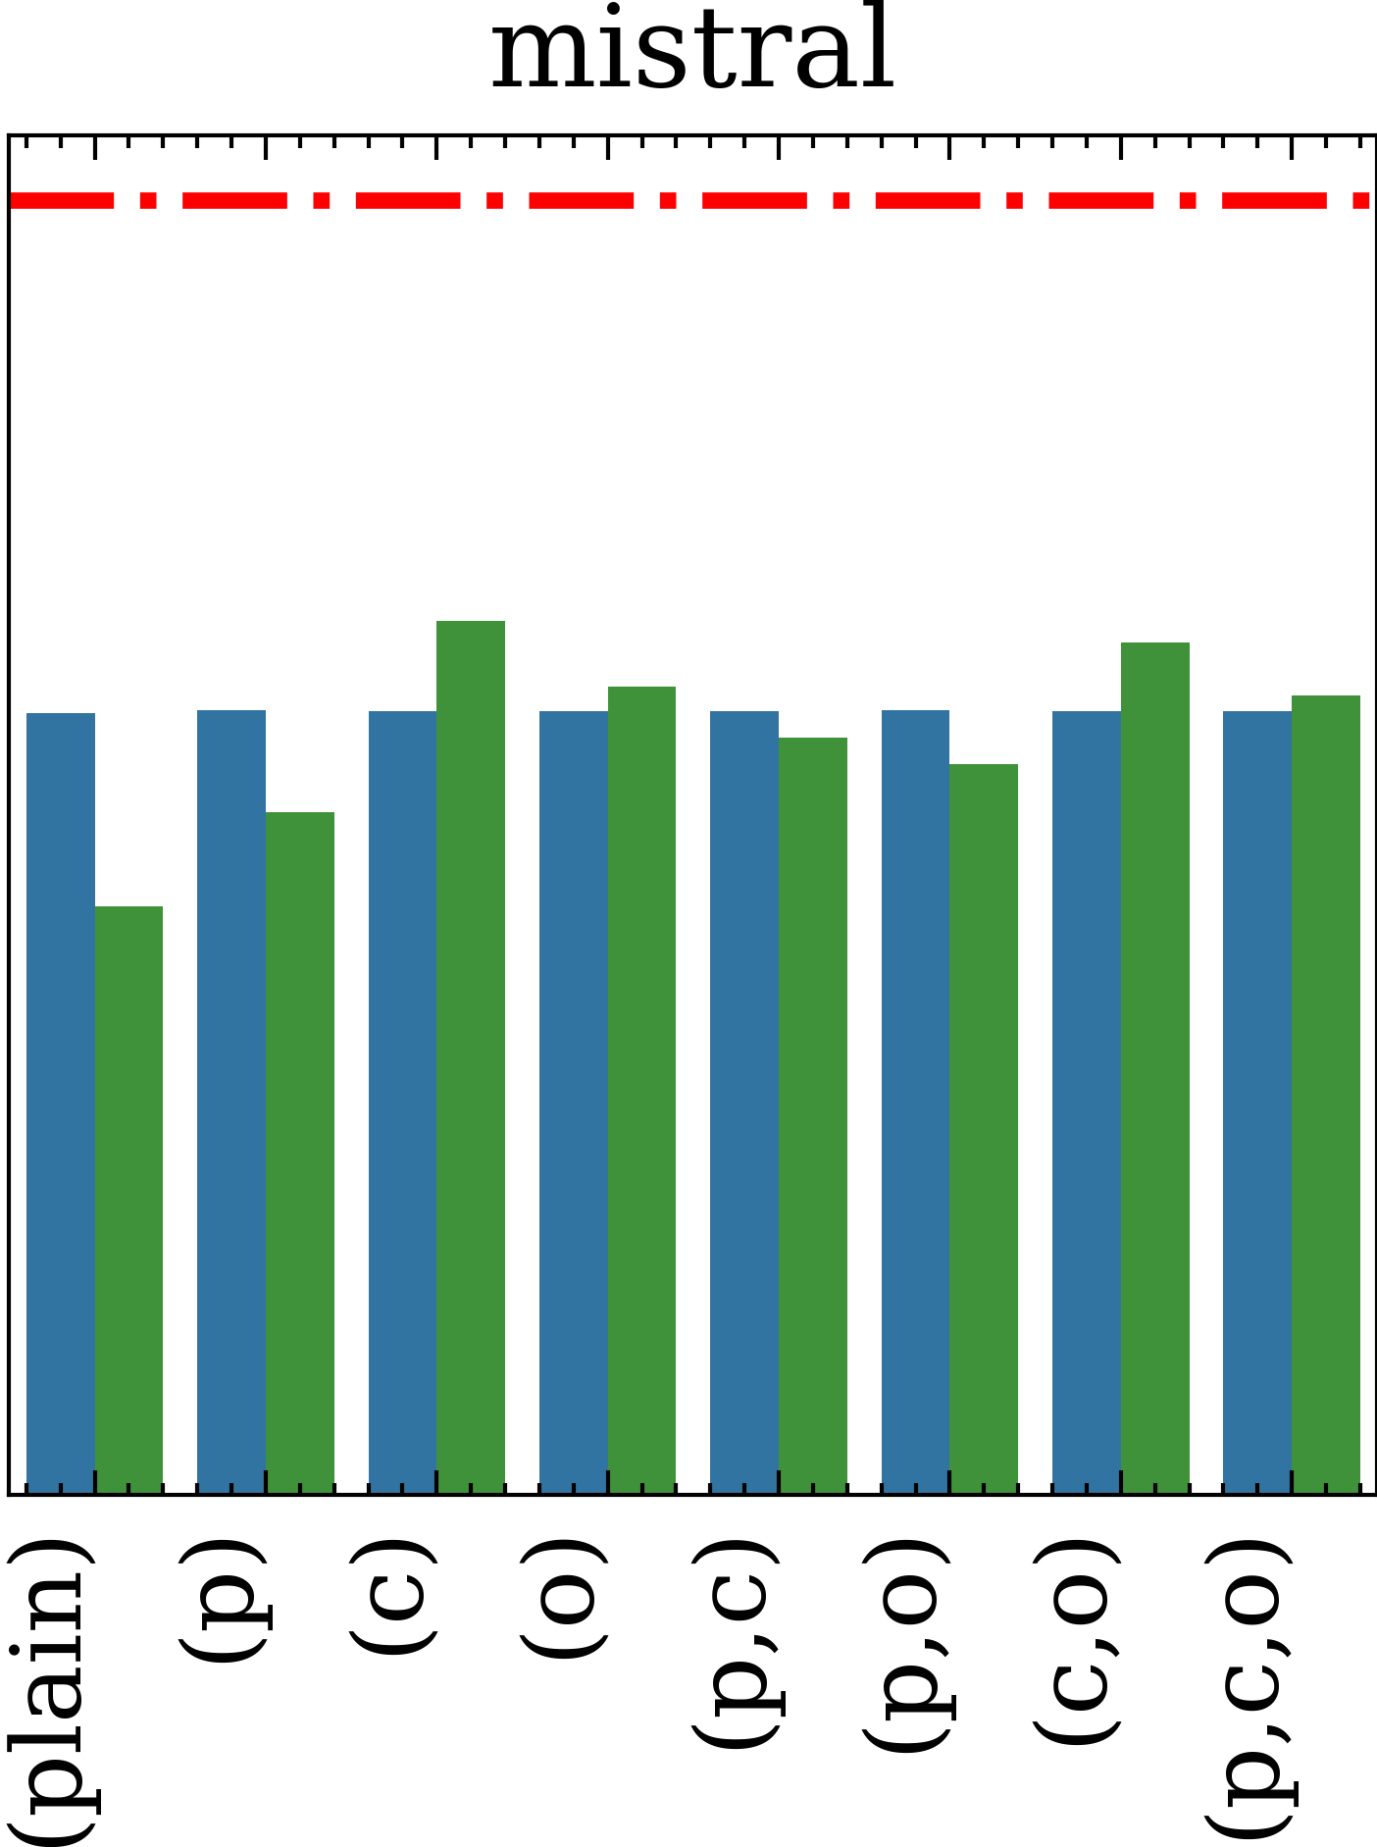
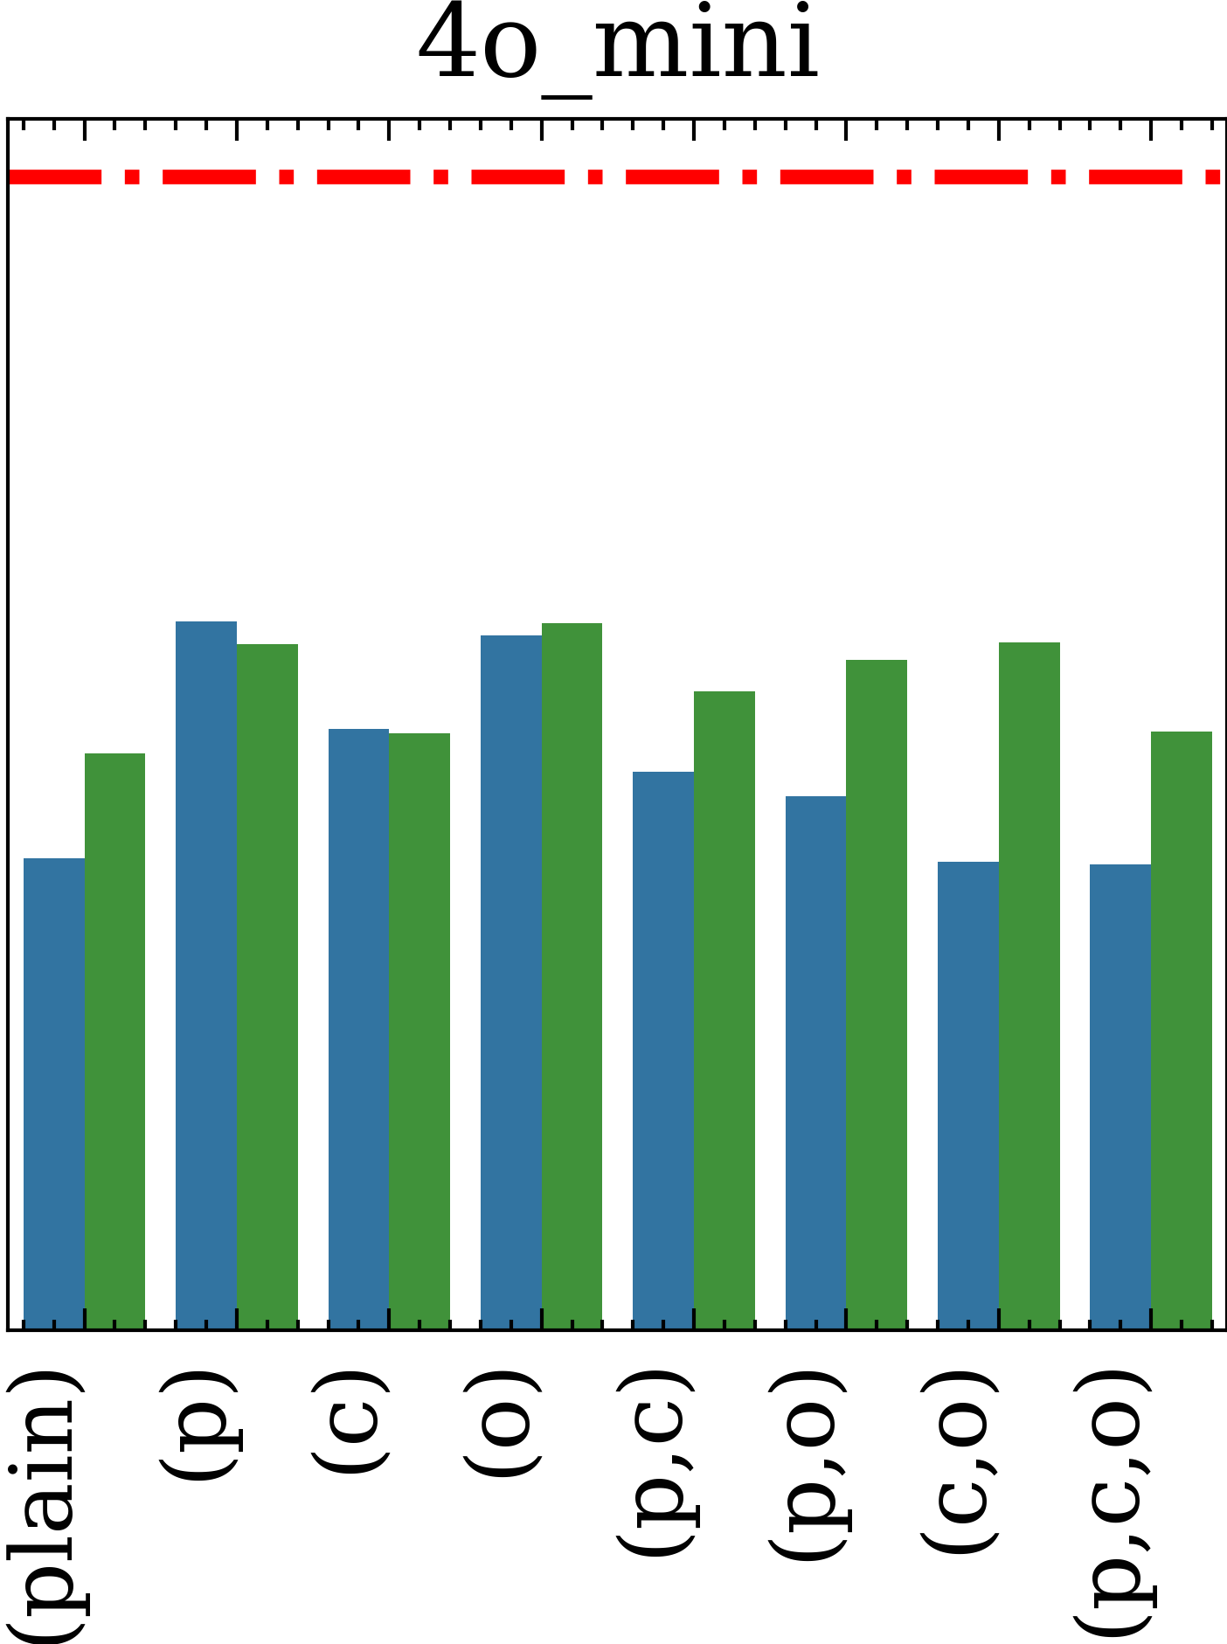
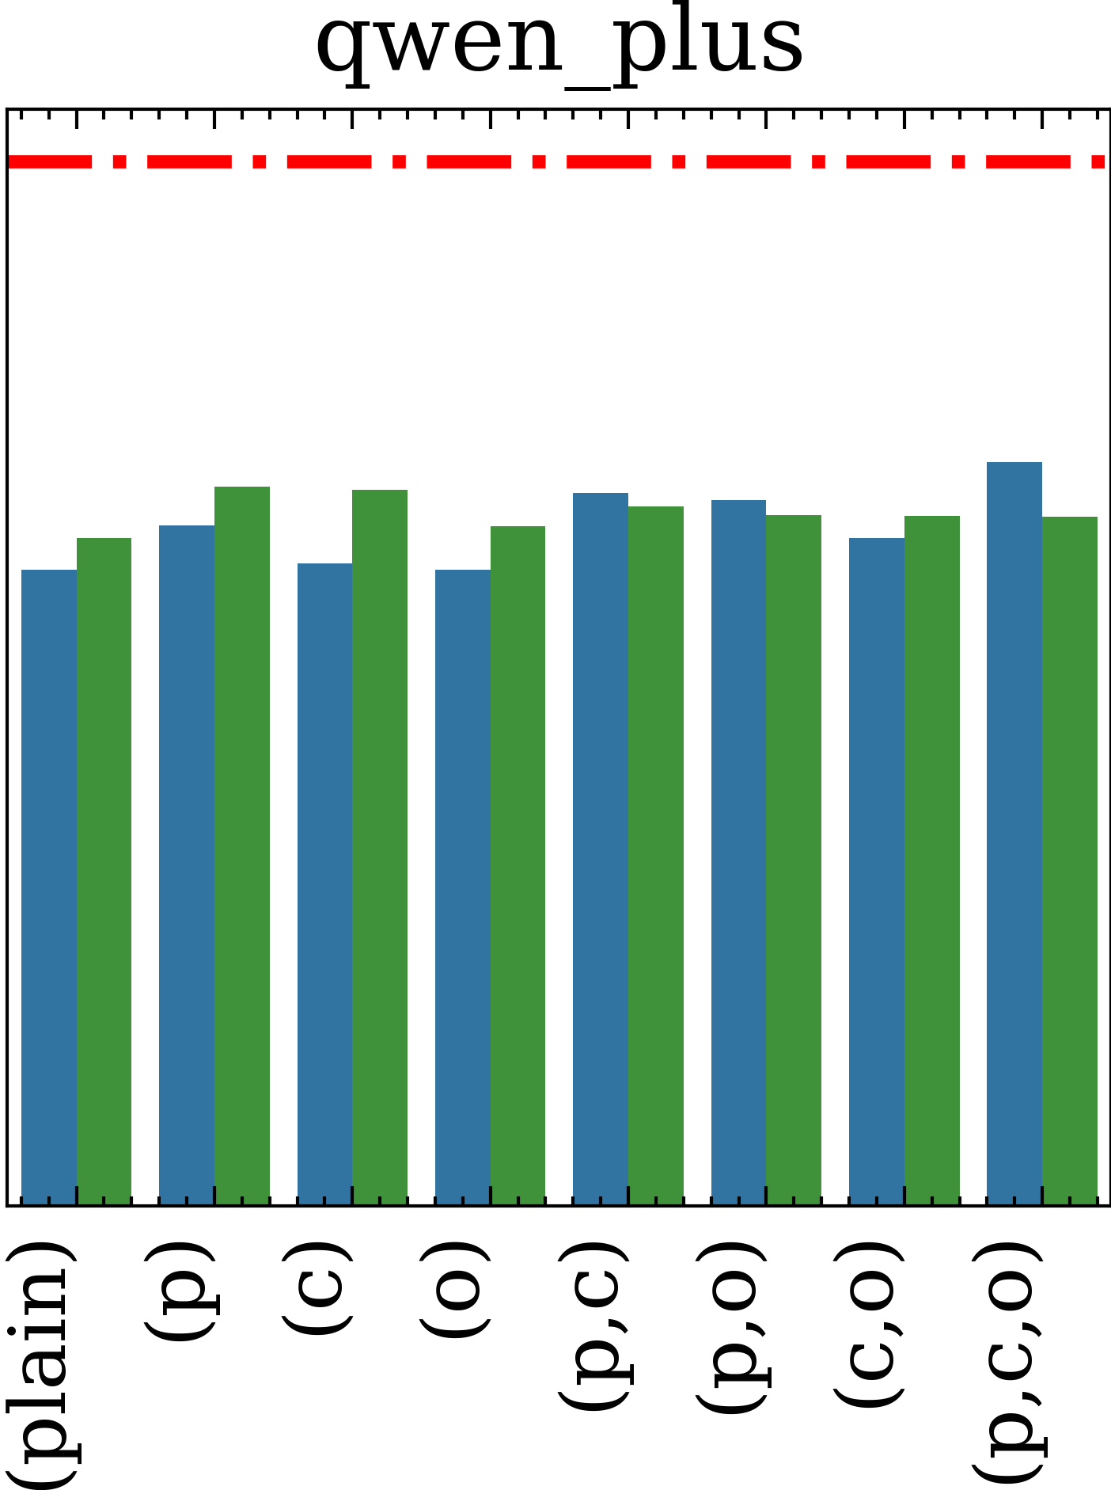
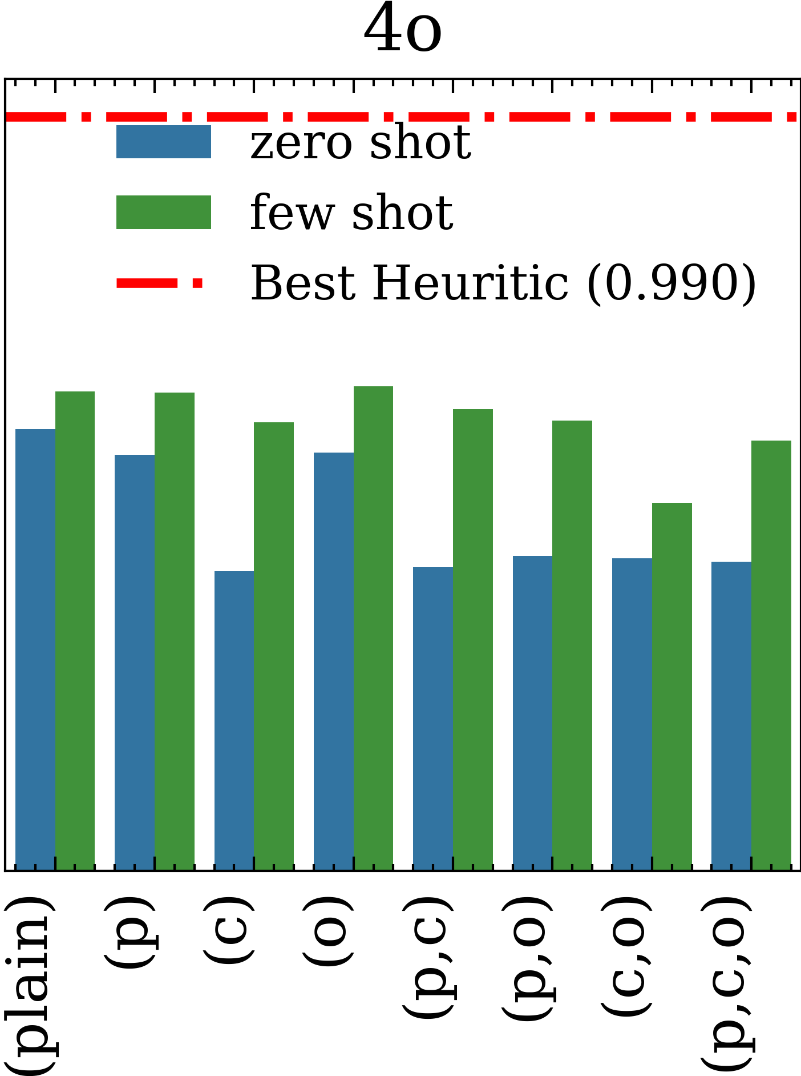

Slide 2
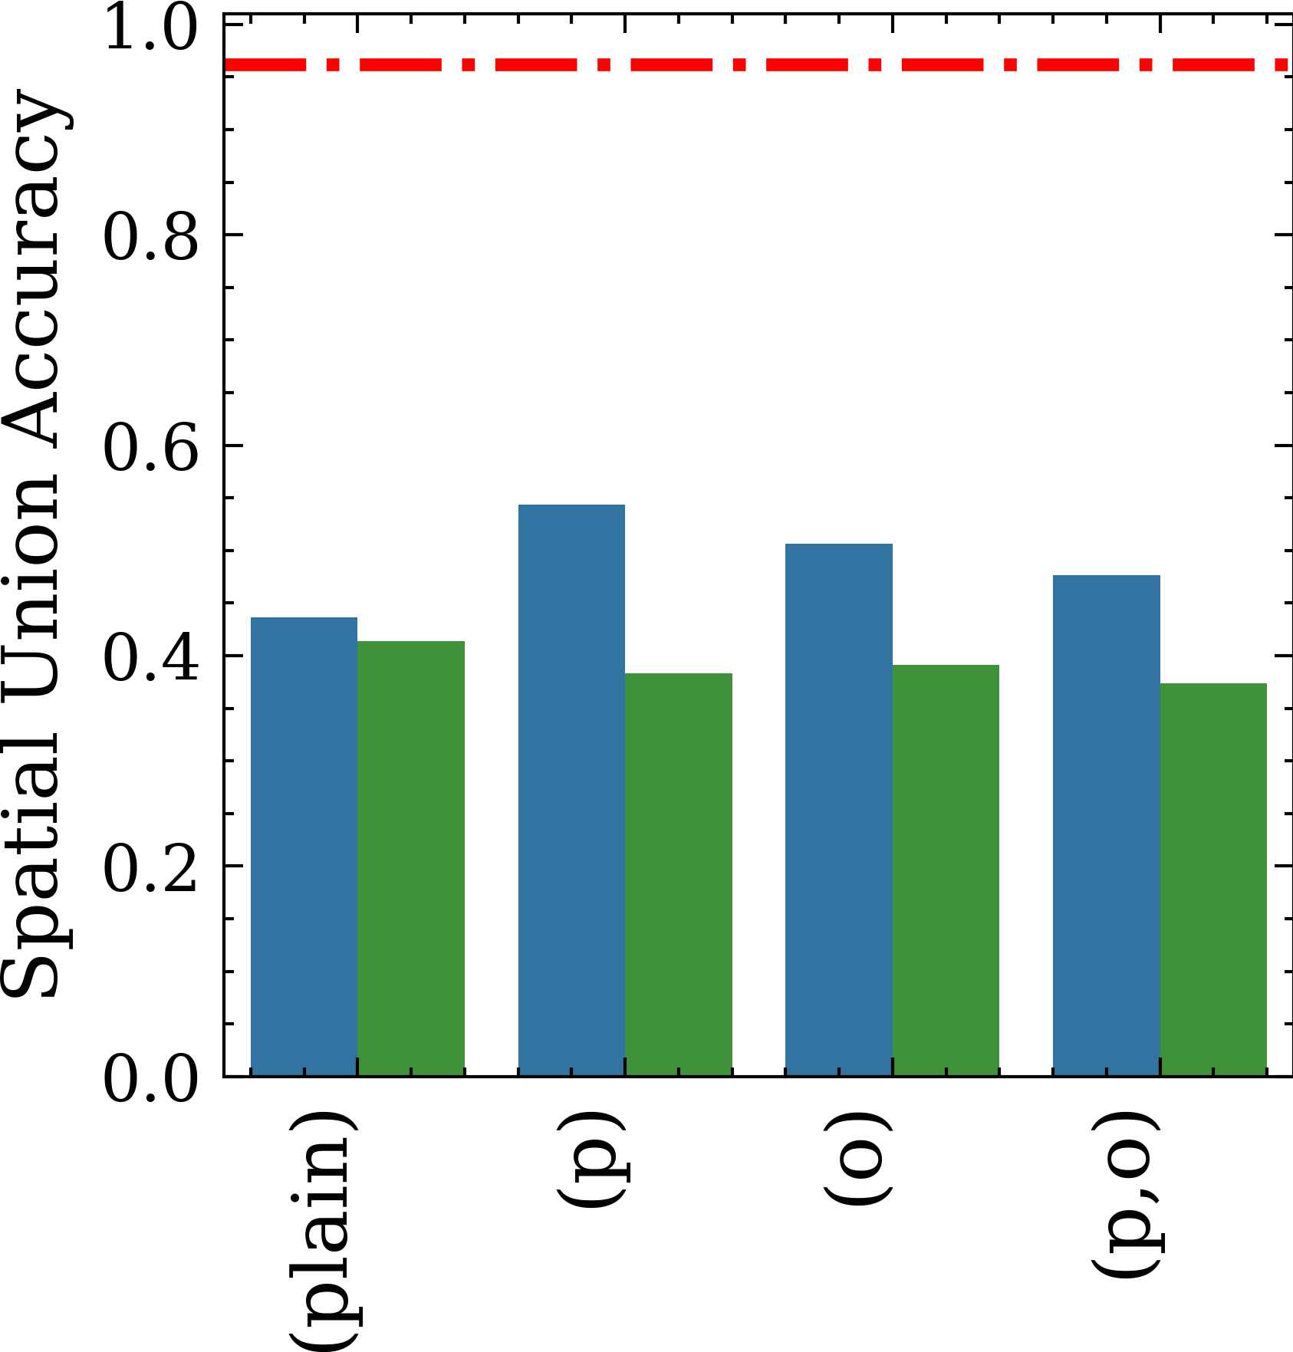
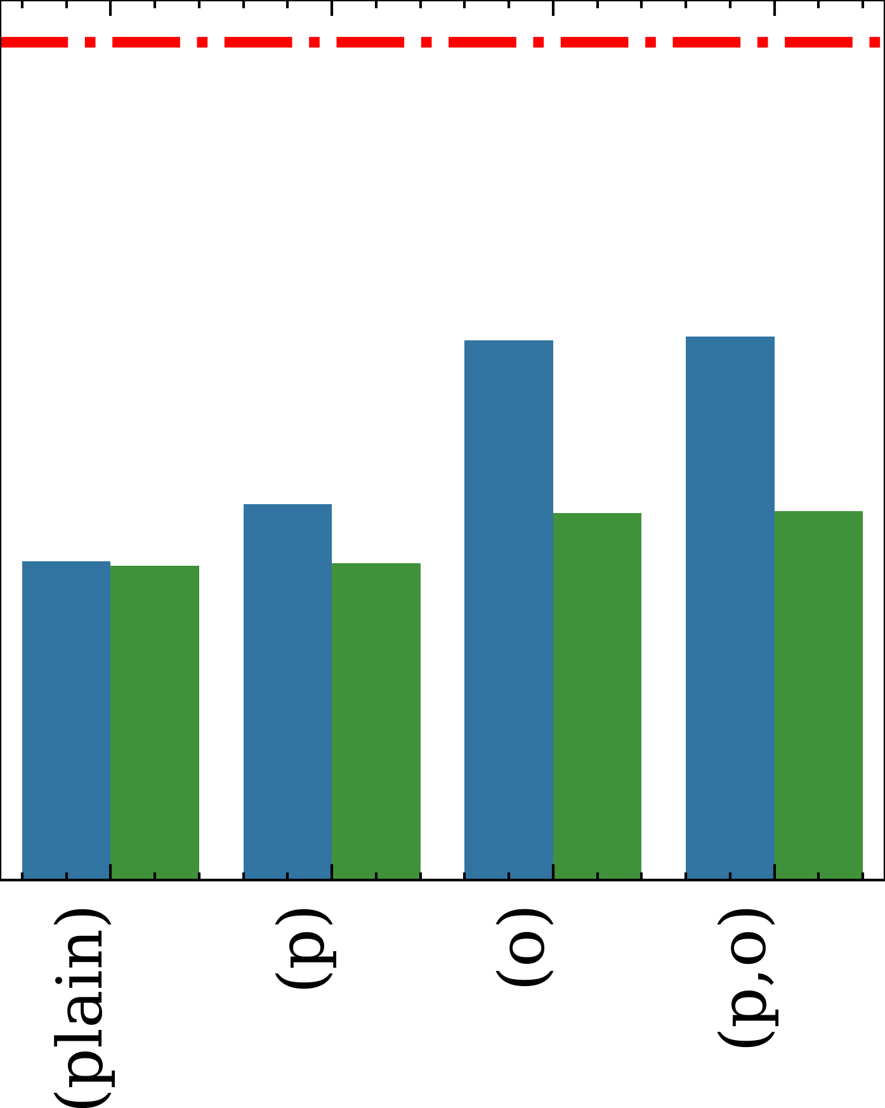
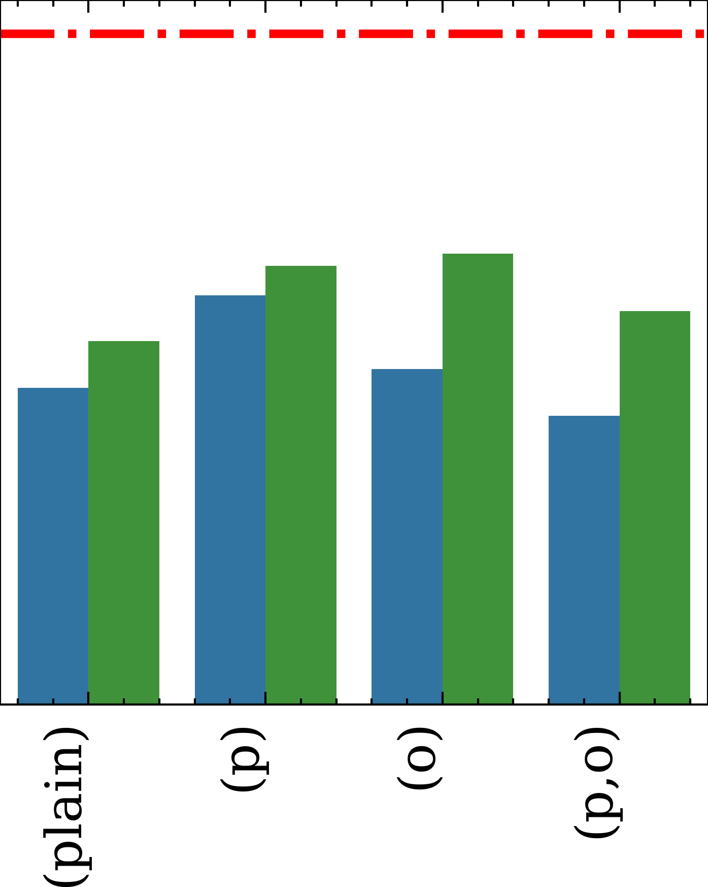
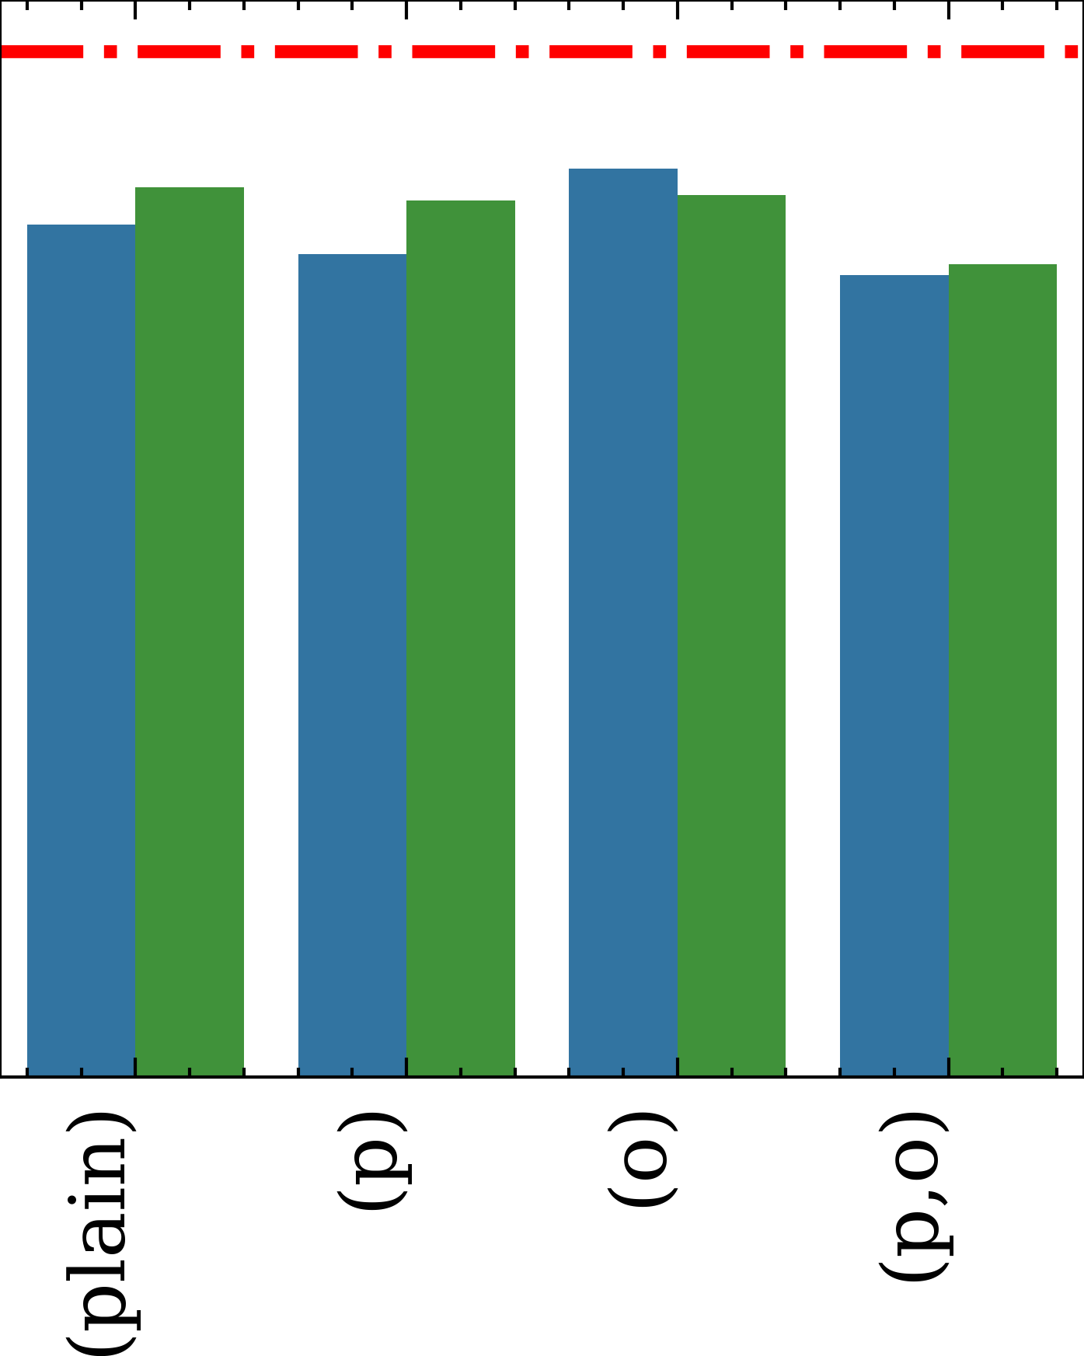
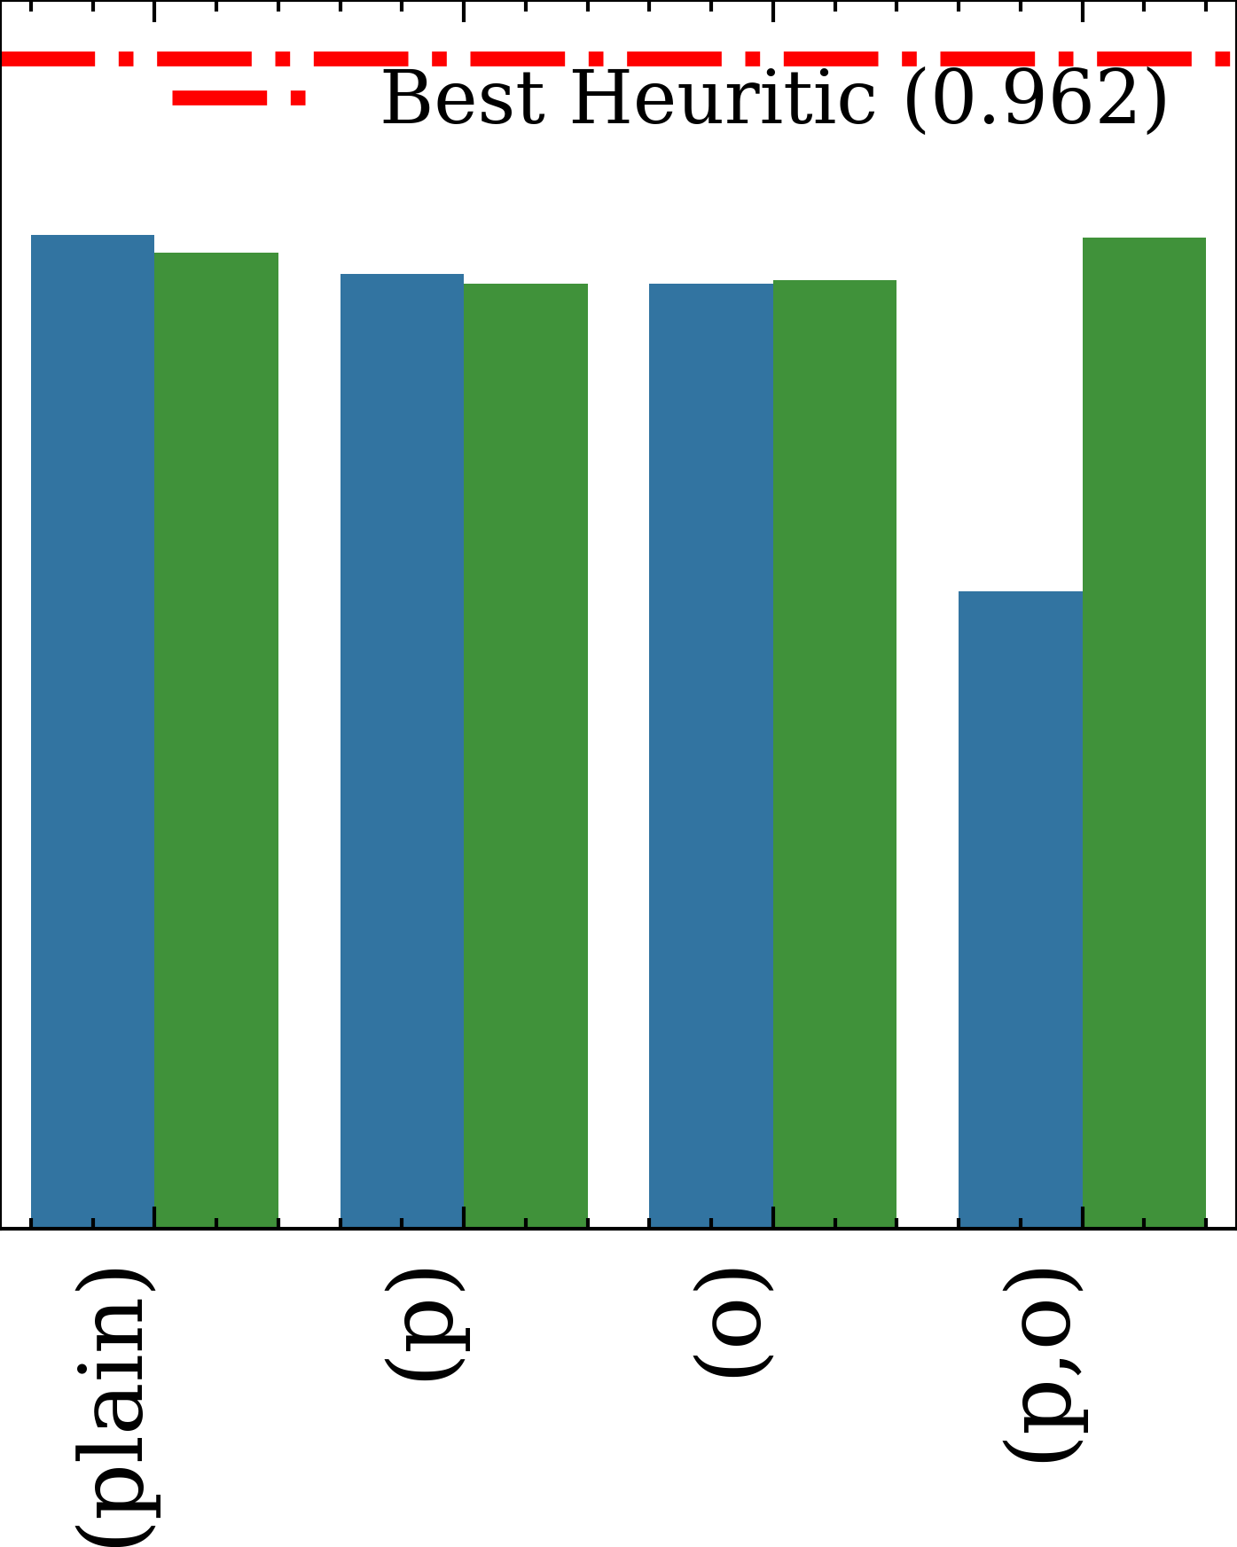

Slide 3
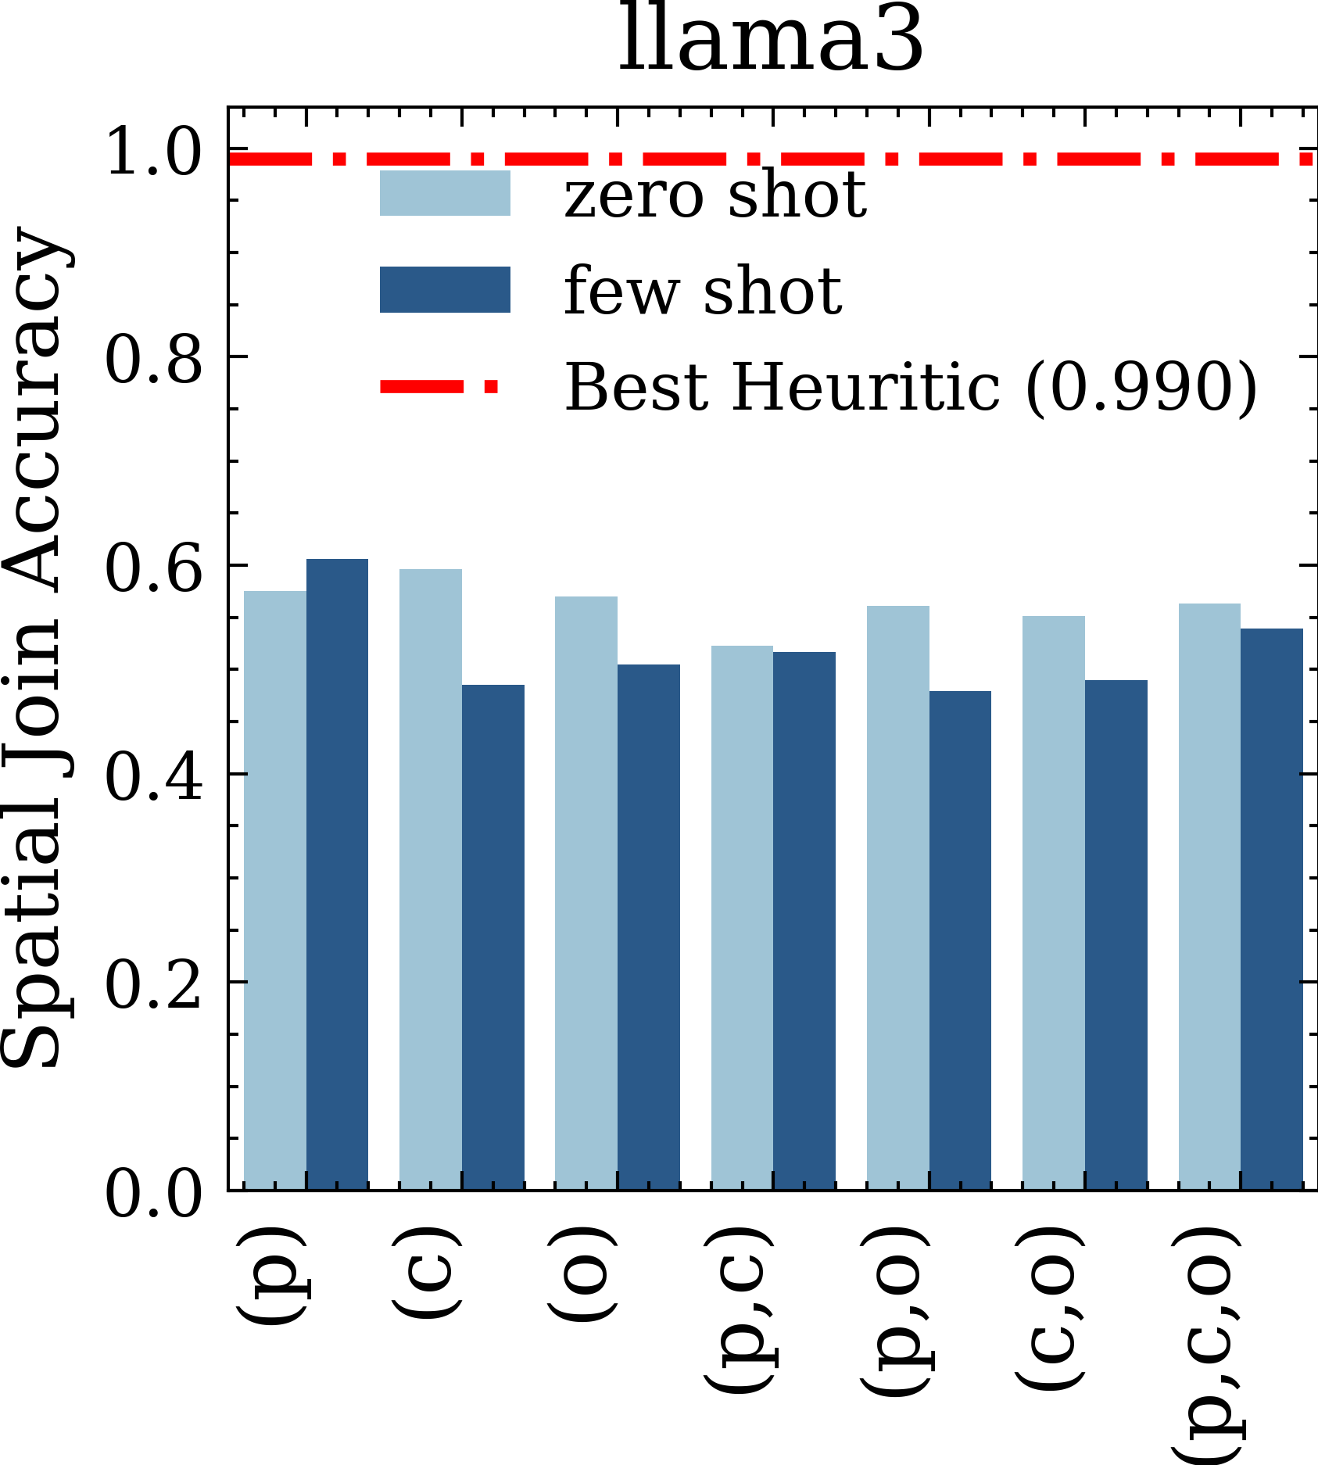
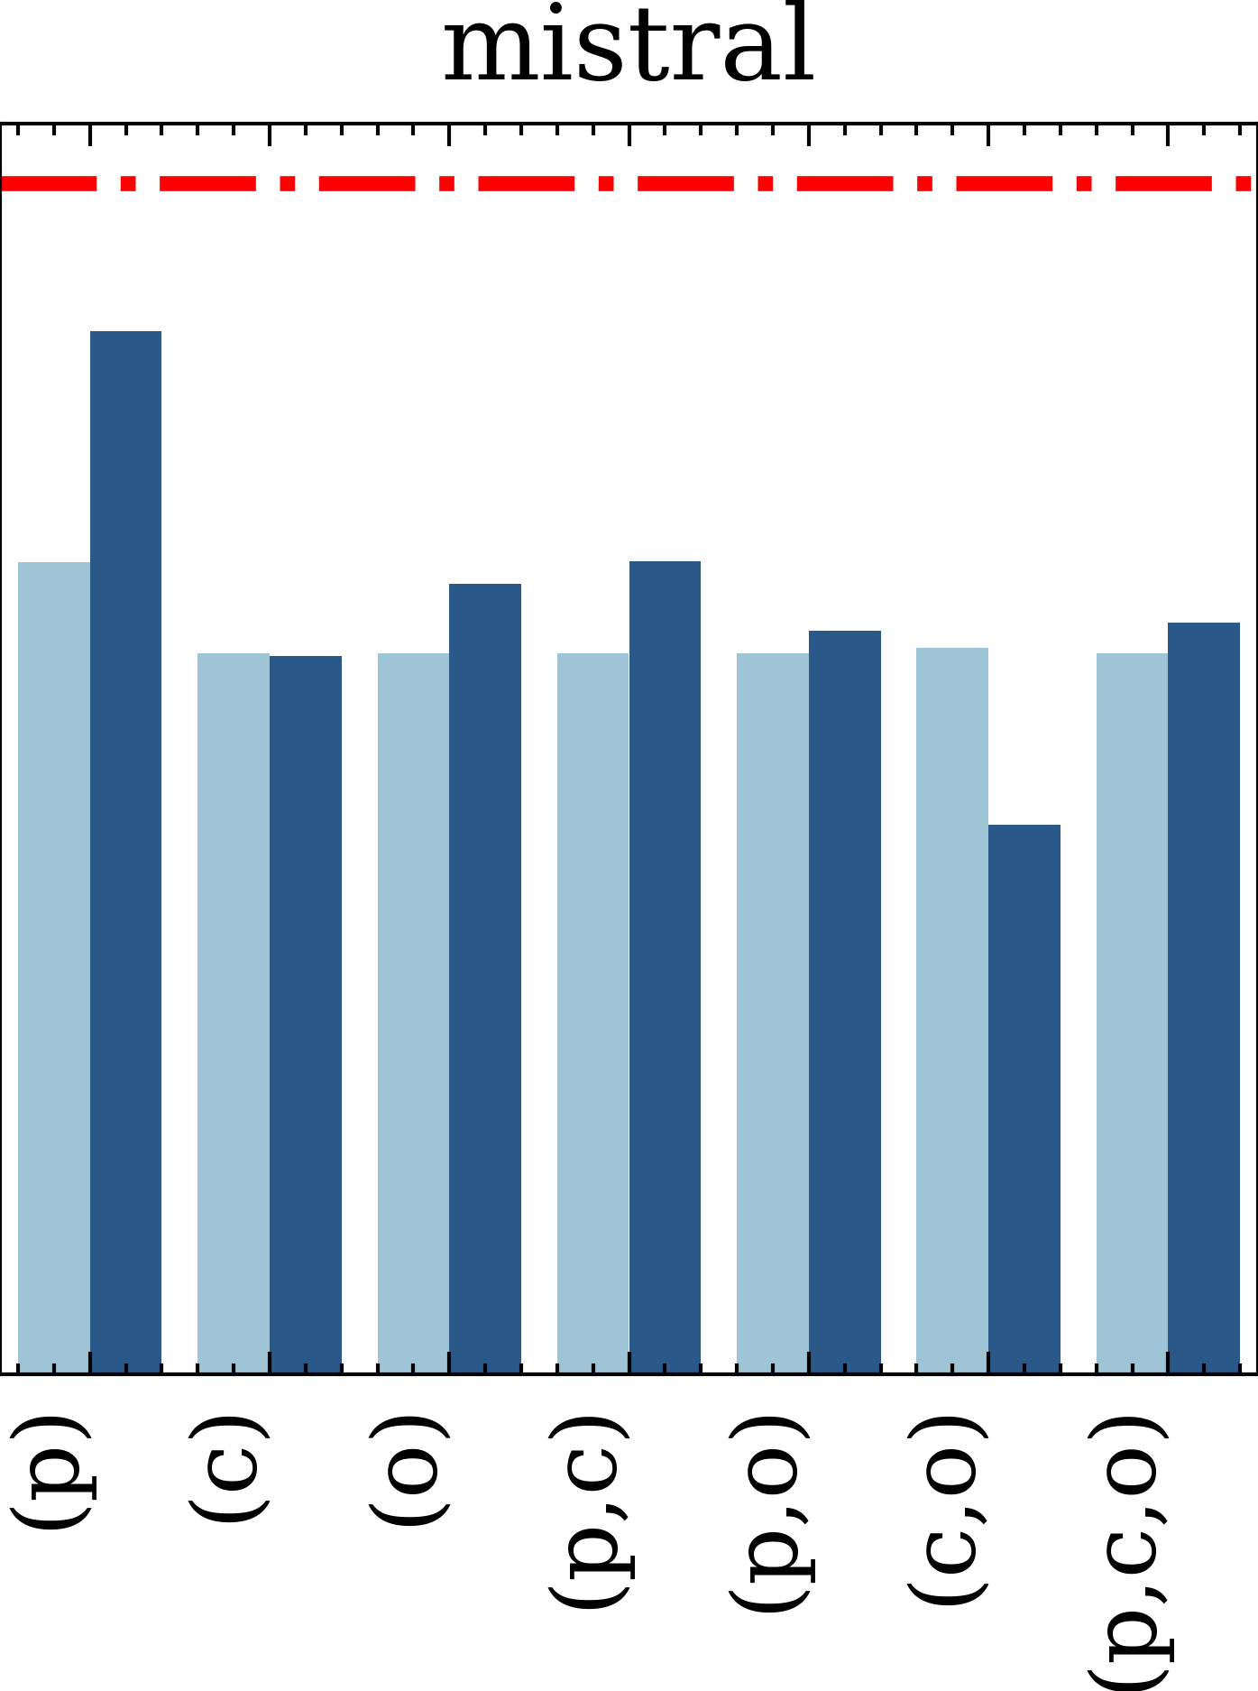
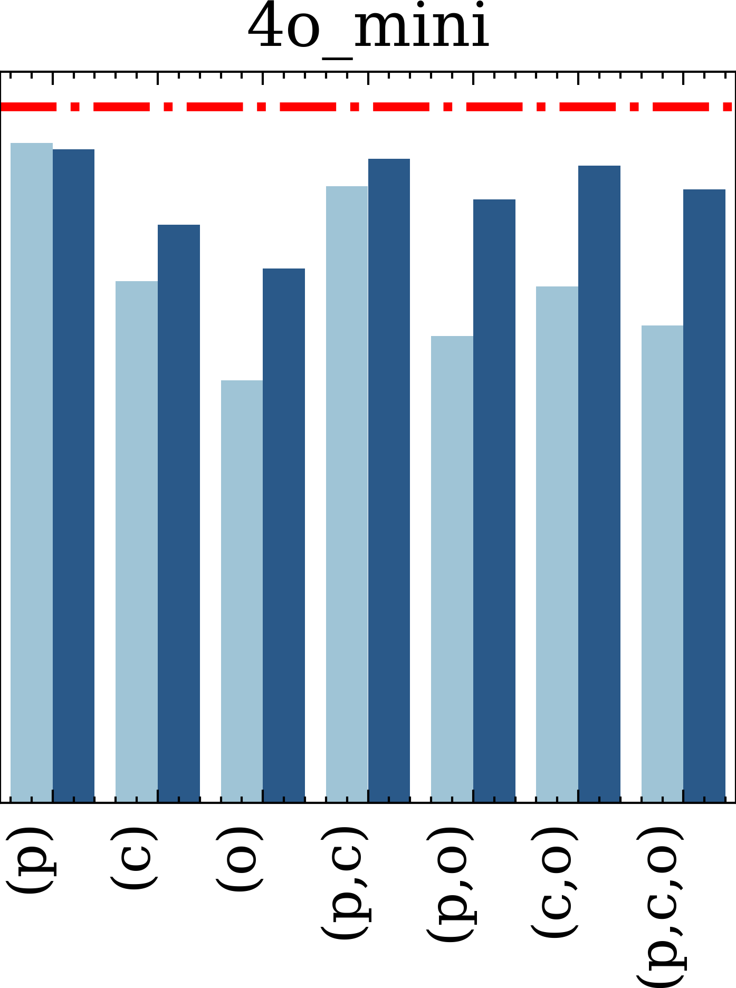
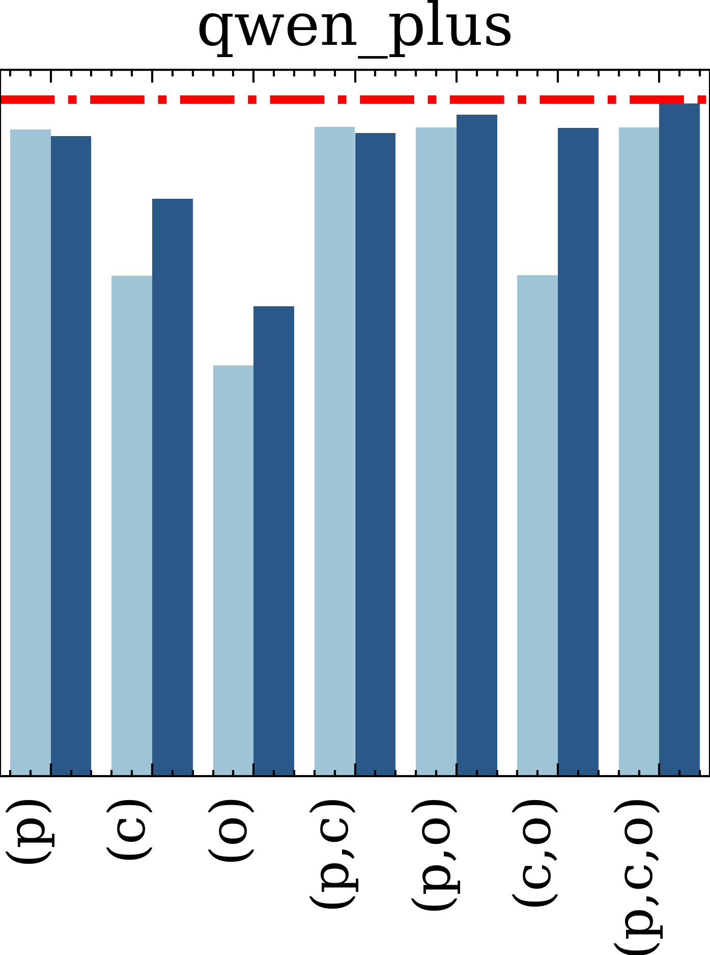
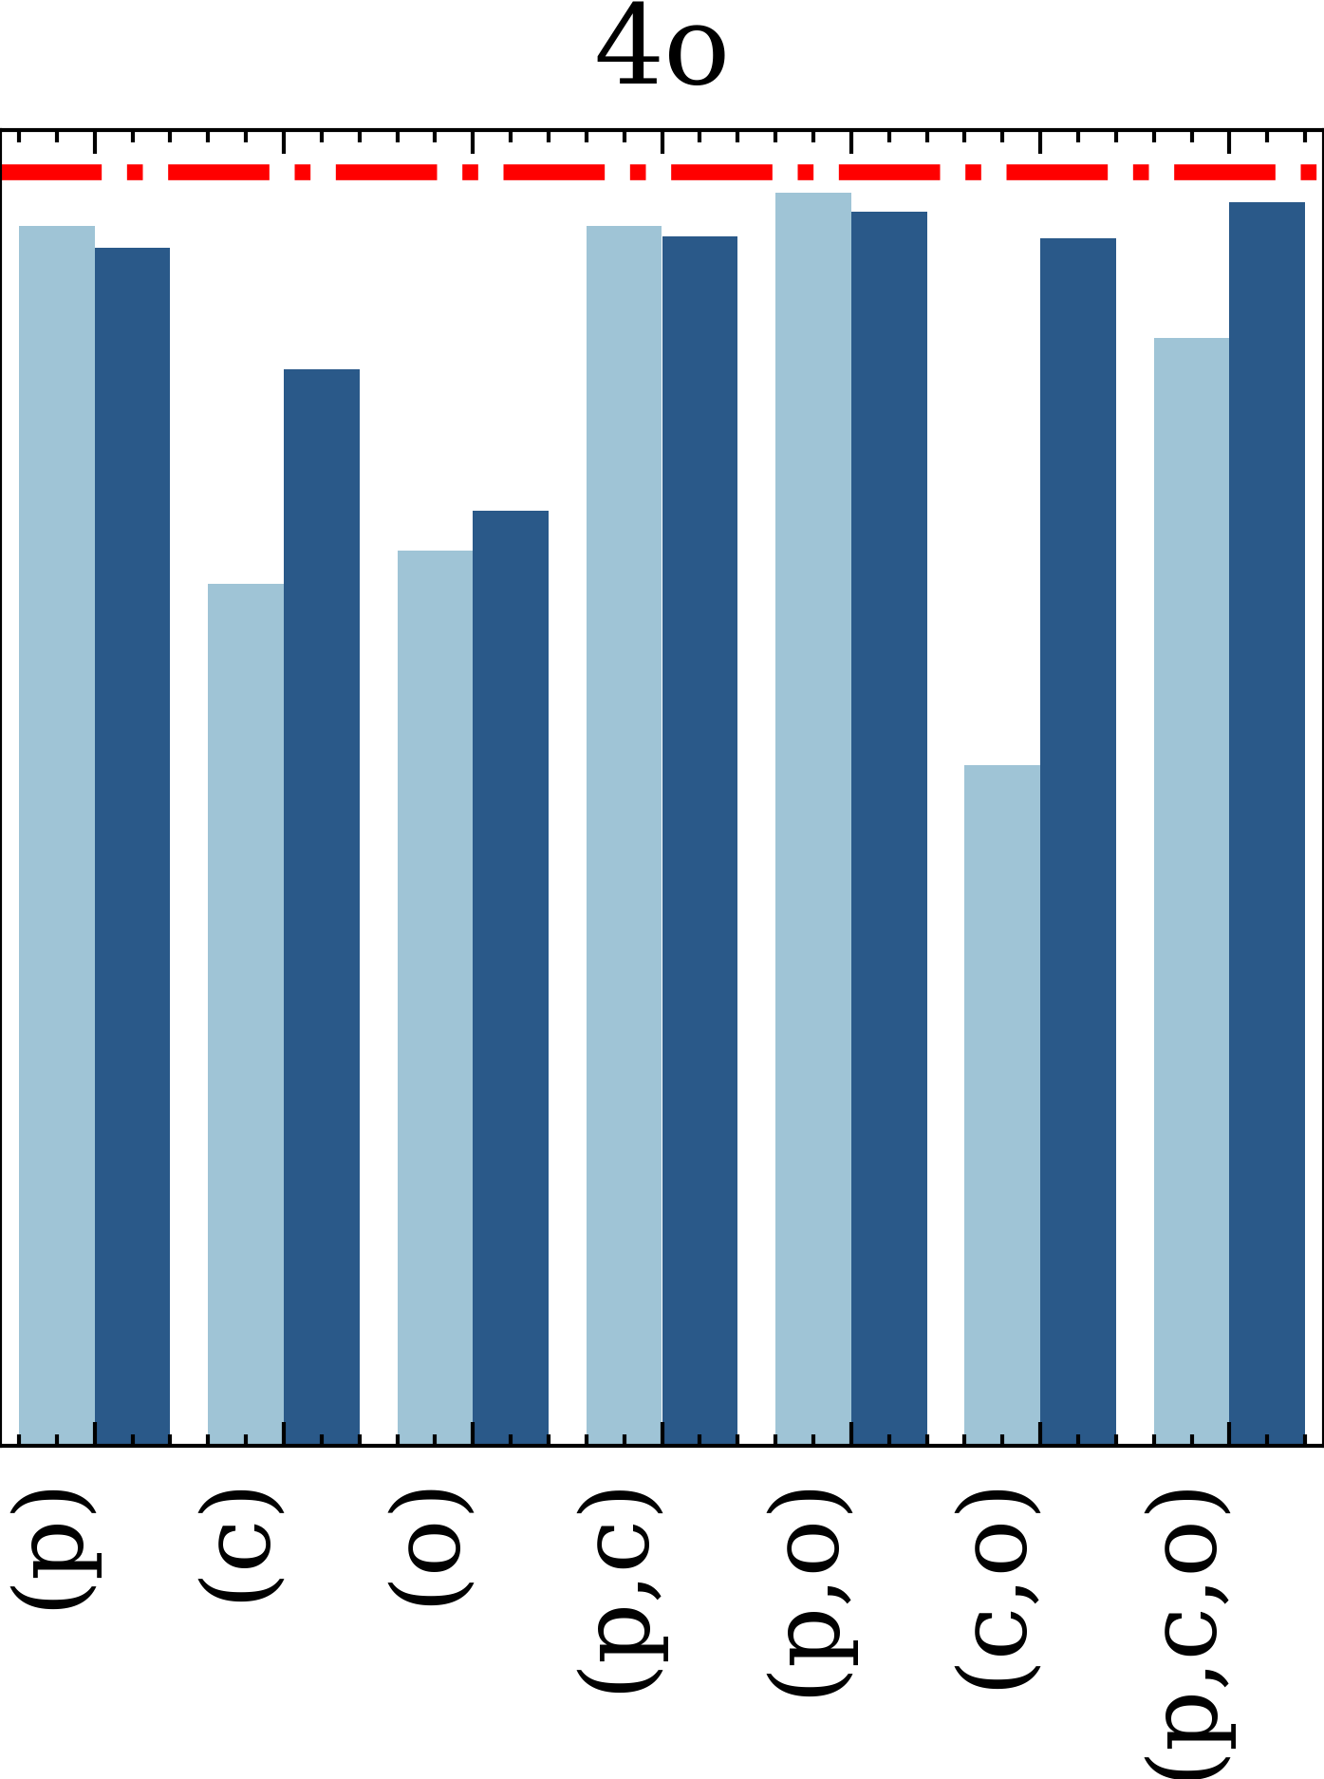

Slide 4
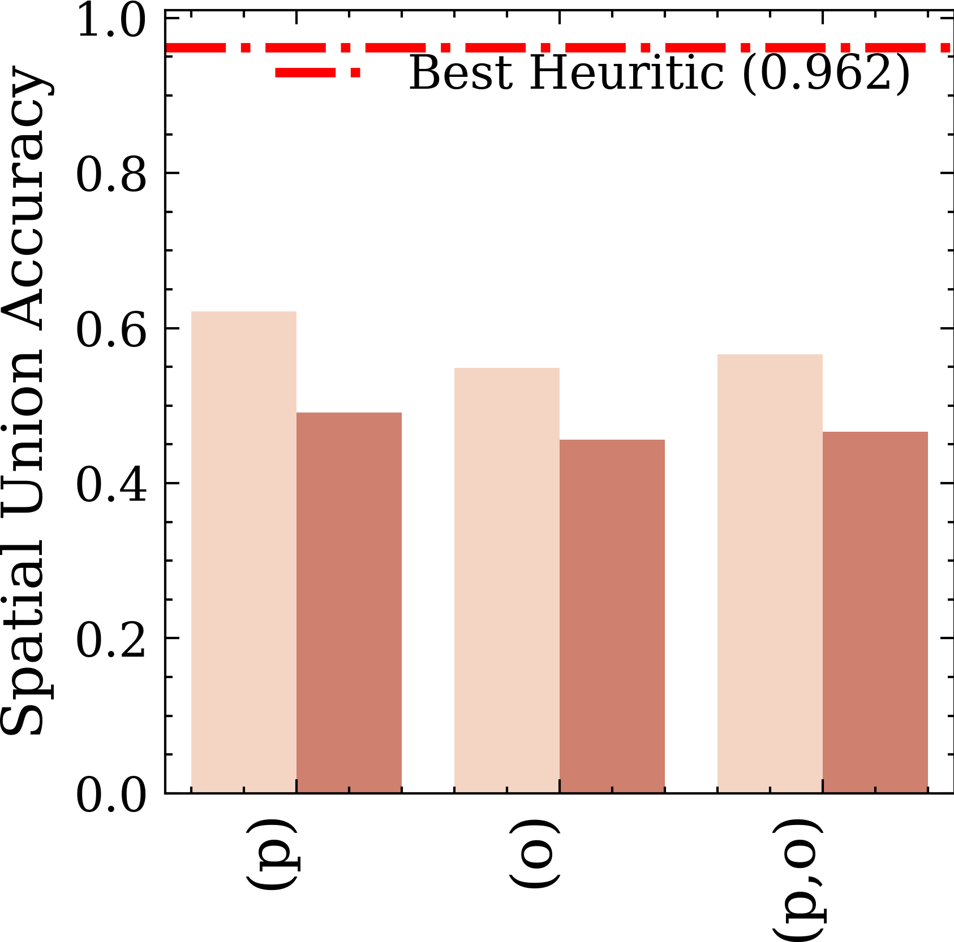
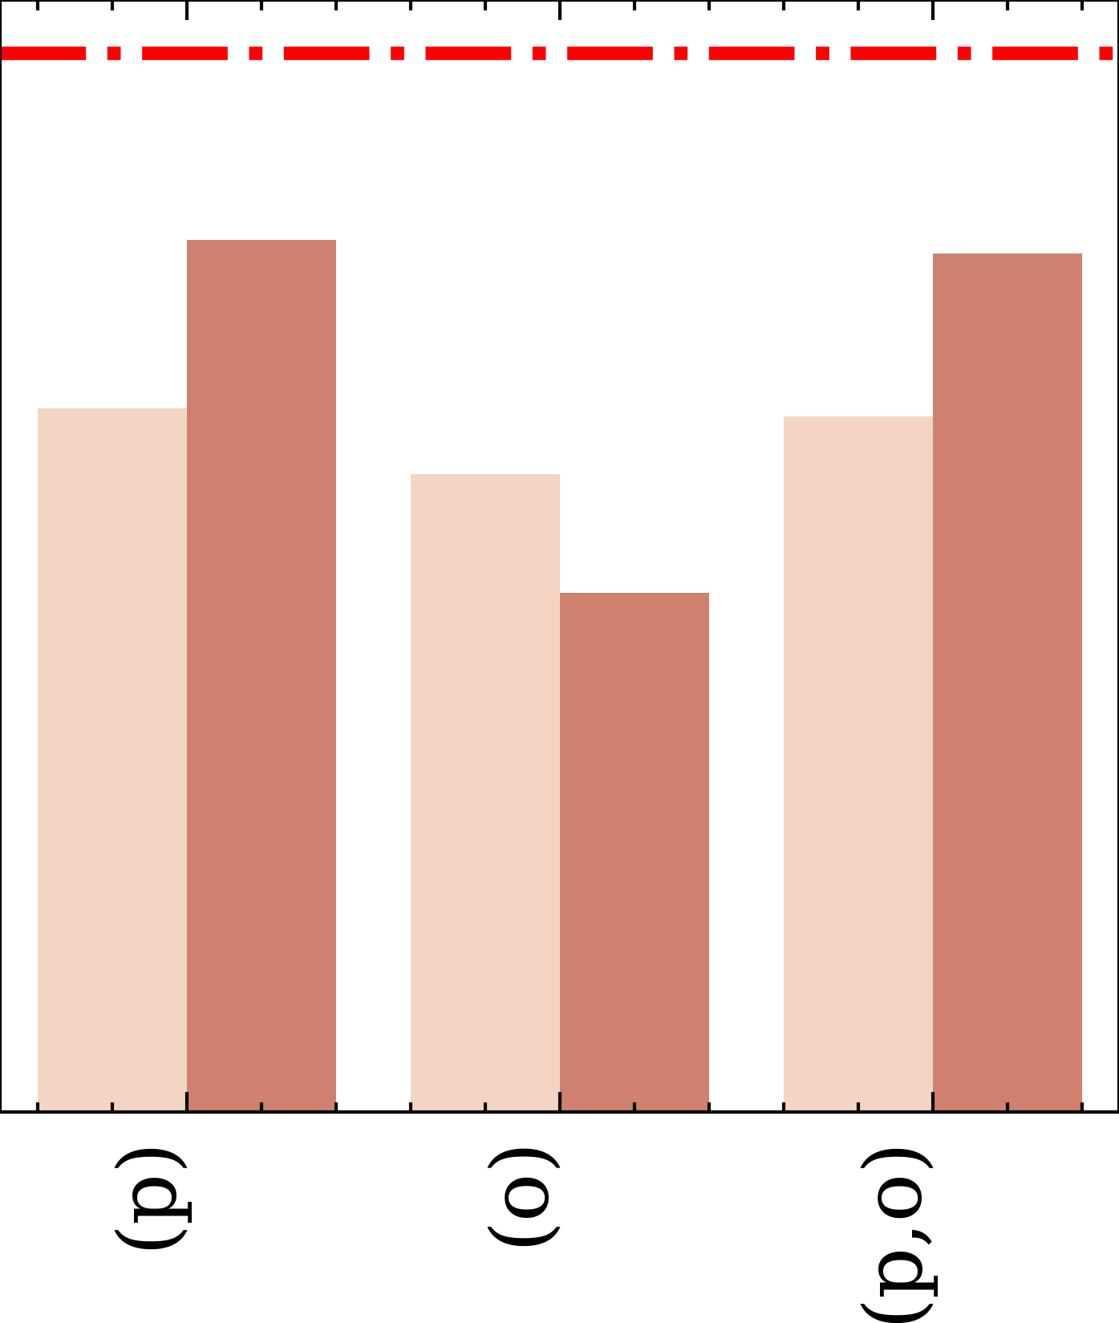
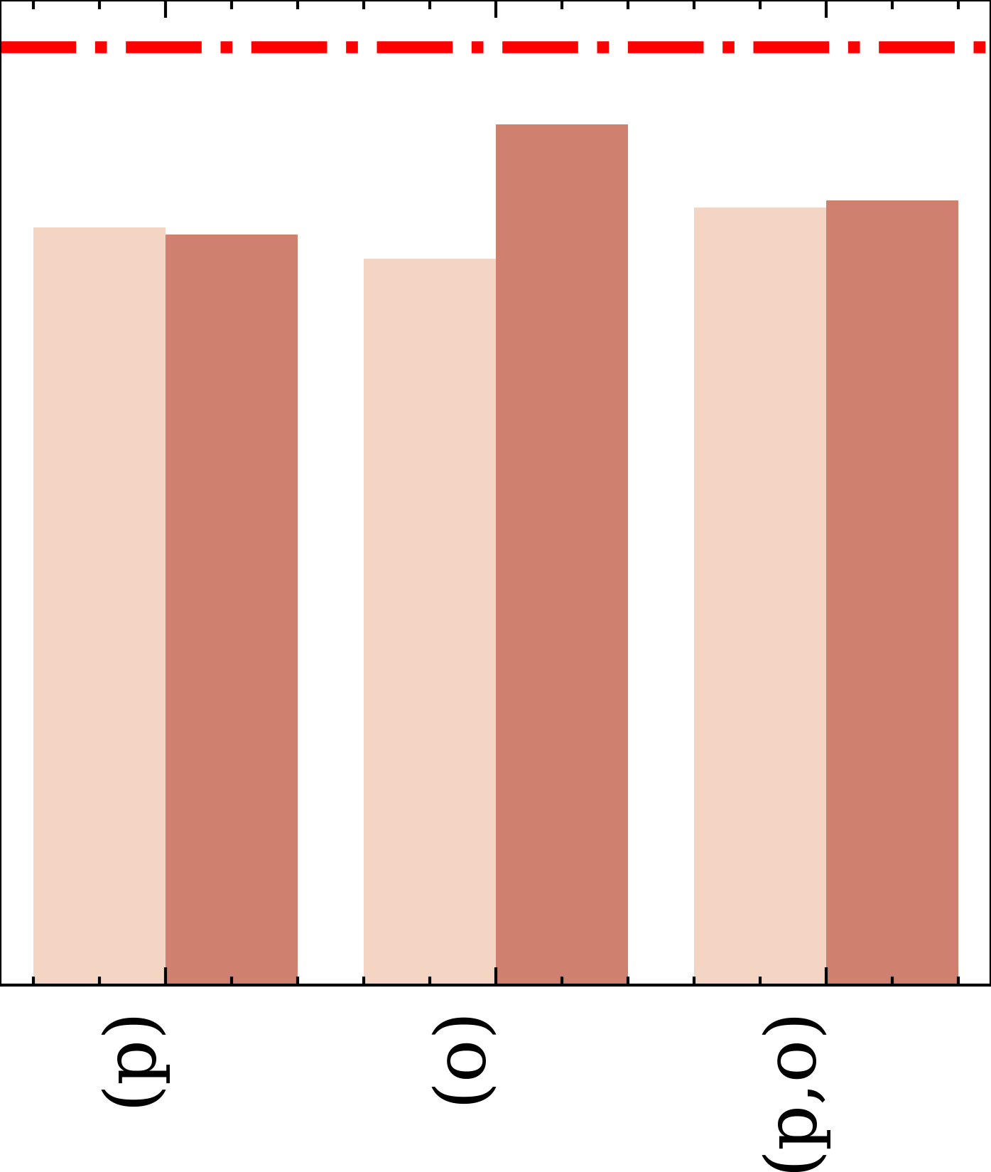
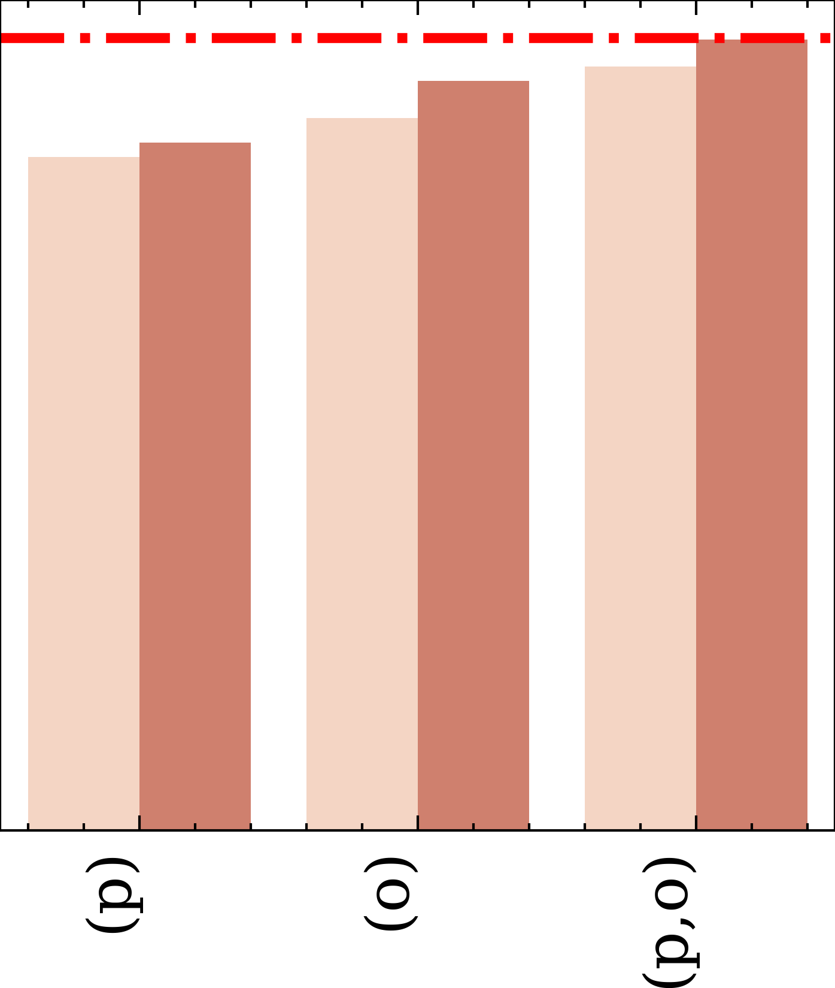
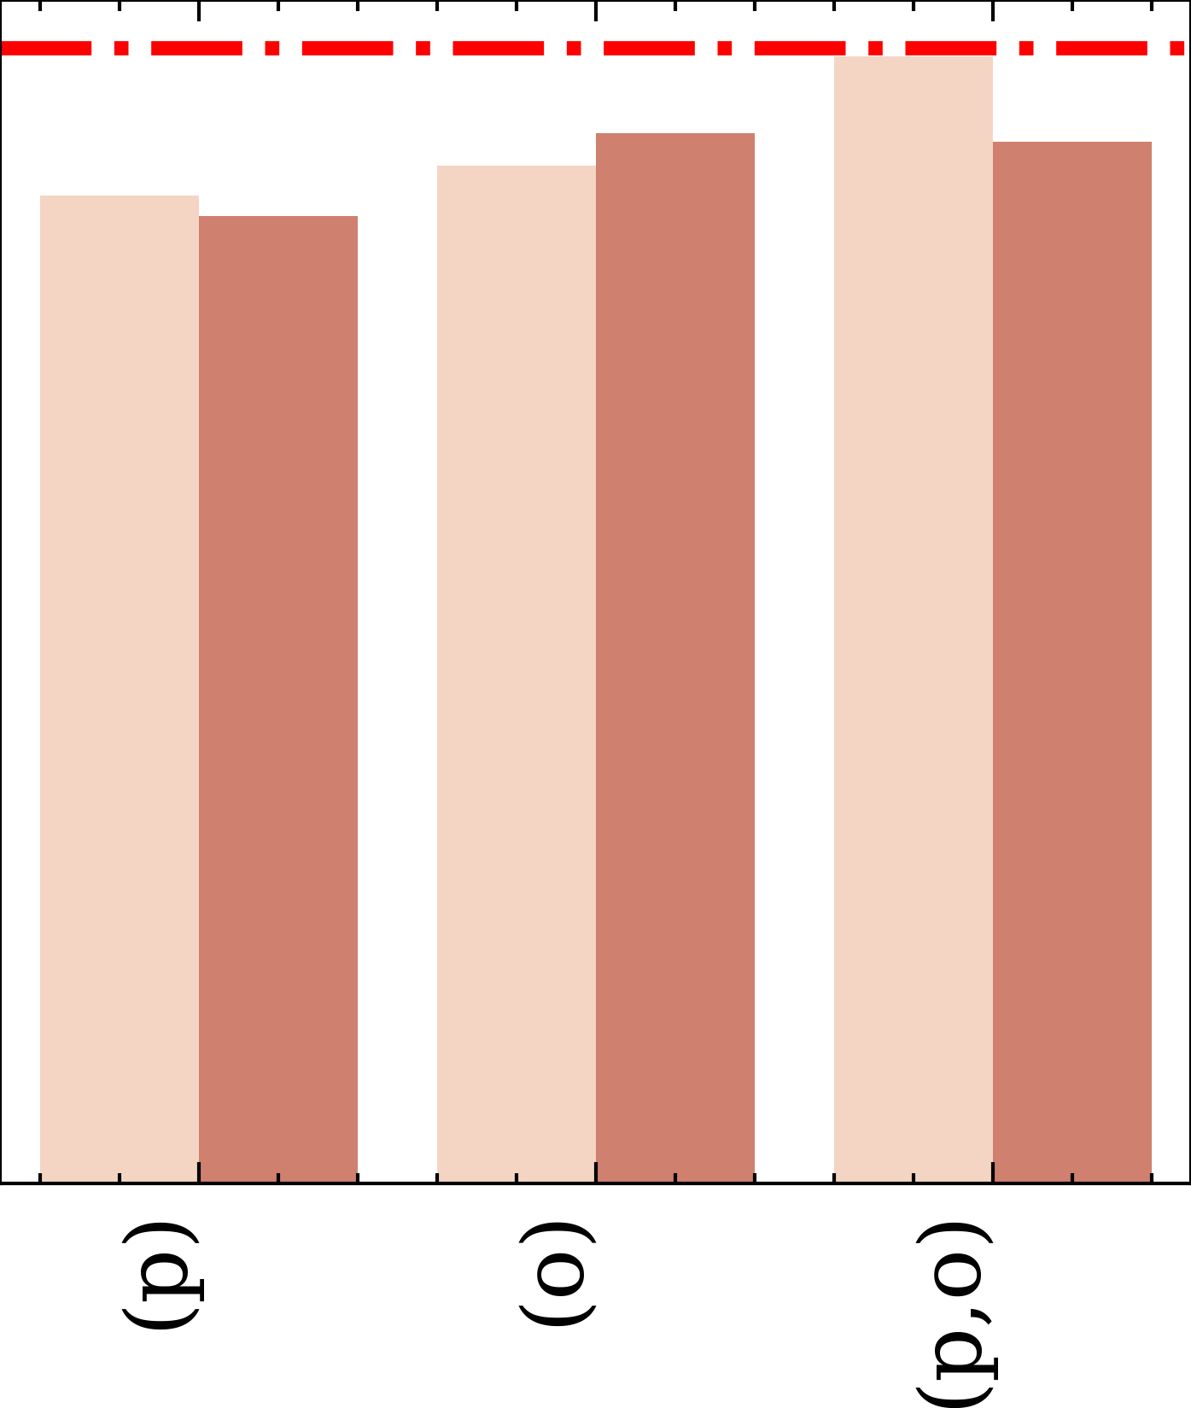

Slide 5


Plain Prompting
Heuristic-Driven Prompting
### Instruction: You are a helpful geospatial analysis assistant. Please determine whether the sidewalk runs alongside the road.
### User:
Sidewalk: {'coordinates': [[-122.2, 47.5], [-122.1, 47.5]]}
Road: {'coordinates': [[-122.5, 47.2], [-122.5, 47.2]]}
### Response: 0
### Instruction: You are a helpful geospatial analysis assistant. Please determine whether the sidewalk runs alongside the road.
### User:
Sidewalk: {'coordinates': [[-122.2, 47.5], [-122.1, 47.5]]}
Road: {'coordinates': [[-122.5, 47.2], [-122.5, 47.2]]}
min_angle: 9.97387
min_distance: 8.72605
### Response: 1
No Topological features
Topological features

