Slide 1
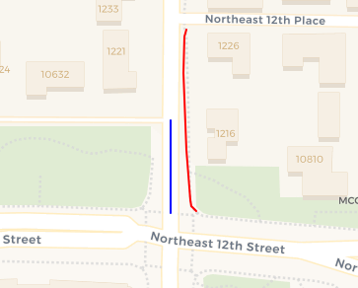
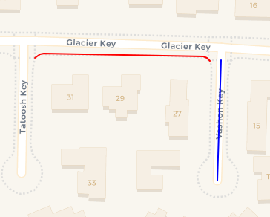
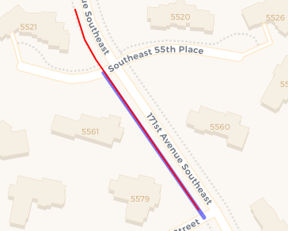
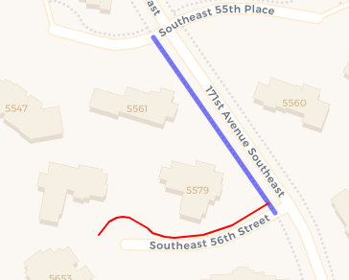
Positive Join Pair
Negative Join Pair
Positive Union Pair
Negative Union Pair

Slide 2
No-Heuristics Prompting
### Instruction: {}
### User:
Sidewalk: {'coordinates': [[-122.2, 47.5], [-122.1, 47.5]]}
Road: {'coordinates': [[-122.5, 47.2], [-122.5, 47.2]]}
### Response: {}
With-Heuristics Prompting
### Instruction: {}
### User:
Sidewalk: {'coordinates': [[-122.2, 47.5], [-122.1, 47.5]]}
Road: {'coordinates': [[-122.5, 47.2], [-122.5, 47.2]]}
min_angle: 9.97387
min_distance: 8.72605
### Response: {}

