Slide 1
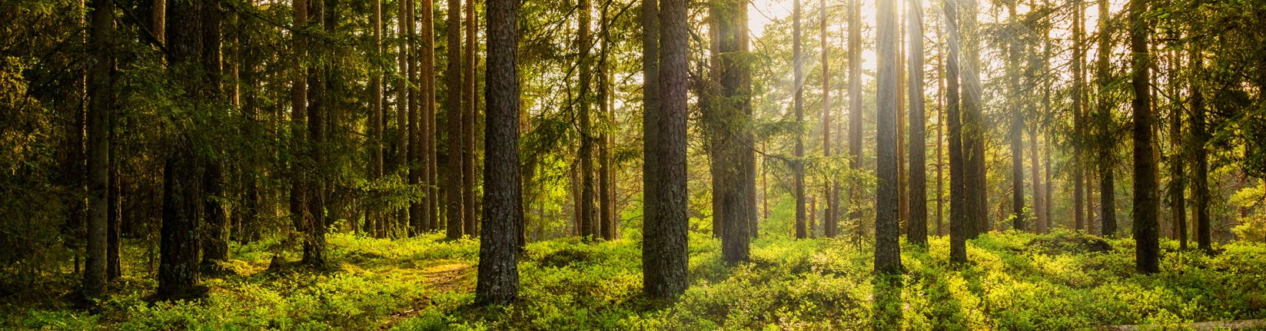
FOREST GROWTH MODEL
REPRESENTING GROWTH TRENDS OVER 400 YEARS
BEN, ASH, ELIANA AND CAITLIN

Slide 2

PROBLEM STATEMENT AND CONSIDERATIONS
The goal of this project is to create a simulation for trees planted in a 100 x 100 metre squared area and model the changes to the plot over the next 400 years
The model is based primarily on the lifespan, height and width of the plants with the seed distribution being dependant on the number of seeds produced and the radius of seed spread
100 x 100 m grid

Slide 3
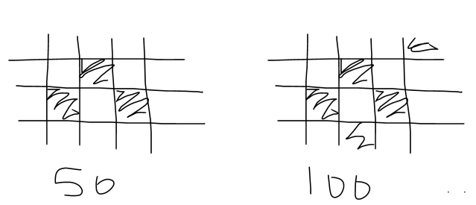
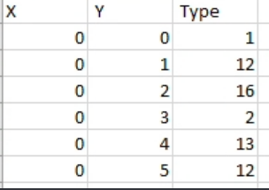

INITIAL OUTPUT IDEA
FINAL OUTPUT IDEA
Print (image or command print) grid of plants every 50 years until year 400
Print a grid with shaded squares that represent that a plant resides in that space
Number the different trees
Code prints coordinates in an excel spreadsheet with the tree number.
We generate a scatterplot
Notes:
We first planned for our project by determining what we wanted the code to output. We initially wanted to create a grid and shade squares to show that a plant is in that square. But we realized no one would be able to determine which plant type is in that square. So we set each tree type to a number 1-16 so it instead prints the tree number in the square it is in.

Slide 4



INITIAL CONDITIONS
Struct
Int …//initialize variables
//set values for variables initialized
//create structure of each plant type that contains:
Parameters
Life Span
End of Life
Current Life
Shade Tolerance
Max shade
Current shade
Sead Radius
Height -> width (⅓ of height)
Temperature (each year)
Growth Rate
Highest rate
Seed Production
Life to seed (Counter)
Max Value (age of tree) -> Compare to amount of seed produced
Note: PLANTS AT YEAR 0 WERE PLACED SEQUENTIALLY 3M APART TO AVOID OVERCROWDING AND ENSURE EACH PLANT GETS ADEQUATE SUNLIGHT
100 m
example:
6m
6m
100 m
1m
1m

Slide 5
INITIALIZING VALUES
//initialize variables and type Code Plan struct plant { int age; int maxAge; float shade; …. //state value of variables //Linked lists with trees -> throw in data | //state value of variables Code Plan: struct plant x; x.age = 0; x.maxAge = newmaxAge; x.shade = 0.0; …… etc…. //include variable x ahead of codes.. //change variable x later

Slide 6
CORE FUNCTIONS - PARAMETERS
// INITIALIZATION Is year 0 set initial year and current year to 0. Trees not grown Set width to 0 //create a while loop for year less than 400 | LIFE OF TREE If the max lifespan life of tree = current year Current year = 0 | HEIGHT //while loop if height is less than max height then… Height = height + growth rate Width = height/3 // if statement (if the current year is the year of seed production) Return seed amount | GROWTH RATE Height = height + growth rate

Slide 7
SEED SPREAD
PROBLEMS
Set parameters of the grid
Random coordinates based on seed spread radius
If tree in the space a seed fell, the seed couldn’t grown (no space/sunlight)
If 2 different seeds fell in a space, seed with higher growth rate grew (would grow faster, take resources)
Accounting for shade using tree width (based off tree width = ⅓ height)
Didn’t get a model for every 50 years
Didn’t account for distance apart for seeds
Very basic user interface (just requires path to mutable csv file)

