Slide 1
Multiple-type, two-dimensional finite bin packing problem
This is a mini project for Fundamental of Optimization course of SOICT – HUST

Slide 2
TABLE OF CONTENTS
01
02
03
04
Introduction
Exact solutions
Heuristic
Statistic

Slide 3
01
Introduction
You can enter a subtitle here if you need it

Slide 4

Problem
?
There are K trucks 1,2,...,K for transporting N packages of 1, 2, ..., N. Trucks have a container size of Wk * Lk. Each package I has size wi * li.
Packages that are placed in same container must not overlap. Assume that the number K can be large, leading to a large number of trucks that are not being used. The cost of using truck k is ck.
Find a way to put these package in the trucks so that the total cost is minimal.
?
?

Slide 5
Exact solutions
02
CP and MIP models

Slide 6
Denotation
N_items is the number of items given
Item i has width w_{i} and height h_{i}
N_bins is the number of bins given
Bin j has width W_{j} , height H_{j} and cost C_{j}

Slide 7
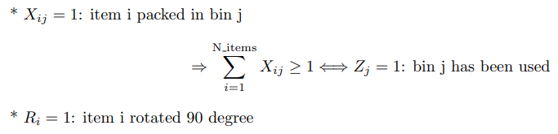
Decision variable

Slide 8
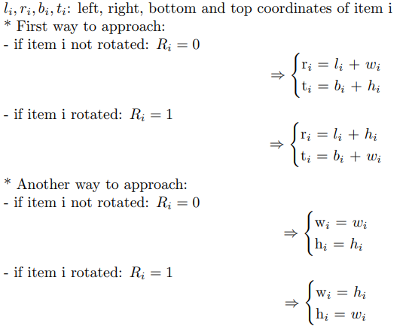
Item’s Coordinate

Slide 9


CP model - Constraints
Each item has to be packed in exactly 1 bin
No two items overlap
Items cannot exceed the bin

Slide 10
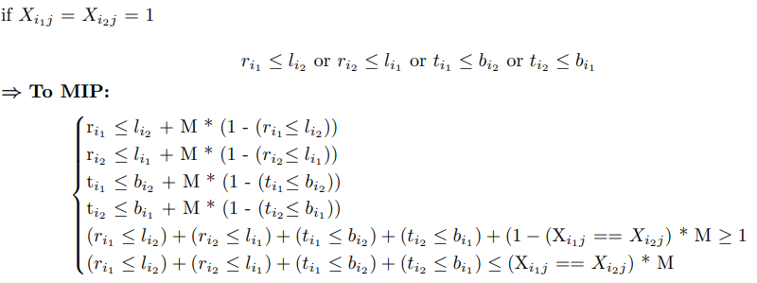
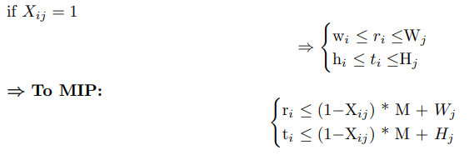
MIP model - Constraints
Each item has to be packed in exactly 1 bin
No two items overlap
Items cannot exceed the bin

Slide 11
Heuristic
03

Slide 12
The heuristic algorithm
Sorting
Destination Bin
Destination Free Rectangle of a Bin
Bins by “density” (cost/area), in descending order
Items by longer side in descending order
Bin First Fit rule – pack the item into the bin with the lowest index (after the process of sorting bins from I); in other words, pack in the first bin that the item fits
Best Short Side Fit rule – choose a free rectangle where the shorter remainder side after insertion is minimized; in other words, minimize the length of the shorter leftover side, ties broken with best longer side (longer leftover side is minimized)

Slide 13
Packing process
Concept of free rectangles: A list of free rectangles represents the free space of the bin. In the Guillotine algorithm, these rectangles are pairwise disjoint
Heuristic algorithms: Combine two algorithms, including Guillotine and Maximal Rectangles

Slide 14
Guilotine
- Pack the item into the first free rectangle of the bin, which means the bin itself, starting with its bottom-left corner.
- For each insertion, split the initial free rectangle into smaller free rectangle(s), which are tracked in a list.
- Whenever a new item is inserted into the bin, choose a free rectangle (with rule II.2) and place the item into its bottom-left corner, then split the chosen rectangle using the Guillotine split rule to produce at most two new rectangles.
- Merge some free rectangles into larger ones if possible.
* Splitting rule: Best Short Side rule - split by horizontal axis if the free rectangle’s width is less than its height; otherwise, split by vertical axis.
* Rectangle merging: if there exists a pair of neighboring rectangles F_{i} and F_{j} such that F_{i} $$∪$$ F_{j} can be exactly represented by a single bigger rectangle, merge these two into one.

Slide 15
Maximal Rectangles
- Rather than choosing one of the two split axes like in the Guillotine algorithm, the Maximal Rectangles algorithm picks both split axes at the same time to ensure that the largest possible rectangular areas are present in the list of free rectangles.
- Because the free rectangles are no longer pairwise disjoint like in the Guillotine algorithm, any free rectangle that intersects the area occupied by the newly inserted item is split to remove the intersection.
- Delete every free rectangle which is fully overlapped by others in the list.

Slide 16
Statistics
04
You can enter a subtitle here if you need it

Slide 17
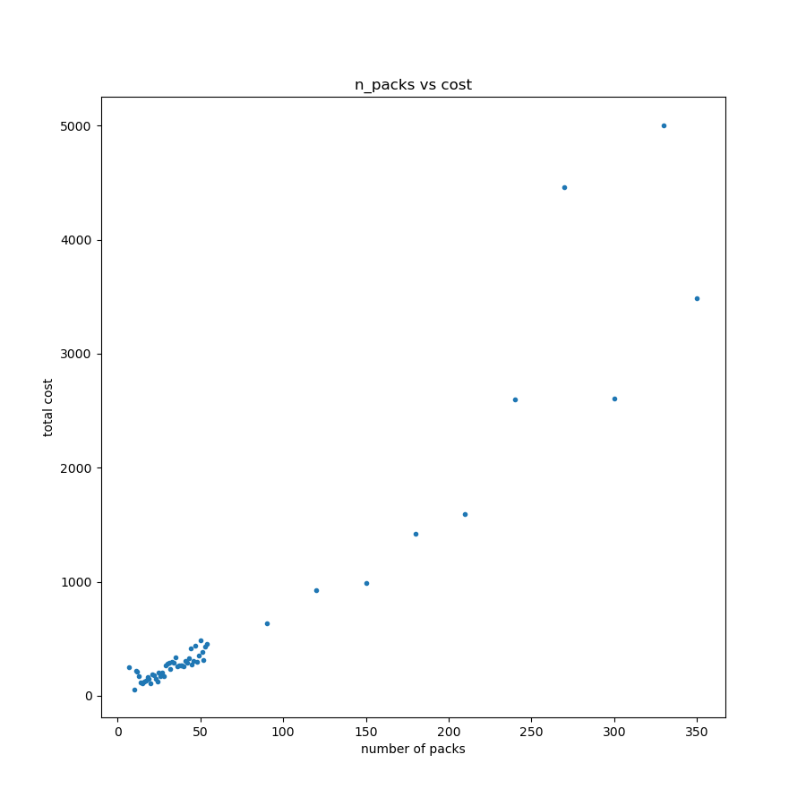
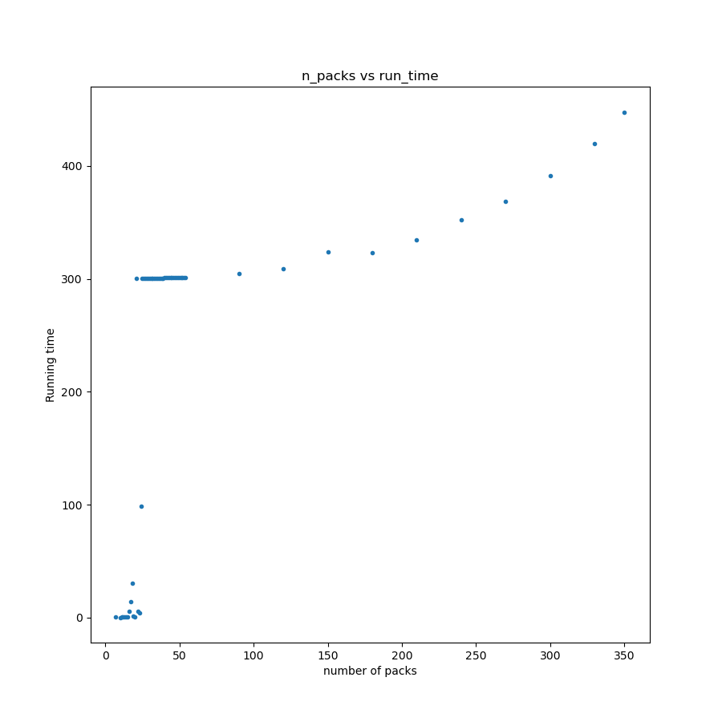
CP model
Out of 58 tests, the model can solve 56, with a 300-second time limitation
The objective values (costs) of solved instances are excellent in general

Slide 18
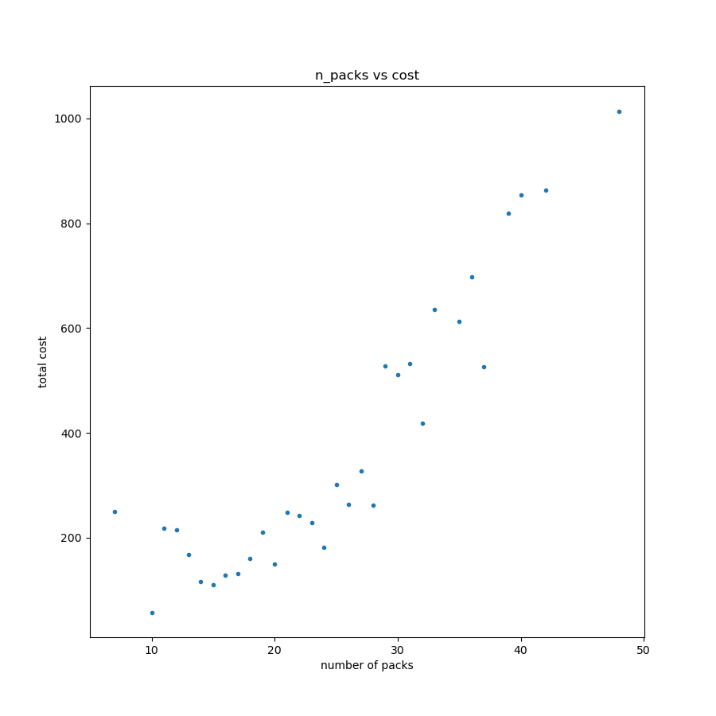
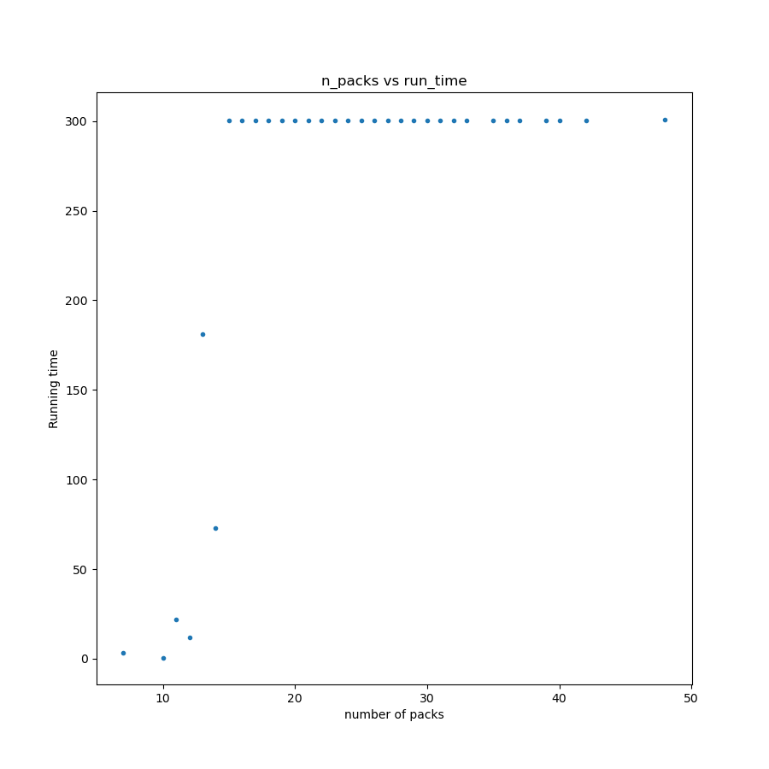
MIP model
Out of 58 tests, the model can solve 32, with a 300-second time limitation
The objective values (costs) of solved instances are quite good in general

Slide 19
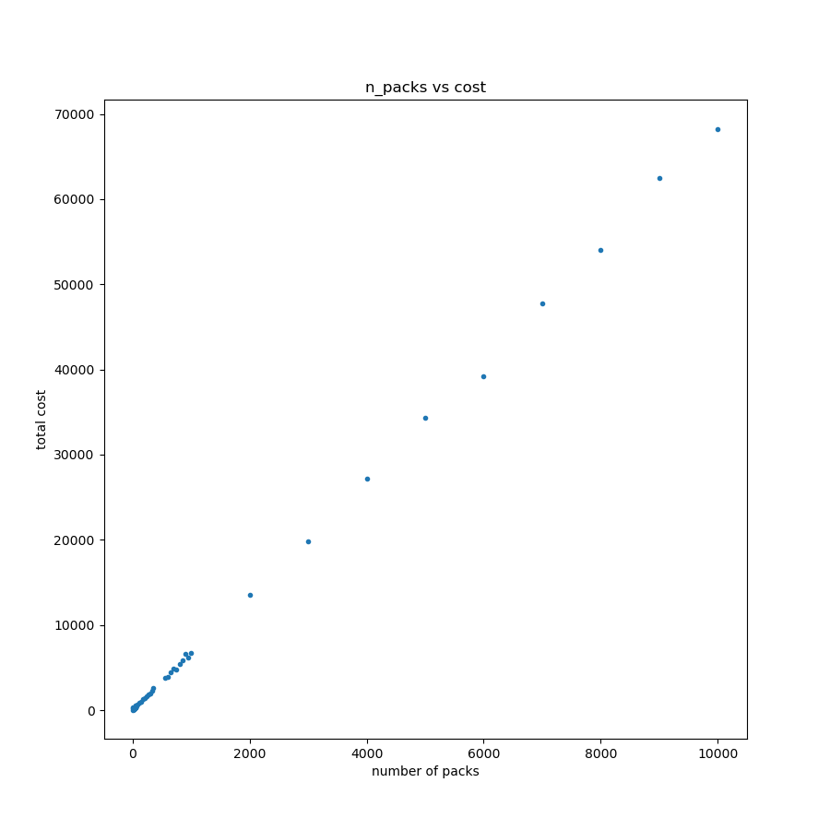
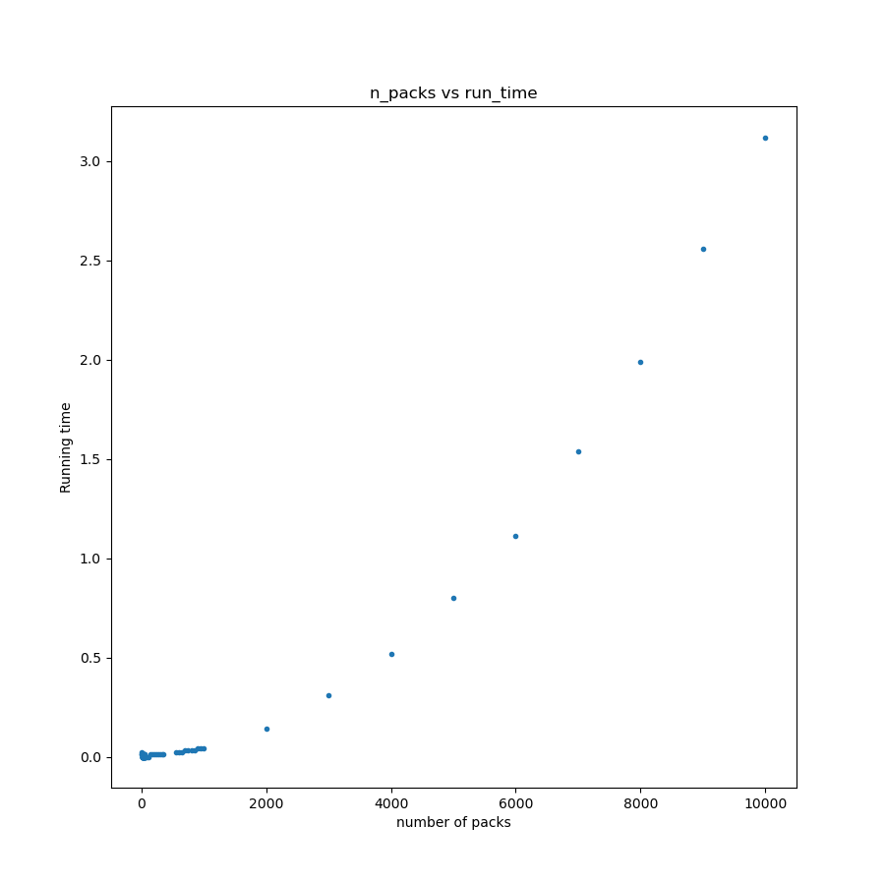
Heuristic
It can solve all 75 tests without a time limitation
The objective values (costs) of instances are good
The running time form an exponential curve with the number of rectangles (test size)

Slide 20


MEET THE TEAM
Phan Dinh Nhat
Nguyen Huu Duan
Chu Minh Ha
Do Quang Minh

Slide 21

Thanks for attention!

