Slide 1
Rx Vision - An Automated System for Tracking Medical Inventory in San Jose District Pharmacy
BY:
De Torres, Jherico M.
Rodriquez, Bernadette Anne H.
Zurbano, Jannie B.
Batangas State University - TNEU/BSIT-SM
Date: July 30, 2025
Notes:
1

Slide 2
Introduction
Brief description of the Project:
Rx Vision is an automated mobile system designed to track medical inventory in San Jose District Pharmacy, simplifying medicine stock management, supplier coordination, and prescription handling.
Importance of mobile app quality:
High-quality apps ensure reliability, security, and usability—critical for medical inventory to prevent errors, reduce delays, and protect sensitive patient data.
Notes:
2

Slide 3
Introduction
Objective of the presentation:
To present the design and quality evaluation of Rx Vision based on the ISO/IEC 25010 software quality model, highlighting its strengths and areas for future improvement.
Notes:
2

Slide 4
Overview of the Mobile App
Name and purpose:
Rx Vision – To simplify medicine inventory management and streamline pharmacy operations through a mobile interface.
Main features:
Inventory tracking with stock details
Supplier management
Prescription processing
User profile and authentication
Notifications and alerts
Target users and platform:
Pharmacists and pharmacy staff using Android platforms.
Notes:
2

Slide 5
What is ISO 25010?
ISO/IEC 25010 is an international standard defining a model for software product quality evaluation.
It provides a framework to assess software based on multiple quality characteristics ensuring comprehensive app quality analysis.

Slide 6
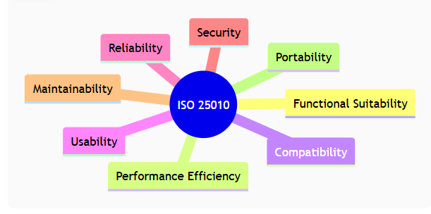
ISO 25010 Quality Mode
The model consists of 8 key software quality characteristics

Slide 7
Functional Suitability
Rx Vision meets all functional requirements: secure login/register, real-time data retrieval for inventory and prescriptions, detailed reporting features.
Example: Users can login securely and view medicine stock levels instantly.
Performance Efficiency
Fast loading screens (Welcome, Login, Homepage) ensure smooth user experience.
Efficient even with limited internet connectivity or lower-end devices due to optimized data handling.
Compatibility
Designed for both Androids supporting multiple OS versions.
Responsive UI adapts to different screen sizes and hardware capabilities.

Slide 8
Usability
Simple, clean interface with clear navigation (e.g., menu with Profile, Inventory, Notifications).
Intuitive design minimizes user errors and supports both tech-savvy and novice users.
Reliability
Stable system with minimal crashes during use.
Error handling present on login (e.g., “Forgot Password”) and form inputs to reduce user frustration.
Security
Authentication system with encrypted passwords.
Protection of user data through secure login and profile management.

Slide 9
Maintainability
Well-documented code structure facilitates updates and debugging.
Modular design supports future feature additions like advanced reporting.
Portability
App deployable on Android with minimal adjustments.
Flexibility to scale and adapt to future platforms.

Slide 10
Overall Benefits to the System
Rx Vision improves inventory accuracy, reduces manual errors, and streamlines pharmacy workflow.
Real-life example: Pharmacy staff can quickly check medicine availability and supplier status on-the-go.

Slide 11
Summary of ISO 25010 Application
Applying ISO 25010 ensures Rx Vision’s quality across essential areas, providing confidence in its usability and reliability.
Suggestions for future work:
Enhance notification clarity and categorization
Add search and filter functions in supplier and prescription modules

Slide 12
Q & A / THANK YOU
Thank you for listening.
Any questions?

