Slide 1
Named Pipe
Assignment 2020/09/28

Slide 2
Requirement
A program (command line mode) runs with two parameters
/server : acts as the named pipe server The server sends back to the client program via the named pipe to tell the registration is complete.
/client : acts as the named pipe client The client program is able to input a player name and send data via named pipe to the server for the player registration.

Slide 3
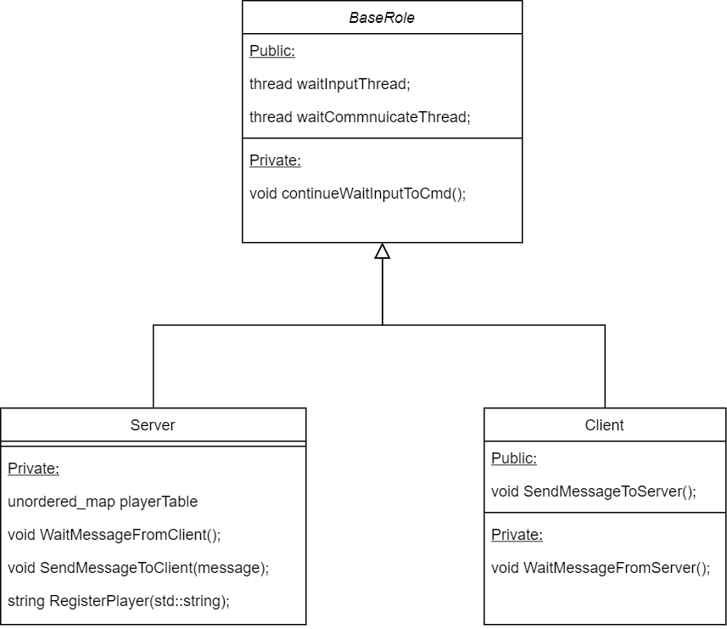
Architecture

Slide 4
Thread 1: WaitCmdInput

Slide 5
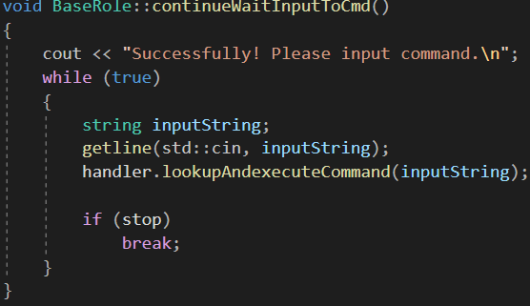
continueWaitInputToCmd

Slide 6
Thread 2: WaitCommnuicate

Slide 7
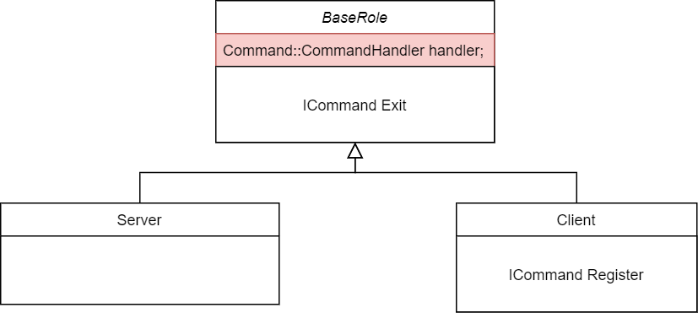
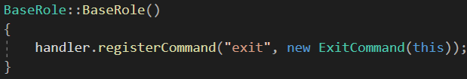
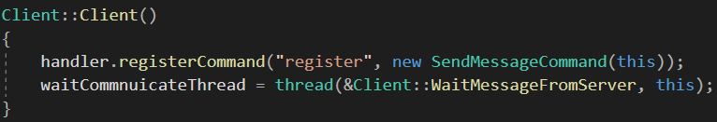
Command Handler

Slide 8
