Slide 1
Functions In Python
Dr. Sini Shibu
BE (CSE), M.Tech (CTA),Ph.D.(CSE)

Slide 2
Learning Objective
By the end of this session, the learner will be able to:
define functions
call functions
pass values to functions
return value from functions
use functions for modular programming

Slide 3
Let’s Begin With A Birthday Analogy

Slide 4
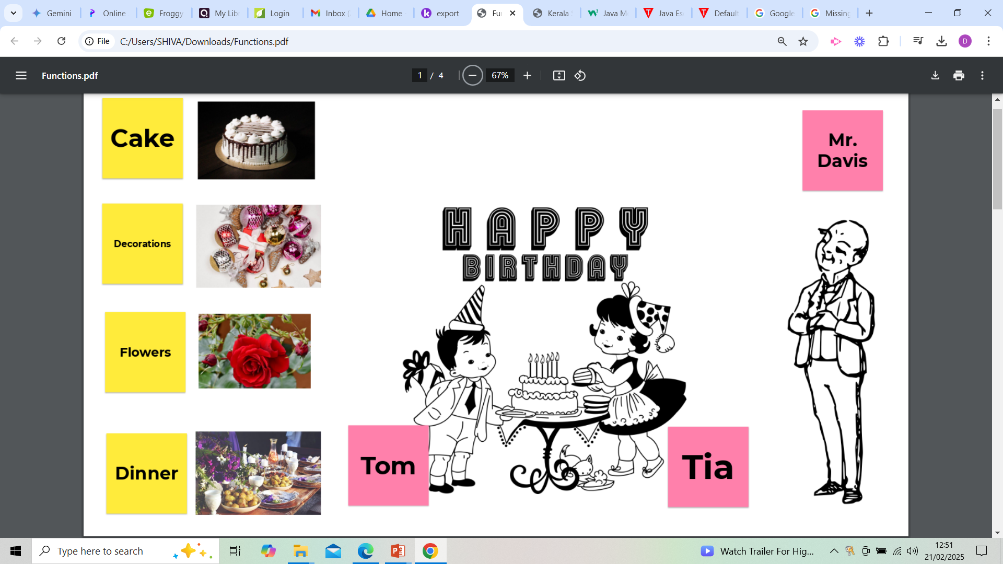

Slide 5
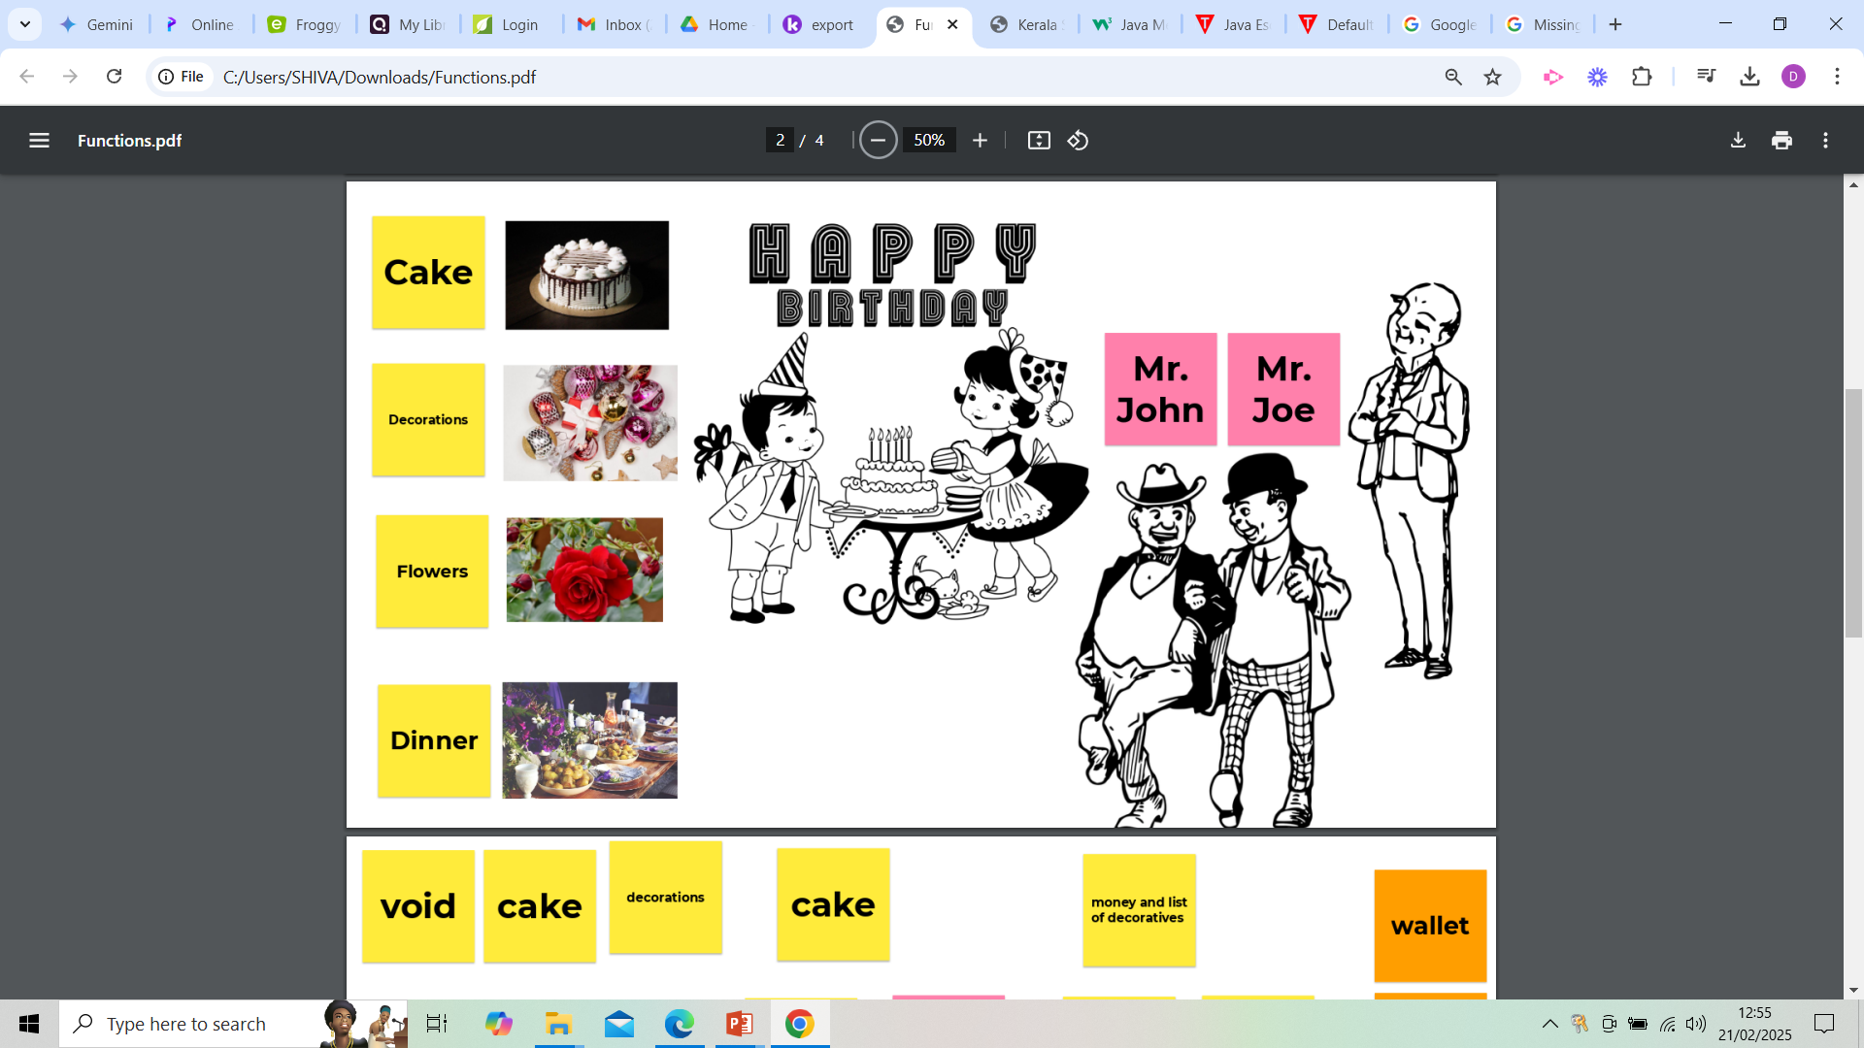

Slide 7
Parameters
Return
Meaning
John
Nil
Nil
Cake and Decorations of his own choice and no return
Cake of Vanilla flavour, Decorations of his own choice and cake will be returned
Vanilla flavour
Cake
Money
Decoratives
Use money for Cake and Decorations, set cake and return decoratives
Need a wallet
Need a notepad
Need a table
Need a bag

Slide 8
Parameters
Return
Meaning
Joe
Nil
Nil
Flowers and dinner items of his own choice and no return
Red flowers, Dinner items of his own choice and return flowers
Red flowers
Flowers
Money,Menu
Flowers
Use money for flowers and dinner, set dinner and return flowers
Need a wallet and a notepad
Need a notepad
Need a flower vase
Need a flower vase

Slide 9
Functions In Python
Defining the function
Syntax:
def function_name( ):
statement1
statement2
……..
function_name( )
A function is a block of code which only runs when it is called.
Functions are used to reuse code: define the code once, and use it many times.
Calling the function
Take care of the indentation

Slide 10
Functions In Python
Example:
def Hello( ):
print(“Hello”)
Hello( )
Example:
def Hello( ):
print(“Hello”)
print(“World”)
Hello( )
Output:
Hello
Output:
Hello
World

Slide 11
Functions In Python
Defining the variables to hold parameters
Syntax:
def function_name(var1,var2 ):
statement1
statement2
……..
function_name(val1,val2 )
Data, known as parameters, can be passed into a function.
Parameters to be sent to function

Slide 12
Functions In Python
Example:
def hello(name): print("Hello",name)
hello("Mary")
Example:
def hello(name,age): print("Hello",name,"!! You are",age, "years old.")
hello("Mary",15)
Output:
Hello Mary
Output:
Hello Mary !! You are 15 years old.

Slide 13
Functions In Python
Syntax:
def function_name( ):
statement1
statement2
……..
return(data)
var=function_name( )
Functions can return values when called.
The returned value must be properly handled.

Slide 14
Functions In Python
Example:
def add(a,b):
return(a+b) c=add(15,20)
print("Sum=",c)
Example:
def product(a,b):
return(a*b)
print("Product=",product(15,20))
Output:
Sum= 35
Output:
Product= 300

Slide 15
Answer The Following
How do you know that no parameters are being passed to a function?
How do you know that parameters are being passed to a function?
How do you know that function is not returning a value?
How do you know that function is returning a value?

Slide 16
Answer The Following
Can a function be defined without parameters and without return value?
Can a function be defined without parameters and with return value?
YES
YES

Slide 17
Let’s Write Functions In Python
# Function to add two numbers. It will not take any parameters nor it will return any value:
def add():
a=15
b=20
print("Sum=",a+b)
add()
Output:
Sum= 35

Slide 18
Let’s Write Functions In Python
# Function to add two numbers. It will take two parameters and it will not return any value:
def add(a,b):
print("Sum=",a+b)
add(15,20)
Output:
Sum= 35

Slide 19
Let’s Write Functions In Python
# Function to add two numbers. It will not take any parameters and it will return the value of sum:
def add():
a=15
b=20
return(a+b)
c=add()
print("Sum=",c)
def add():
a=15
b=20
return(a+b)
print("Sum=",add())
Output:
Sum= 35

Slide 20
Let’s Write Functions In Python
# Function to add two numbers. It will take one parameter and it will return the value of sum:
def add(a):
b=20
return(a+b)
c=add(15)
print("Sum=",c)
def add(a):
b=20
return(a+b)
print("Sum=",add(15))
Output:
Sum= 35

Slide 21
Functions With Default Parameter Values
Functions can have default parameter values
Example:
def power(base, exponent=2):
return base ** exponent print(power(4))
print(power(4, 3))
Output:
16
64

Slide 22
Functions With Default Parameter Values
Functions can have default parameter values
Example:
def power(base=3, exponent):
return base ** exponent print(power(4))
print(power(4, 3))
Default value assignments must start from extreme right
Output:
Error

Slide 23
Figure Out The Output
Code:
def Hello():
print("Hello")
def World():
print("World")
Hello()
World()
Hello()
World()
Output:
Hello
World
Hello
World

Slide 24
Figure Out The Output
Code:
def Hello():
print("Hello")
def World():
print("World")
a=5
b=10
if a>b:
Hello()
else:
World()
Output:
World

Slide 25
Figure Out The Output
Code:
def Hello():
print("Hello")
def World():
print("World")
for i in range(3):
Hello()
World()
Output:
Hello
World
Hello
World
Hello
World

Slide 26
Figure Out The Output
Code:
def Hello():
print("Hello")
def World():
print("World")
for i in range(3):
if i>2:
Hello()
Output:
i will take value from 0 to 2

Slide 27
Figure Out The Output
Code:
def Hello():
print("Hello")
def World():
print("World")
for i in range(3):
if i>2:
Hello()
else:
World()
Output:
World
World
World

Slide 28
Figure Out The Output
Code:
def Hello():
print("Hello")
def World():
print("World")
i=1
while i<=3:
Hello()
if i==3:
World()
i+=1
Output:
Hello
Hello
Hello
World

Slide 29
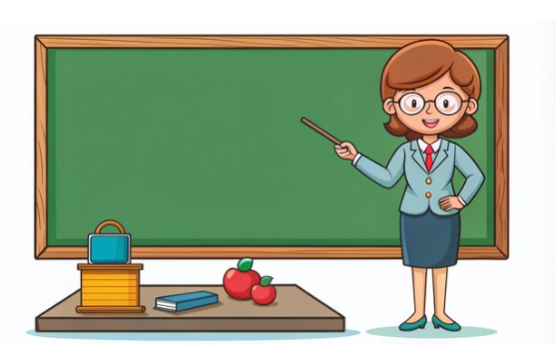
Help The Teacher
Mrs. Thompson, a teacher, wants to print total and percentage of her students. The students have scored marks out of 100 in five subjects.
Let us write a code for this scenario!!!!

Slide 30
Help The Teacher
def total(l):
return ____________
def percentage(l):
return ____________
________
for i in range(1,6):
l.________(int(input("Enter marks:")))
print("Total=",_______________)
print("Percentage=",_________________)
Output:
Enter marks:45
Enter marks:34
Enter marks:67
Enter marks:78
Enter marks:78
Total= 302
Percentage= 60.4
sum(l)
sum(l)/5
l=[ ]
append
total(l)
percentage(l)

Slide 31

Help The Farmer
Jack is a wealthy farmer. He has a lot of square, rectangular and triangular farms. He wants to know the total area of the farms owned by him. Develop a Python script to help Jack.
Let us write a code for this scenario!!!!

Slide 32
Let’s Write Functions In Python
#Function to calculate area of a square:
def square(s):
return(s*s)
#Function to calculate area of a triangle:
def triangle(b,h):
return(0.5*b*h)
#Function to calculate area of a rectangle:
def rect(l,b):
return(l*b)

Slide 33
Let’s Call Functions In Python
#Calling Function to calculate area of a square:
s=float(input("Enter the side of the square field (in m):"))
print("Area of square field:", square(s),"sq.m")
#Calling Function to calculate area of a rectangle:
l=float(input("Enter the length of the rectangular field (in m):"))
b=float(input("Enter the breadth of the rectangular field (in m):"))
print("Area of rectangular field:", rect(l,b),"sq.m")

Slide 34
Let’s Call Functions In Python
#Calling Function to calculate area of a triangle:
b=float(input("Enter the base of the triangular field (in m):"))
h=float(input("Enter the height of the triangular field (in m):"))
print("Area of triangular field:", triangle(b,h),"sq.m")

Slide 35
Let’s Put It All Together
def square(s):
return s*s
def rect(l,b):
return l*b
def triangle(b,h):
return 0.5*b*h
total=0
ch='Y'
while ch=="Y" or ch=="y":
c=int(input("Enter the shape of the field:\n1.Square\n 2.Rectangle\n3.Triangle\nEnter your choice:"))

Slide 36
Let’s Put It All Together
if c==1:
s=float(input("Enter the side of the square field (in m):"))
print("Area of square field:",square(s),"sq.m")
total=total+square(s)
print("Total area=",total,"sq.m")
elif c==2:
l=float(input("Enter the length of the rectangular field (in m):"))
b=float(input("Enter the breadth of the rectangular field (in m):"))
print("Area of rectangular field:", rect(l,b),"sq.m")
total=total+rect(l,b)
print("Total area=",total,"sq.m")

Slide 37
Let’s Put It All Together
elif c==3:
b=float(input("Enter the base of the triangular field (in m):"))
h=float(input("Enter the height of the triangular field (in m):"))
print("Area of triangular field:", triangle(b,h),"sq.m")
total=total+triangle(b,h)
print("Total area=",total, "sq.m")
else:
print("Wrong Choice!!!!")
ch=input("Do you wish to continue (Y/N)?")

Slide 38
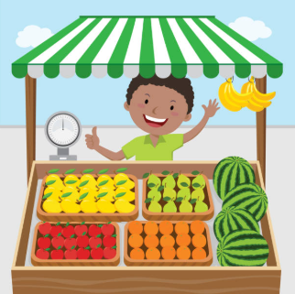
Help The Fruit Seller
Ben is a Fruit seller. He wants you to develop an application for him that calculates the total bill for a customer according to the following rate chart:
Fruit | Cost per kilo
Apples | $5
Mangoes | $3
Oranges | $2.5
Let us write a code for this scenario!!!!

Slide 39
Let’s Write Functions In Python
#Function to calculate bill of apples:
def bill_apple(a):
return 5*a
#Function to calculate bill of oranges:
def bill_orange(o):
return 2.5*o
#Function to calculate bill of mangoes:
def bill_mango(m):
return 3*m

Slide 40
Let’s Call Functions In Python
#Calling Function to calculate bill of apples:
print("Bill of apples=$:", bill_apple(q))
#Calling Function to calculate bill of mangoes:
print("Bill of mangoes=$:", bill_mango(q))
#Calling Function to calculate bill of orangeses:
print("Bill of oranges=$:", bill_orange(q))

Slide 41
Let’s Put It All Together
def bill_apple(a):
return 5*a
def bill_mango(m):
return 3*m
def bill_orange(o):
return 2.5*o
total=0
ch='Y‘
while ch=="Y" or ch=="y":
c=int(input("Enter the fruit:\n1.Apple\n 2.Mango\n3.Orange\n
Enter your choice:"))

Slide 42
Let’s Put It All Together
if c>=1 and c<=3:
q=float(input("Enter the quantity:"))
if c==1:
print("Bill of apples=$", bill_apple(q))
total=total+bill_apple(q)
elif c==2:
print("Bill of mangoes=$", bill_mango(q))
total=total+bill_mango(q)
elif c==3:
print("Bill of oranges=$", bill_orange(q))
total=total+bill_orange(q)
What is the logic?

Slide 43
Let’s Put It All Together
else:
print("Wrong Choice!!!!")
ch=input("Do you wish to continue (Y/N)?")
print("Total bill=$",total)

